Slide 1
Updates from the
EUGridPMA
David Groep, Oct 17st, 2007

Slide 2
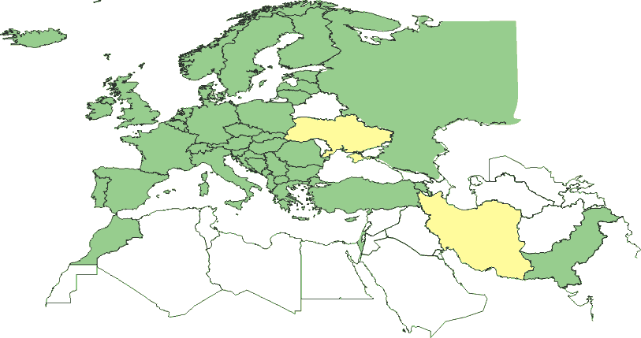
Geographical coverage of the EUGridPMA
Green: EMEA countries with an Accredited Authority
23 of 25 EU member states (all except LU, MT)
+ AM, CH, HR, IL, IS, NO, PK, RS, RU, TR, “SEE-catch-all”
Other EUGridPMA Accredited Authorities:
DoEGrids (.us)
GridCanada (.ca)
CERN

Slide 3
Open Issues 11th EUGridPMA meeting
Handling of compromises
  Closed incidents discuss list for the PMAs with only members
  Redundancy for emergency distribution generation
Continuous Audit Process
  Designated 6 Cas for self-audit and peer review
  (DoEGrids, HellasGrid, CyGrid, SlovakGrid; IUCC, Belnet)
Make TACAR integral part of registration procedure
  Put effort in getting all the existing ones in
Distribution Generation and Format document
Web caching of CRLs
Repository of “good” and “bad” CP/CPS examples
  boilerplate text repository
  On software used

Slide 4
Open Issues 11th EUGridPMA meeting (2)
Adding meaningful OIDs to the EE certs
  Slicing up the 1SCP OID space
  What should be the devisor elements?
  “1SCP” -> “private key protection” -> “key on HW token”
  -> “I’m a robot”?
  EE certs will have multiple OIDs
  Add accredited AP already today … (but not version no.)
F2F requirement: it’s the easiest to formulate, but the “SHOULD” is there for a reason
The Authorization Working Party (DaveK)
RFC3647 mapping of the Classic AP
  BrGrid/LACGrid is the current best CP/CPS…
  Should be a work-item here, including comments

Slide 5
Open Issues 11th EUGridPMA meeting (3)
SLCS profile update
  Harmonize with the wording in MICS and Classic
  Complete before Seattle? ☺
Creation of the closed members-only list, across the IGTF: igtf-members@gridpma.org
PGP keyring linkage for PGP keys on the members page (before Seattle, by each PMA …)

Slide 6
Some dates for you to remember and schedule
Jan 14-16 2008
12th EUGridPMA meeting, Amsterdam, NL (Nikhef)
mid-May , 2008: 13th meeting, Copenhagen, DK
mid-September, 2008: 14th meeting, Lisbon, PT
January 2009: 15th meeting, Nicosia, CY (t.b.c.)

