Slide 1

Firewall Issue Research Group
Document discussion
Thijs Metsch
German Aerospace Center – DLR e.V.

Slide 2

OGF IPR Policies Apply
“I acknowledge that participation in this meeting is subject to the OGF Intellectual Property Policy.”
Intellectual Property Notices Note Well: All statements related to the activities of the OGF and addressed to the OGF are subject to all provisions of Appendix B of GFD-C.1, which grants to the OGF and its participants certain licenses and rights in such statements. Such statements include verbal statements in OGF meetings, as well as written and electronic communications made at any time or place, which are addressed to:
    the OGF plenary session,
    any OGF working group or portion thereof,
    the OGF Board of Directors, the GFSG, or any member thereof on behalf of the OGF,
    the ADCOM, or any member thereof on behalf of the ADCOM,
    any OGF mailing list, including any group list, or any other list functioning under OGF auspices,
    the OGF Editor or the document authoring and review process
Statements made outside of a OGF meeting, mailing list or other function, that are clearly not intended to be input to an OGF activity, group or function, are not subject to these provisions.
Excerpt from Appendix B of GFD-C.1: ”Where the OGF knows of rights, or claimed rights, the OGF secretariat shall attempt to obtain from the claimant of such rights, a written assurance that upon approval by the GFSG of the relevant OGF document(s), any party will be able to obtain the right to implement, use and distribute the technology or works when implementing, using or distributing technology based upon the specific specification(s) under openly specified, reasonable, non-discriminatory terms. The working group or research group proposing the use of the technology with respect to which the proprietary rights are claimed may assist the OGF secretariat in this effort. The results of this procedure shall not affect advancement of document, except that the GFSG may defer approval where a delay may facilitate the obtaining of such assurances. The results will, however, be recorded by the OGF Secretariat, and made available. The GFSG may also direct that a summary of the results be included in any GFD published containing the specification.”
OGF Intellectual Property Policies are adapted from the IETF Intellectual Property Policies that support the Internet Standards Process.
Notes:
IPR Notices Note Well for OGF meetings

Slide 3
Outline
Status
Requirement
Solutions
Current status
of the
documents
Requirements
derived
from
document #1
Solution
-
Requirement
analyses

Slide 4


The next documents
Firewall vendor contributions
Existing
Solution
Description &
Analyses
Grid Firewall
Issues &
Analyses
Grid community
Documents
2 & 3
Emerging/
New
Solution
Description &
Analyses
Document #1
Vendor
community

Slide 5
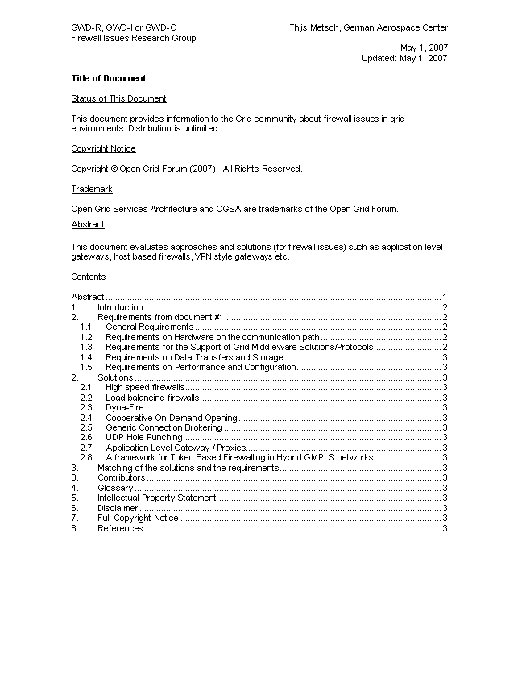
Current status
We are a little bit behind schedule
Draft of document #3 was published last weekend
Biggest working package is currently the mapping of the requirements and solutions
OGF19
OGF20
Collect solutions
Gather requirements
Evaluation / Mapping
Further work
1
2
3
4
5
6
7
8
9
10
11
12
13
14
15
16
17
18
19
20
21
Jan
Feb
Mar
Apr
May

Slide 6
Requirements on firewalls
First block deals with general and hardware requirements
Id | Requirement | Severity | Details
G010 | Use a single port/socket connection for simple transfers | Medium
G020 | Grid resources need to be protected by firewalls | High
G030 | Detect number off ports needed before, after, and during execution | High
G040 | The network and application need to deal with security policies | High
Id | Requirement | Severity | Details
H010 | Routers/Firewalls need to be deal with High bandwidth Networks | High
H020 | Number and kinds of Hardware in a routing path need to be known | Medium

Slide 7
Requirements on firewalls (2)
Requirements for the support of grid middleware solutions
Id | Requirement | Severity | Details
M010 | Support connection from a ephemeral port on client to a grid service port on server | High | To support GT/Unicore
M020 | Support connection from a controllable ephemeral port on the client to a grid service port on the server | High | To support GT
M030 | Support connection from a controllable ephemeral port on the client to a controllable ephemeral port on the server | Medium | To support GT
M040 | Support the usage of internal and external service EPR | Medium
M050 | Support the usage of ephemeral internal EPRs which are mapped to external EPRs | Medium
M060 | Audio and Video ports must be supported | Medium | AccessGrid

Slide 8
Requirements on firewalls (3)
Requirements on performance and data storage
Id | Requirement | Severity | Details
D010 | A single socket connection for control channels is needed | High | GridFTP Connection channel, GSIdCap for dCache, SRM protocol
D020 | Support usage of arbitrary numbers of sockets (which can vary in time) | High | GridFTP Data channel
Id | Requirement | Severity | Details
P010 | High Performance Links in Grids of 10/40Gb/s | High | GPFS needs it, Net of trust
P020 | Dynamic configuration of Firewalls by authorized users | High

Slide 9
Solution & requirement analyses
Name of Solution/ Id of requirement | G010 | G020 | G030 | G040 | H010 | H020 | M010 | M020 | M030 | M040 | M050 | M060 | D010 | D020 | P010 | P020
High speed firewalls | N/A | X | N/A | N/A | X |  | N/A | N/A | N/A | N/A | N/A | N/A | N/A | N/A | X
Load balancing firewalls | N/A | X | N/A | N/A | X |  | N/A | N/A | N/A | N/A | N/A | N/A | N/A | N/A | X
Dyna-Fire | X | X |  | X | N/A |  | X | X | ? |  |  |  |  |  |  | X
Cooperative On-Demand Opening | X | X | ? | X | N/A |  | X | X | ? |  |  |  |  |  |  | X
Generic Connection Brokering | X | X |  | X | N/A |  | X | X | ? |  |  |  |  |  |  | X
UDP Hole Punching | X | X |  | X | N/A |  | X | X | ? |  |  |  |  |  |  | X
Application Level Gateway / Proxies | X | X | ? | X | N/A |  | X | X | ? | X | X |  | ? | ? |  | ?
A framework for Token Based Firewalling in Hybrid GMPLS networks | X | X |  | X | N/A |  | X | X

Slide 10
Conclusions
Unanswered questions
  Are all requirements listed?
  Several holes, question marks on the analyses overview
  What can we do to fill the holes? Start of new solutions?
Next steps & To-Dos
  Next step will be a more detailed evaluation of the contributions and map them to the requirements
  Work on other topics like “firewall as grid resource”
  Looking into missing requirements/solutions

Slide 11
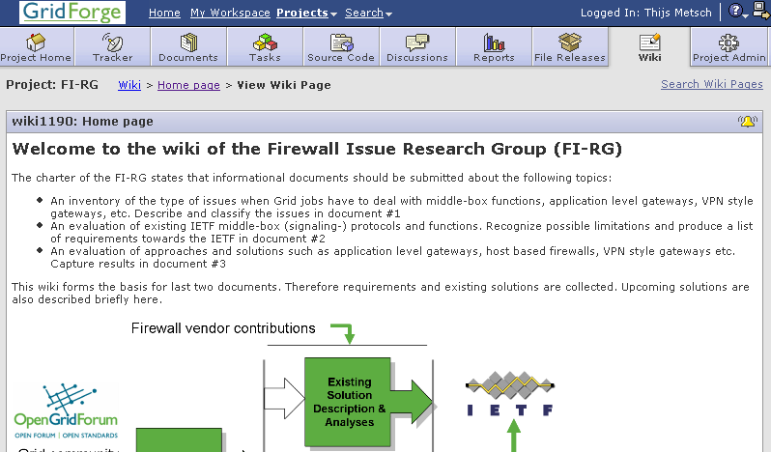
Questions & Suggestions
https://forge.gridforum.org/sf/projects/fi-rg!

Slide 12
Full Copyright Notice
Copyright (C) Open Grid Forum (2007). All Rights Reserved.
This document and translations of it may be copied and furnished to others, and derivative works that comment on or otherwise explain it or assist in its implementation may be prepared, copied, published and distributed, in whole or in part, without restriction of any kind, provided that the above copyright notice and this paragraph are included on all such copies and derivative works.
The limited permissions granted above are perpetual and will not be revoked by the OGF or its successors or assignees.
Notes:
OGF Full Copyright Notice if necessary

