Slide 1
Bridging the Usability Gap New models for secure and usable authentication APGridPMA Plenary Meeting Taipei, 8 March 2010

Slide 2
Outline
Authentication Federation: a road ahead
Brief Background
IGTF Foundation and Structure
Current issues in scalability
New directions
Federation-backed authorities and AAI integration
Private Key Protection
Robot certificates: matching our portal use cases

Slide 3
In the Beginning: the EU DataGrid CACG
In 2000, EDG needed a PKI with a defined assurance level
Early “development” CAs like the Globus CA no longer sufficed
Both end-user and service/host PKI
CACG (actually David Kelsey) tasked to create this PKI
for Grid Authentication only (explicitly no authorization)
no support for long-term encryption or digital signatures
Single CA was not considered acceptable
Single point of attack or failure, too large distances, weak checking
One CA per country, large region or international organization
CA must have strong relationship with RAs and thus with subscribers
A single hierarchy would have excluded existing CAs and not convenient to support with existing software
Coordinated group of peer CAs was most suitable choice
History

Slide 4
A Federation Model for Grid Authentication
CA 2
CA 1
charter
relying party n
CA n
guidelines
CA 3
acceptance
process
relying party 1
A Federation of many independent CAs
Policy coordination based on common minimum requirements (not ‘policy harmonisation’)
Acceptable for major relying parties in Grid Infrastructures
No strict hierarchy with a single top
leverage of national efforts and subsidiarity
Allow incorporation of many pre-existing CAs

Slide 5
‘Reasonable procedure … acceptable methods’
Defined assurance level based on minimum requirmnts
CP/CPS for “acceptable and trustworthy” Grid CAs
https://www.eugridpma.org/guidelines/CACG-minimum-requirements-v1.txt
Minimum requirements for RA - Testbed 1 --------------------------------------- An acceptable procedure for confirming the identity of the requestor and the right to ask for a certificate e.g. by personal contact or some other rigorous method The RA should be the appropriate person to make decisions on the right to ask for a certificate and must follow the CP. Communication between RA and CA ------------------------------- Either by signed e-mail or some other acceptable method, e.g. personal (phone) contact with known person Minimum requirements for CA - Testbed 1 --------------------------------------- The issuing machine must be: a dedicated machine located in a secure environment ... minimum length of user private keys must be 1024 min length of CA private key must be 2048 requests for machine certificates must be signed by personal certificates or verified by other appropriate means ...
lifetime of personal certificates should be no longer than one year.
...
Users must generate their own private key and must keep this private and secure.
History

Slide 6
New CAs: the Accreditation Process
Accreditation Guidelines for EUGridPMA
Basic elements:
Codification of procedures in a CP(S) for each CA
de facto lots of copy/paste, except for vetting sections
Peer-review process for evaluation
comments welcomed from all PMA members
two assigned referees
In-person appearance during a review meeting
Accreditation after remaining issues are addressed
Minimum Requirements evolved into Classic AP
Now much more complex, and at version 4.3
https://www.eugridpma.org/guidelines/

Slide 7
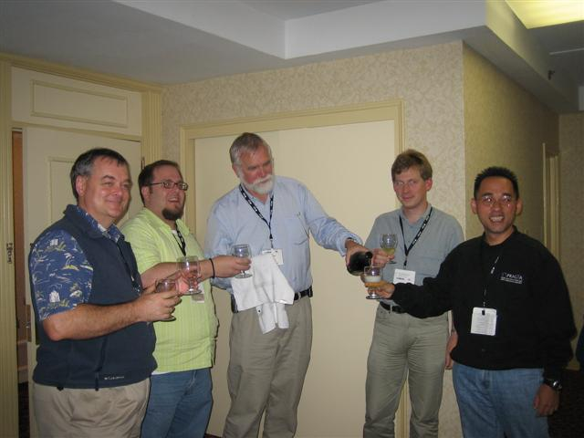
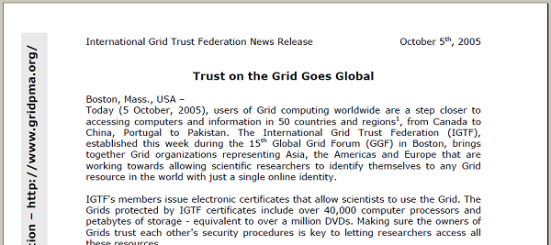
Timeline to Trust
March 2003: the Tokyo Accord
March 2005: IGTF Draft Federation Document GGF13
July 27th : APGridPMA approved version 0.7
September 28th: EUGridPMA approval version 0.9
October 5th: TAGPMA approved version 1.0
October 5th: formal foundation of the IGTF
History

Slide 8
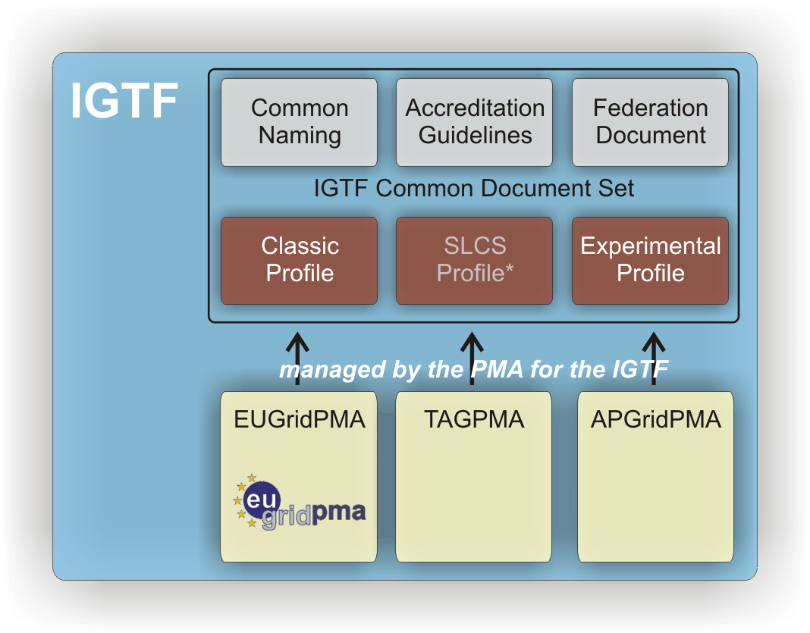


Common Guidelines across the IGTF

Slide 9
Relying Party issues to be addressed
Key characteristics of the request by our Major Relying Parties
1. standard accreditation profiles sufficient to assure approximate parity in CAs
2. monitor [] signing namespaces for name overlaps and issue unique names 3. a forum [to] participate and raise issues 4. [operation of] a secure collection point for information about CAs which you accredit 5. common practices where possible
(list courtesy of the Open Science Grid, backed by EGEE&wLCG)

Slide 10
Growth issues
A few statistics:
86 trust anchors
3 operational authentication profiles
71 distinct authorities
Mid-size CA: 500 active users
Large CA: 5000- 20000 users
Small CA: 1-10 users
Research and educational community in a small country: ~ 1 000 000 people
Number of end-users that understand PKI: << 1 %
How can we maintain both trust and scalability?
But not disenfranchise small communities
And with a focus on end-to-end security risks

Slide 11
Addessing scalability: three directions
Facilitating the issuance process
Short-lived and MICS issuance
Leverage (existing) high-quality identity systems
Mainly centered around research/educational federations
Facilitate user key management and hygiene
Provide key management tools
Outsource end-user key management
Private Key Protection protocol
Relieve users of the key management problem
Since many user may only a few ‘canned’ tasks anyway
Funnel user experience through a portal
Have the portal take care of identity and PKI

Slide 12
Federated CAs

Slide 13
Guidelines: short-lived credential service
Issue short-lived credentials based on another authentication system
e.g. institutional or existing federated administration
on-line issuing (with 140.2 level 2+ HSM or equivalent)
Based on crypto-data held by the applicant
Maybe only subset of entities in the database
Reasonable representation of the person’s real name
Same EE cert format, but no new user-held secrets
Can act like a ‘proxy’ (RFC3820), and has similar risks
The applicant can (and will) use it like a proxy
Risk of EE key exposure is mitigated by its shorter lifetime
Same common guidelines apply
reliable identity vetting to ensure uniqueness in CA’s life

Slide 14
Specifics of a SLCS
Sufficient information must be recorded and archived such that the association of entity and subject DN can be confirmed at a later date.
Qualifying IdMs must suspend or revoke authorization to use the service if the traceability to the person is lost.
The CP/CPS must describe:
How the identity (DN) assigned in the certificate is unique within the namespace of the issuer.
How it attests to the validity of the identity.
How the identity (DN) assigned in the certificate will never be re-issued to another end-entity during the entire lifetime of the CA.
How it provides DN accountability, showing how they can verify enough identity information to trace back to the physical person for at least one year from the date of certification, and in keeping with audit retention requirements.
In the event documented traceability is lost, DN must never be reissued.

Slide 15
MICS vs SLCS
MICS is comparable to a Classic CA
in life time and vetting rigour, but time-shifted & off-loaded to federation or IdM
… which makes it look an awful lot like SLCS!
With
The life time of the cert can be 13 months
To off-set this risk
The requirements on IdM access and -use are stronger
Extra verification data is requested at issuance time to protect against weak or re-used IdM passwords
Active revocation support required
in SLCS: only re-active CRLs required
With proper IdM management, a MICS is just a 33 times a SLCS, but without bothering the user all the time!

Slide 16
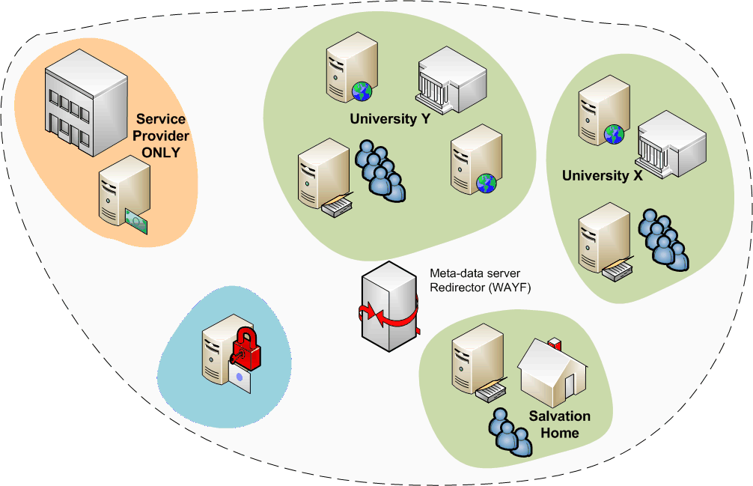
Federations
A common Authentication and Authorization Infrastructure
Allow access to common resources with a single credential

Slide 17
Key element: it needs to scale
Scalability (to 1-10 M people per country)
Various groups of people: students, walk-ins, staff
Each group has different identity profile and LoA
Minimize personnel involvement
Each helpdesk visit is costly
Compliance and regulations
Universities are far more visible than grids
Then, there are easy gains from the federation
Large user base: many people already ‘well known’
Pretty good quality ID: paychecks, student IDs, exams

Slide 18
European Landscape
Identity Federations (or simply federations) are being developed at national level by the NRENs:
Germany, Czech Republic, Switserland, Kalmar Union countries, Netherlands, … and more: all have a working production-quality federation
Different (open source) technologies are used
Shibboleth: UK, Finland, Switzerland, Germany Often-used technology, but not the only one!
PAPI: Spain
PingID (A-Select, Shib, PKI, ADFS, sSPHP,…): Netherlands
Sun Federation Manager based upon Liberty Alliance spec: Norway
Interoperation through use of SAML (2.0)
With thanks to Licia Florio, TERENA

Slide 19
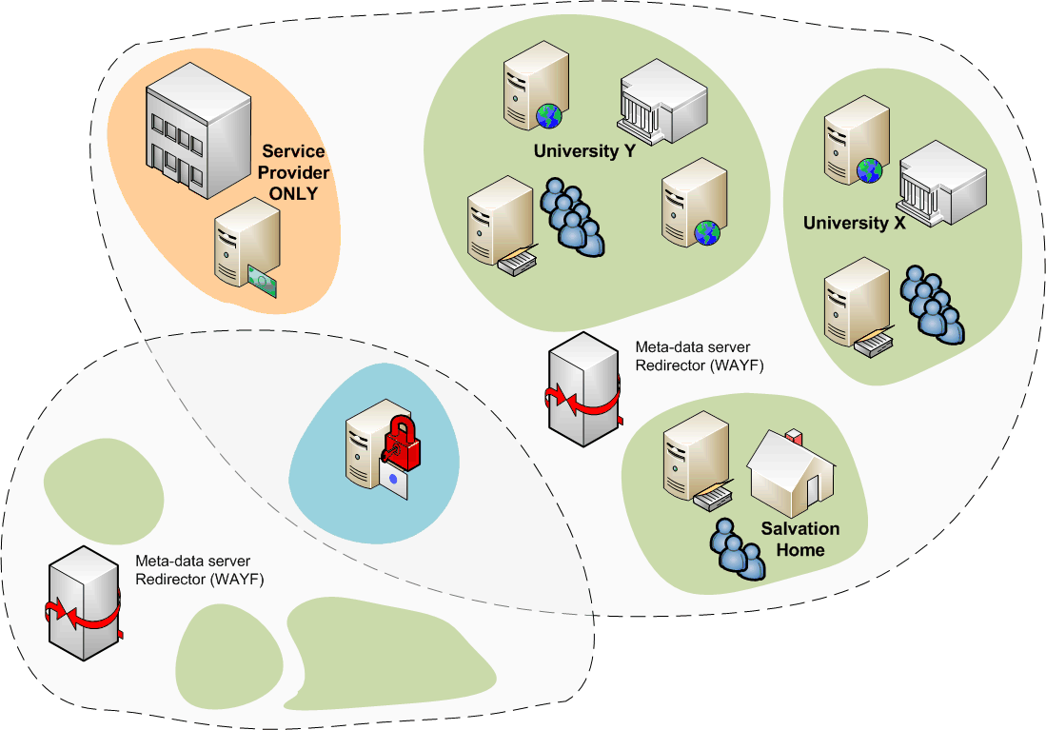
SP ‘multi-federation’
shared service provider

Slide 20
Grid and Federations
Many of the e-Infrastructure users have a federated account anyway
Could give users grid certificates within 5 minutes without any further hassle, if the trust level matches
Allows users to ’try’ the grid
Allows for scaling the number of grid users significantly
Comparable issues and trust levels
Federation assurance levels are coming up, as more diverse services participate in the federation
User account management of IdPs is improving rapidly … far more than grid credential management!

Slide 21
Constraints on a Federated Grid CA
We are the first service to ask for a specific, higher, LoA
LoA slow in catching on
various services in the federation have diverse value
but waiting for it can take years
IdPs and services in a federation loosely coupled
How should loss of affiliation or expiry affect the CA and the issued certs
Pushing requirements on IdPs for one SP is hard
needed to overcome LoA issue, but should be minimal
Contract types and policy convergence required
Any human interaction (helpdesk) is expensive

Slide 22
Matching the ‘easy’ requirements
Persistent and unique naming
IdPs historically tended to recycle login names
even eduPersonPrincipalName is often recyled
only eduPersonTargetedID is immune to thus, but not supported everywhere (and is usually opaque)
this adds a requirement to the federation or to the IdPs
Reasonable representation of names
Given name, surname and nickname are usually considered privacy sensitive
user-approved release of these appears doable
requires evaluation of legal framework

Slide 23
Matching the ‘harder’ requirements
How to protect against re-use of federation login and password (on e.g. Wiki’s, web sites, ISP mail)?
Use a high-value backend IdM as per the MICS requirements
The infamous ‘2nd factor’ actually adds little, and was optional anyway in the Profile
Handling revocation
The CA is ‘just a service provider’, and cannot know bout IdP level comrpomises
Provide an automatic interface for IdPs to revoke certificates, and put down the requirements on the IdP
Assurance level at the IdP
The CA SP is usually the first ‘high-LoA’ application
Requirements put in through legally binding contracts

Slide 24
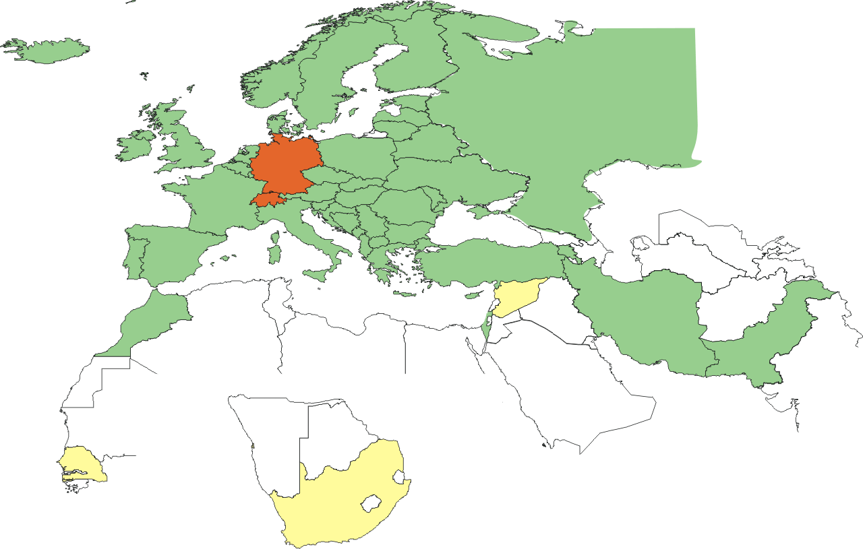
Federation-based SLCS-only countries

Slide 25
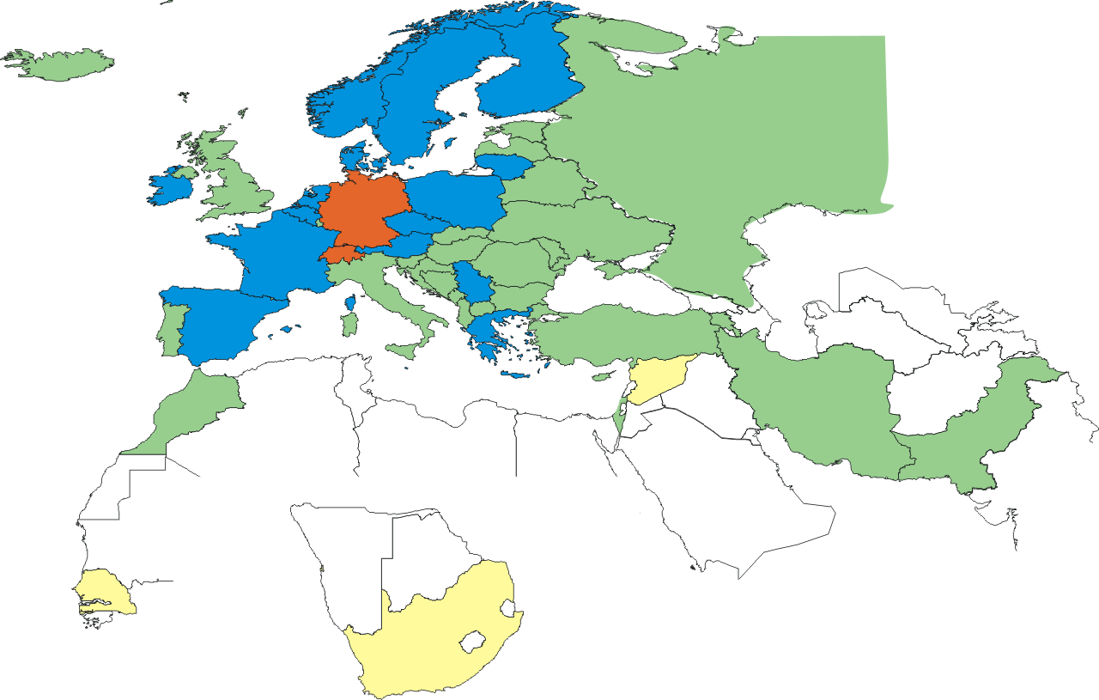
TERENA eScience Personal eligible

Slide 26
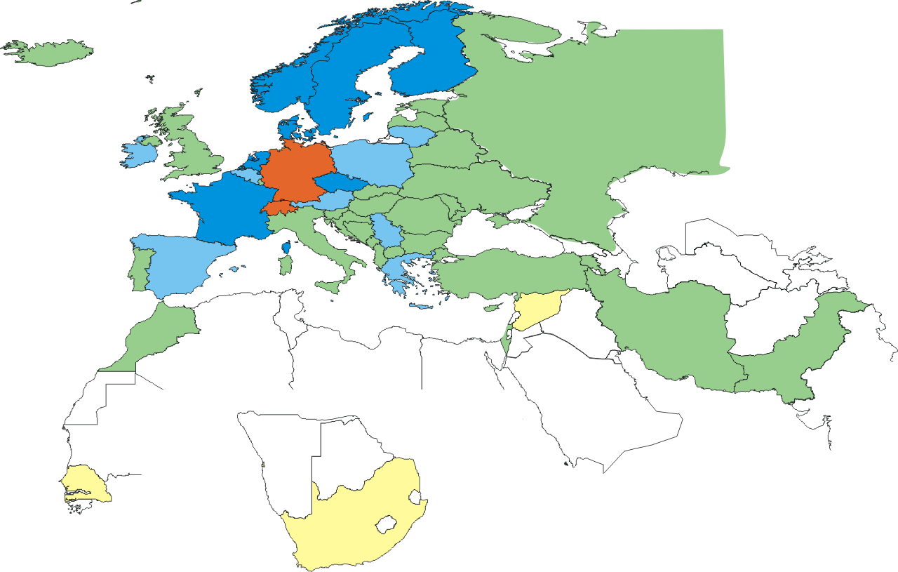
TCS eScience Personal Common Portal
NO
NL
DK
SE
FI
FR
(CZ)
TCS eScience Personal accredited as per Feb 1st

Slide 27
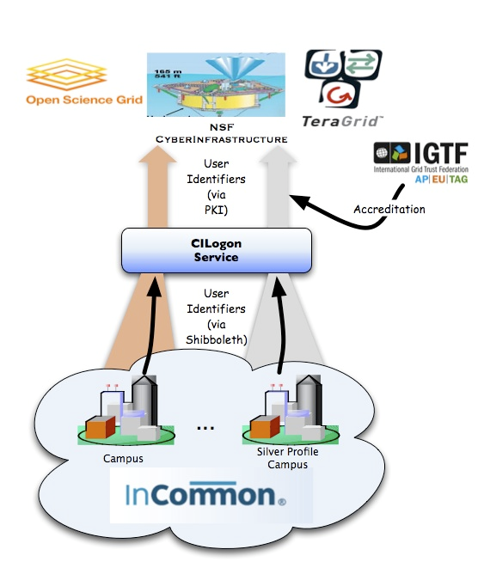

Coming up also elsewhere!
CIlogon
Leverage InCommon silver for a SLCS certificate
http://www.cilogon.org/
ARCS SLCS CA
National federation backed (AAF)
Shibboleth tech based
http://wiki.arcs.org.au/bin/view/Main/SLCS

Slide 28
PKP
Need for guidelines
Enabling new directions
Generation
Storage

Slide 29
Private Key Protection
Formal statement today
User must generate own key material
Keep it private and not share with anyone
Protect it with a strong 12+ character passphrase
Unchanged since v1 on the Minimum Requirements …
De-facto practice
Users generate key material on shared login systems
Store it on shared file systems (NFS, AFS, NT shares)
Protect it with a 4+ character string of unknown quality
MyProxy stores contain proxies of arbitrary validity
Risk assessment and trade-off were never fully done

Slide 30
New directions
Central credential repositories
Managed MyProxy stores
Generation of keys by the CA
Pre-generated certificates by home organisations
Credential generation by SLCS/MICS services
Choice of algorithms, quality of key material assurance
Integrated portals with SLCS capabilities or back-ends

Slide 31
PKP Guidelines
Come up with a set of guide lines that deal with key material
Incremental improvement on current practice
Doable, without alienating users or admins
Enable central repositories
Guide MyProxy stores
Codify a ‘rough consensus’ risk analysis

Slide 32
Scope and aims
This document describes guidelines on the generation and storage of end-user private key material, using secure hardware tokens and appropriate computer systems.
It applies to all systems that store key material on which certificates issued by IGTF accredited authorities are based, and may be used as guidance for any system that holds private key material.
Split document in two parts
generation
storage
Document https://www.eugridpma.org/guidelines/pkp

Slide 33
Generation
Inside a secure hardware token
Locally on an appropriate computer system of which the user is the sole user and administrator
On an appropriate computer system that is administered by the users home organisation
With systems management subject to good rules
On an appropriate computer system that is administered by a third party, provided that …
It is done as the result of an explicit user action
…

Slide 34
Storage
On a secure hardware token from which it cannot be extracted, protected by a pass phrase
On a local file system on an appropriate computer system of which the user is the sole user and administrator
On a local or networked file system on an appropriate computer system that is administered by the users home organisation, protected by a pass phrase
On a networked file system on an appropriate computer system that is administered by third party, provided that
the key is only ever stored a. persistently in encrypted form …

Slide 35
PKP status
Document accepted at the IGTF all-hands meeting
Pending implementation in Authentication Profiles
Completed for Classic AP in January 2010 in v4.3
Classic v4.3 itself is pending endorsement by peer PMAs
SLCS and MICS still to be done
This would enable some novel scenarios where a (national?) service would provide secure managed services for end-users, linked to one or more CAs
Integrated user experience
Less potential for private key exposure
But also a single source of ‘interesting’ data …

Slide 36
Portals and Robots
Robots
1SCP
VO Portal Policy

Slide 37
Robots
Robots, also known as automated clients, are entities that perform automated tasks without human intervention.
Production ICT environments typically support repetitive, ongoing processes - either internal system processes or processes relating to the applications being run (e.g. by a site or by a portal system).
These procedures and repetitive processes are typically automated, and generally run using an identity with the necessary privileges to perform their tasks.

Slide 38
Acceptable Robots
We know what Robots are
Which robots are acceptable end-entities?
De-facto standard set by UKeScience naming, private key handling, keyUsage
Conservative approach chosen Full name in subjectDN, hardware token
Copied by INFN and DutchGrid CAs
Initial consent by EUGridPMA was never formalised
So, what are ‘acceptable robots’?

Slide 39
Definitions of a Robot
Via the 1SCP documents?
No, since the 1SCP series was designed to be orthogonal for RP trust evaluation purposes, not to be normative
1SCP ‘Robot Entities’ { igtf.2.3.3.1 }
Describes the type on entity
NOT whether a particular robot implementation is ‘acceptable’
1SCP ‘PKP Secure Hardware Token’ { igtf. 2.3.1.1}
Says the key is on a hardware token
Not whether this is needed for a Robot, or for a person, or for a Martian

Slide 40
Guideline on Approved Robots
Approved Robots are those robots that meet our criteria for acceptance under the Classic (or MICS, or SLCS) profile:
“This document describes guidelines on the generation and storage of private key material, naming, and permissible key usage of automated clients (robots) that can hold credentials issued by IGTF Accredited Authorities.”
It’s a Guidelines document, not a 1SCP or an AP
Managed by the EUGridPMA, on IGTF request
Assigned OID { igtf.4.1.1.1.6 }
https://www.eugridpma.org/objectid/?oid=1.2.840.113612.5.4.1.1.1.6
https://www.eugridpma.org/guidelines/robot/

Slide 41
But What Do We Approve Of?
Items to reach consensus on
Naming
Key generation
Key storage
Extensions
keyUsage
certificatePolicies
Required contact information in EEC

Slide 42
Naming
Basic naming requirement: The subject distinguished name of a robot MUST unambiguously identify the entity as a robot by including the string “Robot”, followed by a non-alphanumeric, non-whitespace separator, in a commonName component of the subject name. The separator SHOULD be a COLON (“:”).
Then the rest of the name?
The commonName subject DN component(s) of the robot MUST include a humanly-recognisable and meaningful description of the Robot as well as either:
an electronic mail address of a persistent group of people responsible for the robot operations; or
the name of a single natural person responsible for the automated client.

Slide 43
The Robot Key
Initially, all three CAs that were ‘robot enabled’ issued these robot certs only on a hardware token
Risk analysis for the grid environment showed
You need to have the key activated in the token when used in a portal
If the key is activated, any attacker can generate proxies
There can be timeshifted to cover the entire EEC validate date
in fact, the hardware token does the same as a key file
So: the new profile allows robot keys to be in a file

Slide 44
Responsibilities
In case a persistent group of persons is named, this persistent group of responsible people must react appropriately within the certificate revocation grace period to any request for information, and the issuing authority MUST keep the traceability to a single responsible natural person that assumes responsibility for actions undertaken by the robot and for the actions of the all persons in the group of people responsible for the robots operation.
Subscribers are responsible for complying with the private key storage protection criteria and for maintaining appropriate access controls and traceability.

Slide 45
Matching robots to use cases: Portals
Many end-users run the same or comparable work flows
Varying input parameters
Running the same program over different data sets
Compose their own work flow in a dynamic way
and prefer to use a web based or service based front end
These use cases do not all require the same level of assurance
Policy to classify different scenarios
And lay down minimum authN/authZ requirements for each
Classification inspired by EGEE working group on bioportals

Slide 46
VO portal policy
Early 2008: BiG Grid, the Dutch eScience Grid, had actual and current need for portals and a policy to enable these to run
Classified portals in to 4 different groups
no user interaction
Select from a limited number of parameters
Feed data but not executable code
Run your own executable code
Groups have increasing AuthN/AuthZ requirements
Class 1 to 3 only support ‘canned’ (pre-defined) applications
JSPG took over the extension and improvement of this policy
JSPG endorsed version: https://edms.cern.ch/document/972973
Discussion: http://www.jspg.org/wiki/VO_Portal_Policy

Slide 47
VO Portal classes
Class-1 “Web Rendering Automaton”
The Portal may offer services to all Web Users
The Portal must use a Robot Certificate
No data may be stored on the Grid
Portal must keep enough information to associate any interactions with the Grid with a particular Internet address and tcp port of an end user
Class-2 “Parameter” Portals
Portal may offer services to Pseudonymous, Identified and Strongly Identified Web Users
Portal may use a Robot Certificate or alternatively may use the authentication information provided to obtain a User credential (front a SLCS/MICS or MyProxy CA)
Re-usable private data must not be transferred across a network, not even in encrypted form

Slide 48
VO Portal Classes
Class-3 “Data Processing” Portals
Portal may offer services to Identified and Strongly Identified Web Users
Portal may use a Robot Certificate, or alternatively may use the authn information provided to obtain a User cred
Portal must not store or obtain long-lived reusable authn information for Strongly Identified Web Users
Class-4 “Job Management” Portals (full power)
The Portal may offer services only to Strongly Identified Web Users, or to Identified Web Users where both the Portal system itself and the authentication of Identified Web Users meets the requirements of either the SLCS or MICS IGTF Authentication Profile.
The Portal must use User credentials specific to the Web User and use these for all interactions with the Grid.

Slide 49
Robots for Portals
Aim is to
Have portals with robot certificates improve overall security of the system
Improve the user experience
Be practical, in that administrators can setup a portal without being scared away from the policy
and do their ‘thing’ anyway…
VO Portal Policy is
Working in practice for BiG Grid since 2008
Endorsed by the JSPG stake holders (EGEE, wLCG)
Wideer deployment status yet unknown

Slide 50
So, what’s next?
Federated Cas
Setting one up is non-trivial, but worthwhile
Needs (i) a reasonably set-up federation and (ii) institutions that have their identity management in order
New Private Key Protection guidelines
Designed to improve effective security of user keys
Despite looking more ‘lax’
But current practice already is remote from theory
Read the doc, and see if you want to update your own CP/CPS, or encourage your subscribers to try new ways
Robot Certificates
Please: start supporting these
Boiler-plate text can be taken from UK, IT or NL CP/CPS
Adapt to allow also soft tokens as key storage

Slide 51
APGridPMA http://www.apgridpma.org/ EUGridPMA https://www.eugridpma.org/ TAGPMA http://www.tagpma.org/ IGTF http://www.igtf.net/

