Slide 1

Ontology Specification Introduction
(Past GGF Meetings)
Access Services for RDF Data Resources

Slide 2
OGF IPR Policies Apply
“I acknowledge that participation in this meeting is subject to the OGF Intellectual Property Policy.”
Intellectual Property Notices Note Well: All statements related to the activities of the OGF and addressed to the OGF are subject to all provisions of Appendix B of GFD-C.1, which grants to the OGF and its participants certain licenses and rights in such statements. Such statements include verbal statements in OGF meetings, as well as written and electronic communications made at any time or place, which are addressed to:
    the OGF plenary session,
    any OGF working group or portion thereof,
    the OGF Board of Directors, the GFSG, or any member thereof on behalf of the OGF,
    the ADCOM, or any member thereof on behalf of the ADCOM,
    any OGF mailing list, including any group list, or any other list functioning under OGF auspices,
    the OGF Editor or the document authoring and review process
Statements made outside of a OGF meeting, mailing list or other function, that are clearly not intended to be input to an OGF activity, group or function, are not subject to these provisions.
Excerpt from Appendix B of GFD-C.1: ”Where the OGF knows of rights, or claimed rights, the OGF secretariat shall attempt to obtain from the claimant of such rights, a written assurance that upon approval by the GFSG of the relevant OGF document(s), any party will be able to obtain the right to implement, use and distribute the technology or works when implementing, using or distributing technology based upon the specific specification(s) under openly specified, reasonable, non-discriminatory terms. The working group or research group proposing the use of the technology with respect to which the proprietary rights are claimed may assist the OGF secretariat in this effort. The results of this procedure shall not affect advancement of document, except that the GFSG may defer approval where a delay may facilitate the obtaining of such assurances. The results will, however, be recorded by the OGF Secretariat, and made available. The GFSG may also direct that a summary of the results be included in any GFD published containing the specification.”
OGF Intellectual Property Policies are adapted from the IETF Intellectual Property Policies that support the Internet Standards Process.
Notes:
IPR Notices Note Well for OGF meetings

Slide 3
Full Copyright Notice
Copyright (C) Open Grid Forum (2006). All Rights Reserved.
This document and translations of it may be copied and furnished to others, and derivative works that comment on or otherwise explain it or assist in its implementation may be prepared, copied, published and distributed, in whole or in part, without restriction of any kind, provided that the above copyright notice and this paragraph are included on all such copies and derivative works.
The limited permissions granted above are perpetual and will not be revoked by the OGF or its successors or assignees.
Notes:
OGF Full Copyright Notice if necessary

Slide 4
Operational Model
Possible alternatives:
  Graph-oriented
  Object-oriented
Operation types:
  Creation/removal
  Retrieval
  Attachment/detachment
Side issues:
  Inference aware vs inference unaware operations
Notes:
Let’s move to the operational model of the access services. There are at least to possible ways for interacting with the model: following a graph-oriented set of operations or following an object-oriented one.
The graph-oriented operations would involve triple creation, retrieval and deletion. Simple, but not very usable. It doesn’t abstract the data model enough, as the user should have to know beforehand the built-in vocabulary to create, retrieve or delete the triples appropriately.
We have gone for a more object-oriented solution, trying to mimic the data model and providing the useful abstractions that enhance the usability of the final interfaces.
We have identified three sets of operations: creation/removal which deal with the management of instances; retrieval, those used for retrieving data; and attachment/detachment, those for managing the relationships between resources.
There are two key issues that we had to decide when we were beginning with the work:
- Should we have to provide validating operations, that is operations that check the validity of the model as it is being modified? For instance checking the domain and range constraints when creating a new relationship between to resources..
- The other one is related to how the inference mechanisms behave. Do we take into account the whole class hierarchy when retrieving the subclasses of a given class?
We want to provide a set of opperations whose behaviour can vary according the user needs, but giving also to the developer to decide which characteristics he want to develops. So all of these issues are optional, and should be configurable at runtime in those implementations that provide them.

Slide 5
Recalling the design criteria (II)
Interface organization
Two layers:
  Bulk access
  Specialized access
Interface types:
  Native interfaces: mimic classes of the RDF(S) data model
  Utility interfaces: provide additional functionalities that enhance usability
Message definition:
  Direct data access:
    Retrieval of directly associated information
    Creation of new data (including attachments)
    Deletion of existing data (including detachments)
  Indirect data access
    Delegation of access to services that provide specialized access to a subset of associated information
Notes:
Regarding the organization of the interfaces and operations, we have used the following criteria:
First we have splitted the interfaces in two layers, according to the granularity of the operations. There is a bulk layer in which we can create and delete instances and there is also a specialized layer where we manage the relationships between instances, and provide specific retrieval operations.
We have identified two types of services/interfaces, native ones which mimic the main classes of the RDF(S) data model and the utility services/interfaces. These ones are convenient abstractions that provide further functionalities that enhance the overall usability of the services.
Regarding to the operations themselves, we have left to direct data access those related to the retrieval, creation and deletion of data. Indirect data access has been used for moving from interfaces which provide coarse grained access to those that provide a specialized fine grained access.

Slide 6
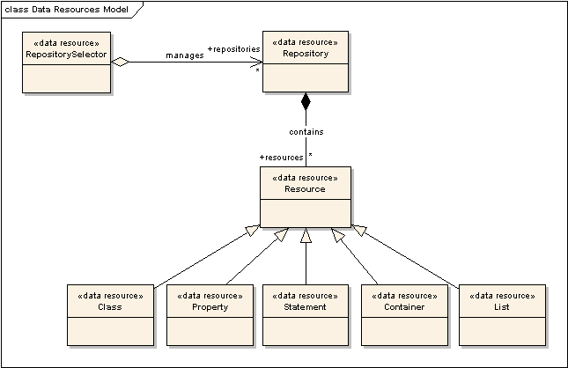
Current status (I)
Data resources
Notes:
Two kinds of data resources, from bottom to top:
Resources that mimic RDF(S) modelling elements:
General: Resource
Specific: Class, Property, Statement, Container, List
Convenience abstractions
Repository
RepositorySelector (collection)
Such level of granularity allows finer grain of control over the concrete parts of the data sets (access policies, read/write permissions, etc)
Resources as views of the data resource

Slide 7
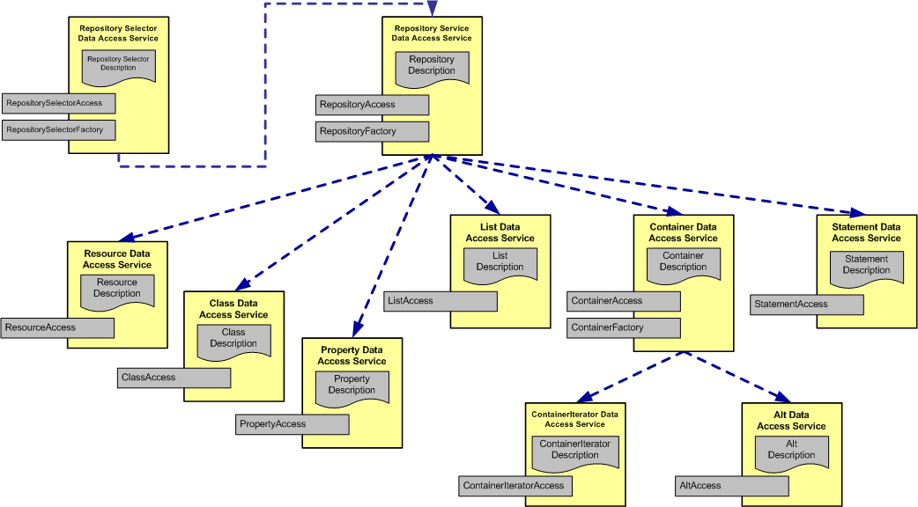
Current status (II)
Interface organization
Notes:
This picture shows which interfaces we have already identified and how they are organized.

Slide 8
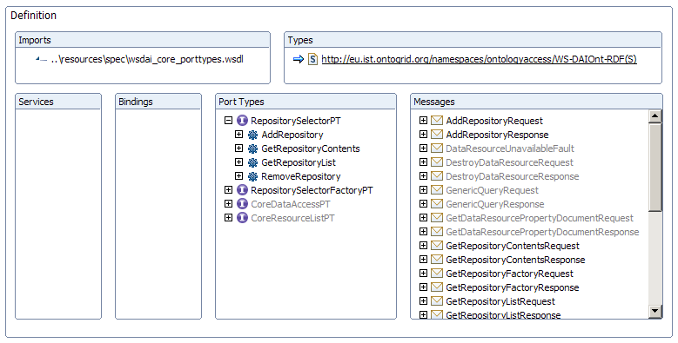
Current status (III), Interfaces provided (I)
RepositorySelector
NEW
Meter el RepositorySelector
Indicar que es nuevo

Slide 9
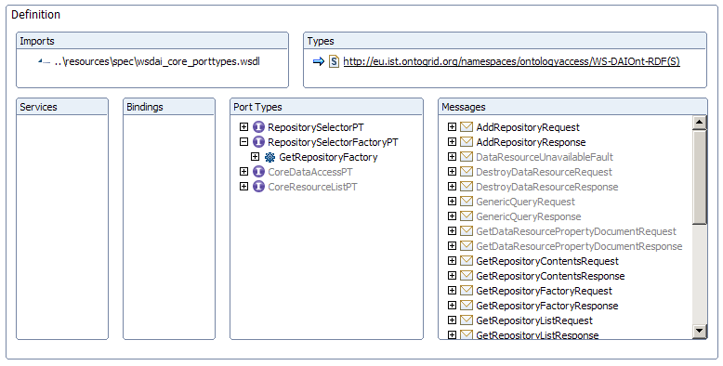
Current status (III), Interfaces provided (II)
RepositorySelectorFactory
NEW

Slide 10
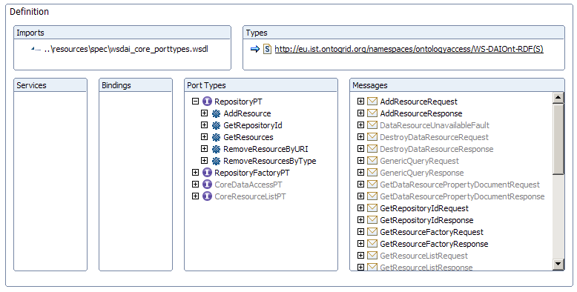
Current status (III), Interfaces provided (III)
Repository
CHANGED
Notes:
The RepositoryAccess interface is the frontend to the repository. It provides the basic functionalities for retrieving, creating and deleting contents to the repository, taking into account the specificities of the data element that is to be created, a class, a property, etc. This interface is, as you can imagine, part of the bulk layer.

Slide 11
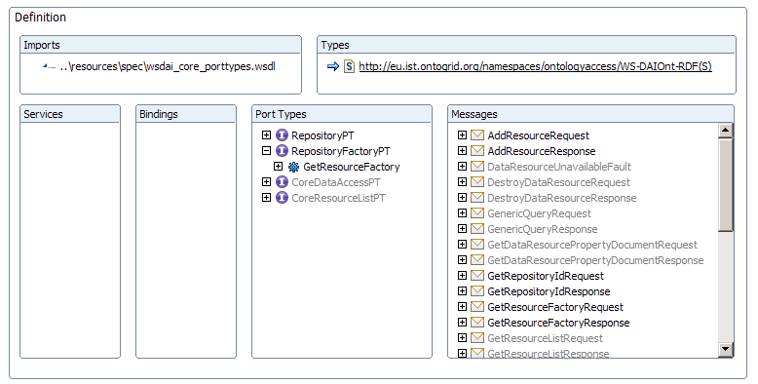
Current status (III), Interfaces provided (IV) RepositoryFactory
CHANGED
Notes:
The RepositoryFactory is also in the bulk layer. It provides operations that allow the delegation of access to a specialized access interface, according to the nature of the element.

Slide 12
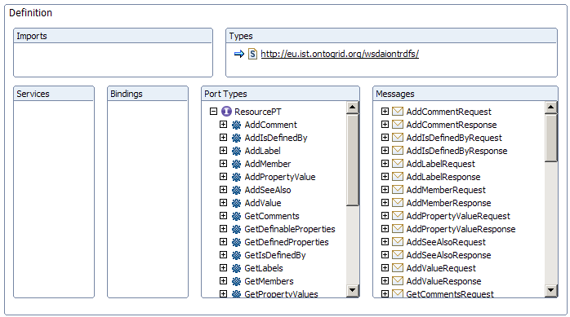
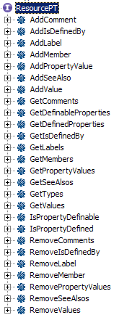
Current status (III), Interfaces provided (V)
Resource
CHANGED
Notes:
From now on, we will see interfaces that belong to the specialized layer.

Slide 13
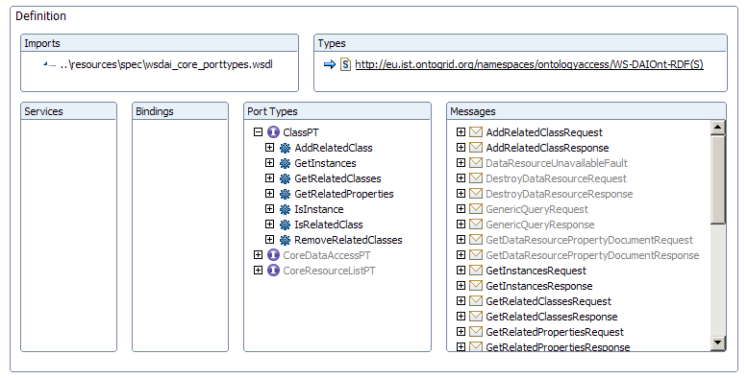
Current status (III), Interfaces provided (VI)
Class
CHANGED
Notes:
The ClassAccess interface provide methods for managing the class hierarchy, and for managing the instance of concrete class. Given a concrete class, we can add sub and super classes, find out which classes are sub or super classes and which are the instances of the class.

Slide 14
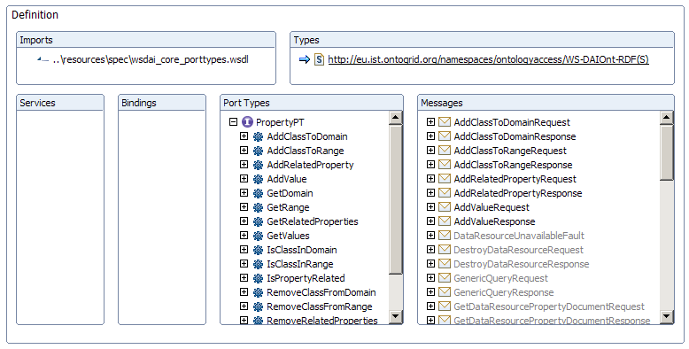
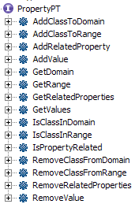
Current status (III), Interfaces provided (VII)
Property
CHANGED
Notes:
The PropertyAccess interface provides operations for dealing with properties: constraining the domain and range, adding values for resources, retrieving and deleting those values.

Slide 15
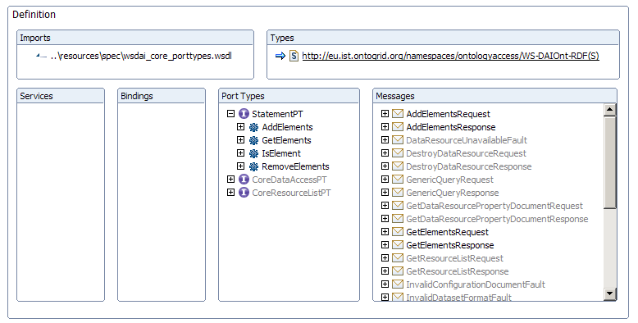
Current status (III), Interfaces provided (VIII)
Statement
CHANGED
Notes:
The StatementAccess interface deals with reification information, it provides operations for specifying the subject, predicate and object of a Statement and for retrieving or removing them.

Slide 16
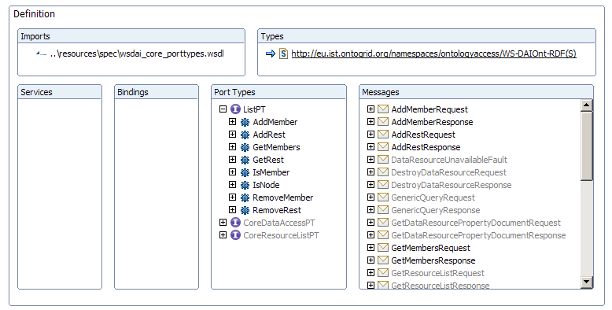
Current status (III), Interfaces provided (IX)
List
UPDATED
Notes:
The ListAccess interface provides operations for dealing with RDF lists: managing first and rest elements, mainly.

Slide 17
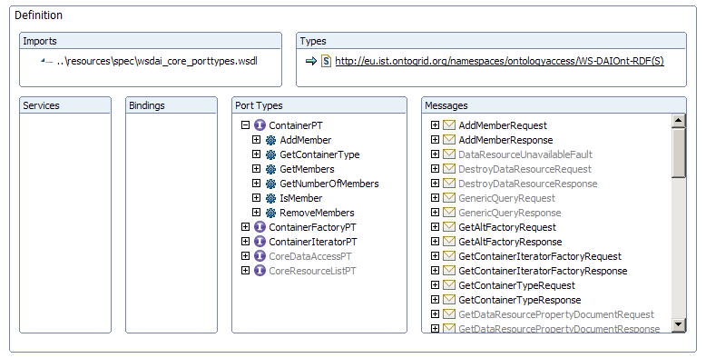
Current status (III), Interfaces provided (XI)
Container
UPDATED
Notes:
The ContainerAccess interface is provided for dealing with the RDF container abstraction, that is managing its members, accessing to them by means of its position.

Slide 18

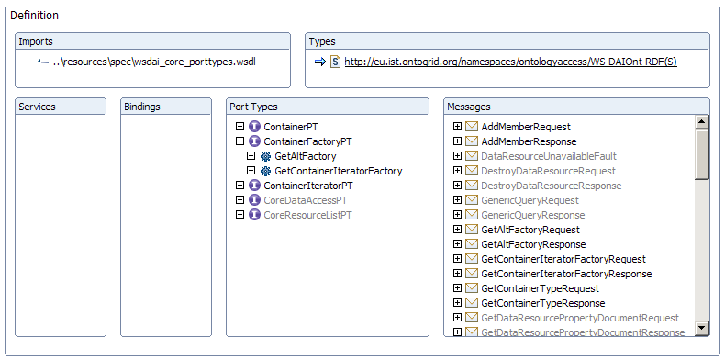
Current status (III), Interfaces provided (XII)
ContainerFactory
UPDATED
Notes:
The ContainerFactory interface provides operations for delegating the access of the container to a specialized interface: and iterator interface or the alt interface.

Slide 19
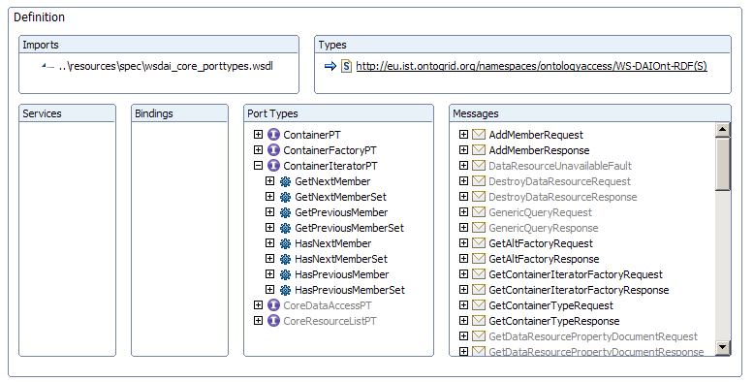
Current status (III), Interfaces provided (XIII)
ContainerIterator
UPDATED
Notes:
The ContainerIteratorAccess interface is an utility abstraction provided for traversing a container without of caring about the exact position of the members.

Slide 20
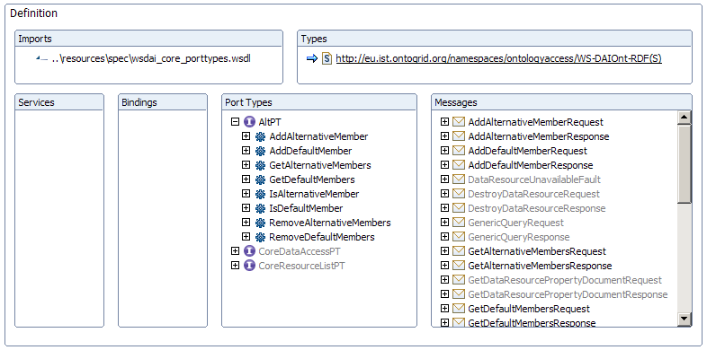
Current status (III), Interfaces provided (XIV)
Alt
UPDATED
Notes:
Finally we have the AltAccess interface. The RDF class Alt is a type of Container which is a little bit different from the other built-in containers (Bag and Seq). The RDF Alt container separates the members in default and alternative ones. Therefore we have created an interface that provides specific operations for dealing with this issue.

Slide 21
Future Work
Behavioural aspects
  Static properties
  Configurable properties
Test suite
Sample use cases
Glossary of terms
Notes:
As future work, we have to finish some operations that are not fully defined. We also have to work in those behavioural aspects that I commented before. They are mostly related with the static and configurable properties of the interfaces. Finally, we are still to produce a joint glossary that will be used in the querying part and in the ontology one.

