Slide 1
GNS-WSI2
Grid Network Service -
Web Services Interface, version 2
Atsuko Takefusa¹, Michiaki Hayashi², Akira Hirano³,
Shuichi Okamoto⁴, Tomohiro Kudoh¹, Takahiro Miyamoto²,
Yukio Tsukishima³, Tomohiro Otani⁴, Hidemoto Nakada¹,
Hideaki Tanaka², Atsushi Taniguchi³, Yasunori Sameshima⁴
1. National Institute of Advanced Industrial Science and Technology (AIST)
2. KDDI R&D Laboratories,
3. NTT Network Innovation Laboratories,
4. National Institute of Information and Communications Technology (NICT)

Slide 2





G- lambda project overview
Joint project of KDDI R&D labs., NTT, NICT and AIST.
G-lambda project has been started in December 2004.
The goal of this project is to establish a standard web services interface (GNS-WSI) between Grid resource manager and network resource manager provided by network operators.

Slide 3
The G-lambda Team
Shuichi Okamoto
Tomohiro Otani
Yasunori Sameshima
Akira Hirano
Yasunori Sameshima
Wataru Imajuku
Takuya Ohara
Yukio Tsukishima
Atsushi Taniguchi
Masahiko Jinno
Yoshihiro Takigawa
Tomohiro Kudoh
Hidemoto Nakada
Atsuko Takefusa
Yoshio Tanaka
Fumihiro Okazaki
Satoshi Sekiguchi
Hiroshi Takemiya
Motohiko Matsuda
Seiya Yanagita
Katsuhiko Okubo
Masatoshi Suzuki
Hideaki Tanaka
Tomohiro Otani
MunefumiTsurusawa
Michiaki Hayashi
Takahiro Miyamoto

Slide 4
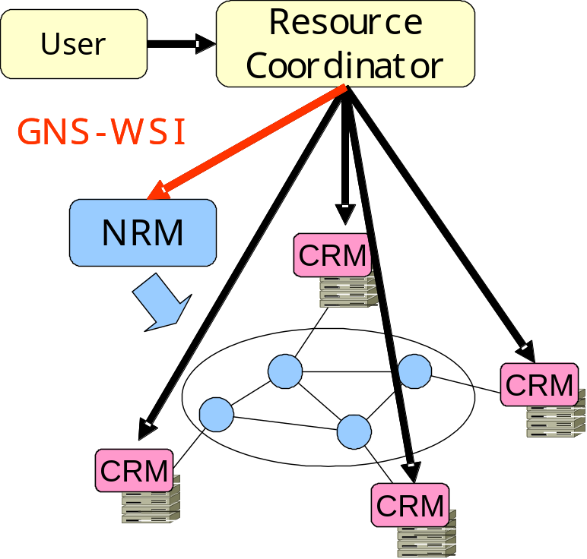
GNS-WSI
Grid Network Service - Web Services Interface
Interface to enable advance reservation of bandwidth from Grid applications and middleware
Based on the Web Services interface technology
Can be used for inter-domain coordination
Polling-based non-blocking
operations
  Advance reservation of a path
  between end points
  Modification of reservation
  (i.e. reservation time or duration)
  Query of reservation status
  Cancellation of reservation
Booking request (netResourceReservation)
Site IDs, Reservation Time, Bandwidth(, availability, latency)
(Example: Site A-B, 15:00-18:00, 1Gbps)

Slide 5
GNS-WSI2 (GNS-WSI ver. 2)
GNS-WSI ver. 1 in 2005
  Provides simple Web services based interface
    Reservation requests are identified by the "path reservation ID" operation parameter
  1-phase commit
GNS-WSI2 (GNS-WSI ver. 2) in 2006
  Based on WSRF (Web Services Resource Framework)
    Standard WS interface for "stateful" services
    Reservation requests are identified by Endpoint Reference (EPR)
  Support 2-phase commit protocol
    Distributed transaction processing by GRC is available

Slide 6
GNS-WSI2 Services
ReservationFactoryService
  Creates ReservationResource instance in ReservationService
  Provides network resource information
ReservationService
  Provides general reservation operations
    reservation, modification, release
  Creates ReservationCommandResource instance in ReservationCommandService
ReservationCommandService
  Enables 2 phase commit and non-blocking operation
(xxxResource is a service instance for each user request)

Slide 7
GNS-WSI2 Operations
Service | Operations | Remarks
Reservation Factory Service | createReservationResource | creates reservation resource
 | netResourceQuery | discovery of resources between designated sites
 | netAvailableResourceQuery | discovery of available resources
Reservation Service | netResourceReservation | advance reservation request
 | netResourceModification | modification request
 | netResourceRelease | release request
 | getResourceProperty(QName) | returns specified ReservationResource property
Reservation Command Service | getResourceProperty | returns CommandStatus
 | commit | commit the request
 | abort | abort the request

Slide 8
Service Parameters
(Most of them are defined by GNS-WSI ver. 1)
Parameter | Usage | Value | Remarks
Site ID (APoint, ZPoint) | ID to specify A and Z points | String | Name or ID of sites
bandwidth | Bandwidth of the resource | Positive integer (kbit/s)
latency | Latency between end points | Positive integer (msec)
availability | Network protection of network resource | Integer (-2³² ～ 2³²-1) | 0 = Un-protected 1 = Protected
Reservation time (startTime, endTime) | Start time and end time of the reservation | xsd:dateTime | YYYY-MM-DDTHH:MM:SSZ
localUsername | user name of certificate | String | GT4 GSI
reservationStatus | status of reservation | String | Created/Reserved/Activated/Released/Error
commandStatus | status of each command | String | Initial/Prepared/Committed/Aborted
resourceStatus | status of network resource | String | Available / NotAvailable

Slide 9
ReservationStatus Transition Process (Reservation)
A property of ReservationResource
Represents current "Reservation"
status for each requested path
ReservationStatus:
  Created
  Reserved
  Activated
  Released
  Error
createReservationResource
netResourceReservation
cmd aborted
Created
internal
error
netResourceReservation cmd committed
internal
error
netResourceModification
cmd committed/aborted
netResourceRelease
cmd aborted
Reserved
Error
activate
internal
error
netResourceModification
cmd committed/aborted
netResourceRelease cmd aborted
Activated
netResourceRelease
cmd committed
release
netResourceRelease cmd committed
Released

Slide 10
CommandStatus Transition Process (ReservationCommand)
A property of ReservationCommandResource created by reservation commands (e.g. netResourceReservation)
Represents current
requested operation status
CommandStatus:
  Initial
  Prepared
  Committed
  Aborted
Initial
pre-command
succeeded
pre-command
failed
abort request
timeout
Prepared
Aborted
commit request
Committed

Slide 11
An example XML exchanged through GNS-WSI2
Client
(E.g. GRS,
Resource
Coordinator)
Create reservation request instance for WSRF
NRM
Reference of the instance
Booking request (netResourceReservation)
Site IDs, Reservation Time, Bandwidth(, availability, latency)
(Example: Site A-B, 15:00-18:00, 1Gbps)
Reference of the requested reservation
Get command status
"Prepared"
GNS-WSI2
Commit the requested reservation
Get reservation status
"Reserved"

Slide 12
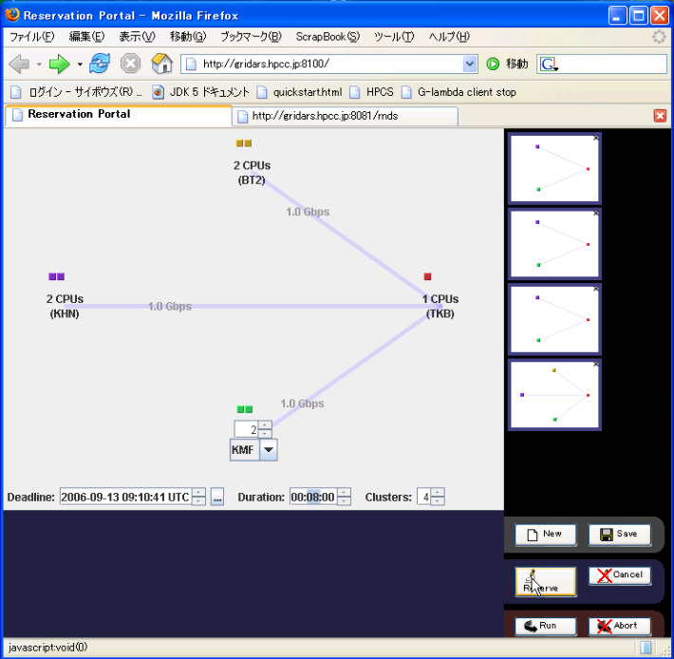
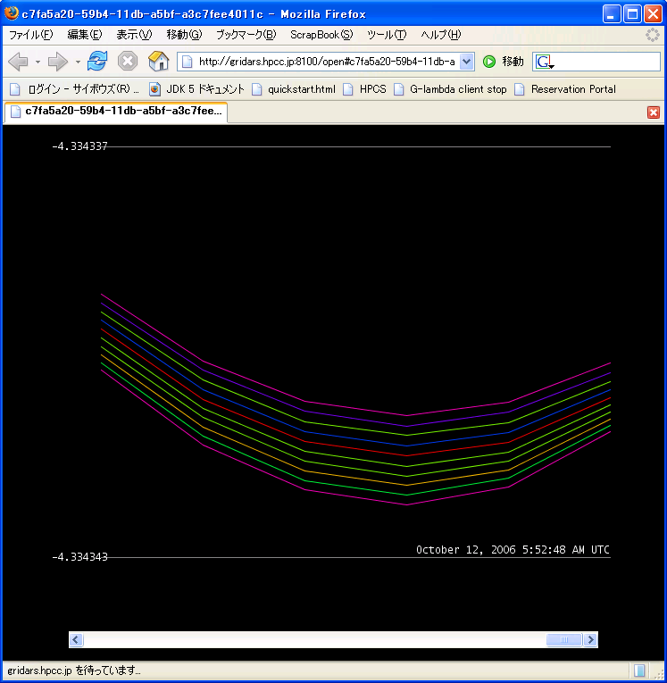
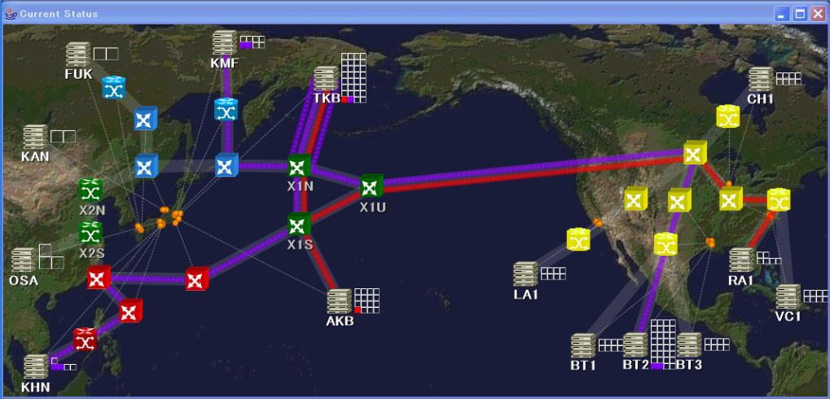
GNS-WSI2 Demonstration [GLIF2006, SC06]
G-lambda & Enlightened collaboration
Allocate trans-pacific resources with advance reservation
Perform a parallel molecular dynamics simulation over the reserved resources

Slide 13
Reference Implementation of GNS-WSI2
GridARS-WSRF is a reference implementation of the GNS-WSI2 NRM WSRF I/F module
  GridARS: Grid Advance Reservation-based System framework for Grid Co-allocation developed by AIST
Network resource providers do not need to write complicated WSRF services code
Developed using Globus Toolkit 4, Java WS Core
  Can support GSI
Resource properties have been implemented persistently
Used by GNS-WSI wrapper developed by the EnLIGHTened team and AIST-NRM at the demonstration
  KDDI and NTT NRMs have different implementation

Slide 14
Conclusions
GNS-WSI2 defined by G-lambda
Based on WSRF (Web Services Resource Framework)
Support 2-phase commit protocol
  Distributed transaction processing by GRC is available
Reference implementation will be available from
http://www.g-lambda.net/

