Slide 1
Topology related attributes used for
Provisioning and Access Control Policy Definition in
Multidomain Network Resource Provisioning
Yuri Demchenko
SNE Group, University of Amsterdam
NML-WG meeting, OGF27
13 October 2009, Banff, Canada

Slide 2
Outline
  Network Resource Provisioning model and policy definition use cases
  XACML Policy datamodel
  XACML-NRP attributes – Subject, Resource, Action, Environment
    Example topology aware policy defintion
  XACML-NRP implementation
    Resource ID expression format
    Policy resolution and finding
    Attributes set/metadata extensibility
  Discussion and suggested security policy related NML attributes
This work was done as a part of the Phosphorus project “Lambda User Controlled Infrastructure for European Research” (October 2006 - June 2009)
http://www.ist-phosphorus.eu/

Slide 3
Network Resource Provisioning (NRP) Model
4 major stages/phases in NRP operation/workflow
  (Advance) reservation consisting of 3 basic steps
    Resource Lookup
    Resource composition (including options)
    Component resources commitment, including AuthZ/policy decision, and assigning a global reservation ID (GRI)
  Deployment – reservation confirmation and distributing components/domain configuration (including trusted keys distribution)
  Access (to the reserved resource) or consumption
    Authorisation session management with AuthZ tickets and tokens
  Decommissioning
    Provisioning session termination
    Accounting
  Relocation (under consideration)
Rationale
  Supports the whole provisioned resource life-cycle
  Specifically oriented on combined Grid-Network resource provisioning
  Integrating resource provisioning into the upper layer scientific workflow

Slide 4
Multidomain Network Resource Provisioning (NRP) –
Stages and interdomain communication
Token based signalling and access control
GRI – Global Reservation ID
AT – Access Token
PT – Pilot Token
AzTicket – AuthZ ticket for multidomain context mngnt
Pilot Token type 1-3 is used at the Stage 1 Reservation for signalling and interdomain context communication
  * As container for GRI and AzTicket
Pilot Token type 4 is used at the Stage 2 Deployment for setup information communication
Access Token/Ticket is used at the Stage 3 Access
IDC/AAA
IDC/AAA
IDC/AAA
DC/AAA
GRI
GRI
GRI
Service
(AAA)
plane
PAP
PAP
PAP
PDP
PDP
PDP
PT4(AzTick)
PT4(AzTick)
Dest
Host
TVS
TVS
TVS
AT
AT
AT
AT
Control
plane
User Client
PEP
PEP
PEP
DC/NRPS
DC/NRPS
DC/NRPS
Appli- cation
Network plane
NE
NE
NE
IDC/DC – Interdomain/Domain Controller
NRPS – Network Resource Provisioning System
NE - Network Element
AAA – AuthN, AuthZ, Accounting Server
PDP – Policy Decision Point
PEP – Policy Enforcement Point
TVS – Token Validation Service

Slide 5
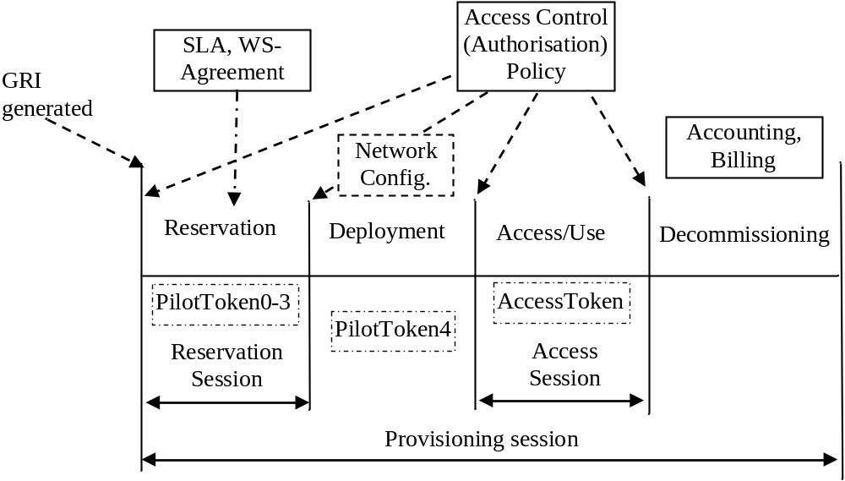
NRP stages and Authorisation session types
Requires consistent security and session context management
Global Reservation ID (GRI) is created at the beginning of the provisioning session (Reservation stage) and binds all sessions

Slide 6
XACML Policy format and Policy Obligations
XACML standard specifies XACML policy format and XACML request/response messages
Policy consists of Policy Target and Rules
  Policy Target is defined for the tuple
  Subject-Resource-Action (-Environment)
    Note: Match function is limited to 2 variables
  Policy Rule consists of Conditions and may contain Obligations
  Policy Obligation defines actions to be taken by PEP on Policy decision by PDP
XACML PDP returns all Obligations that match policy decision (defined by attribute “FulfillOn”) from both PolicySet and comprising individual policies
XACML Request message contains attributes of Subject, Resource, Action, Environment
  Resource element can contain resource description
  Environment element may contain additional information, e.g. session related context
XACML Policy
XACML Request
Rule Combination
Algorithm
Subject
Policy Target
{S, R, A, (E)}
Attributes
Resource
Rule ID#1
Attributes
Rule Target
{S, R, A, E}
Resource Content
Condition
AttrDesignat
Action
Match List
Attributes
…
Rule ID#n
Environment
Attributes
Obligations

Slide 7
XACML-NRP Profile
XACML-NRP Authorisation Interoperability profile for Network Resource Provisioning
  Part of the Phosphorus Project deliverable D.4.3.1 - "GAAA toolkit pluggable components and XACML policy profile for ONRP“
  http://www.ist-phosphorus.eu/files/deliverables/Phosphorus-deliverable-D4.3.1.pdf
  Incorporates and extends XACML-Grid profile https://edms.cern.ch/document/929867/1
    Developed as EGEE-OSG-Globus cooperation and implemented in the Globus and gLite middleware
  Attribute identifiers and attribute identification
    URL-style and registered namespace http://authz-interop.org/nrp/xacml
      Both XACML-Grid and XACML-NRP
    SAML/XACML style – Attribute identifiers are attributes to more generic attribute names

Slide 8
Basic use cases for policy definition in NRP
Access stage
  Use case 1: "User A is only allowed to use user endpoints X, Y and Z"
    Defined as TNA (Transport Network Address)
  Use case 2: "User A is only allowed to use endpoints in domain N and M“
  Use case 3: “User/Group A is only allowed to invoke method/action X, Y, and Z”
  Use case 4: “User/Group A is only allowed to invoke method X,Y, and Z based on session delegation”
    Including interdomain access and delegation
Reservation stage
  Use case 5: “Apply {topology restrictions} to the path reservation in the next domain”
  Use case 6: “Check/match {topology/path restrictions} from the previous domain”

Slide 9
Topology description formats/languages
  Topology related attributes enable topology aware policy definition (e.g. use cases 5 and 6)
  3 topology description formats reviewed
    Phosphorus Harmony/NSP (XML based)
    NDL by UvA (RDF based)
    OSCARS (2008) (XML based)

Slide 10
Example (1) - Harmony Topology description
<ns4:Domains>
<ns3:DomainId xmlns:ns3="http://ist_phosphorus.eu/nsp">dummy</ns3:DomainId>
<ns3:Relationship xmlns:ns3="http://ist_phosphorus.eu/nsp">subdomain</ns3:Relationship>
<ns3:SequenceNumber xmlns:ns3="http://ist_phosphorus.eu/nsp">1171</ns3:SequenceNumber>
<ns3:Description xmlns:ns3="http://ist_phosphorus.eu/nsp">
Virtual dummy domain</ns3:Description>
<ns3:ReservationEPR xmlns:ns3="http://ist_phosphorus.eu/nsp"> http://localhost:8080/nrpsDummyReservation/services/MyService</ns3:ReservationEPR>
<ns3:TopologyEPR xmlns:ns3="http://ist_phosphorus.eu/nsp"> http://localhost:8080/nrpsDummyTopology/services/MyService</ns3:TopologyEPR>
<ns3:NotificationEPR xmlns:ns3="http://ist_phosphorus.eu/nsp"> http://localhost:8080/nrpsDummyNotification/services/MyService</ns3:NotificationEPR>
<ns3:TNAPrefix xmlns:ns3="http://ist_phosphorus.eu/nsp">128.0.0.0/16</ns3:TNAPrefix>
<ns3:avgDelay xmlns:ns3="http://ist_phosphorus.eu/nsp">50</ns3:avgDelay>
<ns3:maxBW xmlns:ns3="http://ist_phosphorus.eu/nsp">1111</ns3:maxBW>
</ns4:Domains>
RequestContextPath="./xacml-context:Resource/xacml-context:Attribute/xacml-context:AttributetValue/ns4:Domains/ns3:avgDelay"

Slide 11
Example (2) – NDL (2008) topology description
<!-- TDM3.amsterdam1.netherlight.net -->
<ndl:Device rdf:about="#tdm3.amsterdam1.netherlight.net">
<ndl:name>tdm3.amsterdam1.netherlight.net</ndl:name>
<ndl:locatedAt rdf:resource="#amsterdam1.netherlight.net"/>
<ndl:hasInterface rdf:resource="#tdm3.amsterdam1.netherlight.net:501/1"/>
<ndl:hasInterface rdf:resource="#tdm3.amsterdam1.netherlight.net:501/2"/>
<ndl:hasInterface rdf:resource="#tdm3.amsterdam1.netherlight.net:505/3"/>
<ndl:hasInterface rdf:resource="#tdm3.amsterdam1.netherlight.net:505/4"/>
</ndl:Device>
<!-- all the interfaces of TDM3.amsterdam1.netherlight.net -->
<ndl:Interface rdf:about="#tdm3.amsterdam1.netherlight.net:501/1">
<ndl:name>tdm3.amsterdam1.netherlight.net:POS501/1</ndl:name>
<ndl:connectedTo rdf:resource="#tdm4.amsterdam1.netherlight.net:5/1"/>
<ndl:capacity rdf:datatype="http://www.w3.org/2001/XMLSchema#float">1.2E+9</ndl:capacity>
</ndl:Interface>
<ndl:Interface rdf:about="#tdm3.amsterdam1.netherlight.net:501/2">
<ndl:name>tdm3.amsterdam1.netherlight.net:POS501/2</ndl:name>
<ndl:connectedTo rdf:resource="#tdm1.amsterdam1.netherlight.net:12/1"/>
<ndl:capacity rdf:datatype="http://www.w3.org/2001/XMLSchema#float">1.2E+9</ndl:capacity>
</ndl:Interface>

Slide 12
Example (3) – OSCARS (2008) topology description
<!-- blue-es1 to blue-es2 -->
<staticPathEntry id="blue-es1-blue-es2">
<srcEndpoint>urn:ogf:network:domain=blue.pod.lan:node=vlsr1:port=3:link=11.2.1.2</srcEndpoint>
<destEndpoint>urn:ogf:network:domain=blue.pod.lan:node=vlsr3:port=3:link=11.2.5.1</destEndpoint>
<path id="blue-es1-blue-es2">
<hop id="1">
<linkIdRef>urn:ogf:network:domain=blue.pod.lan:node=vlsr1:port=3:link=11.2.1.2</linkIdRef>
</hop>
<hop id="2">
<linkIdRef>urn:ogf:network:domain=blue.pod.lan:node=vlsr1:port=5:link=11.2.3.1</linkIdRef>
</hop>
<hop id="3">
<linkIdRef>urn:ogf:network:domain=blue.pod.lan:node=vlsr3:port=5:link=11.2.3.2</linkIdRef>
</hop>
<hop id="4">
<linkIdRef>urn:ogf:network:domain=blue.pod.lan:node=vlsr3:port=3:link=11.2.5.1</linkIdRef>
</hop>
</path>
<availableVtags></availableVtags> <!-- deprecated: leave blank -->
</staticPathEntry>

Slide 13
Resource/topology related attributes
Attribute name | Attribute ID | Full XACML attributeId semantics (ns-prefix = http://authz-interop.org/nrp/xacml)
Domain | domain-id | {ns-prefix} /resource/domain-id
Subdomain | subdomain | {ns-prefix} /resource/sub-domain
VLAN | vlan | {ns-prefix} /resource/vlan
TNA | tna (+ tna-prefix) | {ns-prefix} /resource/tna-prefix/tna
Node | node | {ns-prefix} /resource/node
Network path | path | {ns-prefix} /resource/path
Link | link-id | {ns-prefix} /resource/link-id
avrDelay | delay | {ns-prefix} /resource/delay
maxBW | bandwidth-max | {ns-prefix} /resource/bandwidth
Realm | realm | {ns-prefix} /resource/realm {ns-prefix} /realm
Resource type | resource-type | {ns-prefix} /resource/resource-type ({ns-prefix} /resource/device)
Resource federation | federation | {ns-prefix} /resource/federation
Domain ID (network domain)
Subdomain
Node or TNA and TNA prefix
Interface ID or Link ID
Device or resource-type
Link parameters: average delay and maximum bandwidth
ReservationEPR that may directly or indirectly define the resource federation or security/ administrative domain
Federation that defines a number of domains or nodes sharing common policy and attributes
Realm defines project/task related association and may have own namespace

Slide 14
Subject related attributes
Attribute name | Attribute ID | Full XACML attributeId semantics (ns-prefix = http://authz-interop.org/nrp/xacml)
Subject ID | subject-id | {ns-prefix} /subject/subject-id
Subject confirmation *) | subject-confdata | {ns-prefix} /subject/subject-confdata
Subject context **) | subject-context | {ns-prefix} /subject/subject-context
Subject group | subject-group | {ns-prefix} /subject/subject-group
Subject role | subject-role | {ns-prefix} /subject/subject-role
Subject federation | Federation | {ns-prefix} /subject/federation
*) Subject confirmation attribute may contain subject credentials
  Currently supported SAML2.0, Proxy/VOMS Attribute Certificate, Unicore6 SAML2, AuthN Ticket
  Validated by PEP before sending to PDP
**) Subject context is used for policy resolution

Slide 15
Action related attributes and enumerated values
Attribute name | Attribute ID | Full XACML attributeId semantics (ns-prefix = http://authz-interop.org/nrp/xacml)
Action ID | action-id | {ns-prefix} /action/action-id
Action type | action-type | {ns-prefix} /action/action-type/{value}
Attribute name | Enumerated value | XACML attribute value (ns-prefix = http://authz-interop.org/nrp/xacml)
Action type | create-path | {ns-prefix} /action/action-type/create-path
 | activate-path | {ns-prefix} /action/action-type/activate-path
 | cancel | {ns-prefix} /action/action-type/cancel
 | access | {ns-prefix} /action/action-type/access

Slide 16
Environment related attributes
Environment attributes define additional required for the policy decision
  Previous domain confirmation in multidomain NRP
  Authorisation context
    AuthZ session credentials or AuthZ ticket/token
  Obligations, Delegation (or account mapping) from the previous domain
    User ID or group to which access is delegated
    Actions which need to be taken when processing request or granting access
    Topology restrictions, e.g. minimal bandwidth, delay, VLAN, etc.

Slide 17
XACML-NRP Policy Obligations
Suggested policy obligations for multidomain NRP
  Intra-domain network/VLAN mapping for cross-domain connections
    Can be used to map external/interdomain border links/endpoints to internal VLAN and sub-network
  Account mapping (inter/cross-domain)
  Type of service (or QoS) assigned to a specific request or policy decision
  Quota assignment
  Service combination with implied conditions (e.g., computing and storage resources)
  Usable resources e.g. number of access/view, volume of traffic, etc
    Advance Resource Reservation (ARR) type – Fixed, Deferrable, Malleable

Slide 18
Example(1): Resource and Subject attributes and Policy resolution
PEP API Request components
ResourceInputURI =
"http://testbed.ist-phosphorus.eu/viola/harmony/source=10.3.1.16/target=10.7.3.13“
ResourceMap = resource-id=http://testbed.ist-phosphorus.eu/viola/harmony,
resource-realm=testbed.ist-phosphorus.eu
resource-domain=viola
resource-type=harmony
source=10.3.1.16
target=10.7.3.13
SubjectMap = subject-id=WHO740@users.testbed.ist-phosphorus.eu,
subject-role=researcher, subject-context=demo041,
subject-confdata=“IGhA11...8bUktYh”}
Policy file = {policy-dir}/nrp/testbed.ist-phosphorus.eu/viola-policy-harmony-demo041.xml
Resolution functionality is supported by GAAA-TK/API library functional components: NamespaceResolver, AttributeResolver, PolicyResolver

Slide 19
Example (2): XACML Request message
<Request>
<Subject SubjectCategory="urn:oasis:names:tc:xacml:1.0:subject-category:access-subject">
<Attribute AttributeId="urn:oasis:names:tc:xacml:1.0:subject:subject-id" DataType="http://www.w3.org/2001/XMLSchema#string" Issuer="http://testbed.ist-phosphorus.eu/phosphorus/aaa/AttributeIssuer" IssueInstant="2008-12-03T12:10:21.218000000+01:00">
<AttributeValue>WHO740@users.testbed.ist-phosphorus.eu</AttributeValue></Attribute>
<Attribute AttributeId="http://authz-interop.org/AAA/xacml/subject/subject-role">
<AttributeValue>researcher</AttributeValue></Attribute>
<Attribute AttributeId="http://authz-interop.org/AAA/xacml/subject/subject-context">
<AttributeValue>demo041</AttributeValue></Attribute>
<Attribute AttributeId="http://authz-interop.org/AAA/xacml/subject/subject-confdata">
<AttributeValue>aaa:authn:gaaapi:subject:confirmed</AttributeValue></Attribute>
</Subject>
<Resource>
<Attribute AttributeId="urn:oasis:names:tc:xacml:1.0:resource:resource-id">
<AttributeValue>http://testbed.ist-phosphorus.eu/viola/harmony</AttributeValue></Attribute>
<Attribute AttributeId="http://authz-interop.org/AAA/xacml/resource/resource-realm">
<AttributeValue>testbed.ist-phosphorus.eu</AttributeValue></Attribute>
<Attribute AttributeId="http://authz-interop.org/AAA/xacml/resource/resource-domain">
<AttributeValue>viola</AttributeValue></Attribute>
<Attribute AttributeId="http://authz-interop.org/AAA/xacml/resource/target">
<AttributeValue>10.7.3.13</AttributeValue></Attribute>
<Attribute AttributeId="http://authz-interop.org/AAA/xacml/resource/source">
<AttributeValue>10.3.1.16</AttributeValue></Attribute>
</Resource>
<Action>
<Attribute AttributeId="urn:oasis:names:tc:xacml:1.0:action:action-id" >
<AttributeValue>create-path</AttributeValue></Attribute>
</Action></Request>

Slide 20
Example (3) – Topology/Path information in ResourceContent
<xacml-context:Resource><xacml-context:ResourceContent>
<ns4:Domains>
<ns3:DomainId xmlns:ns3="http://ist_phosphorus.eu/nsp">dummy</ns3:DomainId>
<ns3:Relationship xmlns:ns3="http://ist_phosphorus.eu/nsp">subdomain</ns3:Relationship>
<ns3:SequenceNumber xmlns:ns3="http://ist_phosphorus.eu/nsp">1171</ns3:SequenceNumber>
<ns3:Description xmlns:ns3="http://ist_phosphorus.eu/nsp">
Virtual dummy domain</ns3:Description>
<ns3:ReservationEPR xmlns:ns3="http://ist_phosphorus.eu/nsp"> http://localhost:8080/nrpsDummyReservation/services/MyService</ns3:ReservationEPR>
<ns3:TopologyEPR xmlns:ns3="http://ist_phosphorus.eu/nsp"> http://localhost:8080/nrpsDummyTopology/services/MyService</ns3:TopologyEPR>
<ns3:NotificationEPR xmlns:ns3="http://ist_phosphorus.eu/nsp"> http://localhost:8080/nrpsDummyNotification/services/MyService</ns3:NotificationEPR>
<ns3:TNAPrefix xmlns:ns3="http://ist_phosphorus.eu/nsp">128.0.0.0/16</ns3:TNAPrefix>
<ns3:avgDelay xmlns:ns3="http://ist_phosphorus.eu/nsp">50</ns3:avgDelay>
<ns3:maxBW xmlns:ns3="http://ist_phosphorus.eu/nsp">1111</ns3:maxBW>
</ns4:Domains>
</xacml-context:ResourceContent></xacml-context:Resource>
xacml:RequestContextPath="./xacml-context:Resource/xacml-context:ResourceContent/
xacml-context:Attribute/xacml-context:AttributetValue/ns4:Domains/ns3:avgDelay"

Slide 21
Example (3) - XACML Policy Rule to match ResourceContent
<Rule RuleId="urn:oasis:names:tc:xacml:2.0:scas-policy:example001:rule" Effect="Permit">
<Target/>
<Condition FunctionId="urn:oasis:names:tc:xacml:1.0:function:integer-greater-than">
<Apply FunctionId="urn:oasis:names:tc:xacml:1.0:function:string-bag">
<AttributeValue DataType="http://www.w3.org/2001/XMLSchema#integer">100</AttributeValue>
</Apply>
<AttributeSelector RequestContextPath="RequestContextPath=
"./xacml-context:Resource/xacml-context:Attribute/xacml-context:AttributetValue/
ns4:Domains/ns3:avgDelay"
MustBePresent="true" DataType="http://www.w3.org/2001/XMLSchema#integer"/>
</Condition>
</Rule>

Slide 22
XACML-NRP implementation – GAAA-TK Java library
  XACML-NRP profile is implemented in the GAAA-TK Java library
    As configurable metadata/constants set (XML metadata file and Java constants)
    Supports also XACML-Grid profile
  GAAA-TK library provides all necessary AuthZ mechanisms and service components to support AuthZ sessions context and Obligations handling
    AuthZ ticket format for extended interdomain AuthZ session management
    Supports Pilot token based Interdomain signalling and access control with Access tokens
    Can be used and ensure signalling and access control transparency at all Networking layers (Service, Control and Data planes)
  Integrated into the Phosphorus project Network Service Plane (NSP Harmony) test-bed and uses simple XACML policy model
  Recent Version 0.8 is available from http://staff.science.uva.nl/~demch/projects/aaauthreach/index.html

Slide 23
GAAA Toolkit pluggable AAA/AuthZ components
The proposed model
intends to comply
with both the generic
AAA-AuthZ framework
and XACML AuthZ
model
ContextHandler functionality can be extended to support all communications between PEP-PDP and with other modules
Obligation Handler supports OHRM
TTVS supports session based credentials – Access and Pilot tokens and tickets
AzReq ServReq (Srv,Subj,Act))
AuthZ Gateway
(AuthZ Handler)
ServReq(Srv,Oblig2)
Resource NE/GMPLS
AzReq (Srv,Subj,Act))
XACMLAzResp
PEP
Obligation Handler
NRPS/
Srv IFAuthZ API
Validate (AuthzToken)
Context Handler
TTVS
GAAA-AuthZ
XACMLAzReq (S,R,A,E)
XACMLAzResp
(AzDcsn,Oblig)
XACMLPolicy
(Target(S,R,A,E), Rules(S,R,A,E),
Oblig0)
Supports remote callout in case of external AuthZ service DCAS
PDP
PAP
TTVS – Ticket and token validation and handling service

Slide 24
Future developments
  Adopting XACML-NRP attributes/metadata to actual NML and NSI attributes and AAA interface definition
  Considering moving XACML-Grid and XACML-NRP profiles to the OGF standardisation process
  Developing conformance test for XACML-Grid and XACML-NRP profiles
  Expected future development framework – newly approved EU project GEYSER “Generalised Architecture for Dynamic Infrastructure Services”
    On-demand network infrastructure provisioning
    Policy based SLA negotiation and Network Resource Provisioning model

Slide 25
Suggestions for security related NML/topology attributes
  Path and/or segment definition and description format
  Definition of administrative and security domains
    In addition to network domain (is it based on DNS domain/subdomain?)
  Metadata configuration file binding instant topology/segment/path description to infrastructure related services
    Namespace resolution service, AAA services/authorities, Policy RefID/authority, trust anchors
  Is path finding in the scope of NML-WG?
    It can be conditional and may require policy enforcement
  Need a way/agreement to match network/topology related attributes between NML-WG and NSI-WG
    Is a Logical (Infrastructure) Composition Layer a solution?

Slide 26
Additional information
  XACML2.0 datamodel and Obligations definition
  Domain definition and domain related security context
  Administrative domain vs Security domain vs Security Association

Slide 27
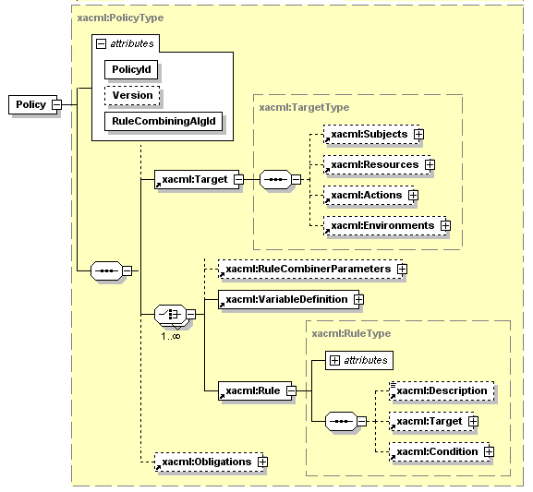
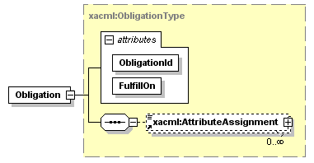
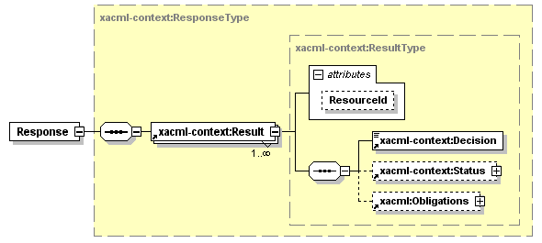
XACML2.0 Policy Datamodel
XACML Response message contains all Obligations that match policy decision (defined by attribute “FulfillOn”) from both PolicySet and comprising individual policies

Slide 28
XACML Policy Obligations - Definition
Policy Obligation is one of the policy enforcement mechanisms
  Obligations are a set of operations that must be performed by the PEP in conjunction with an authorization decision [XACML2.0]
Obligations semantics is not defined in the XACML policy language but left to bilateral agreement between a PAP and the PEP
PEPs that conform with XACMLv2.0 are required to deny access unless they understand and can discharge all of the <Obligations> elements associated with the applicable policy
Element <Obligations> / <Obligation>
  The <Obligation> element SHALL contain an identifier (in the form of URI) for the obligation and a set of attributes that form arguments of the action defined by the obligation. The FulfillOn attribute SHALL indicate the effect for which this obligation must be fulfilled by the PEP

Slide 29
Policy definition assumptions for NRP
  Users and resources are described/identified by their unique ID’s and may have also assigned attributes, e.g.
    User attrs: user group, role, federation
    Resource attrs: domain/subdomain, resource type, level of service
  Users and resources (domains and endpoints) may be organised/associated into administrative and/or security domains or federations
    A user and a resource can be a member of one or multiple associations
  Different domains and endpoints participating in network connection (for which the authorisation is requested) may belong to different federations or security associations
  Only authenticated user may have access to protected resources
    User authentication is confirmed by issuing AuthZ assertion by trusted AuthN service or creating user related security context environment of the started process
  User authentication may be resulted in the following:
    service or process session initiation;
    release of the user attributes or credentials;
  Depending on the user attributes (federations, groups, roles) the user can be assigned specific level of service
    To access a network resources a user identity may need to be mapped to a specific (pool) account

Slide 30
Administrative domain vs Security domain vs Security Association
  Domains can be considered as network, administrative or security
    Network domains are more static
    Administrative domain is managed by the resource owner (or user administration)
    Security domain is defined by common trusted identity or attribute management authority
  Security association
    Security association can be created dynamically, e.g. for managing project, resource provisioning agreement
      VO or Shibboleth federation are two examples
    Authorisation session as a kind of security association

Slide 31
Multi-domain NRP – Domain definition and domain related security context
Domains are defined (as associations of entities) by a common policy under single administration, common namespaces and semantics, shared trust,etc.
Domain related security context may include
  namespace aware names and ID’s
  policy references/ID’s
  trust anchors (CA)
  authorities reference (AAA, AuthZ, AuthN, Policy Authority, CA)
  Additionally, each domain may have/create own dynamic/session related security context (at the reservation and access stages)
Multi-domain NRP AuthZ infrastructure
  Multiple policies processing and combination, including obligated/conditional policy decisions and delegation
  Attributes/rules mapping/converting based on inter domain trust management infrastructure
  Policy support for different logical organisation of resources, including possible constraints on resource combination and interoperation

