Slide 1
Discussion Context
NIST Cloud definition and extension to address network and infrastructure issues
Discussion of the ISPD-RG Infrastructure definition
Notes:
NIST has defined Cloud infrastructure and architecture, we should augment on what they have done (extend, find deficiencies (e.g. missing network component))

Slide 2
NIST Activity on Cloud Computing
NIST – Collaboration on Cloud Computing Reference Architecture development
http://collaborate.nist.gov/twiki-cloud-computing/bin/view/CloudComputing/WebHome
Draft SP 800-145 The NIST Definition of Cloud Computing (Draft)
http://csrc.nist.gov/publications/drafts/800-145/Draft-SP-800-145_cloud-definition.pdf
DRAFT Cloud Computing Synopsis and Recommendations
http://csrc.nist.gov/publications/drafts/800-146/Draft-NIST-SP800-146.pdf
Draft SP 800-144 Guidelines on Security and Privacy in Public Cloud Computing
http://csrc.nist.gov/publications/drafts/800-144/Draft-SP-800-144_cloud-computing.pdf
NIST Cloud Standards Roadmap group
http://collaborate.nist.gov/twiki-cloud-computing/pub/CloudComputing/StandardsRoadmap/NIST_CCSRWG_092_NIST_SP_500-291_Jul5.pdf
SP 800-125 Guide to Security for Full Virtualisation Technologies
http://csrc.nist.gov/publications/nistpubs/800-125/SP800-125-final.pdf

Slide 3
NIST Cloud definition – Draft SP 800-145 (1)
NIST Definition of Cloud – missing network provisioning, just “limited control over network”
Cloud computing is a model for enabling ubiquitous, convenient, on-demand network access
to a shared pool of configurable computing resources (e.g., networks, servers, storage,
applications, and services) that can be rapidly provisioned and released with minimal
management effort or service provider interaction. This cloud model promotes availability and
is composed of five essential characteristics, three service models, and four deployment
models.
Cloud Infrastructure as a Service (IaaS). The capability provided to the consumer is to
provision processing, storage, networks, and other fundamental computing resources
where the consumer is able to deploy and run arbitrary software, which can include
operating systems and applications. The consumer does not manage or control the
underlying cloud infrastructure but has control over operating systems, storage,
deployed applications, and possibly limited control of select networking components
(e.g., host firewalls).
Notes:
ATOS (IT integrator) folks have indicated that if latency cannot be bounded, Cloud services cannot be used
This applies especially to the financial sector (e.g. stock trading)

Slide 4
NIST Cloud definition – Draft SP 800-145 (2)
Draft SP 800-145 The NIST Definition of Cloud Computing (Draft) http://csrc.nist.gov/publications/drafts/800-145/Draft-SP-800-145_cloud-definition.pdf
Five essential clouds characteristics
On-demand self-service
Broad network access
Resource pooling
Rapid elasticity
Measured Service
3 service/provisioning models
Software as a Service (SaaS)
Platform as a Service (PaaS)
Infrastructure as a Service (IaaS)
4 deployment models
Public cloud
Private cloud
Community cloud
Hybrid cloud

Slide 5
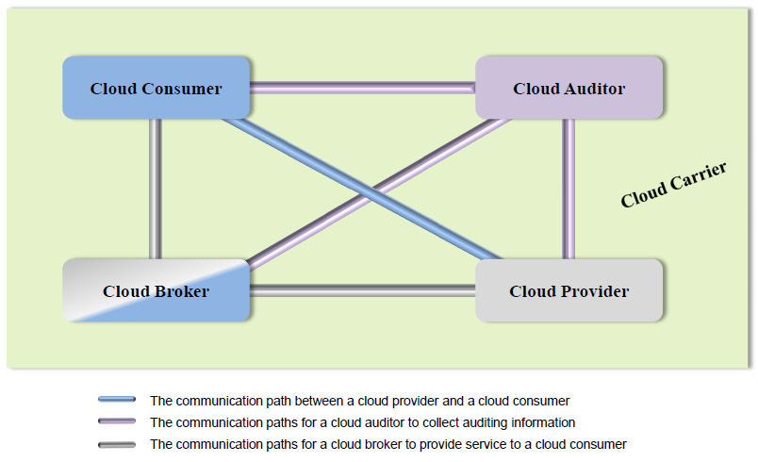
NIST Cloud Computing Reference Architecture (CCRA) 2.0 - Main Roles (1)
Cloud Carrier as a role to accommodate telco’s interests
Notes:
NIST role definition, Cloud carrier is everywhere!

Slide 6
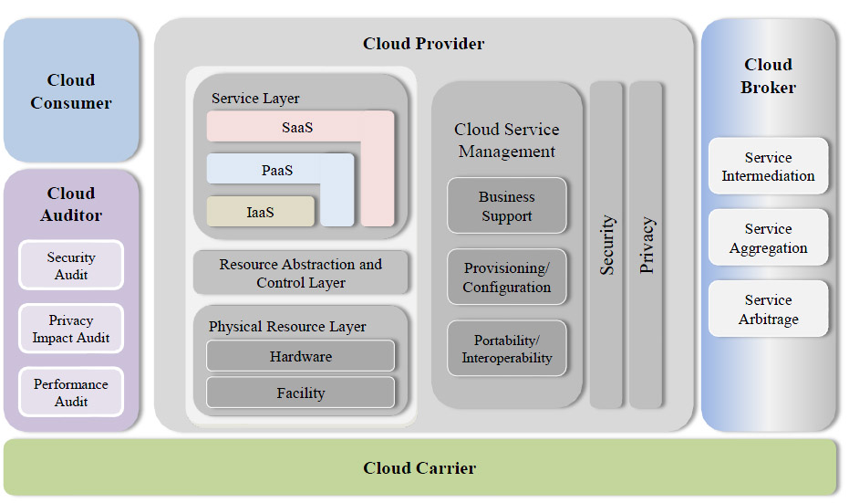
NIST Cloud Computing Reference Architecture (CCRA) 2.0 – Consolidated View
txt
Notes:
Cloud carrier is specified to provide intermediary and transport services between Cloud Providers to Cloud Consumers, but NIST has not specified any service parameter (e.g. QoS, latency, etc (see slide 8)) to define the Cloud carrier

Slide 7
Dedicated Network Provisioning in Clouds
This issue is not addressed in details in any of currently proposed Cloud Computing (CC) architectures
There cannot be a consistent infrastructure QoS without (dedicated) network provisioning
Specifically for Optical networks
Telco, network providers and telecom equipment vendors are working in this direction
GEYSERS project is an example of network+IT infrastructure virtualisation

Slide 8
Extending Cloud IaaS definition (in the context of ISOD-RG)
The suggested extensions to the Cloud IaaS model to meet requirements of the critical enterprise services:
Define layered cloud services model that should be suitable for defining main inter-layer and inter-service (functional) interfaces
Add topology aware infrastructure view
Define resources and services virtualisation as one of generic cloud features (TBD)
Include improved network services definition capable of provisioning required QoS and allowing control from user run applications.
At the business/operational level, the CCRA should be extended to address the following features:
Improved definition of the Cloud Carrier role, operational model and interaction with other key actors
Extended set of basic roles to reflect typical for telecom operators/providers business relations:
Cloud/infrastructure Operator, Customer, and User (in place of the currently used consumer role)
Other cloud service models PaaS and SaaS should also allow management of QoS and other network related parameters
Notes:
Building virtualization model for lower transport layer enables easy migration to Cloud services

Slide 9
Infrastructure definition by Wikipedia (1)
The physical components of interrelated systems providing commodities and services essential to enable, sustain, or enhance societal living conditions.
Infrastructure is the basic physical and organizational structures needed for the operation of a society or enterprise, or the services and facilities necessary for an economy to function.
The term typically refers to the technical structures that support a society, such as roads, water supply, sewers, power grids, telecommunications, and so forth.
Viewed functionally, infrastructure facilitates the production of goods and services; for example, roads enable the transport of raw materials to a factory, and also for the distribution of finished products to markets.
In military parlance, the term refers to the buildings and permanent installations necessary for the support, redeployment, and operation of military forces.
Etymology
the word infrastructure has been used in English since at least 1927 and meant: The installations that form the basis for any operation or system.
The military use of the term achieved currency in the United States after the formation of NATO in the 1940s, and was then adopted by urban planners in its modern civilian sense by 1970.

Slide 10
Infrastructure definition by Wikipedia (2)
“Hard” vs “Soft” infrastructure
“Hard” infrastructure: Transport, energy, water communication
“Soft” infrastructure: institutional, industrial, social
The Internet, including the internet backbone, core routers and server farms, local internet service providers as well as the protocols and other basic software required for the system to function.

Slide 11
Open Group Integrated Information Infrastructure Reference Model (III-RM) http://pubs.opengroup.org/architecture/togaf9-doc/arch/
Infrastructure support business processes
Integrated information so that different and potentially conflicting pieces of information are not distributed throughout different systems
Integrated access to that information so that staff can access all the information they need and have a right to, through one convenient interface
The following components are involved
Applications and applications platform
Operating System and Network services
Communication infrastructure
Infrastructure application including management tools
Notes:
Open Group ref.

Slide 12
Infrastructure definition by Sjaak Laan http://www.sjaaklaan.nl/pivot/entry.php?id=142
IT infrastructure is the total set of foundation components and non functional attributes that enables applications to function.
Typical IT infrastructure characteristics are:
IT infrastructure is usually shared by a multiple applications
IT infrastructure is more static and permanent than the applications running upon it
The management of the infrastructure is disconnected from the system management of the applications running on top of it
The departments owning infrastructure components is different from the department owning the applications running on it
Foundation components
Servers, datacenters, networking, virtualisation, OS, end user devices
Notes:
Interesting definition

Slide 13
Infrastructure definition - Discussion
Infrastructure definition in the context of Cloud based and general virtualised services, in addition to standard IT infrastructure, should include such components as
Virtual Machines (VM), Storage, Utilities, Network
Global distributed centers by Cloud providers
Cloud infrastructure may be multi-layer, including
Internal Cloud provider infrastructure which is provided as a services, and
External or inter-Cloud infrastructure that can be provided by either Cloud operator/integrator or network services provider
The provisioned infrastructure services should be characterized and include the following features
Topology definition for infrastructure services including computing and storage resources and interconnecting them network infrastructure
Using well-defined infrastructure/topology description format
Related topology transformation operations for optimization (homomorphic, isomorphic, QoS, energy aware etc.)
Allow control from user application or upper layers (e.g. PaaS, SaaS)

Slide 14
Infrastructure definition - Discussion
Contribution is requested from the meeting

