Slide 1
Data Services:
Impact of WS-Resource Framework
March 10, 2004
Allen Luniewski
Grid/On-Demand Strategy
IBM Data Management, SWG
luniew@us.ibm.com

Slide 2
Data Service – Key Concepts
Virtualize Data
  Describes an abstract view of some data.
  Over data resource(s) and possibly other data services
  Providing means to access and modify data through this abstract view.
Provides interfaces to:
  define, modify and introspect the abstract view
  access and modify the data via this abstract view

Slide 3
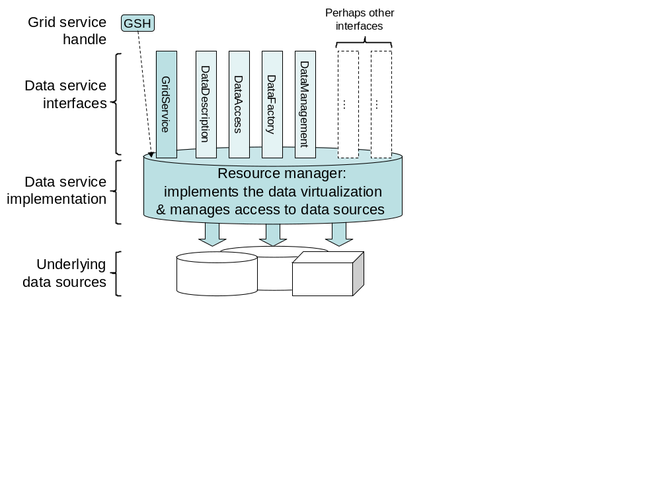
Data Service – Original Proposal

Slide 4
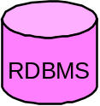
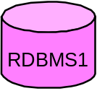
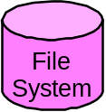
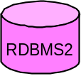
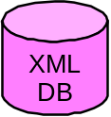
DataService
Example
SQL Client
XML Client
Flat file Client
DataService
Replica
Cache
Replica
Replica
WLM
Resource Mgr
Placement
Manager
Cache
Replica
DataService
DataService

Slide 5
WSRF Changes
GSH/GSR replaced by WS-Addressing endpoint reference
  Optionally, WS-RenewableReference
DataDescription interface replaced by:
  operations “inherited” from WS-Resource
  a WS-Resource Properties document
    with TBD common elements
WS-Resource Properties
  DAIS to define common elements
  Extensions will need to be defined, e.g., Relational, XML, File, …
Lifetime management via WSRF lifetime management patterns
  Plus data service specific operations to control lifetime

Slide 6
WSRF Changes
DataFactoy
  TBD
  To follow guidelines of WS-Resource
  Extensions/derivations from/to particular data services
WS-Agreement dependency
  Still in specification but an interim approach will be taken
A Data Service is:
  A WS-Resource compliant web service
  That implements one or more of the 3 Data Service interfaces
    Directly or via “extension”
  And/or provides a WS-Resource Properties document

Slide 7
Data Service – in WSRF
Endpoint
Reference
Perhaps other
interfaces
EPR
Data service
interfaces
DataManagement
DataFactory
…
DataAccess
…
Resource manager:
implements the data virtualization
& manages access to data sources
Data service
implementation
Underlying
data sources

Slide 8
Summary
WS-Resource Framework induces changes to DataServices
Changes are more “syntax” than semantics
Data Services still provides virtualized access to information on the grid:
  Provides service-based Access with specified QoX
  Basis for Integration and Virtualization
  Supports heterogeneous, distributed data via open protocols
  Data Placement capabilities provided

Slide 9
Questions?

