Slide 1
NSI wg Architecture
Elements
John Vollbrecht Internet2

Slide 2
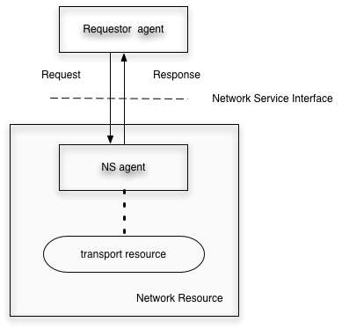
Base Architectural Elements
Requestor Agent and NS Agent communicate over NSI
In SDN or ION
  the NS agent is the IDC or OSCARS
  the requestor agent is an app running on a web server
  the transport resource is the network managed by the IDC or OSCARS
  the network resource is the combination of network and agent
Naming of these may be need to be modified – especially based on the next slide

Slide 3
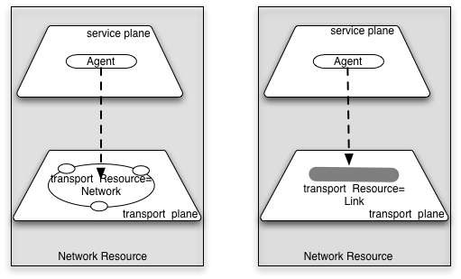
Transport Resources
Two transport resource types are used in NS architecture.
A network is a resource controlled by an agent which has ports on its edges. A network allocates its resources to connections between ports on the network
A link is a resource which allocates resource to connections between ports on different networks
ION and SDN are examples of a transport resource called a network.
A Cross connect between ION and SDN in Chicago or NY is an example of a link.
A more interesting example of a link would be a cross atlantic fiber owned by IRNC and connecting to networks on either side of the Atlantic
Naming here is confusing. In particular the difference between network as a transport resource and a Network Resource as the name of the combination of agent and network

Slide 4
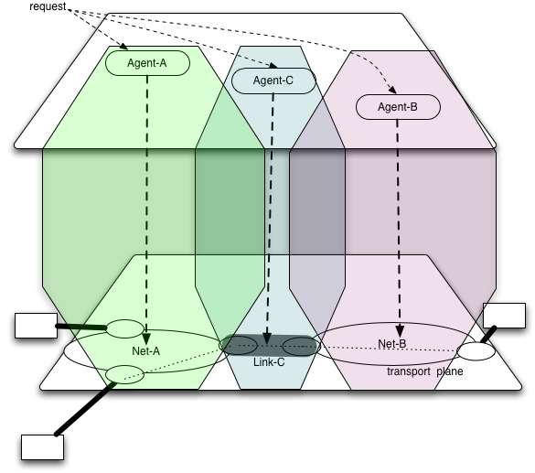
Combining
Network Resources
Network resources exist on both the transport and service plane.
On the transport plane
links and networks connect at ports
Clients[aka users] connect to networks at access ports
Links connect to networks at link ports
A set of interconnected links and networks is called a topology
On the service plane
Agents connect to requestor agents with trusted connections over the IP Internet.
A set of agents and connections between agents is called service plane topology
In ION, net A might be ION and B might be a RON, the Link might be an Ethernet between ION and the RON DCN.
In this example the Link might be owned by the RON and the agent for the link the same as the agent for the RON network.
In ION NS agents can also be requestor agents. Service plane topology in ION is identical to transport plane topology, agent-A and C are connected and Agent B and C are connected.

Slide 5
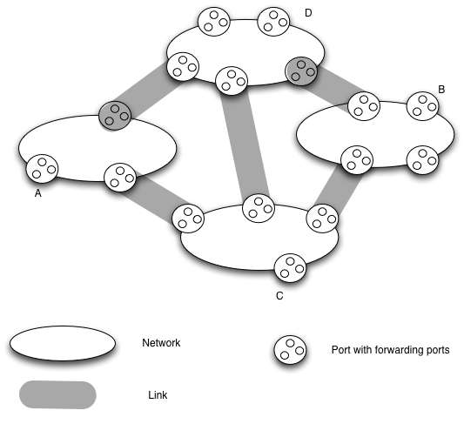
Transport topology
Transport topology is a set of interconnected networks and links
Networks have ports
  Access ports are where clients attach to a network
  Link ports are where links to other networks attach
Ports have forwarding ports
In this infrastructure connections are created between forwarding points
  Within network by network agent
  Between networks by link agent
  Across networks by concatenating connections at ports
In ION this the IDC topology is Ethernet Ports with subports being VLANS. All ports on edge of ION and associated nets are Ethernet.
In ION the networks might be ION, SDN, AutoBahn, a RON

Slide 6
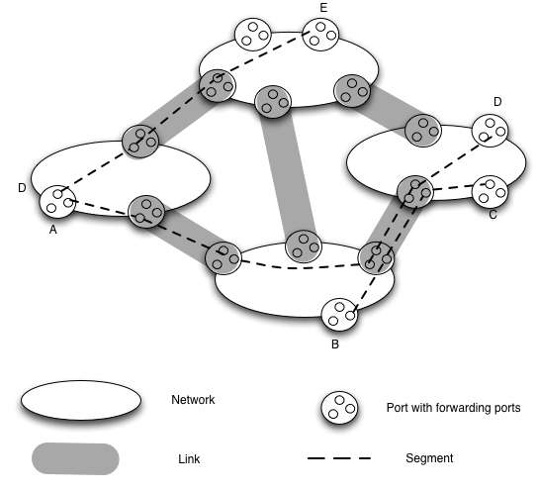
Creating segments over transport topology
Connections can be created between forwarding port
  - Connection between any two ports is a segment
  - Segments can be concatenated at forwarding ports to create longer segments
  Connection between access ports is called a network connection
In IDC networks, each segment is a VLAN between ports on network. VLAN ids may be translated at some forwarding points depending on hardware capabilities. A network connection is a VLAN between Ethernets on Access sites. Some access may be on untagged Ethernet that is mapped to VLAN at the Access port.

Slide 7
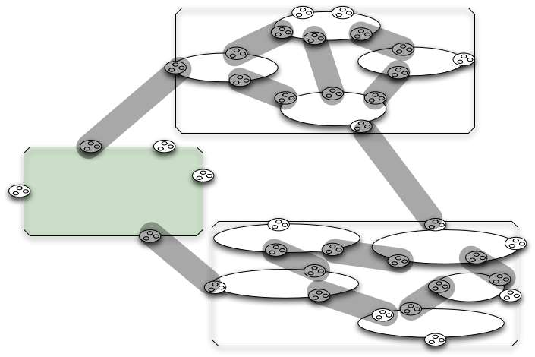
Routing Areas
Networks can be aggregated into a Routing Area.
Each Routing area can be treated as a network by other networks or Routing Areas
This concept is useful in Discovery and pathfinding

Slide 8
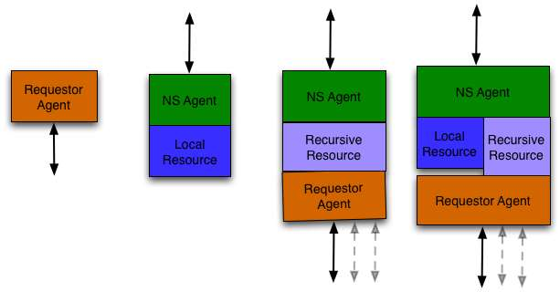
Service Plane Topology
Four types of agents are described
1) Requestor only -this is typically the ultimate user of the network resources
2) NS Agent only. This is typically an agent for a network provider that is not federated with other networks
3) NS Agent with a recursive capability to request resouces from other NS Agents. In the first case there is no local resource. This might be the case for middleware requesting resources from multiple NS Agents
4) NS agent with both local and recursive resources. This is the case when daisy chain requests are supported by a federation of NS agents
In the ION case, the requestor only agent is the initial requestor for a connections – the web server or application. Other ION agents are IDCs, and IDCs are all combination of NS agent with local and recursive resources

Slide 9
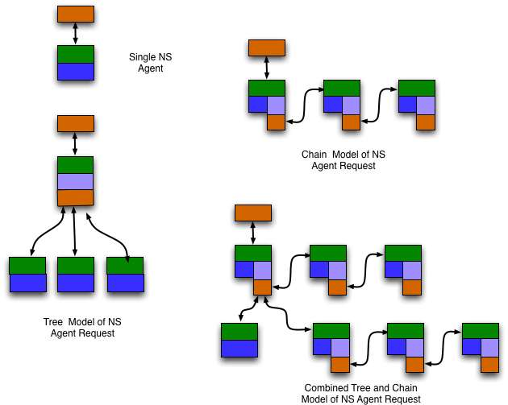
Service Plane Request Patterns
Requests for transport resources go to NS Agent
NS Agent receives a request, and must satisfy that request to its requestor
if local resource satisfy then success
Otherwise
  If remote resource might satisy then request remote resouce
    If remote resources succeed
      Success
    Else
      fail
  Else request fails
Each NS must be able to determine how to satisfy the request
Each NS appears to requestor as providing the total resource
Pathfinding maps from request to segments
From segments to NS agents

Slide 10
Names and Concepts
  Network Resource
    - Good concept bad name we need a new name
  Requestor Agent
    - client rather than agent?
  Network Service Agent
    - Service Server?
  Transport Resource
    See next slide

Slide 11
Transport Terminology
Network
Link
  Is this better modeled as a simple network
Port
  Belongs to Network, should It also belong to link
Segment
  Resource for “automated” connection between ports
Forwarding port – concatentation point for segments within port
Segment concatenation
Network connection
  - What is provided by network – segment between “end points”
Topology
Routing Area
For transport terminology need to determine role of NSI and NML in describing concepts and defining names for this model

Slide 12
Network Agents
Topology requirements
Agents must advertise Ports available
  May advertise different ports to different users
  Must advertise what is connected to a port
Request for segment is for connection between ports
Agent determines if it can resolve this request
  By local resource
  By recursive resource
    Requests resources from other NS agents

Slide 13
Issues
Separation of NS agent finding and reservation
  My view is that agent finding is a service outside the scope of NSI – a service used by NSI
    NSI specifies interface that allows it to be used in different settings
  Agent finding is a part of recursive resource
    Returns the agent(s) /segments to request recursivel
    Need to define how request and reply information are defined

Slide 14
Recursive Resource
Recursive resource is queried to determine if a request can be satisfied
  Request can be in several forms
  End ports only
  Pre defined segments + final port
  Full list of segments
    This includes initial segments + segments to be verified

Slide 15
Resolving Recursive Resources
Where request has end ports only
    Look up end ports
      May be in request or may be names associated with end ports
    Get NS agents of ports
    Do Pathfinding using a topology and determine either
      next agent to request
      sequence of segments to request

Slide 16

Questions

