Slide 1
Application Level Gateway
Securing services using a Proxy
Thijs Metsch (German Aerospace Center – DLR e.V.)
OGF19, 30.01.2007, FI-RG Meeting

Slide 2

Outline
Structure of the presentation
Introduction
Introduction Security concepts
ALG
Design of an ALG Usage of the ALG Demonstration
Look-out
Classification Conclusions Questions (RFT)

Slide 3




Security concepts
Idea and strategy
Federal Office for Information Security (BSI)(BSI) suggests a packet filter – Application-Level-Gateway (ALG) – packet filer (PAP) concept
A ALG (or proxy) prevents direct communication between the partners. But he accepts requests and forwards them to the destination
Possible to control the direction of data flow

Slide 4
Security concepts (2)
Duties of the components
Packet filter
Application Level Gateways / Proxy
Advantages for this concept
  Forms a basis for a high security level
  Simple to extends with e.g. IDS, virus scanners
  Usage of security issues on servers can be prevented
Traffic Management
Load balancing
Primary filter
Validation of traffic
Accounting
Logging
Support for Non blocking buffered I/O

Slide 5
Application Level Gateway
Design for a Web Service Proxy
GRAM
Support
Listener
Validation&
Mapping Unit
RFT
Support
Sender
Consumer
Supplier
Bidirectional communication
User authentication
Own
Services
Polling
Fetcher
…
Cache
Framework

Slide 6
Realization
Advantages of plug-in based design
Create a Proxy which understands SOAP and supports Web- and Grid services.
Technical details
  Decision based upon information in SOAP messages
  Validation in specialized plug-ins (e.g. with help of a schema)
  Load balancing by coupling of several proxies
Advantages of a plug-in based design
  Easy to extend
  Simple integration of (new) communication protocols
  Support for in-house developed services.

Slide 7
Usage of the ALG
Solutions for several strategies
Using an ALG as Web Service Proxy
  Authentication of users with the help of GSI
  No knowledge about what is actually going on
Validation of all actions taken by users
  Knowledge about all operations can be gained (Accounting, Logging)
  Increases latency
Usage as a “firewall opener”
  Support for non-blocking buffered I/O (RFT/GridFTP)
  Can become complicated
Usage is based upon desired security level

Slide 8



Demo
ALG in use
Job
Cog Desktop
ALG
Globus
Container
Demo

Slide 9
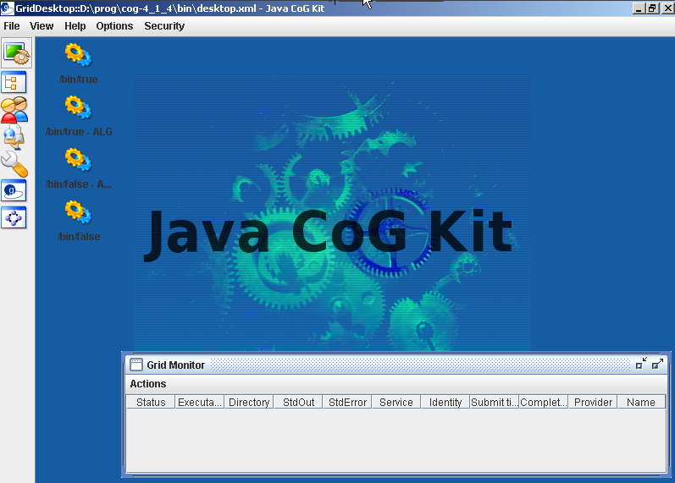
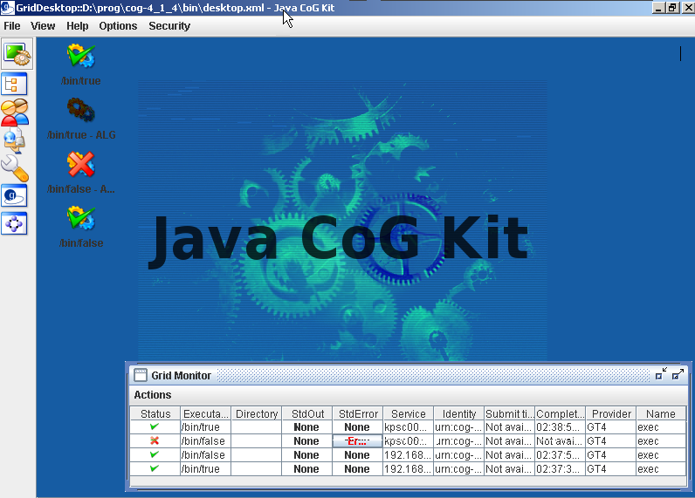
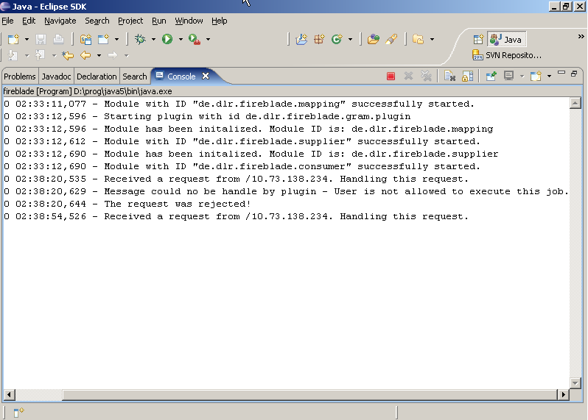
Submitted directly to globus container
Submitted through an ALG
Submitted directly to globus container

Slide 10

Classification of the ALG
Advantages and disadvantages
Advantages
  Less LOC in ALG means less bugs
  Filter and delete content in requests
  Force early and strong authentication
  Logging and Accounting
  Block some attacks (with help of an IDS)
  No modification of client and servers
Disadvantages
  Complexity in configuration and maintenance of the ALG
  Downsizes maximal throughput
  Higher latencies
Still an ALG would one be a part of a security concept

Slide 11
Conclusions
Current status and future work
Proven remedy (e.g. in IBM Websphere Web Service Gateway, Xtradyne WS-DBC, Visonys Airlock or other HTTP/Email Proxies)
Usage of modern technologies
  Java and Axis (Which means support for Tomcat and Globus Toolkit)
  Available for OGSA/WSRF-based Grids
Prototype has been implemented
Future work
  Support of virtual organizations
  Integration of firewall hardware (for port opening)
  Integration of IDS, VPN-Tunnels and Virus scanners

Slide 12

Questions & Suggestions?
Further references
„Globus Toolkit Version 4: Software for Service-Orientated Systems“,
Ian Foster
„Globus Firewall Requirements“,
Von Welch
„Firewall Issues Overview“,
Open Grid Forum
„Konzeption von Sicherheitsgateways“,
Bundesamt für Sicherheit in der
Informationstechnik
“Simple Object Access Protocol”,
W3 Konsortium

Slide 13
Support for RFT (Reliable File Transfer)
ALG as an firewall opener
1
RFT Plug-In
XML
Schema
Mapping Module
2
validate
3
Detect an RFT request with the help of the SOAP message
Handoff to a RFT plug-in for further validation
Open firewall for participants
or alter request; start own gridFTP server; act as cache

