Slide 1
Update on the deployment of e-Infrastructrure services in Africa
Roberto Barbera, University of Catania, INFN and Consorzio COMETA - Italy
(roberto.barbera@ct.infn.it)
info@ei4africa.eu
www.ei4africa.eu

Slide 2
The eI4Africa Project: Overview (http://www.ei4africa.eu)
An EU/FP7 project funded by the EC (DG CONNECT) under the ‘Capacities Programme’
Spanning 24 months ( 1st of Nov. 2012 – 31st of Oct. 2014)
With the aim of:
Boosting the Research, Technological Development and Innovation (RTDI) potential of African e-Infrastructures
Supporting policy dialogues
Enhancing Africa-EU cooperation
In the framework of the joint Africa-EU Strategic Partnership on
Trade, regional integration and infrastructures (JAES Partnership 3)
Science, information society and space (JAES Partnership 8)

Slide 3
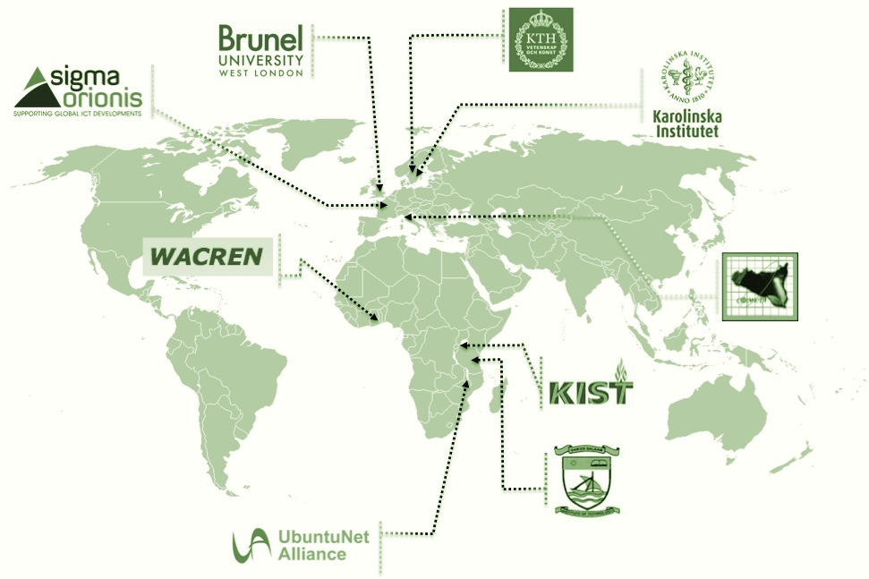
The eI4Africa Project: Partnership (http://www.ei4africa.eu/partners)
Sigma Orionis - France
(Project Coordinator)
Brunel University - UK
(Project Technical Coordinator)
CoeICT/DIT - Tanzania
COMETA - Italy
Karolinska Institutet - Sweden
KTH - Sweden
REHCE/KIST - Rwanda
UbuntuNet Alliance - Malawi
WACREN - Ghana
(Affiliated partner)

Slide 4
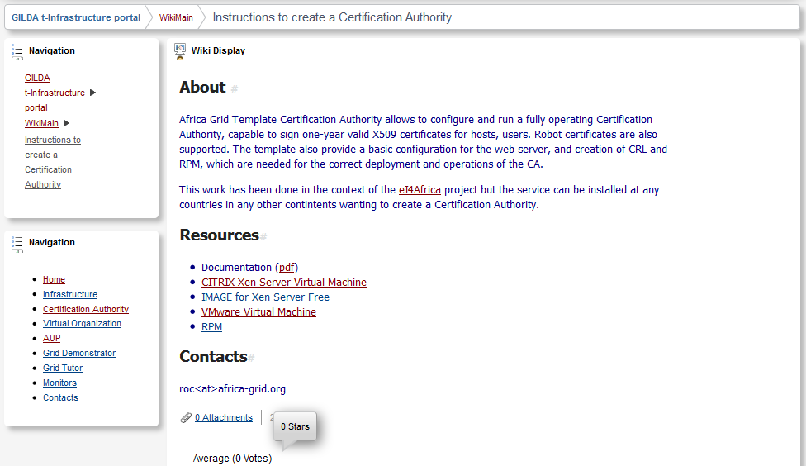
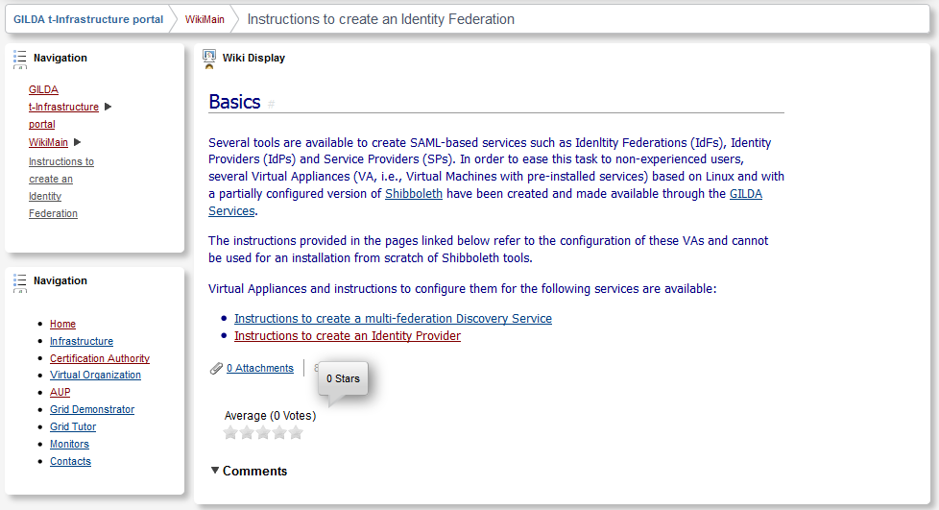
Training material for CAs and IdPs/IdFs

Slide 5
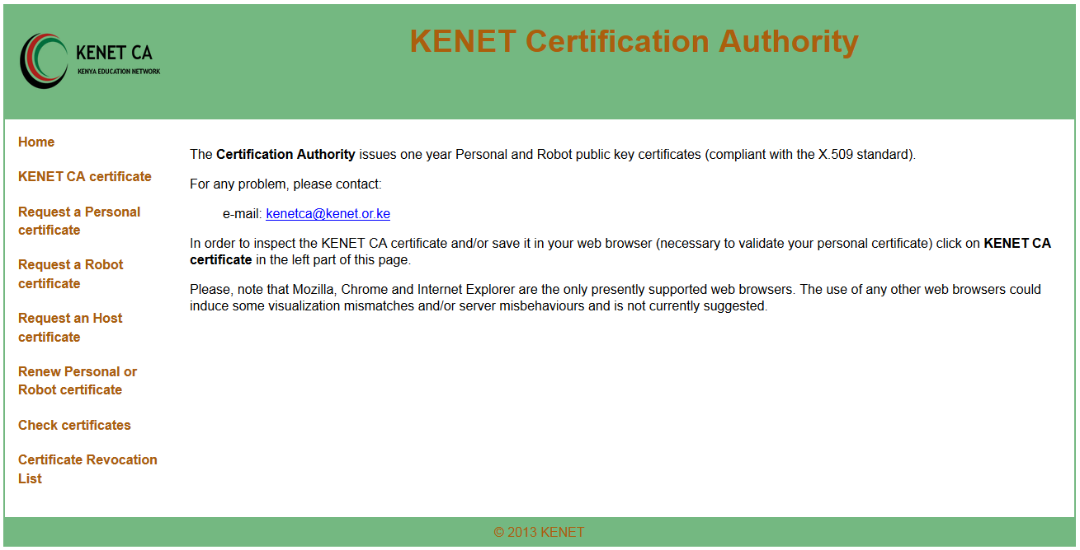
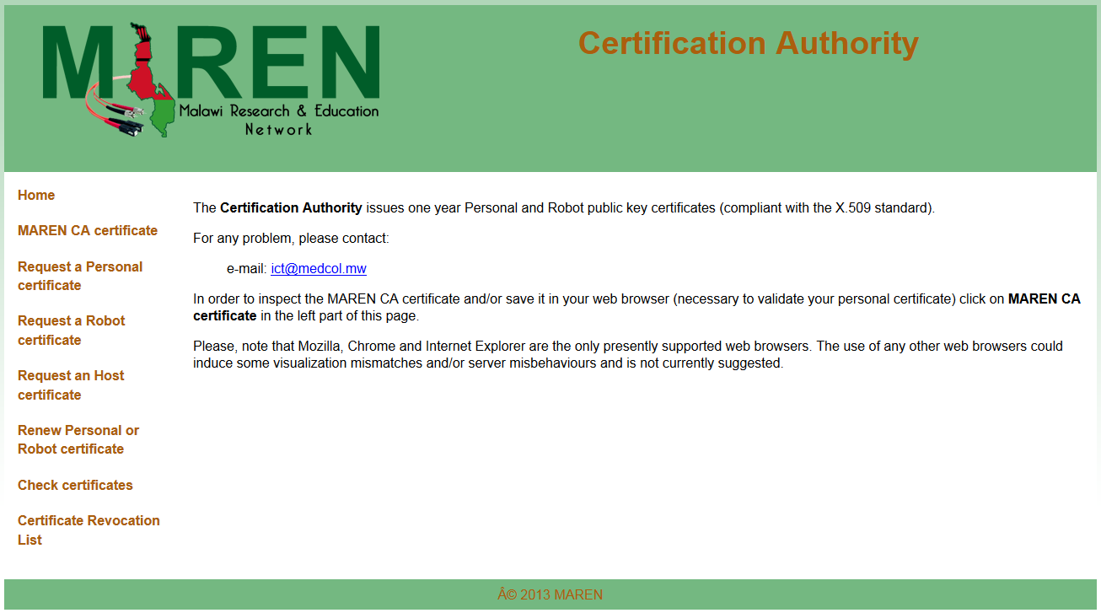
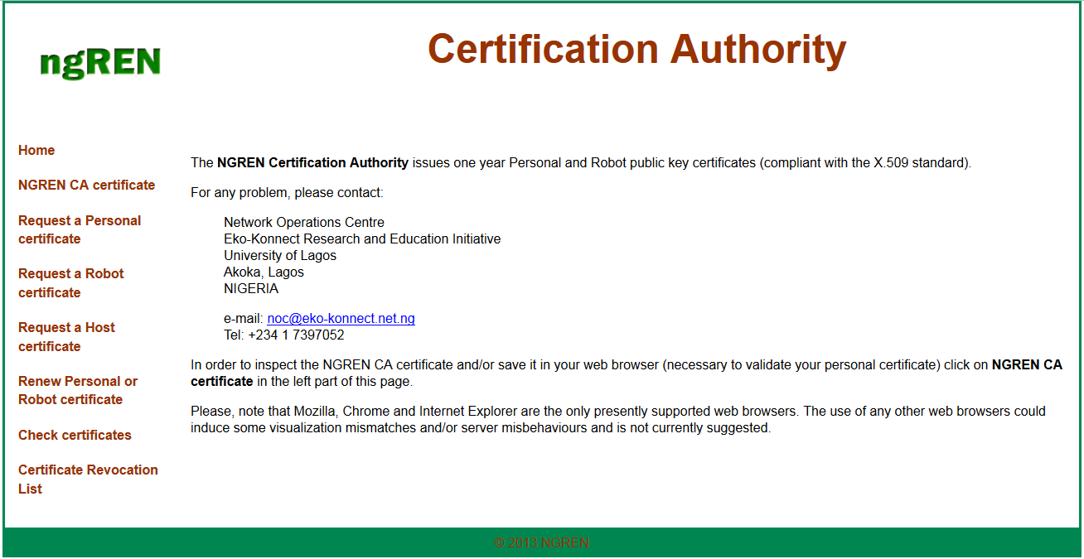
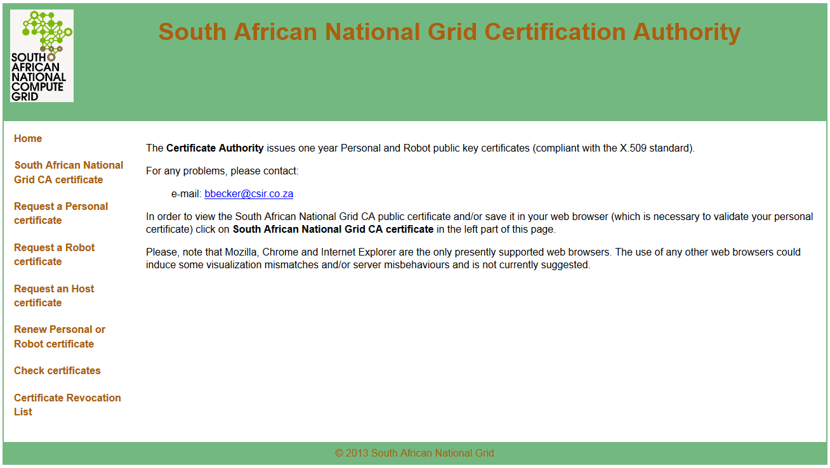
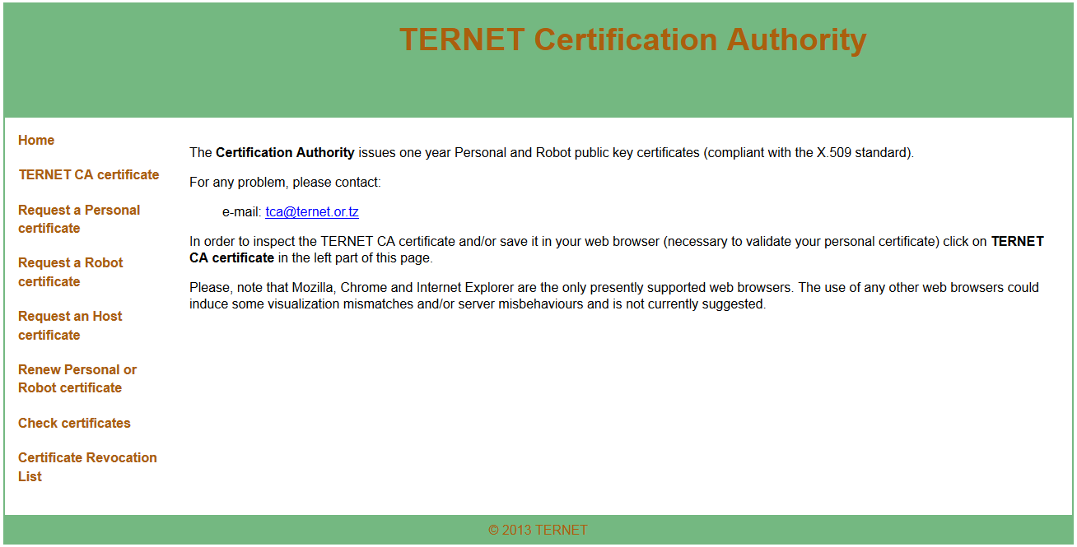

Status of CA deployment
CP/CPS documents are in preparation based on examples of already accredited CA’s

Slide 6
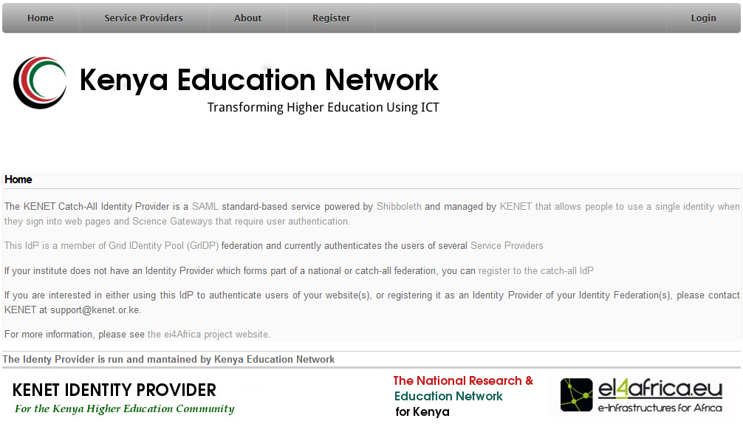
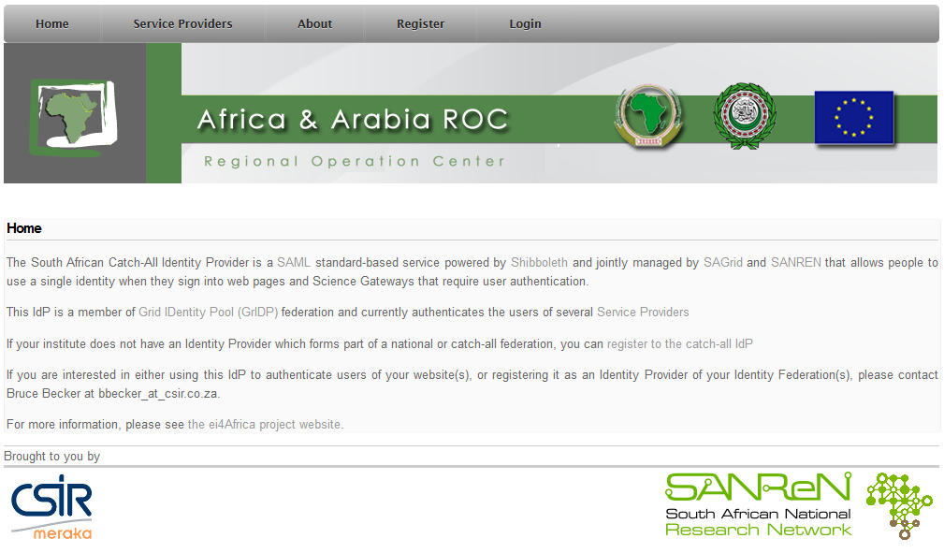

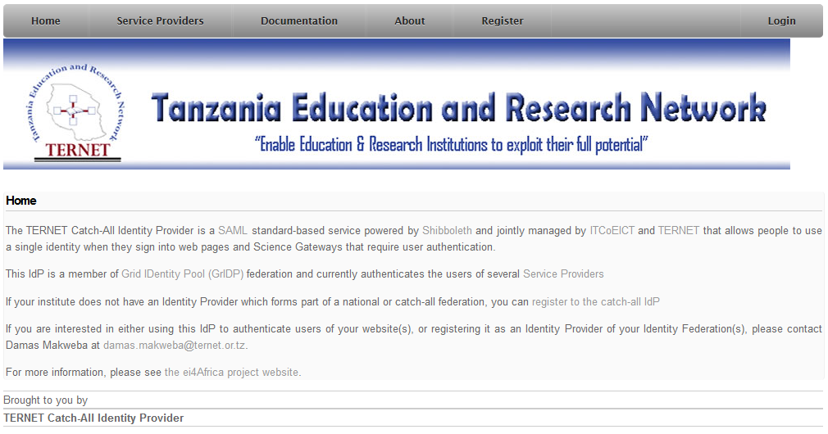
Status of IdP deployment
Policy documents are in preparation based on examples of already established IdF’s
Framework agreement under discussion with Comodo to provide a service like TCS in Africa

Slide 7
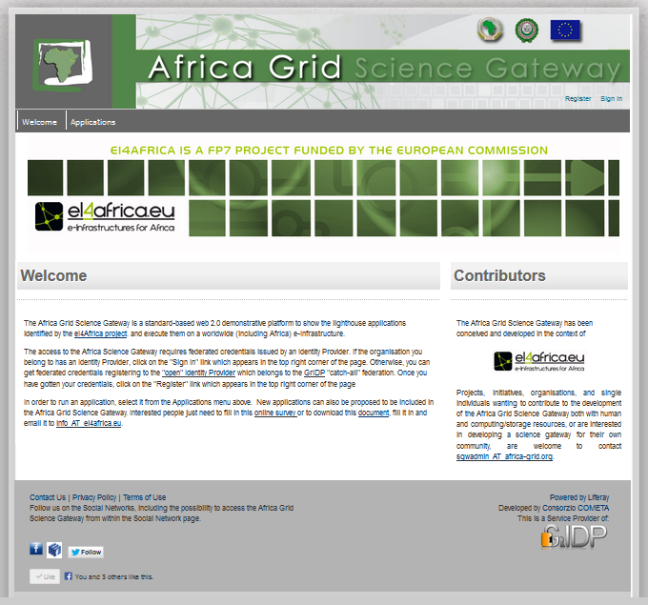
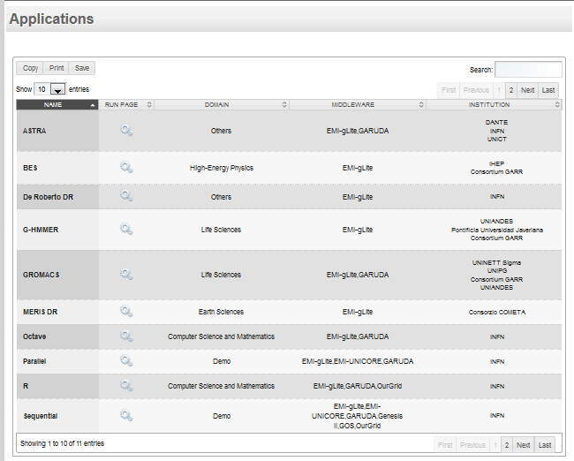
The Africa Grid Science Gateway (http://sgw.africa-grid.org)
Other Service Providers are being connected to the established IdP’s

Slide 8
Thank you !

