Slide 1
CDDLM
XML-based Configuration Description Language
Jun Tatemura
NEC Laboratories America
GGF11 – June 7, 2004

Slide 2
Overview
CDDLM introduction
XML-CDL review
  Service-Oriented Deployment Framework
  Data model
  CDL functionalities
[Discussion] Semantics within the context of CDDLM Basic Services/Component Model

Slide 3
CDDLM
Configuration Description, Deployment, and Lifecycle Management
Automated Deployment and configuration
  Given system platforms as grid resources, how we can configure them to run our applications?
Configuration Description
  Configuration data model
  Configuration properties
  Data dependencies
Deployment
  Manages a sequence of operations to deploy a specific application on platforms
Lifecycle Management
  Deploy – start – stop – undeploy
  Lifecycle state model

Slide 4
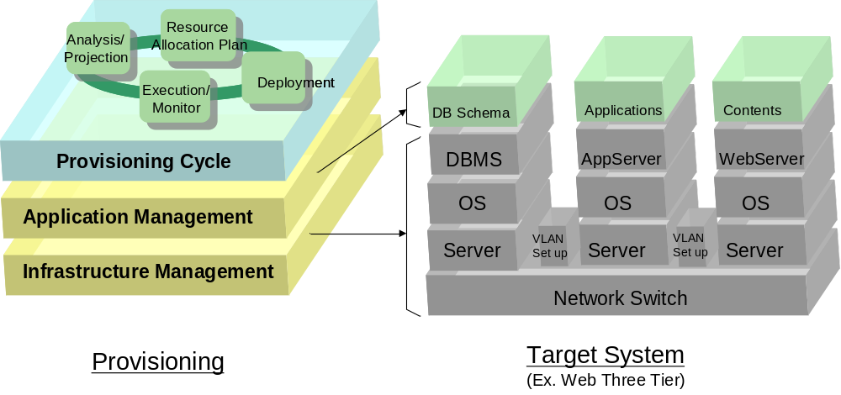
Background: Provisioning Cycle
CDDLM’s scope is a part of provisioning cycle

Slide 5
Components and Component Services
How applications are deployed on top of infrastructure
J2EE app
application
Service
Requester
Component
Service
Application
server
application
application
infrastructure
Service
Requester
Component
Service
Linux
infrastructure

Slide 6
CDDLM Documents
Foundation Document
SmartFrog-based CDL
XML-based CDL
Basic Services [CDDLM WG #2]
Component Model [CDDLM WG #3]

Slide 7
CDL and Basic Services/ Component Model
Example: Three-tier web applications
provides
Application
Wrapper
Provider (developer)
User (who deploys)
refers to
CDL
Template
CDL
Template
CDL
Template
provides
CDL Template
For 3tier app
(schema, default values,…)
(application structure,…)
Resource provider
refers to
Web
server
Component
service
Web
server
CDL
For a specific
deployment
request
Web
server
submit
Basic
Service
Component
service
App
server
App
server
App
server
discovered resources
agreed values
DB
server
Component
service
DB
server
discovery and
agreement
Resource
Broker
DB
server

Slide 8
[Draft Review]
XML Configuration Description Language Specification
Revision 0.2

Slide 9
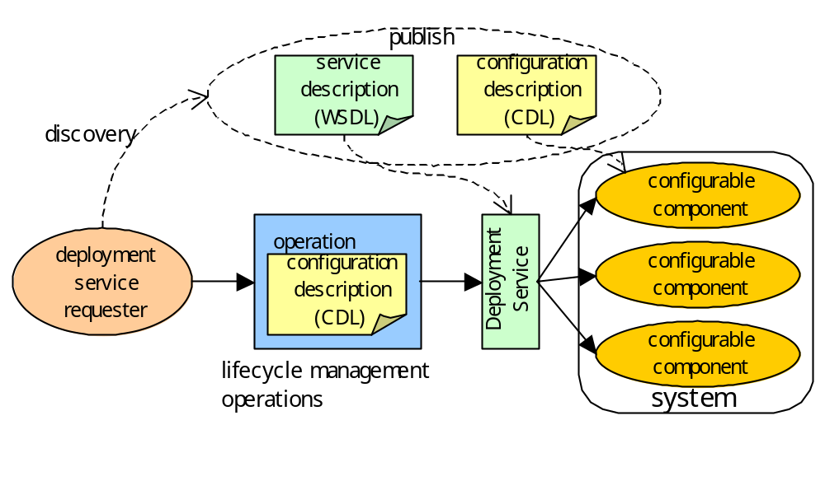
Service Oriented Deployment
Architecture

Slide 10
Configurable Components
A resource with which a service can be deployed
  e.g., a Linux server
Configuration Properties
  The user can configure the component by giving values of these properties.
Configurable Component Providers
  A provider of configurable components publishes description on these components so that users can configure these components properly.
Component Lifecycle
  A component has status in terms of deployment lifecycle such as deployed and running. The CDL does not assume any specific lifecycle model.

Slide 11
Use of CDL [1]: Configurable Components
A provider describes configurable components that are to be published. The description MAY include the following information:
  Property names
  Property types
  Default values of properties
  Whether property values are required or optional
  Properties that are automatically assigned in deployment time
Extensibility: The description MAY include extra information using other specifications (e.g., security, policy)

Slide 12
Systems
A system is a set of configurable components required to deploy a service.
System Lifecycle
  A system has status in terms of deployment lifecycle, which is defined based on status of configurable components within the system. For example, a system is running when all the components in the system are running.

Slide 13
Use of CDL [2]: System Configuration
A system configuration is described and used in order to deploy a system that consists of configurable components.
  The configuration MAY include
    References to configurable components
    Values of properties
    Value dependencies among properties
Two types:
  Deployable System Configuration
    ready to be used in deployment.
  Partial System Configuration
    used as modules with which a deployable system description is composed.

Slide 14
Deployment Services
A deployment service handles deployment and lifecycle management of a system from deployment to un-deployment.
Deployment Service Providers
  A provider of deployment services may or may not be a provider of configurable components.
Lifecycle Management Operations
  The deployment service provides operations to control system lifecycle.
Lifecycle Monitoring Services
  The deployment service provides ways to monitor the lifecycle status of the system.

Slide 15
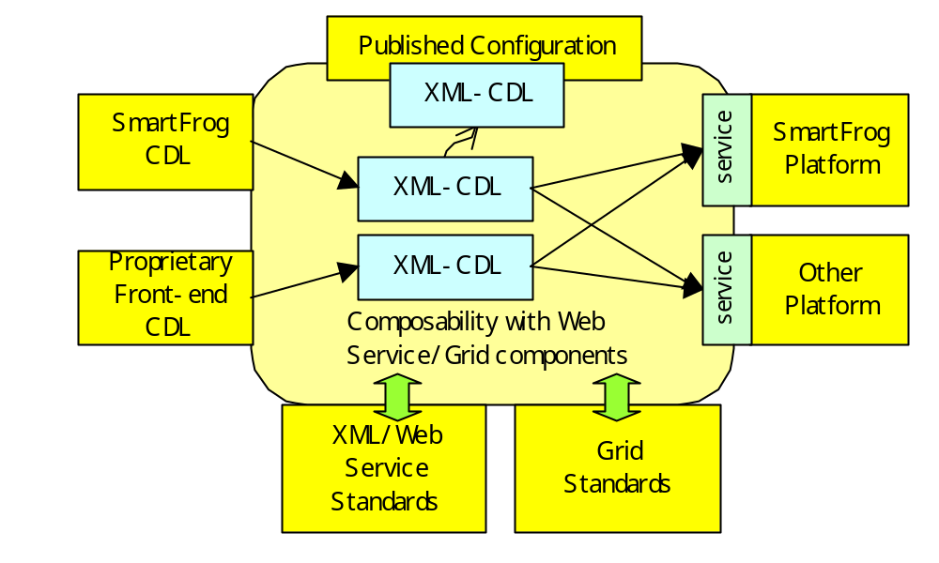
Two CDLs: SmartFrog and XML-CDL
XML-CDL for composability and interoperability

Slide 16
Property Lists
Data required to configure a component is given as a list of properties, each of which has a name and a value.
Properties and property lists are represented as XML data defined with a domain specific schema.
<WebServer>
<hostname>example.com</hostname>
<port>80</port>
<maxClients>150</maxClients>
</WebServer>

Slide 17
Configuration Description
Functionalities
In order to dynamically generate property lists for configurable components from multiple sources, which may be given from different organizations in different timing, the language provides XML notations for the following functionalities:
  Unique naming of property lists
  Inheritance of property lists
  References that define data dependency between properties
The language processor resolves this inheritance and reference structure and makes property lists available for configuration of the corresponding components.

Slide 18
Document Structure
<cdl:cdl targetNameSpace=xsd:AnyURI?>
<cdl:import …/>*
<cdl:include …/>*
<cdl:types …/>?
<cdl:configuration …/>?
<cdl:component …/>*
<cdl:system …/>*
</cdl:cdl>

Slide 19
Property Name
@cdl:name
A unique name MAY be specified to indicate a property list by inserting cdl:name attribute. Combined with the namespace name specified with cdl:cdl/@targetNamespace, the property list is uniquely referred to with QName.
<WebServer cdl:name=”mywebserver”>
<hostname>www.example.com</hostname>
<port>80</port>
</WebServer>

Slide 20
Property Mode
@cdl:mode
required
  The user of the configurable component MUST assign values of this property.
optional
  The user of the configurable component MAY assign values of this property.
automatic
  The value of this property is given by the provider of configurable components at deployment time. Users of configurable components MUST NOT assign values of this property but MAY refer to this property with references.
<hostname cdl:mode=”automatic”/>

Slide 21
Inheritance
@cdl:extends
The value of the @cdl:extends attribute is the QName of the property list that is to be inherited. Property values in the referred list are used as default values of the referring list.
<WebServer cdl:name=”genericserver”>
<hostname />
<port>80</port>
</WebServer>
<Tomcat cdl:name=”tomcat” cdl:extends=”genericserver”>
<port>8080</port>
<maxThreads>200</maxThreads>
</Tomcat>

Slide 22
References
@cdl:refroot and @cdl:ref
@cdl:refroot document root of XPath
  The name of a property list (QName)
  Default: the (innermost) named property list that include the reference (@cdl:ref)
@cdl:ref XPath expression
<hostname cdl:refroot=”QName”? cdl:ref=”XPath”/>

Slide 23
References:
Examples [1]
<cdl:configuration>
…
<a cdl:name=”a”>
<b>test</b>
<c>100</c>
<d>200</d>
<e>
<f>abc</f>
<g>def</g>
</e>
</a>
…
<aa cdl:name=”aa”>
<b cdl:refroot=”a” cdl:ref=”/b” />
<c>300</c>
<d cdl:ref=”/c” />
<e>
<f cdl:refroot=”a” cdl:ref=”/e/g”/>
<g cdl:ref=”/e/f”/>
</e>
</aa>

Slide 24
References:
Examples [2]
Default of @cdl:refroot
  Named property list that include the reference
<aa cdl:name=”aa”>
<b cdl:refroot=”a” cdl:ref=”/b” />
<c>300</c>
<d cdl:ref=”/c” />
<e>
<f cdl:refroot=”a” cdl:ref=”/e/g”/>
<g cdl:ref=”/e/f”/>
</e>
</aa>

Slide 25
References:
Function and Extensibility
Function
  XPath string functions, number functions, and numeric operators
Extensibility
  Another language (e.g., XPath 2.0) MAY be specified
<hostname>www.example.com</hostname>
<num1>10</num1>
<num2>20</num2>
<url cdl:ref=“concat(“http://”, /hostname, “index.html”)”/>
<total cdl:ref=”/num1 + /num2”/>
<cdl:cdl pathLanguage=xsd:anyURI? …/>

Slide 26
Component and System
A configurable component (to be published)
  A special case of a property list
A system (to be deployed)
  A special case of a property list
<cdl:component name=”dbserver” extends=”dbtemplate”>
<url cdl:mode=”automatic”/>
…
</cdl:component>
<cdl:system name=”webapp”>
<WebServer cdl:extends=”webserver” …/>
<AppServer cdl:extends=”appserver” …/>
<Database cdl:extends=”database” …/>
</cdl:system>

Slide 27
Import and Include
cdl:import – reference to external configuration description (a namespace)
cdl:include – insertion of a part of configuration description from external data sources
<cdl:import namespace=”http://example.com/serverconfig/”
location=”http://example.com/serverconfig.cdl”/>
…
<cdl:configuration xmlns:ex=”http://example.com/serverconfig/”>
<MyServer cdl:extends=”ex:genericwebserver” …/>
…
</cdl:configuration>
<cdl:cdl targetNamespace=uri2…>
<cdl:include location=”http://example.org/baseconfig.cdl”/>
<cdl:component name=”b”…/>
</cdl:cdl>

Slide 28
[Discussion]
CDL Semantics – relationship to Basic Services/Component Model

Slide 29
Ralationship between CDL and Basic Services’ Lifecylce Management
CDL gives Basic Services
  Data Dependency
  System Structure (hierarchy)
Lifecycle
Management
Operations
Basic Services
Sequences
of Operations
CDL
System structure
Data dependency
Lifecycle Model
Lifecycle states
State dependency
Others

Slide 30
Data Dependency
CDL’s data dependency gives constraints to Basic Service’s operation sequencing
Component A
Component B
Component C
reference
reference
Automatic property:
Value assigned in deployment time
Component A must be deployed before B and C

Slide 31
System Structure
Hierarchy MAY be used for abstraction of operations and notifications
  Operation: sequence of operations to subcomponents
  Notification: aggregation of notifications (or states) from subcomponents
Semantics is out of CDL’s scope
Sequence generation
Lifecycle management operation
Notifications
(monitoring)
Aggregation
Operations
Lifecycle status notification

Slide 32
Lifecycle Models
Models on lifecycle of hierachical components
Various lifecycle models (from simple to complicated) MAY be applied (domain dependent)
Thus, Semantics of CDL hierarchy should be extensible
Subcomponents are independent
(no dependency)
Subcomponents are sequentially operated
Operations are programmable (e.g. BPEL)
Model 1
Model 2
Model N
Basic Service Lifecycle Management
Framework

Slide 33
Composability between Lifecycle Models and CDL
Any notation on lifecycle models MAY be attached to CDL system structure
Basic Services may specify a default lifecycle model
<websystem cdl:name=“…”…
lcm:model=“model1”…>
<cacheservers …
lcm:model=“model2” …/>
…
</websystem>
Model B
Model A

Slide 34
Other Functionalities Composed with CDL
Publish and Discovery process
  Of configurable component types
    Resource types
  Of configurable component instances
    Resource instances
Binding to resource instances
  WS-RF based: WS-Addressing
    wsa:EndPointReference
  OGSI (ver1) based
  Future extension
Uploading software modules on configurable components

Slide 35
Summary
CDDLM introduction
  Basic Service, Component Model
  Two CDLs: SmartFrog and XML-CDL
XML-CDL review
  Service-Oriented Deployment Framework
  Data model: property lists
  CDL functionalities: naming (@cdl:name), property mode (@cdl:mode), inheritance (@cdl:extends), reference (@cdl:ref),…
CDDLM Basic Services/Component Model
  CDL gives data dependency and hierarchical structure
  CDL is composable with lifecycle models, binding to resource instances, etc.

