Slide 1

CDDLM
Component Model
Steve Loughran
HP Laboratories

Slide 2
disclaimer
work in progress
not in perfect agreement with current draft component model doc
view it as an annotated response/followup to that draft
Notes:
This is not an attempt to push back and say "use something we have", but more a "here are the things of today's designs that we think works well and are simple enough to be practicable"

Slide 3
declaration
component model ::=
how you build code to integrate with CDDLM

Slide 4
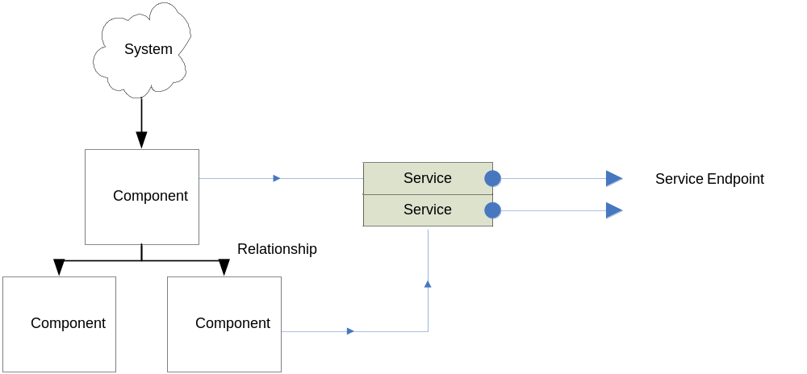
not the graph of components in a deployment descriptor
Notes:
a deployment descriptor defines a nested attribute set.
Not everything in here is instantiable, and the timing of their deployment may change. But that does not stop you from getting/setting the attrs.

Slide 5
the extension hierarchy of language level components
does not imply
implementation inheritance

Slide 6
Declaration Inheritance does not imply implementation inheritance
<WebServer cdl:name="webserver">
<port>80</port>
</WebServer>
<tomcat cdl:name="tomcat" cdl:extends="webserver"/>
<axis cdl:name="axis" cdl:extends="webserver"/>

Slide 7
Proposed Component Model
Every component has a SOAP endpoint that Basic Services can talk to
Every component is a WSDM manageable thing (i.e. WS-RF resource)
Components may not be in the same process as the runtime
Cross platform; manageable.

Slide 8
Implications
Need to deploy/exec component processes
Basic Services messages+ Component Model messages defines the APIs
Rely on WS-* security model(s) for authentication
Communications limited to common types

Slide 9
Component Integration
Components will reuse other components
Recommend: delegation and not inheritance across components
Recommend: use Basic Services to bind stuff
Basic Services stores the deployment graph plus the attributes
Notes:
You may have class inheritance, but this is not visible to the deployment infrastructure

Slide 10
Resource Management
Can components provide resource information?
Examples:
use of a Tomcat component implies Java; memory from maxMem attribute.
a linux/x86 binary sets the platform
research topic?
Notes:
It'd be nice, wouldn’t it. But you cannot infer needs except at run time, if compound components have different semantics than 'deploy everything'. Conditional, sequential and iterative containers can vary resource needs dynamically.
What we can do is have a component that interacts with the resource manager, so does it sequentially.

Slide 11
document proposals
attributes
state
health
errors

Slide 12
5.1.1 Attribute Query and Modification
Every attribute declared within a CDL for an object will have a interface for retrieving the attributes property value.
This interface will follow the standard get/set pattern for attribute retrieval.
This is simply a requirement that each object provide a comprehensive set of get/set definitions for each of its exposed attributes.
Notes:
This is where I diverge a bit from what the doc says, based on experience from Ant.
-if you export direct set/get operations then things call them and you can never take attributes away or change their type. Plus you cannot

Slide 13
5.2.1 attributes
<complexType name="WebServer"><all>
<element name="hostname" type="xsd:string"/>
<element name="port" type="xsd:int"/>
</all></complexType>
<portType name=" Configuration">
<operation name="getWebServer">
<input name="getWebServerInstance"
message="tns:getWebServerInput">
<output name="getWebServerAttributes"
message="tns:getWebServerInput">
</operation>
<operation name="setWebServer">
</operation>
</portType>
Notes:
Ask things their state. Return an enum + extra info (undefined).

Slide 14
this is the Ant model
package org.apache.tools.ant.taskdefs;
public class Java extends Task {
public void setJvmargs(String s) {
log("jvmargs is deprecated. ",
Project.MSG_WARN);
cmdl.createVmArgument().setLine(s);
}
}
Notes:
This is what ant does. We don’t have a way of taking old stuff away. We cannot change the type of things, but can overload stuff the way you cannot in WS-I approved WSDL.

Slide 15
direct binding brittle
RunJava jvm;
int m;
...
jvm.setMaxMemory(48);
jvm.setAssertions(true);
m=jvm.getMinMemory();
jvm.setAttributeNotInRunJava("test") ; //error
jvm.setAttributeTakenAway("test") ; //error
Notes:
1. You cannot change type

Slide 16
the SmartFrog model
public class RunJavaImpl extends PrimImpl
implements RunJava {
public synchronized void sfDeploy()
throws SmartFrogException,RemoteException {
super.sfDeploy();
classname=sfResolve("classname",
(String)null,true);
Vector jvmArgs=(Vector) sfResolve(jvmargs,
(Vector)null,false);
...
}
}
Notes:
Smartfrog: you ask for attributes. you can ask for the attrs of anything else, you specify the type and you can spec if things are needed or optional.
This is really via BasicServices, we just use parent classes as this is inproc and implemented by the base class.
Lets you ask for things, add new stuff, find attrs of things that are not yet deployed or even instantiable.
weaknesses: no obvious way to determine from code what the attrs are. No direct way to set attributes between components, except via the deployment graph.

Slide 17
mediated is much more flexible
BasicServices services;
...
services.setAttribute(jvm, "maxMemory",48);
services.setAttribute(jvm, "assertions",true);
m=services.getIntAttribute(jvm, "minMemory");
services.setAttribute(jvm, "attributeNotInRunJava","test");
services.setAttribute(jvm, " attributeTakenAway","test");
change notification?
Notes:
The alternative is to set/get attrs via the framework. This is somewhat more independent of change (you can do type conversion) , and implement the notification of change differently. Plus if you enable logging in Basic Services you can see what is going on.
But what about invocation of method operations. Should you build Soap messages and route them off via Basic Services, or make RPC-like calls to endpoints.

Slide 18
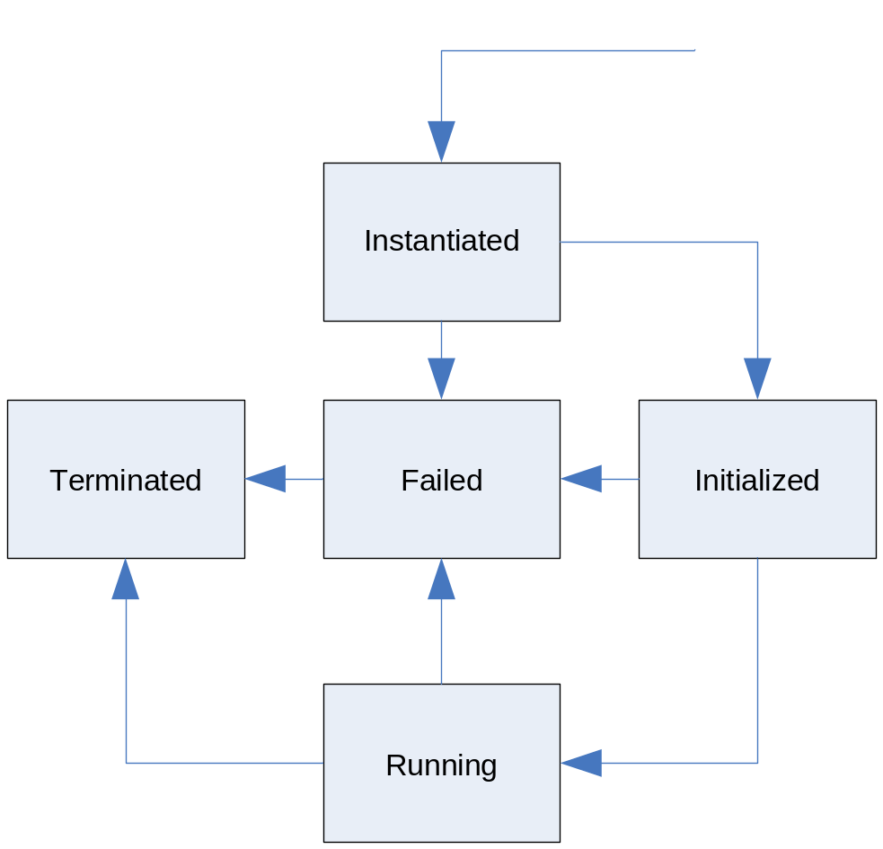
state
add terminate without running?
Notes:
Good point from Stuart: can we terminate something without running it?

Slide 19
5.2.1 state query
<message name="queryStateInput"/>
<message name="queryStateOutput">
<part name="state" type="cdl:LifecycleState"/>
<part name="stateInfo" type="xsd:string"/>
<part name="extendedState" type="xsd:any"/>
</message>
<operation name="queryState">
<input name="queryStateRequest" message="tns:queryStateInput">
<output name="queryStateResponse"
message="tns:queryStateOutput">
</operation>
Notes:
Ask things their state. Return an enum + extra info (undefined).

Slide 20
5.2.2 state transition
<message name="stateAction">
<part name="action" type="cdl:StateAction"/>
</message>
<message name="stateActionResult">
<part name="result" type="xsd:boolean"/>
<part name="resultState" type="cdl:LifecycleState"/>
</message>
<operation name="enactStateAction">
<input name="stateActionRequest"
message="tns:stateAction">
<output name="stateActionResponse"
message="tns:stateActionResult">
</operation>
1. return boolean or faults?
2. terminate an undeployed component?
Notes:
This is the generic change state request. Stuart proposes returning true/false + final state.
My view: anything that doesn’t change into the state you request is a failure, failures should be faulted.
NB: time to enter states. starting a program does not imply that it is ready to accept connections.
The way we do this in both ant and smartfrog is to have tester classes that do things –probe ports for being open, test for files being available, and spin till they are ready.

Slide 21
Health
component do simple health checks
Basic Services/parent components handle failure
detect failure of child
detect failure of parent
network partition == failure

Slide 22
Health in SmartFrog
every component probes own health
recurses through components
if tests fail: failure
if parent doesn’t probe: child fails and (usually) undeploys itself
action on child failure is the choice of the parent
Notes:
Simple binary model of health
Failure reported upstream
Parent components choose action (propagate up, start failure handler, start next in sequence), perhaps based on type of termination (normal shutdown, unexpected failure)

Slide 23
WSDM Integration
Configuration info in the CDL needed to configure WSDM health monitors
Failure of services can be detected by WSDM
But reported to CDDLM system (yes?)
How to handle SLA violations?

Slide 24
5.3.1 Health Query
<message name="getHealthStateInput"/>
<message name="getHealthStateOutput"/>
<part name="state" type="xsd:string"/>
<part name="healthInformation" type="xsd:any"/>
<part name="recoverable" type="xsd:boolean"/>
</message>
<operation name="getHealthState">
<input name="getHealthStateRequest"
message="tns:getHealthStateInput">
<output name="getHealthStateResponse"
message="tns:getHealthStateOutput">
</operation>
binary aggregates more easily

Slide 25
5.3.2 Extended Error Query
<message name="getExtendedErrorInput"/>
<part name="infoType" type="cdl:ExtendedErrorType"/>
</message>
<message name="getExtendedErrorOutput"/>
<part name="extendedInformation" type="xsd:any"/>
</message>
<portType name="Maintenance">
<operation name="getExtendedErrorInformation">
<input name="getExtendedErrorRequest"
message="tns:getExtendedErrorInput">
<output name="getExtendedErrorResponse"
message="tns:getExtendedErrorOutput">
</operation>
</portType>
why not just throw faults on operations?
Notes:
Maybe I don’t understand something here. But we have WS-BasicFaults with arbitrary XML inside. Lets use that for trouble.
now the doc says we can include a log here. But IMO there is a logging working group, lets use that for logging.

Slide 26
5.3.3 Maintenance Task Action
<message name="taskActionInput"/>
<message name="taskActionOutput"/>
<part name="taskName" type="xsd:string"/>
<part name="taskContents" type="xsd:uri "/>
</message>
<operation name="taskAction">
<input name="taskActionRequest"
message="tns:taskActionInput">
<output name="taskActionResponse"
message="tns:taskActionOutput">
</operation>
difference from SOAPAction?
Parameters?
Route via Basic Services?
Notes:
1. do we need this at all, can we just have a generic SOAPAction
2. if we have it, what are the params. I'd go for URI + xsd:any both ways,
3. can/should we route via basic services?

Slide 27
Faults
SOAPFault vs. WS-BaseFault?
Propose: WS-BaseFault for citizenship
Work with it as an XML doc, not some native struct
Add: hostname element
Extend it with subclasses?

Slide 28
Conclusions
we have a model for components as separate WSDM manageable endpoints
we have some early WSDL for components
but are still exploring foundational issues

