Slide 1
GEANT OpenCall – NSI CONTEST
Radek Krzywania (PSNC)
on behalf of NSI-CONTEST Team
OGF Meeting, 7 November 2026

Slide 2



What is NSI-CONTEST
Network Service Interface Conformance Test Suite
NSI-CONTEST aims at building an NSIv2.0 Compliance Test Suite (CTS) that will be offered to the developers as a test service platform
GEANT OpenCall project
    Joint efforts of PSNC (Poland) and Nextworks (Italy)

Slide 3
Overview

Slide 4

Main Objectives
Provide a new framework for validating the compliance of external BoD systems with the NSI v2.0 protocol
Design and develop a set of tools constituting the NSI v2.0 Conformance Testing Suite
Produce complete documentation of test scenarios and usage guides for software developers to run specific tests against the suite
Provide online platform for testing

Slide 5
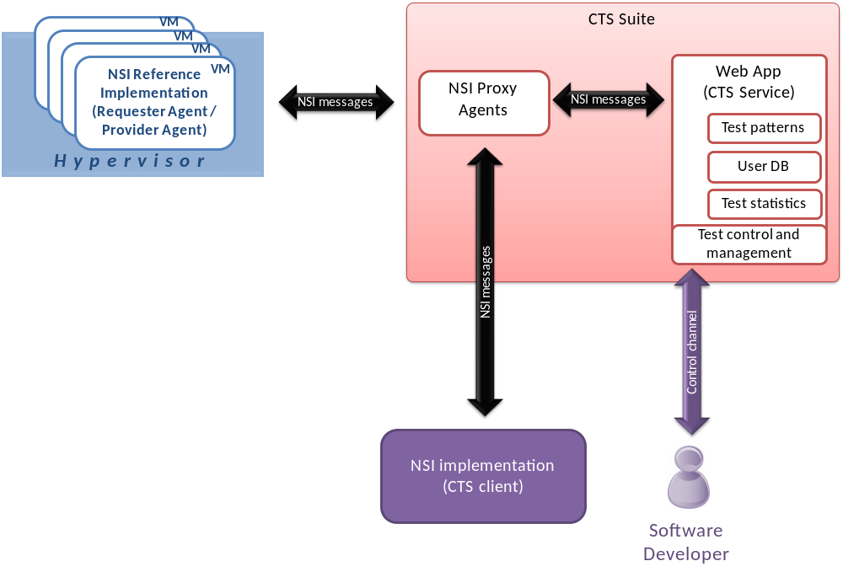
NSI v2.0 CTS High Level Architecture
Dynamically instantiated to handle multiple users
Implements
the NSI state machine
Controls the test execution
Instantiates NSI Ref. Impl. virtual machines
Configures NSI Proxy Agents
VMs dynamically configured to meet requirements of planned tests

Slide 6
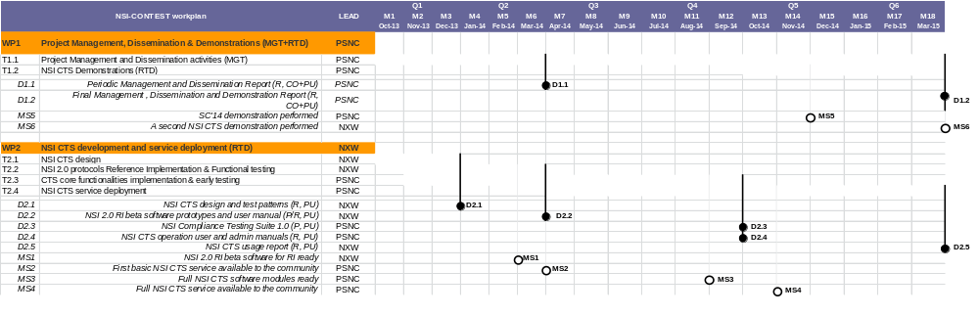
Workplan
Jan 2014
Project has started in October 2013
Demonstration on Supercomputing 2014
Analysis and design,
Preliminary specification,
NSI Prototype
CTS implementation
and testing

Slide 7

Benefits
Support for development and testing process of NSI applications and services
    Reference implementation of NSI 2.0 protocol
    step between internal testing and going to production
Provides early feedback for integration and system tests
Isolation, customization and repeatability of users tests
Reduces efforts (and potentially costs) for testing existing implementations
    if they work with NSI-CONTESTS, they will work with each other (no need for testing matrix)
In cases where the specification interpretation is not clear, NSI-CONTEST will produce coherent behaviour
Online platform
    single point of contact for users (NSI-CONTEST web application account)

Slide 8

What will be tested
Message testing
    syntax and sematics checking for parameters
    recording message flows
Workflows testing
  Custom test cases
    also predefined test cases with typical scenarios
  State machines validation, versioning
  Simulating different behaviours and conditions:
    unexpected situations (i.e. going down) and generating different error events
    timeouts
    NRM processing time
Pathfinding simulation
  connections path validation (for Aggregators)
Basic stress-tests
  checking performance under different conditions

Slide 9
What will NOT be tested
Network data plane
    however testing platform will simulate timings related to network configuration, but without real connections
User NRM (Domain Manager)
    but user is still able to test NRM, data plane and its connections internally
Custom service extensions
    only P2PServiceBaseType supported
Different authentication/authorization frameworks
Topology Service
    standard for NSI Topology not finished (?)
    in CTS platform testing topologies will be predefined
    currently each system updates topology manually and it is internal part of NSI Providers implementations

Slide 10
Workflows

Slide 11
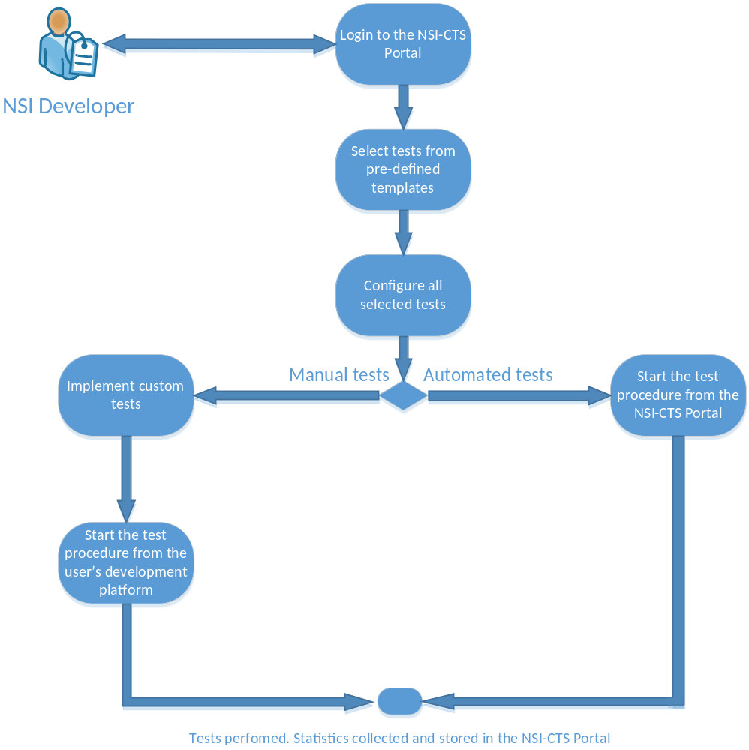
Workflow description – running tests
Step1: NSI developer registers to the portal
Step2: Select tests to be run (from pre-defined templates)
Step3: Configure and prepare tests for running (this also includes the configuration of the tested NSI suite)
Step4: Two kinds of test scenarios:
automated tests: all auto in NSI CTS after the developer’s trigger
manual tests: require further actions of the developer (e.g. implementation of relevant jUnit test cases). The test procedure will be initiated from the user’s development platform (e.g. Eclipse)
Step 5: Results collected and stored in the NSI CTS portal

Slide 12
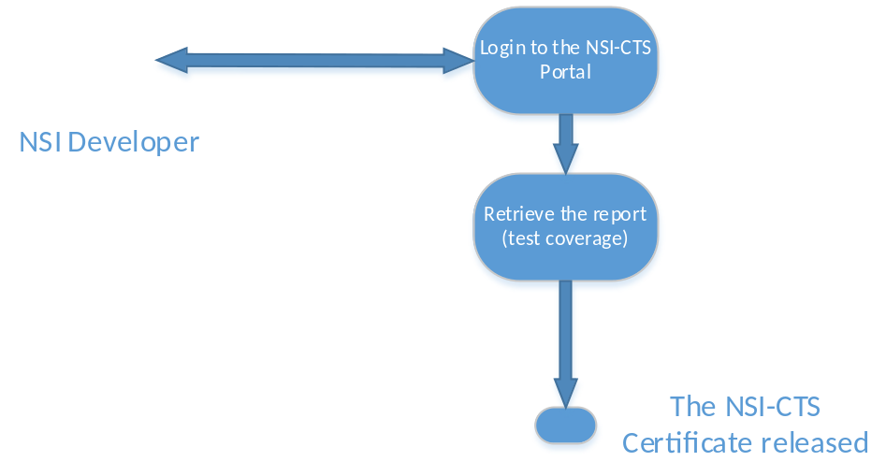
Workflow description – getting test results
Step1: The user logins to the portal
Step2: After successful login the user retrieves the test report, which includes the test coverage
Step3: The user receives the NSI-CTS certificate, which summarizes compliance with the NSI v2.0 standard

Slide 13
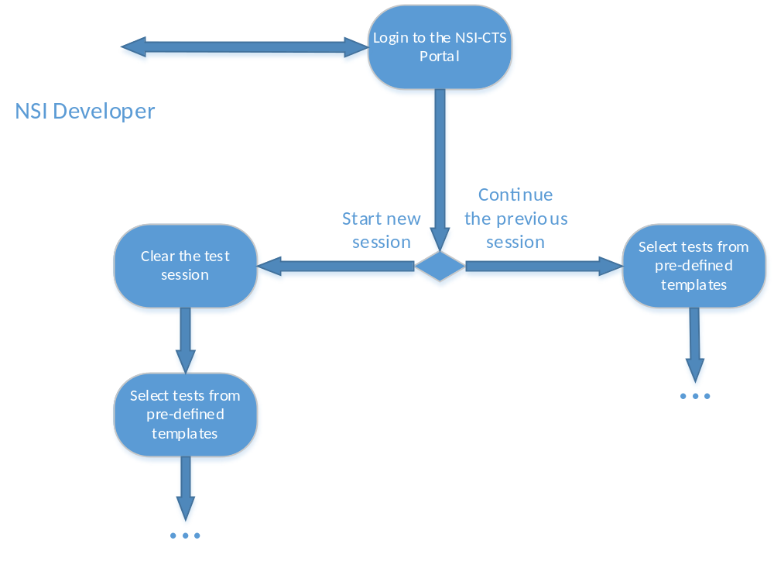
Workflow description – continuing tests
Step1: The user logins to the portal
Step2: Decide to start a new testing session, or continue the previous one (e.g. to increase the coverage of tests)
  Step 2a (start a new session): the NSI-CTS clears the testing session. The user proceeds with a selection of pre-defined tests from the portal
  Step 2b (continuation of he previous session): the user selects new tests to be performed and continues with testing

Slide 14
Agent Roles Testing

Slide 15

Testing Requester Role
Validation of request message formatting
NSI SUT
NSI-RI
Requestor agent
Test 1
Provider agent
Test 2
Coordinator
Validation of sequence & content of the rec.d messages according to the NSI FSMs
Emulated NRM
(configurable)
Generation of configurable events and messages, compliant with the NSI FSMs
It could either represent the ultimate provider or an aggregator, thus hiding all the complexity of an inter-domain topology (e.g. generation of errors related to remote domains).

Slide 16
Testing Requester role (cont.)
For validating NSI client applications like cloud provider extensions to NSI.
NSI-CTS does not trigger user requester
NSI-CTS can provide users with guidance on how he should proceed
    testing is performed according to the test definition
NSI-CTS collects messages sent by Requester and validates them according to the test template
Supports both sync and async communication scenarios (e.g. if firewall presence is simulated)

Slide 17
Testing Provider Role
Ultimate Provider Agent test
Generation of configurable request messages
NSI-RI
NSI SUT
Requestor agent
Test 1
Provider agent
Test 2
Coordinator
Validation of rec.d message formatting
Generation of configurable events and messages, compliant with the NSI FSMs
Validation of sequence & content of the rec.d messages according to the NSI FSMs

Slide 18
Testing Provider role (cont.)
Validates Agent that manages a single domain.
User provides necessary information (service url, provider NSA, a pair of STPs)
Or NSI-CTS retrieves that info from topology service (provided that user advertises his topology)
User chooses a test scenario, for example: full reservation cycle (reserve, reserveCommit, provision)
NSI-CTS issues web service calls suitable for the given test case
Once tests are done, the results are gathered and presented in accessible form

Slide 19
Testing Aggregator Role
NSI-RI
Requestor agent
Test 1
NSI SUT
Coordinator
Aggregator agent
Test 2
NSI-RI
NSI-RI
Ultimate provider or aggregator agent.
Provider agent
Provider agent
Coordinator
Coordinator
…
Emulated NRM
(configurable)
Emulated NRM
(configurable)

Slide 20
Testing Aggregator Role
Agent validation for multi-domain environments
To test Aggregator Topology Service will have to use predefined topologies
User must be able to provide its own topology so that it connects with NSI-CTS domains
NSI-CTS web application allows user to position himself as one of the middle domain in topology
    chain and tree structures supported
Test scenario executes and aggregator/path computation of user implementation is checked
Will be supported only if topology format and exchange mechanism is declared stable by the NSI Group

Slide 21
Testing Scenarios

Slide 22
Testing Scenarios
Define location of user SUT during the workflows testing
2 scenarios with local and remote user software
Different requirements and technical challenges

Slide 23
Scenario 1 – NSI SUT at user’s premises
Scenario:
  NSI SUT running at the user’s premises
  NSI-RI running on one or more VMs in the NSI-CONTEST infrastructure
Requirements:
  Secure interconnection (tunneling) between user’s premises and NSI-RI VMs might be needed or running SUT outside the firewalled network
Pros:
  Fully independent from user implementation
  No restictions for recompiling, redeploying and dependencies updating
  Less legal issues with user software licenses
  User is able to test NRM behaviour indirectly on its own premises
Cons:
  Possible dependencies on user network infrastructure (e.g. firewall, etc.)
    may need providing tunneling mechanism for bidirectional NSI connections, e.g. through VPN, GRE, ssh tunnels
  Security issues not covered in NSI-CONTEST
    the user is responsible for the configuration of its own infrastructure

Slide 24
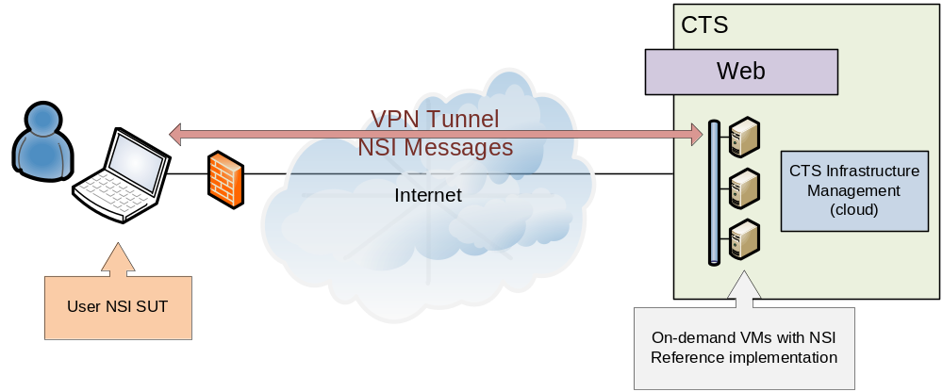
Scenario 1 – NSI SUT at user’s premises

Slide 25
Scenario 2 - NSI SUT uploaded on VM hosted @ NSI-CTS
Scenario:
  VMs templates made available for the users, with the most common development environments (e.g. java+eclipse+maven+git)
    Templates will be defined considering inputs from the users
    The user can also define its own templates
  NSI-RI running on one or more VMs in the NSI-CONTEST infrastructure
Requirements:
  User has to get access to SUT VM and upload his code
  User should be provided with mechanisms to install his sw dependencies (libraries, compilers, software project management tool like maven), or all-in-one templates
Pros:
  The user requests one/more VMs with a given template, obtains full access to the VMs and deploys its own implementation on those VMs
  Interconnection between user’s VMs and NSI-RI VMs, both running on the NSI-CONTEST infrastructure, created on-demand
  Fully independent from user implementation and network infrastructure
Cons:
  Extra resources (VM for SUT) needed at CTS
  Rebuilding, redeploying or debugging process might be more problematic
  SUT is a bridging VM between internal test network and public network
  Need to check/poll for more useful SUT VM templates and apps on board
  Requires additional support from NSI-CONTEST Team
  Potential legal issues with licenses

Slide 26
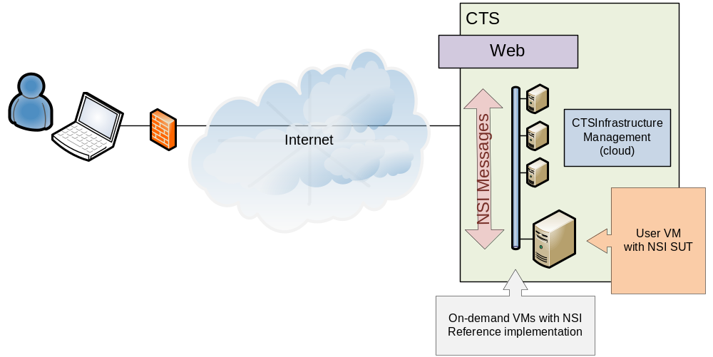
Scenario 2 - NSI SUT uploaded on VM hosted @ NSI-CTS

Slide 27
Thank you
Bartosz Belter <bartosz.belter@man.poznan.pl>
Michal Balcerkiewicz <michalb@man.poznan.pl>
Michal Giertych
<mikus@man.poznan.pl>
Lukasz Podleski
<docere@man.poznan.pl>
Gino Carrozzo
<g.carrozzo@nextworks.it>
Giada Landi
<g.landi@nextworks.it>
Giacomo Bernini
<g.bernini@nextworks.it>

