Slide 1

Dynamic Circuit Networks
Topology Description Issues
OGF - Feb 2008
John Vollbrecht
Internet2

Slide 2
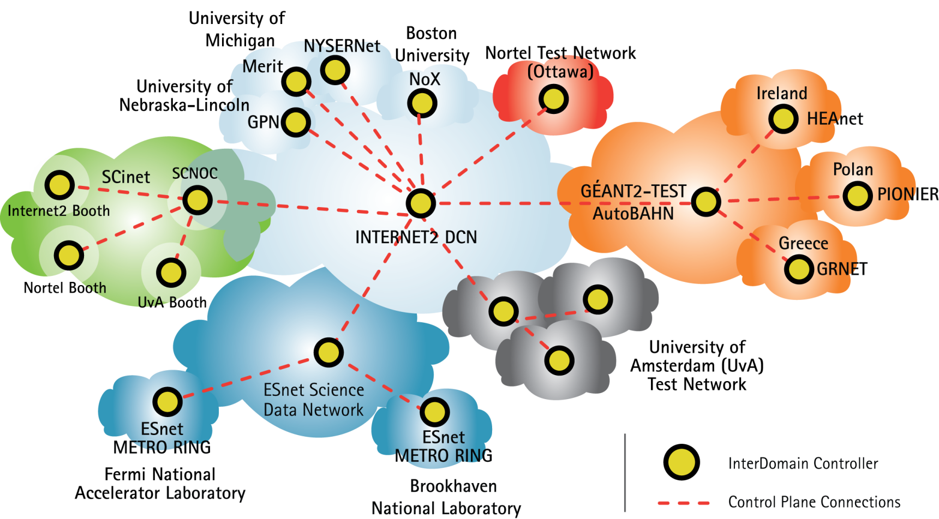
Global DCN Infrastructure at SC07 timeframe

Slide 3

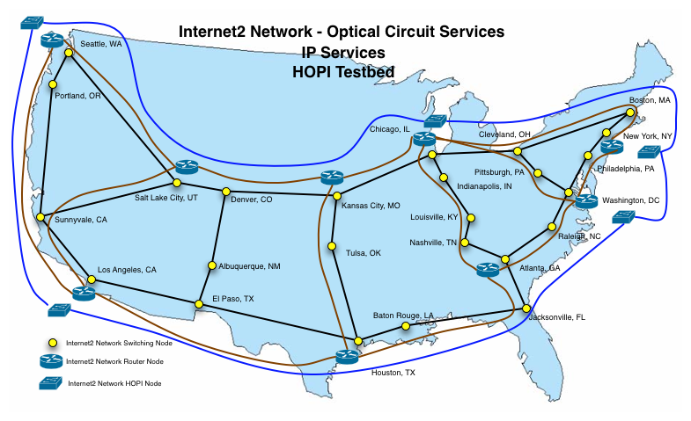
Notes:
Image Slide

Slide 4
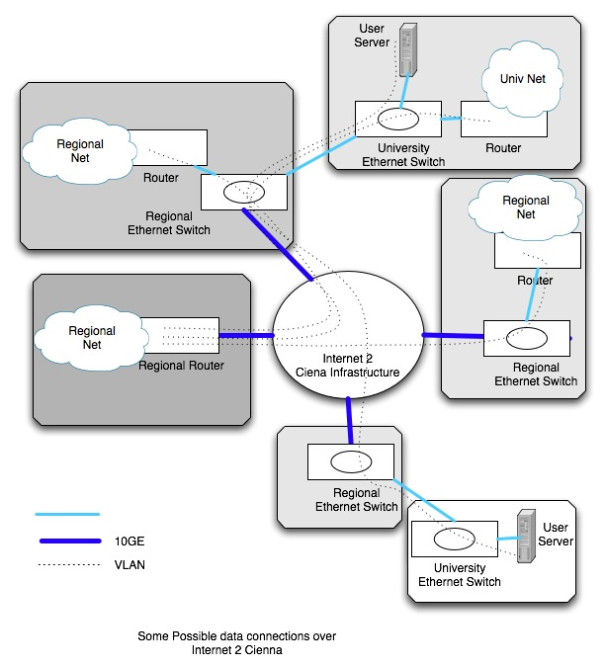
I2 DCN Structure

Slide 5
Representing interconnections
For each domain or network have a topology description
Description is for the net, and includes info on connections from the net to external devices
Seems to me that external description can be lifted from the internal description as it
  Multi -domain nets are interconnected by interdomain links
  Only domain part of link name is important for interdomain pathfinding

Slide 6
Multi-domain Lambda Map - challenge
It seems that having a common description for networks is very important for pathfinding and for mapping (e.g. GLIF map)
Challenge is to create map that uses external links in network domain files to show a global file of networks and GOLES

Slide 7
Topology Description Issues
What is a link
  Logical connection between ports/nodes
  Multiplexing of Circuits over link
  How to describe what is multiplexed
    VLANS, VCGs, Waves
    Is there a descripton for these
  And any adaptation points that allow changing from one technology to another
  Difference between what is available and what is confirmed
  (e.g. can use VLAN 2,4,200,2003 vs use VLAN 4)

Slide 8
DCN-GOLE
Connecting Networks to each other
GOLES seem very much like normal domains, except
  They do not apply their own policy
  They are assumed to not refuse any connection based on physical limits
Issue with GOLES connecting to each other
  need to independly describe link between GOLES
    How is this done?

Slide 9
Adding new Link
Probably a future issue -
If I want to create a link at a lower layer and then use it to multiplex circuits on that link
  How do I describe a port and link
  May use the same physical port as another link
  Do I need to create sub-links or links on links

Slide 10
Status of defining NML
Seems important to have a common definition of topology
  DCN, GLIF
  Would like to interoperate with others
  How does OGF relate to work done at IETF (PCE, OSPF-TE and other)

