Slide 1


Data Service Specification:
RDF(S) Ontology Access Strawman
Access Services for RDF Data Resources
Miguel Esteban Gutiérrez
Univ. Politécnica de Madrid

Slide 2

OGF IPR Policies Apply
“I acknowledge that participation in this meeting is subject to the OGF Intellectual Property Policy.”
Intellectual Property Notices Note Well: All statements related to the activities of the OGF and addressed to the OGF are subject to all provisions of Appendix B of GFD-C.1, which grants to the OGF and its participants certain licenses and rights in such statements. Such statements include verbal statements in OGF meetings, as well as written and electronic communications made at any time or place, which are addressed to:
    the OGF plenary session,
    any OGF working group or portion thereof,
    the OGF Board of Directors, the GFSG, or any member thereof on behalf of the OGF,
    the ADCOM, or any member thereof on behalf of the ADCOM,
    any OGF mailing list, including any group list, or any other list functioning under OGF auspices,
    the OGF Editor or the document authoring and review process
Statements made outside of a OGF meeting, mailing list or other function, that are clearly not intended to be input to an OGF activity, group or function, are not subject to these provisions.
Excerpt from Appendix B of GFD-C.1: ”Where the OGF knows of rights, or claimed rights, the OGF secretariat shall attempt to obtain from the claimant of such rights, a written assurance that upon approval by the GFSG of the relevant OGF document(s), any party will be able to obtain the right to implement, use and distribute the technology or works when implementing, using or distributing technology based upon the specific specification(s) under openly specified, reasonable, non-discriminatory terms. The working group or research group proposing the use of the technology with respect to which the proprietary rights are claimed may assist the OGF secretariat in this effort. The results of this procedure shall not affect advancement of document, except that the GFSG may defer approval where a delay may facilitate the obtaining of such assurances. The results will, however, be recorded by the OGF Secretariat, and made available. The GFSG may also direct that a summary of the results be included in any GFD published containing the specification.”
OGF Intellectual Property Policies are adapted from the IETF Intellectual Property Policies that support the Internet Standards Process.
Notes:
IPR Notices Note Well for OGF meetings

Slide 3
Full Copyright Notice
Copyright (C) Open Grid Forum (2006). All Rights Reserved.
This document and translations of it may be copied and furnished to others, and derivative works that comment on or otherwise explain it or assist in its implementation may be prepared, copied, published and distributed, in whole or in part, without restriction of any kind, provided that the above copyright notice and this paragraph are included on all such copies and derivative works.
The limited permissions granted above are perpetual and will not be revoked by the OGF or its successors or assignees.
Notes:
OGF Full Copyright Notice if necessary

Slide 4
Outline
Introduction
Recalling the design criteria
  Operational model
  Interface organization
Current status
  Data resources
  Interface organization
  Interfaces provided. Changes sinces previous version.
Pending work
Outstanding issues
Summary
Future work
Notes:
This is the outline of the presentation. Firstly I will introduce our “vision” about the RDF(S) access intitiative, in short, what we want to achieve and how does it fit inside the WS-DAI view. I will also review what RDF(S) is, so everybody who is not familiar with it, will have something to start with and understand our work.
After that I will present the RDF(S) data model as it is of main concern for the ontology access.
I will continue pointing out some issues about the operational model of the ontology access interfaces designed.
How the interfaces are organized and the concrete specification will be explained later.
I will conclude with a short summary and the future work.

Slide 5
Introduction (I)
The RDF(S) Access Vision
What is all about?
  Providing an access mechanism to RDF(S) data sources
Two different means for interacting:
  Query access: using SPARQL
  Ontology access: using ontological primitives based on the RDF(S) model
Alternative, but not exclusive!
  Use each one according to your needs…
Notes:
The RDF(S) access initiative is about providing an access mechanism to data defined by mean of RDF.
The objective is to develop a set of services which provide a standard access interface to RDF data, which can be used in the OGSA architecture regardless of the underlying physical infrastructure used for storing that data (Sesame, Jena, Kowari, Oracle…)
We have identified to different ways for interacting with RDF repositories:
- Via queries, as you will see later on.
- Via ontology access primitives, that is, using basic access methods based upon the model/formalism used for representing the data, in other words, taking into account the structures defined by RDF(S), and the relationships between them.
But having two alternative ways of interacting with the RDF repositories doesn’t mean that they are exclusive, on the contrary, they should be used simultaneously according to the concrete requirements of the client application.

Slide 6
Introduction (II)
How does this fit with the WS-DAI approach
WS-DAI
Sets general pattern for realisations
Extensions for specific kinds of data resource
Possible Future Realisations
WS-DAIR
WS-DAIX
WS-DAI-RDF
Relational
SQL
XML
XQuery/XPath
SPARQL,
Ontology Ops
Notes:
The data access mechanism that we are developing sits below the WS-DAI specification. The
realizations will provide specialized methods that will take into account the special syntax and semantics
of the RDF(S) data and expose it appropriately, and will do it following the WS-DAI guidelines and
patterns for defining data access interfaces and services, like WS-DAIR does for relational databases
and WS-DAIX does for XML sources.

Slide 7
Recalling the design criteria (I)
Operational Model
Possible alternatives:
  Graph-oriented
  Object-oriented
Operation types:
  Creation/removal
  Retrieval
  Attachment/detachment
Side issues:
  Checked vs non-checked operations
  Inference aware vs inference unaware operations
Interface behaviour variable according these issues.
We will go back to this later on
Notes:
Moving now to the RDF(S) ontology access, and recalling what was presented in the OGF18
we have developed the interfaces and messages following an object-oriented approach for interacting
with the underlying data resources.
We have identified three sets of operations: creation/removal which deal with the management of
instances; retrieval, those used for retrieving data; and attachment/detachment, those for managing the
relationships between resources.
There were other design issues in the beginning, which are still not clear how they can be implemented
and are part of the outstanding issues. We will go back to them later on.

Slide 8
Recalling the design criteria (II)
Interface organization
Two layers:
  Bulk access
  Specialized access
Interface types:
  Native interfaces: mimic classes of the RDF(S) data model
  Utility interfaces: provide additional functionalities that enhance usability
Message definition:
  Direct data access:
    Retrieval of directly associated information
    Creation of new data (including attachments)
    Deletion of existing data (including detachments)
  Indirect data access
    Delegation of access to services that provide specialized access to a subset of associated information
Notes:
Regarding the organization of the interfaces and operations, we have used the following criteria:
First we have splitted the interfaces in two layers, according to the granularity of the operations. There is a bulk layer in which we can create and delete instances and there is also a specialized layer where we manage the relationships between instances, and provide specific retrieval operations.
We have identified two types of services/interfaces, native ones which mimic the main classes of the RDF(S) data model and the utility services/interfaces. These ones are convenient abstractions that provide further functionalities that enhance the overall usability of the services.
Regarding to the operations themselves, we have left to direct data access those related to the retrieval, creation and deletion of data. Indirect data access has been used for moving from interfaces which provide coarse grained access to those that provide a specialized fine grained access.

Slide 9
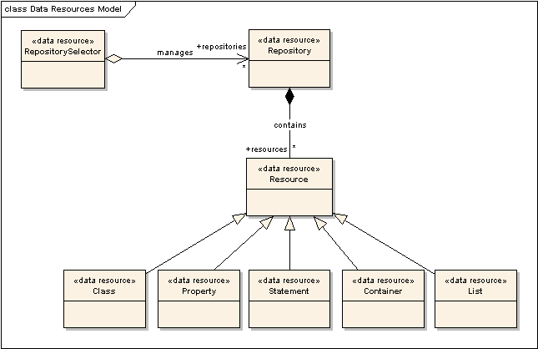
Current status (I)
Data resources
Notes:
Two kinds of data resources, from bottom to top:
Resources that mimic RDF(S) modelling elements:
General: Resource
Specific: Class, Property, Statement, Container, List
Convenience abstractions
Repository
RepositorySelector (collection)
Such level of granularity allows finer grain of control over the concrete parts of the data sets (access policies, read/write permissions, etc)
Resources as views of the data resource

Slide 10
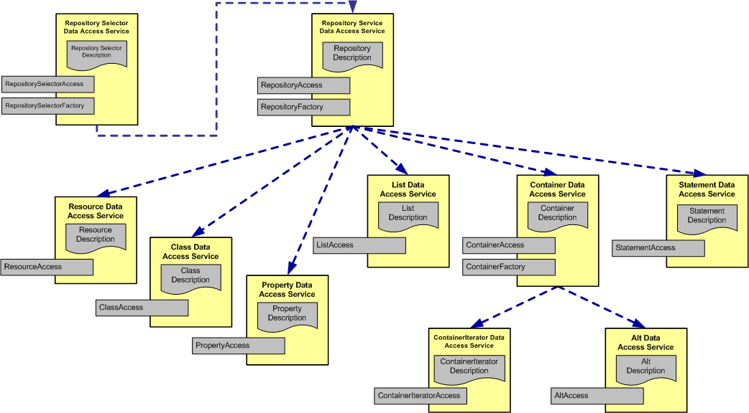
Current status (II)
Interface organization
Notes:
This picture shows which interfaces we have already identified and how they are organized.

Slide 11
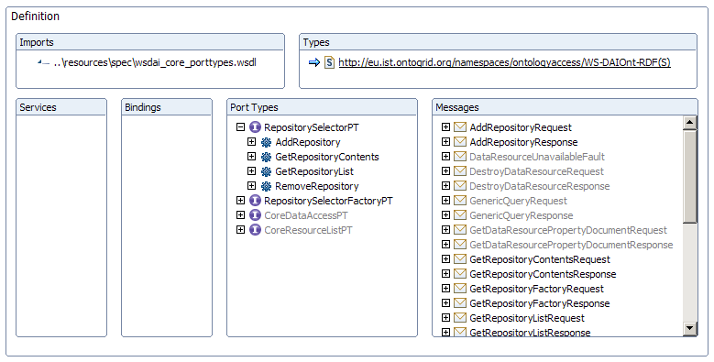
Current status (III), Interfaces provided (I)
RepositorySelector
NEW
Meter el RepositorySelector
Indicar que es nuevo

Slide 12
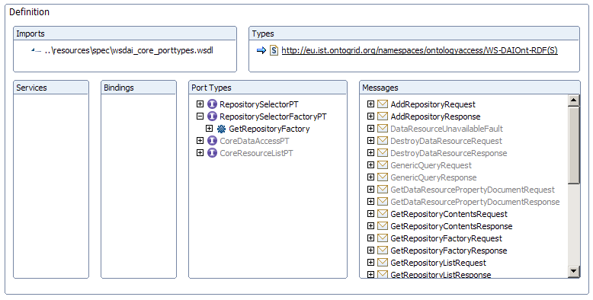
Current status (III), Interfaces provided (II)
RepositorySelectorFactory
NEW

Slide 13
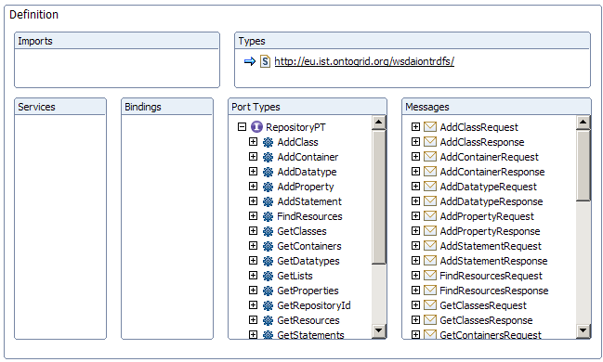
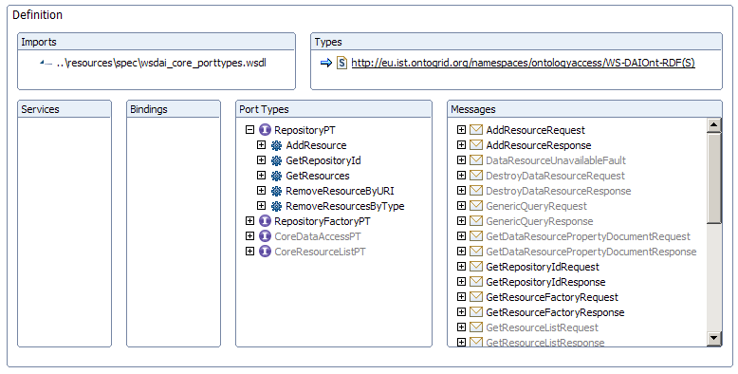
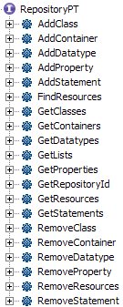
Current status (III), Interfaces provided (III)
Repository
CHANGED
Notes:
The RepositoryAccess interface is the frontend to the repository. It provides the basic functionalities for retrieving, creating and deleting contents to the repository, taking into account the specificities of the data element that is to be created, a class, a property, etc. This interface is, as you can imagine, part of the bulk layer.

Slide 14
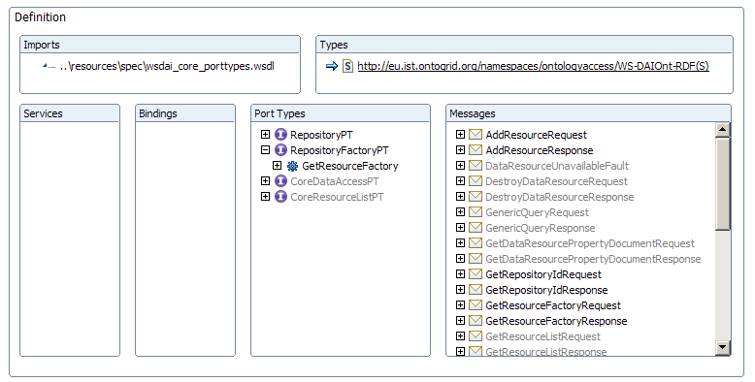
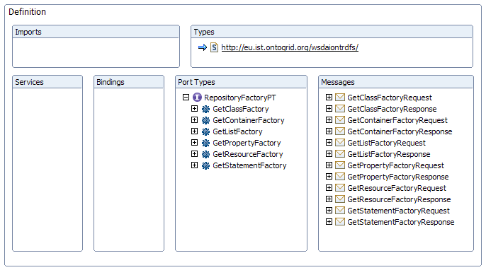
Current status (III), Interfaces provided (IV) RepositoryFactory
CHANGED
Notes:
The RepositoryFactory is also in the bulk layer. It provides operations that allow the delegation of access to a specialized access interface, according to the nature of the element.

Slide 15
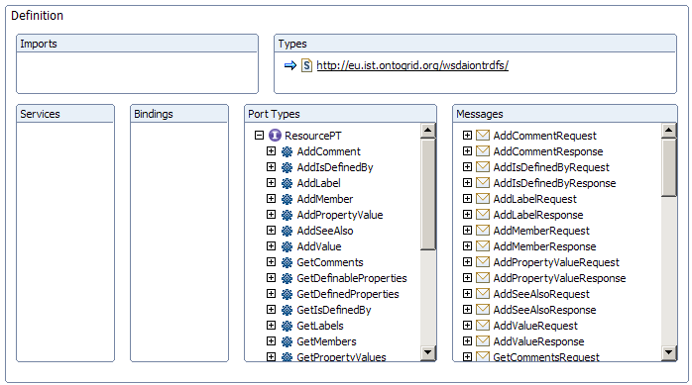
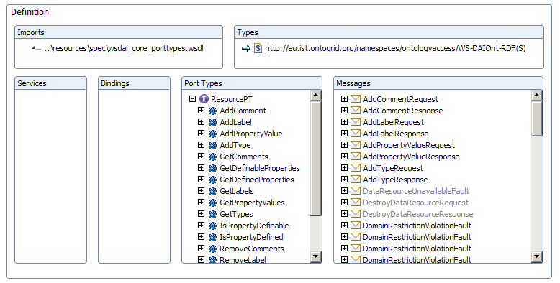
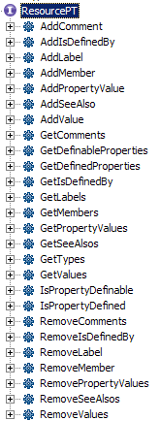
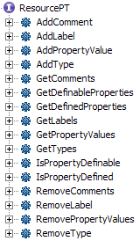
Current status (III), Interfaces provided (V)
Resource
CHANGED
Notes:
From now on, we will see interfaces that belong to the specialized layer.

Slide 16
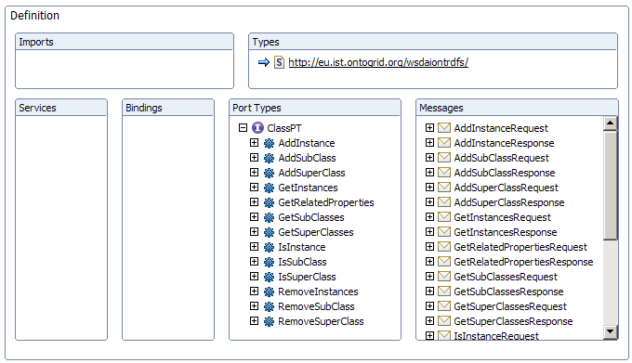
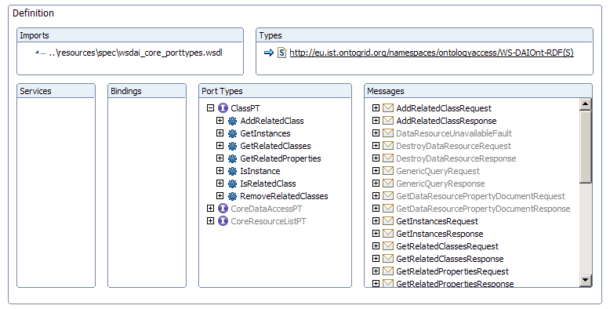
Current status (III), Interfaces provided (VI)
Class
CHANGED
Notes:
The ClassAccess interface provide methods for managing the class hierarchy, and for managing the instance of concrete class. Given a concrete class, we can add sub and super classes, find out which classes are sub or super classes and which are the instances of the class.

Slide 17
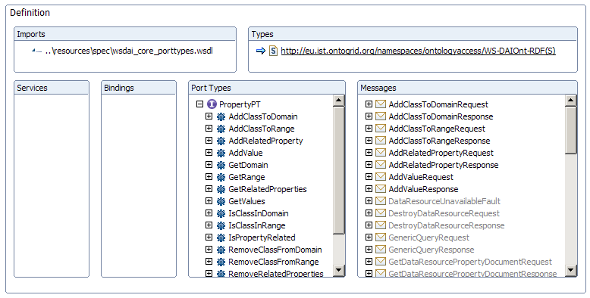
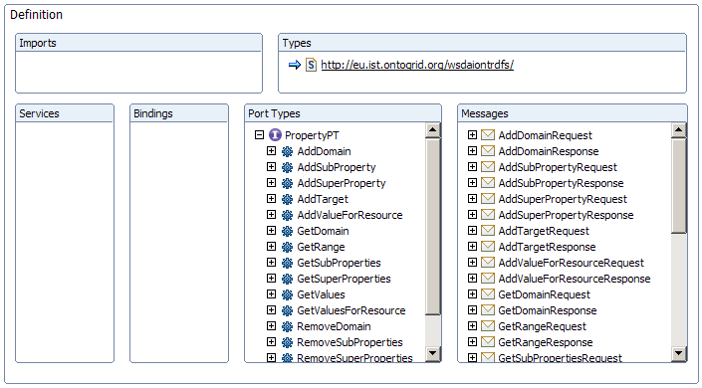
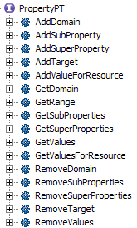
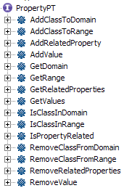
Current status (III), Interfaces provided (VII)
Property
CHANGED
Notes:
The PropertyAccess interface provides operations for dealing with properties: constraining the domain and range, adding values for resources, retrieving and deleting those values.

Slide 18
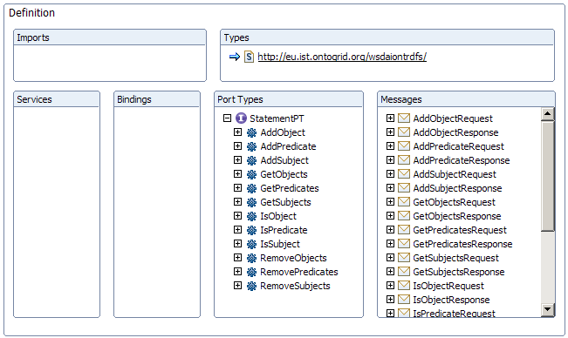
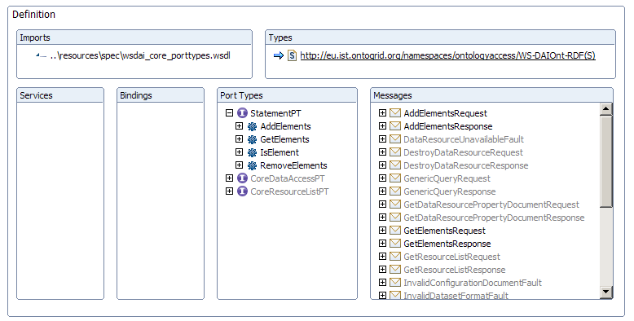
Current status (III), Interfaces provided (VIII)
Statement
CHANGED
Notes:
The StatementAccess interface deals with reification information, it provides operations for specifying the subject, predicate and object of a Statement and for retrieving or removing them.

Slide 19
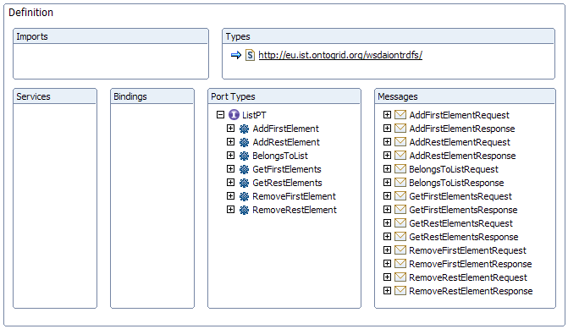
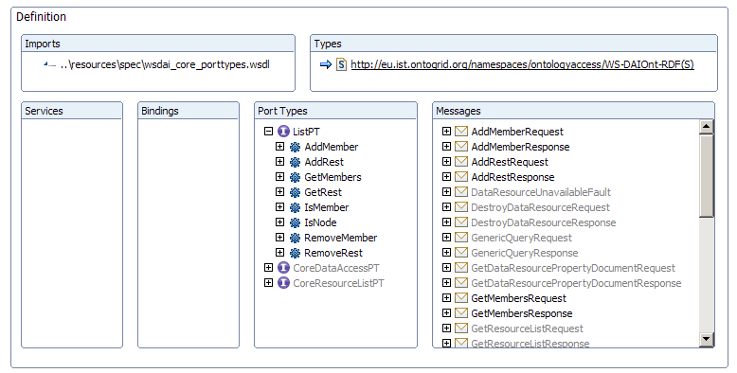
Current status (III), Interfaces provided (IX)
List
UPDATED
Notes:
The ListAccess interface provides operations for dealing with RDF lists: managing first and rest elements, mainly.

Slide 20
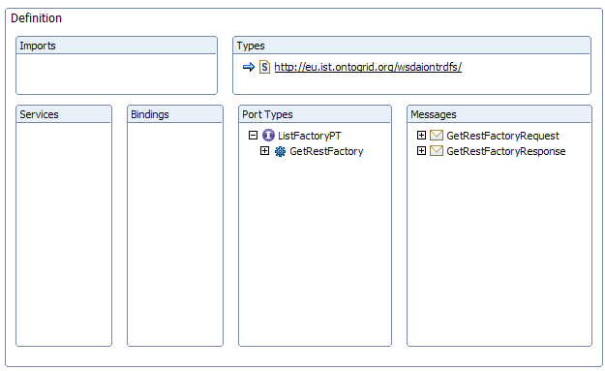
Current status (III), Interfaces provided (X)
ListFactory
REMOVED
Notes:
The ListFactory is provided for traversing the List.

Slide 21
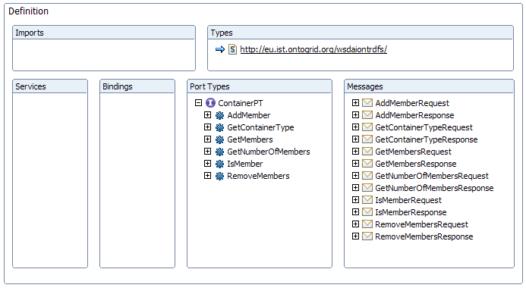
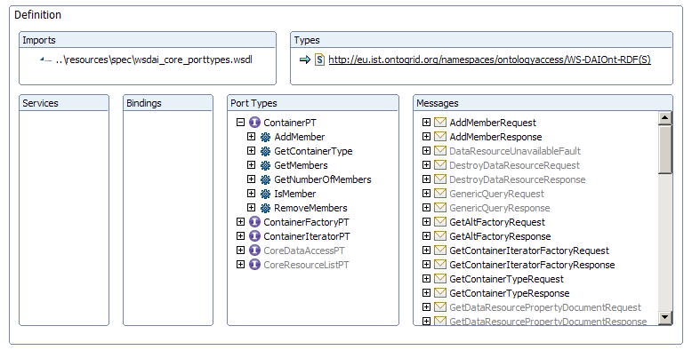
Current status (III), Interfaces provided (XI)
Container
UPDATED
Notes:
The ContainerAccess interface is provided for dealing with the RDF container abstraction, that is managing its members, accessing to them by means of its position.

Slide 22
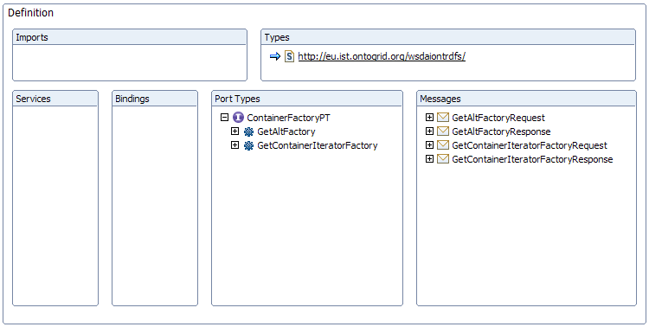
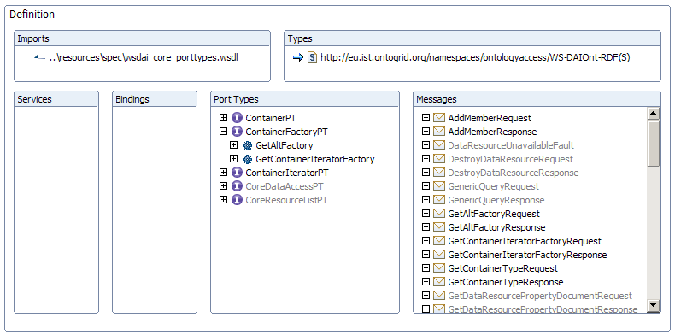
Current status (III), Interfaces provided (XII)
ContainerFactory
UPDATED
Notes:
The ContainerFactory interface provides operations for delegating the access of the container to a specialized interface: and iterator interface or the alt interface.

Slide 23
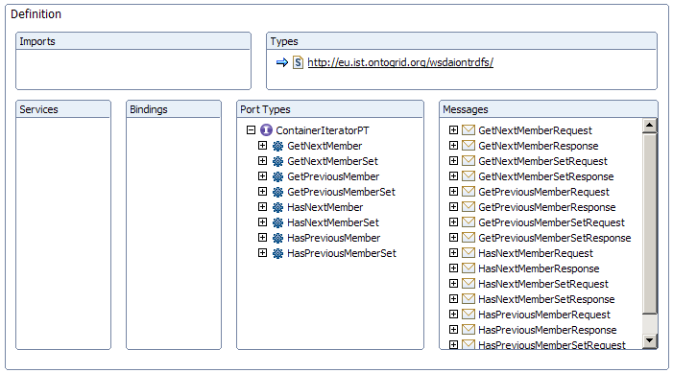
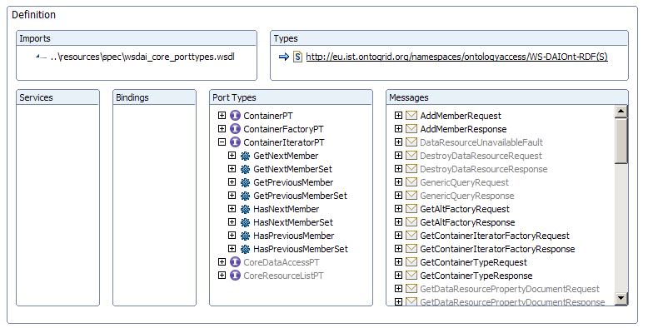
Current status (III), Interfaces provided (XIII)
ContainerIterator
UPDATED
Notes:
The ContainerIteratorAccess interface is an utility abstraction provided for traversing a container without of caring about the exact position of the members.

Slide 24
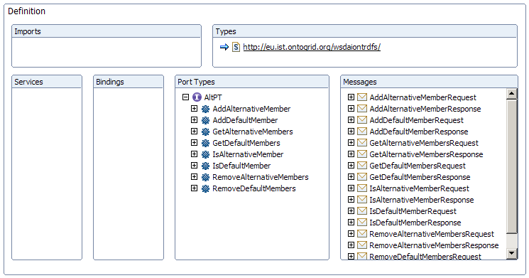
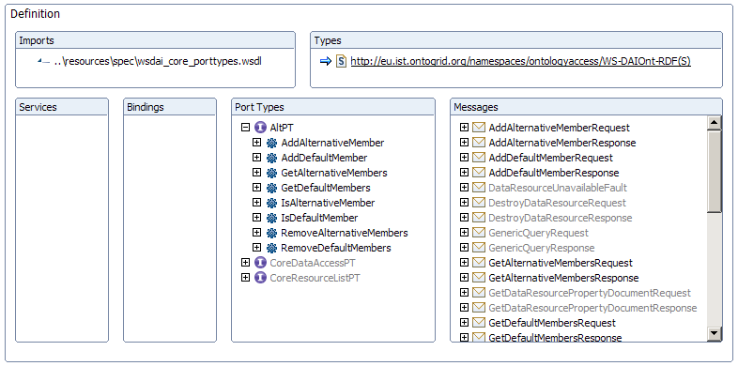
Current status (III), Interfaces provided (XIV)
Alt
UPDATED
Notes:
Finally we have the AltAccess interface. The RDF class Alt is a type of Container which is a little bit different from the other built-in containers (Bag and Seq). The RDF Alt container separates the members in default and alternative ones. Therefore we have created an interface that provides specific operations for dealing with this issue.

Slide 25
Pending work
Refactorings issues:
  Message/argument naming
  Message semantics based on argument cardinalities
  Cardinality restriction
Blank node management
Support for rdfs:seeAlso and rdfs:isDefinedBy in the Resource interface
Deprecate instance modification capabilities from the Property interface

Slide 26
Outstanding issues
Variable interface behaviour:
  Checked vs non-checked operations
  Inference aware vs inference unaware operations
Resource naming (URI based) and addressing
Lists & Containers:
  Traversal (individuals vs sets)
  Support for ad-hoc lists/containers

Slide 27
Summary
Ontology-based access operations
  Following object-oriented principles
Provided interfaces that,
  Mimic main classes of the data model, or
  Abstract useful functionalities that enhance usability
Some figures:
  13 interfaces provided (2 new, 1 removed)
  85 operations available (40 operations less)
Notes:
Summaryzing, we have created a set of interfaces for accessing RDF that provide ontology-based operations for the task. We have provided interfaces that mimic the RDF(S) data model or abstract a useful set of functionalities that enhance the “user” experience…
All of this has been done following object orientation practices.
Some figures about the spec…

Slide 28
Future Work
Behavioural aspects
  Static properties
  Configurable properties
Test suite
Sample use cases
Glossary of terms
Notes:
As future work, we have to finish some operations that are not fully defined. We also have to work in those behavioural aspects that I commented before. They are mostly related with the static and configurable properties of the interfaces. Finally, we are still to produce a joint glossary that will be used in the querying part and in the ontology one.

Slide 29

Thanks for your attention, questions?

