Slide 1

Security Area Affiliated Groups
CAOPS-WG
David Groep
Security Area Meeting
OGF19
January 29th, 2007

Slide 2

CAOPS WG
Chartered goals
develop operational procedures and guidelines that facilitate the use of technologies for “cross grid” authentication (X.509 and others)
Organization
documents, best practices for technologies,
coordination of AuthN trust fabric (e-Science)
Meetings
Thursday 1 Feb, 09.00 – 10.30 (documents)
Thursday 1 Feb, 11.00 – 12.30 (IGTF)

Slide 3
Documents under discussion
OCSP requirements for Grids
Olle Mulmo, Mike Helm, Jesus Luna, Oscar Manso, Milan Sova
  requirements on relying parties and responders
  service architecture options
  site caches, clearing house, high-level responders
  document complete, awaiting WG last call

Slide 4
Documents under discussion
Grid Certificate Profile
Mike Helm, David Groep
  guidance and rationale for naming and extensions in X.509 certificates, for CAs and end-entities
  builds on deployment experience of IGTF
  document in final stages

Slide 5
Documents under discussion
Authentication Service Profile
Tony J. Genovese, David Groep, Christos Kanellopoulos
  Definition of what and Authentication Profile is
  Requirements for writing Authentication Profiles

Slide 6
Documents under discussion
Audit Guidelines
Yoshio Tanaka, Hardi Teder
  Provide guidelines for auditing CAs
  Auditing Check List

Slide 7
Documents under discussion
Namespace Policy
David Groep, Olle Mulmo, Von Welch
  Identify the requirements on the expression of the namespace constraints policy and on the processing and interpretation semantics of the policy by the relying parties

Slide 8
Policy coordination and IGTF
Policy harmonization and coordination for
trust relationships for Grid authentication
Based on three regional coordination bodies:
  APGridPMA (Asia Pacific Area, current IGTF Chair)
  EUGridPMA (EMEA)
  TAGPMA (North, Meso, and Latin America)
Variety of technologies to make identity assertions
  “Classic” X.509 issuing authorities
  end-entity self-service authorities based on existing data
  federations (e.g. Shib based) ‘gatewayed’ into X.509 space

Slide 9
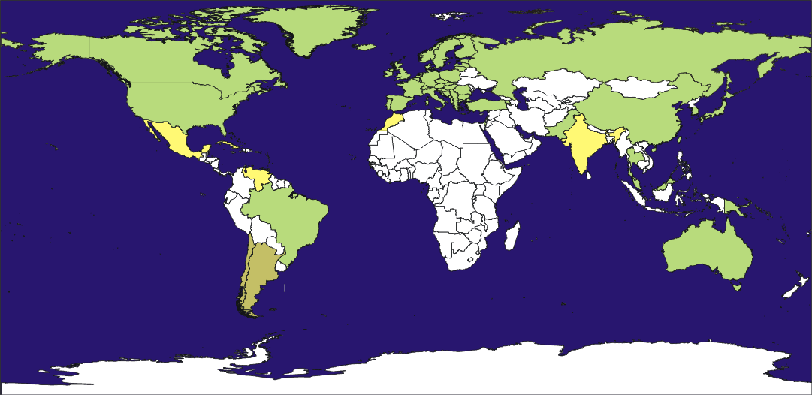
IGTF Global Coverage

Slide 10
Recent developments
new sources of authentication:
  Classic X.509: direct ID vetting, secured infrastructure
  Member-integrated Credential Services: leveraging existing (national) federations, with comparable ID vetting to classic
  Short-lived credential services: existing back-end federation or site ID system, with more ‘limited’ traceability
gradual introduction of ‘levels of assurance’
  discussions during this OGF, in quite many sessions,
  will likely influence the way the IGTF goes forward

Slide 11
CAOPS-WG
Meetings
Thursday 1 Feb, 09.00 – 10.30 (IGTF)
Thursday 1 Feb, 11.00 – 12.30 (Documents)
Information
WG Chairs: Darcy Quesnel, Christos Kanellopoulos
IGTF Chair: Yoshio Tanaka

