Slide 1

Glue-WG
Sergio Andreozzi (INFN-CNAF) - speaker
Laurence Field (CERN)
Balazs Kònya (Lund University) 31 January 2007

Slide 2

Agenda
Introduction
Charter
Group organization
  Email Lists, Webpages, Gridforge, Wikis
  Meetings and phone calls
Expected results
  Use Case Document
  Glue-2.0 schema
Relationships with other Groups
Actions
  Use case collecting
    Responsibilities for each area
  Identifying main entities
  Draft Schema
    Responsibilities for each service
Open Discussion

Slide 3
Glue Origins
GLUE: Grid Laboratory Uniform Environment
  Collaborative effort between DataTAG and iVDGL
    focusing on interoperability
      started in April 2002
Produced an information schema
  Version 1.0 September 2002
  Version 1.1 April 2003
  Version 1.2 May 2005
  Version 1.3 December 2006
Contributors:
  DataGrid, Globus, PPDG, GriPhyn, APACGrid, NorduGrid, UNICORE, EGEE, OSG, NGS
Web page:
  http://glueschema.forge.cnaf.infn.it/

Slide 4
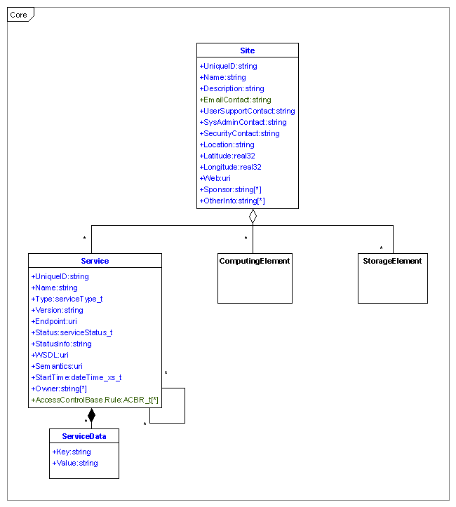
Glue 1.3 Core

Slide 5
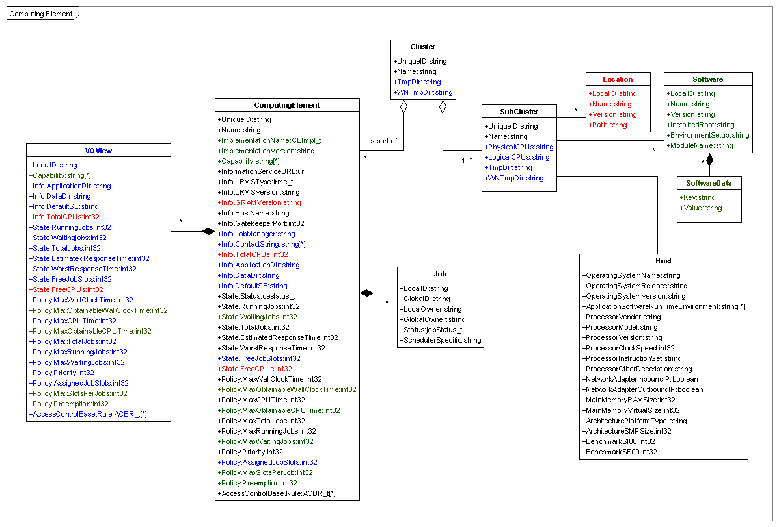
Glue 1.3 Computing Element

Slide 6
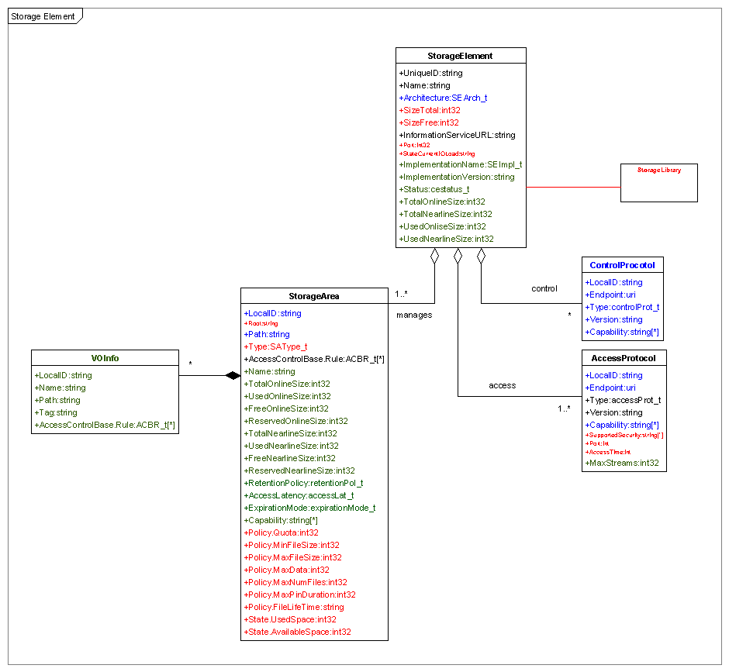
Glue 1.3 Storage Element

Slide 7
A Selection of Open Issues
1.x versions were kept backwards compatible
Non-backwards compatible changes required
  To address structural issues
  To reflect OGF standards
  Cover missing semantics
Consolidate production experience
  From EGEE, OSG, Nordugrid and Naregi

Slide 8
GIN-CG
Short term information system interoperability
  What can we do for SC06?
Between 9 grids and 300 sites
  5 different systems and 4 different schema
What was the minimal set of attributes needed?
  Depends on the use case
Can we create information system translators?
  non-existing information can not be translated!
Conclusion
  We can live with different systems but not content
  Agreement need on information for common use cases

Slide 9
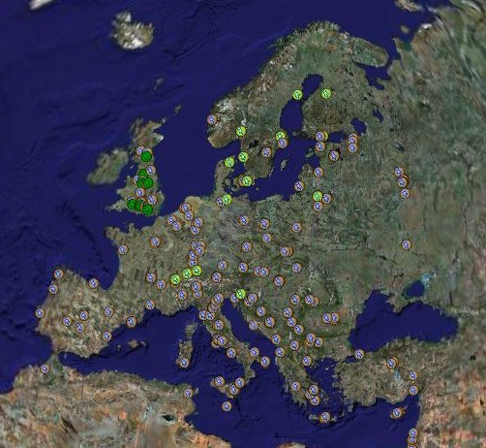
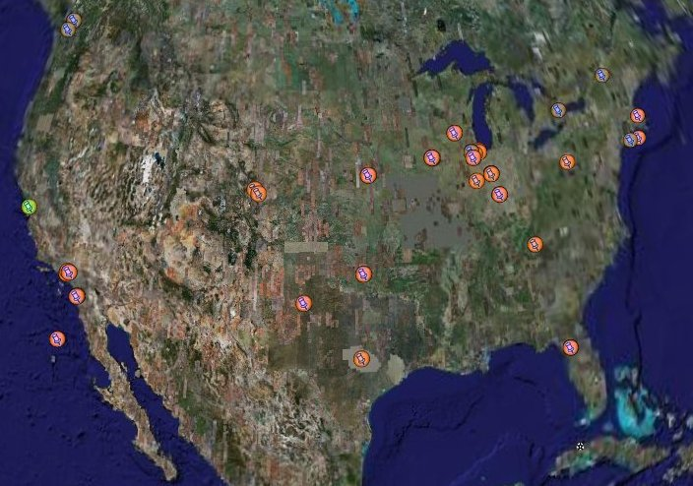
Google Earth Demo

Slide 10
Existing Production Schemas
Glue Schema
  Version 1.3
Nordugrid Schema
  Started in 2002
  Describes;
    Computing resources including grid jobs and user views
    Other services such as Storages
Naregi extensions to CIM
  CIM is missing “Grid” information
4-5 years of production experience

Slide 11
Glue Meeting Oct 2006
Participation
  EGEE, OSG, Nordugrid, OMII-UK, OMII-EU, Unicore, NGS
Main Purpose.
  To Finalize Glue version 1.3
  Preliminary discussions on Glue 2.0
Suggested moving into OGF
  Agreement by a unanimous decision
Scope Glue 2.0
  Must meet existing use cases
    For existing Glue users, Nordugrid and Naregi
  Fix problems with Glue 1.3
  Reflect existing OGF standards
  Add new uses cases but with lower priority
    Use cases which span multiple grid infrastructures
http://indico.cern.ch/conferenceDisplay.py?confId=a063538

Slide 12
SD Meeting Dec 2006
Discuss a common way to do Service Discovery between Grids.
  EGEE, OSG, Nordugrid, Teragrid
“Service Discovery is the question asked and the answer which is returned”
  Questions can be anything that is generic for all services
  The answer is a handle
    Service Access Point
    Service Information Endpoint
A resource is seen as a properly as a service
  Resources need a unique identifier to avoid double counting
Requires a generic Service Schema
http://www.nordugrid.org/events/sid06.html

Slide 13
SD Meeting Dec 2006
Selecting services requires service specific information
  A schema needs to be defined for each service type
Dynamic Vs Static Attributes
  All attributes can change
  Different is the expected frequency
  Schema design needs to take into consideration expected frequency.
    High frequency values should be grouped
Other outcomes:
  A common Service Discovery API is needed
    The API will be defined in the SAGA-WGs.
    Similar plugins were developed as part of the gin activity
  A common information provider interface would be helpful
    It was decided that this would be just a command returning XML

Slide 14
Glue-WG
Glue Schema activity now in OGF
Co-chairs
  Balázs Kónya
  Laurence Field
  Sergio Andreozzi
Email:
  glue-wg@ogf.org
  Subscribe:
    http://www.ogf.org/mailman/listinfo/glue-wg
GridForge:
  http://forge.gridforum.org/sf/projects/glue-wg

Slide 15
Initial Supporters
Infrastructures
  EGEE, OSG, Nordugrid, NGS, Naregi
• MiddleWare
  ARC, gLite, R-GMA, Unicore, OMII-UK, OMII-EU

Slide 16
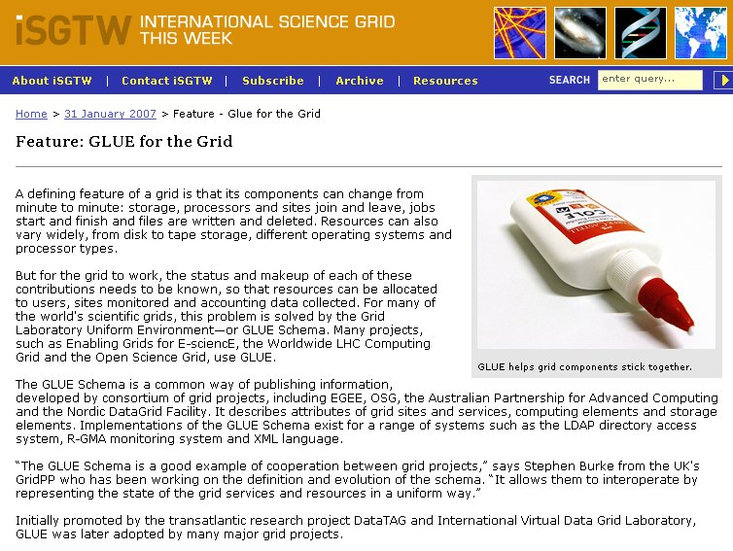
Glue in the News
http://www.isgtw.org/?pid=1000255

Slide 17
Focus – From the Charter
The GLUE-WG will provide a recommendation for an abstract information model which is expressed via a schema, independent of information system implementations.
The schema will define the set of attributes and attribute semantics, the relationship between the attributes and the syntax for attribute values where applicable.
The main purpose of the schema is to facilitate interoperation between grid infrastructures via enabling the development of interoperating grid middleware components and as such the schema will be designed in response to existing use cases.
The focus will be on use cases which span multiple grid infrastructures that may rely on different middleware. The collected use cases will be published as a information document.
The existing version 1.3 of the Glue Schema document and Norudgrid Schema will be used as a starting point for the work.
The abstract schema definition will enable concrete schema to be rendered in various formats. These renderings are not seen as an output of the group but is the ultimate result of the work.

Slide 18
Scope - From the Charter
The schema will be based on the already existing Glue schema (version 1.3), which is already being used in many production Grids.
The work will be a major revision of this schema and the result will become Glue version 2.0.
The work will document the existing use cases of the Glue 1.3 schema, NorduGrid schema and the CIM vendor extension from NAREGI, to ensure that all existing use cases can still be met.
Additional use cases will be collected, evaluated and prioritized.
The Glue 1.3 schema will be redesigned so that it incorporates the existing experiences of the current production schemas and meets the requirements imposed by the use cases.

Slide 19
Milestones
Milestone | Due Date | Deliverabile | Description
M1 | OGF19 | D1 | BOF to define initial document coverage, outline, and solicit authors
M2 | OGF 19 | D2 | Collection of existing and additional use cases
M3 | OGF 20 | D2 | Use Case Document ready
M4 | OGF 20 | D3 | Draft of Schema Document
M5 | OGF 21 | D3 | Final Schema Document

Slide 20
Glue-WG Relationships
SAGA and Friends
  Service Discovery API
JSDL WG
  Resource elements
GSM WG
  Storage entities
GIN WG
  Use cases
OGSA WG
  Information model for BES
OGSA-BES
  Information model
Planning to have F2F meetings with groups and OGF 20

Slide 21
Organizational Issues
Mailing Lists
  Old Glue mailing list will be closed next week
    Subscribe to the new list
      Invitation will be sent
Web Pages
  Old Glue site will be kept
    Glue 2.0 related things will moved to GridForge
Issue Tracker
  Current Glue 2.0 Issues will be moved into GridForge
Documents
  Latest Glue 1.3, Nordugrid and Naregi schema documents
    Will be added to GridForge for background information
Everyone should use the new email list and wiki!
Phone calls every two weeks or when necessary
  Notices will be sent to the email list

Slide 22
Agenda
Introduction
Charter
Group organization
  Email Lists, Webpages, Gridforge, Wikis
  Meetings and phone calls
Expected results
  Use Case Document
  Glue-2.0 schema
Relationships with other Groups
Actions
  Use case collecting
    Responsibilities for each area
  Identifying main entities
  Draft Schema
    Responsibilities for each service
Open Discussion

Slide 23
Full Copyright Notice
Copyright (C) Open Grid Forum (2006). All Rights Reserved.
This document and translations of it may be copied and furnished to others, and derivative works that comment on or otherwise explain it or assist in its implementation may be prepared, copied, published and distributed, in whole or in part, without restriction of any kind, provided that the above copyright notice and this paragraph are included on all such copies and derivative works.
The limited permissions granted above are perpetual and will not be revoked by the OGF or its successors or assignees.
Notes:
OGF Full Copyright Notice if necessary

