Slide 1





Firewalls and GMPLS Networks:
A token based approach
Firewall Issues - Research Group meeting
OGF 19 - Chapel Hill, NC - Januari 30th 2006
Leon Gommans
University of Amsterdam

Slide 2
Accessing GMPLS network resources.
Optical network connections are increasingly perceived as expensive and valuable resources.
Optical connections might be high-jacked in cases where it is difficult to separate “sheep” from “goat” application traffic (Matthew 25:32).
GMPLS control plane signalling uses RSVP protocol requests (to open / keep a link), which are send (over a secured channel) every few seconds: (re-)authorization of such requests must be simple and fast.
RSVP enforcement therefore demands complex authentication and authorization processes to be performed separately and in advance. The token model allows such an approach. Outsourcing models do not.
Although RSVP signaling can be secured to some degree, the transport itself is not secured - Question: Can a firewall help?

Slide 3
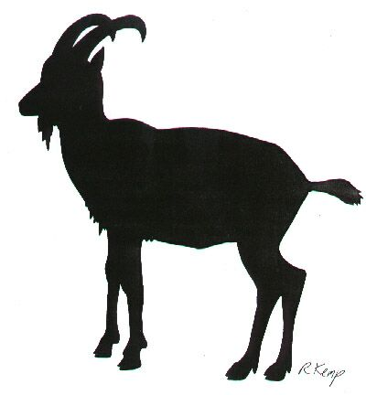

Problem 1: “goat” applications can potentially use storage service across the optical link after “sheep” has opened the link.
Application
Host
Storage Host
Application
B
Application
A
Storage
Middleware
Control plane
LSR
Client
LSR
LSR
LSR
Client
Data plane
Optical
Switch
Optical
Switch

Slide 4
Problem 2: Multiple goat hosts can potentially use same network link when a sheep application accesses the storage host
Host
A
Storage Host
Application
B
Application
A
Storage
Middleware
Control plane
LSR
Client
LSR
LSR
LSR
Client
Host X
Data plane
Optical
Switch
Optical
Switch
Host Y

Slide 5
Typical setup: Sheep application A (or its Middleware) requests network link via AAA Service that governs the GMPLS network resource.
Application
Host
Storage
Host
Application
B
Application
A
AAA
Server
Storage
Middleware
Policy
Enforcement
Point
LSR
Client
LSR
LSR
LSR
Client
Optical
Switch
Optical
Switch

Slide 6
Typical real setup: Firewall separates the public transit network from the application hosts. Firewall could also interact with GMPLS network as a (proxy-) client.
Host
A
Storage
Host
Application
B
Application
A
Storage
Transit
Network
Middleware
Control plane
Fire
Wall
Fire
Wall
LSR
Client
LSR
LSR
LSR
Client
Host X
Data plane
Campus
Network
Optical
Switch
Optical
Switch
Host Y

Slide 7
Application / Middleware may still have to talk to the same network resource authorization service.
Question: How should a firewall interact with GMPLS
Host
A
Storage
Host
Application
B
Application
A
Storage
AAA
Server
Middleware
Policy
Enforcement
Point
Control plane
Fire
Wall
Fire
Wall
LSR
Client
LSR
LSR
LSR
Client
Host X
Data plane
Campus
Network
Optical
Switch
Optical
Switch
Host Y

Slide 8
The token concept
Authority
Service
Request
User
AuthZ info (eg time)
Service
PEP
Access
Request
.

Slide 9
Token inside GMPLS RSVP Path, generated by LSR client
RSVP TE PATH
Source
Address
Destination
Address
RFC
2750
Request
ID
Request
ID
HMAC-SHA1
Token
Key

Slide 10
Token validation at Policy Enforcement Point
RSVP TE PATH
Source
Address
Destination
Address
RFC
2750
Request
ID
Schedule
Token verify


Time slot verify
HMAC-SHA1

Slide 11
A possible way to interact
+ rule
5
Host
A
Storage
Host
Application
B
Application
A
Storage
1
AAA
Server
4
2
Middleware
Policy
Enforcement
Point
3
+ rule
Control plane
6
Fire
Wall
Fire
Wall
LSR
Client
LSR
LSR
LSR
Client
Host X
Data plane
Campus
Network
Optical
Switch
Optical
Switch
Host Y

Slide 12
Plans
Approaches will be researched in EU IST PHOSPHORUS project using GMPLS software developed in the NSF DRAGON project.
Firewall GMPLS signaling concepts will be implemented using the IETF FORCES architecture deploying an Intel IXP NPU development platform in collaboration with Hitachi European Laboratory and University of Padras in Greece.
Integrate meta-scheduler deployed in German VIOLA project as requestor of the network resource.
Considering integration with Intrusion Detection work performed in EU IST NextGrid project to signal and identify “goat” requests.
Demo planned at SuperComputing ‘07.

