Slide 1

GLUE Entities
OGF 20 - Manchester, 8 May 2007

Slide 2

OGF IPR Policies Apply
“I acknowledge that participation in this meeting is subject to the OGF Intellectual Property Policy.”
Intellectual Property Notices Note Well: All statements related to the activities of the OGF and addressed to the OGF are subject to all provisions of Appendix B of GFD-C.1, which grants to the OGF and its participants certain licenses and rights in such statements. Such statements include verbal statements in OGF meetings, as well as written and electronic communications made at any time or place, which are addressed to:
    the OGF plenary session,
    any OGF working group or portion thereof,
    the OGF Board of Directors, the GFSG, or any member thereof on behalf of the OGF,
    the ADCOM, or any member thereof on behalf of the ADCOM,
    any OGF mailing list, including any group list, or any other list functioning under OGF auspices,
    the OGF Editor or the document authoring and review process
Statements made outside of a OGF meeting, mailing list or other function, that are clearly not intended to be input to an OGF activity, group or function, are not subject to these provisions.
Excerpt from Appendix B of GFD-C.1: ”Where the OGF knows of rights, or claimed rights, the OGF secretariat shall attempt to obtain from the claimant of such rights, a written assurance that upon approval by the GFSG of the relevant OGF document(s), any party will be able to obtain the right to implement, use and distribute the technology or works when implementing, using or distributing technology based upon the specific specification(s) under openly specified, reasonable, non-discriminatory terms. The working group or research group proposing the use of the technology with respect to which the proprietary rights are claimed may assist the OGF secretariat in this effort. The results of this procedure shall not affect advancement of document, except that the GFSG may defer approval where a delay may facilitate the obtaining of such assurances. The results will, however, be recorded by the OGF Secretariat, and made available. The GFSG may also direct that a summary of the results be included in any GFD published containing the specification.”
OGF Intellectual Property Policies are adapted from the IETF Intellectual Property Policies that support the Internet Standards Process.
Notes:
IPR Notices Note Well for OGF meetings

Slide 3
Agenda
Follow-up from the use cases session (10 min)
Purpose of this session
Main Elements
  Site
  Service
  Virtual Organization
  Grid Job
Computing Element
Storage Element (scheduled for later time)

Slide 4
Follow-up from use cases
Received suggestion to make an informational document with collected use cases
  Volunteers for editing?
Template should be improved
  Context, motivations
  Suggestions for improvements are welcome

Slide 5
Purpose of this session
Present the initial draft of GLUE 2.0 for:
  Main entities
  Computing Element
  https://forge.gridforum.org/sf/wiki/do/viewPage/projects.glue-wg/wiki/InitialSketchOnEntities?_message=1178631771698
The presentation contains lots of questions that we suggest to discuss at the end
Initiate a discussion and collect feedback
  E.g..see Steve Fisher comments to the list

Slide 6
Main Entities

Slide 7
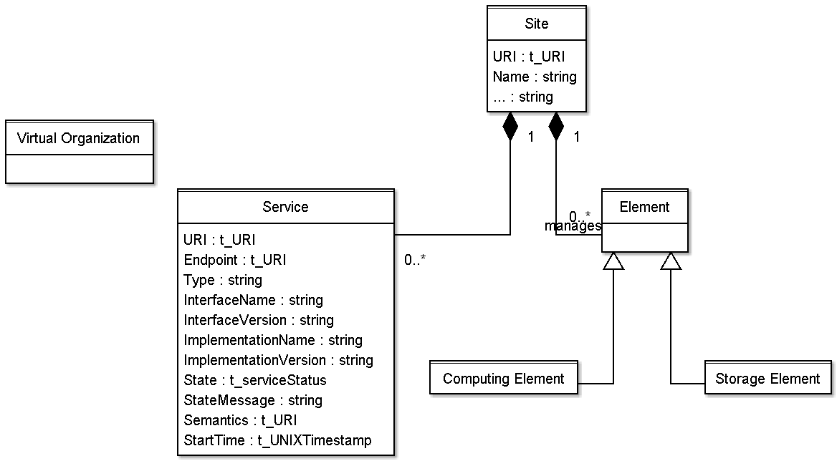
UML for Main Entities
Job
Authorization

Slide 8
Site
administrative domain grouping resources and services managed by the same set of persons
Possible properties:
  URI, Name, Description, Contact (Email, Web page, ...), Location (Latitude, Longitude, ...?), Sponsor, OtherInfo

Slide 9
Service
An abstracted, logical view of actual software components having a well-defined interface and offering one or more functionalities
  It does have network endpoint(s)
  It abstracts some functionality

Slide 10
Service
Service and Endpoint;
  Do we need to represent only one endpoint or multiple endpoints?
  if many endpoints, then do we need per-endpoint information?
  in Web Services world, a service instance has a single endpoint;
the service should have extension hooks like key,value pairs or tag set
properties:
  URI (ex-UniqueID), Name, Type, Version, Endpoint, Status, StatusInfo, WSDL (?), Semantics, StartTime, Owner (?), AccessControlBaseRule (AuthorizationInfo), ServiceData=set of (Key,Value), Authentication (nordugrid-cluster-issuerca-hash, nordugrid-cluster-trustedca nordugrid-cluster-issuerca)
For some services, there will be the need to create service-specific schema
  tentative types:
    Computing
    Storage Management
    File Transfer

Slide 11
Resource
In OGSA, a resource is an entity that is useful in a Grid environment and offered through service(s)
  tentative types:
    Computing:
    Storage (+ files)
    Network
    Data
    Instrument
    Software (?)

Slide 12
Element
grouping concept for services and the related resources; it is introduced in order to capture the relationship among services managing or abstracting the access to resources
  you can have service without resource
    e.g., GridFTP server
  the same resource can be shared across multiple services
    e.g., SRMv1 and SRMv2.2 services on top of the same resource
    e.g., CREAM and GRAM interface to the same batch system

Slide 13
Element
can we have multiple resources served by the same service?
what is the definition of the resource for us?
policy information is part of services or resources or an independent entity?
investigate other definitions like WSRF definitions
tentative types:
  Computing
  Storage

Slide 14
Job
the job information is a snapshot of the information related to a job as soon as it is created in a Grid
  e.g., when it is submitted to the Broker
strongly needed by NorduGrid
need to model different types of jobs
  e.g., single processor job, collection of jobs, workflows
  a job type can be useful
  at the moment, we consider only a single job

Slide 15
Job
Job information model is expected to be used by many services
  e.g., broker, accounting system, computing element
some of the job attributes should possibly map the OGF usage record spec
important is the job state model

Slide 16
Job
properties:
  ID (globalID, localID, globalOwner, localOwner, nordugrid-job-jobname), Requests/Environment (nordugrid-job-reqwalltime, nordugrid-job-reqwalltime nordugrid-job-reqcputime, nordugrid-job-runtimeenvironment, nordugrid-job-cpucount, nordugrid-job-stdout nordugrid-job-stderr nordugrid-job-stdin), Status (nordugrid-job-comment, nordugrid-job-status, nordugrid-job-queuerank, nordugrid-job-rerunable, nordugrid-job-exitcode, nordugrid-job-errors, nordugrid-job-executionnodes, nordugrid-job-execcluster, nordugrid-job-execqueue, nordugrid-job-usedwalltime nordugrid-job-usedmem nordugrid-job-usedcputime, nordugrid-job-completiontime, nordugrid-job-submissionui, nordugrid-job-submissiontime, nordugrid-job-clientsoftware, nordugrid-job-gmlog, nordugrid-job-sessiondirerasetime, nordugrid-job-proxyexpirationtime)

Slide 17
Other entities
Virtual Organization
  (see definition in the wiki)
Authorization
Do we need a separate entity for these?
If so, which aspects should be described?

Slide 18
Computing Element

Slide 19
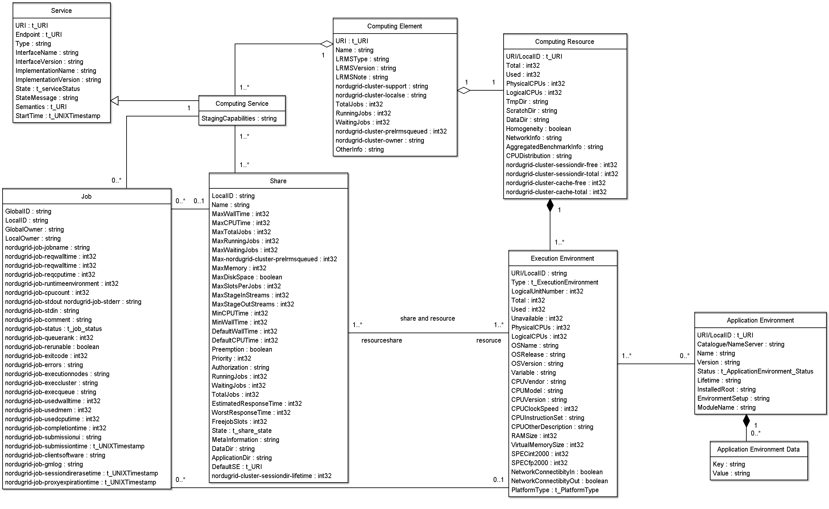
https://forge.gridforum.org/sf/sfmain/do/downloadAttachment/projects.glue-wg/wiki/InitialSketchOnEntities?id=atch4376

Slide 20
https://forge.gridforum.org/sf/sfmain/do/downloadAttachment/projects.glue-wg/wiki/InitialSketchOnEntities?id=atch4376

Slide 21
Computing Element
Specialization from Element
  grouping concept for computing services and the related computing resource;
a Computing Element is managed by a single Local Resource Management System;
a Local Resource Managent System can be a batch system or other types of systems
The OS can be the simplest case of LRMS. The Computing Element may contain aggregated status information.

Slide 22
Computing Element
Properties:
  URI, Name, LRMS(Type, Version, Note) (if the hypothesis that a CE maps to a set of resources managed by the same LRMS), nordugrid-cluster-support?, nordugrid-cluster-localse (similar to Glue.CESEBind.SEUniqueID), TotalJobs, RungningJobs, WaitingJobs, nordugrid-cluster-prelrmsqueued, nordugrid-cluster-owner, OtherInfo (e.g., to adversite a URL of a web page giving info about this element)

Slide 23
https://forge.gridforum.org/sf/sfmain/do/downloadAttachment/projects.glue-wg/wiki/InitialSketchOnEntities?id=atch4376

Slide 24
Computing Resource
Specialization of Resource
  grouping concepts for a set of different types of execution environments; used to have aggregated information
Properties:
  URI/LocalID (?), Total, Used, Physical/LogicalCPUs, Shared directories (e.g., TmpDir, ScratchDir, DataDir), Homogeneity, NetworkInfo (type of internal network available among the execution environments), Aggregated/Global Benchmark Info (?), CPUDistribution (number of boxes:number of CPUs, it can be repeated, e.g.: 1:16 3:2), nordugrid-cluster-sessiondir-free, nordugrid-cluster-sessiondir-total, nordugrid-cluster-cache-free, nordugrid-cluster-cache-total

Slide 25
https://forge.gridforum.org/sf/sfmain/do/downloadAttachment/projects.glue-wg/wiki/InitialSketchOnEntities?id=atch4376

Slide 26
Execution Environment
a description of hardware and software characteristics that defines the environment available to and requestable by a Grid job when submitted to a Computing Service
the software part is described by the Application Environment entity (besides the OS)
a computing resource is a collection of execution environments
the execution environments can be of different types
  a typical implementation of an execution environment is a computing node
  a virtual machine image that can be requested by a job represents also a possible execution environment
  different virtual machine images/execution environments can coexist on the same node

Slide 27
Execution Environment
Properties:
  URI/LocalID (?), Type (e.g., virtualnode, realnode, smp, thread, multicore), LogicalUnitNumber (?), Total, Used, Unavailable, Physical/LogicalCPUs, CPU (Vendor, Model, Version, ClockSpeed, InstructionSet, OtherDescription), Memory (RAMSize, VirtualSize), OS (Name, Release, Version), Node benchmark (e.g., SPECInt2000, SPECfp2000), NetworkConnectivity (Inbound, Outbound), PlatformType (e.g., IA64),

Slide 28
https://forge.gridforum.org/sf/sfmain/do/downloadAttachment/projects.glue-wg/wiki/InitialSketchOnEntities?id=atch4376

Slide 29
Application Environment
description of the application software environment available within one or more execution environments
  it can be in relationship with an execution environment entity and/or with the computing resource entity
  it should be used also for application environments described in terms of a simple tag (like the attribute RunTimeEnvironment in GLUE 1.3)
what about if they are available to only a certain VO/set of VOs?
properties:
  ID (URI, local, global, relative?), Catalogue/NameServer, Name, Version, Status (e.g.: tested, dynamic, installable), Lifetime, Bootstrapping (InstalledRoot, EnvironmentSetup, ModuleName), SoftwareData: (key,value)

Slide 30
https://forge.gridforum.org/sf/sfmain/do/downloadAttachment/projects.glue-wg/wiki/InitialSketchOnEntities?id=atch4376

Slide 31
Computing Service
a specialization of Service
with addition of a relationship to a computing element and a relationship to the shares
properties:
  Implementation (Name, Version), staging capabilities?

Slide 32
https://forge.gridforum.org/sf/sfmain/do/downloadAttachment/projects.glue-wg/wiki/InitialSketchOnEntities?id=atch4376

Slide 33
Share
a utilization target defined by a set of policies, by status information and by an association to resources
a typical implementation of a share is a batch queue with the associated policies and status information
the same share can be implemented using different batch system configuration/strategies
in complex batch systems, it is possible to define different set of policies for the same batch queue, this will imply a share for each set of policies
a share can be implemented by virtual machines management systems
the model supports heterogeneity by being able to represent different execution environments associated to the same share

Slide 34
Share
properties:
  LocalID, Name, Max(WallTime, CPUTime, TotalJobs?, RunningJobs, WaitingJobs, nordugrid-cluster-prelrmsqueued, Memory, DiskSpace, SlotsPerJob, StageInStreams, StageOutStreams), Min (CPUTime, WallTime), Default (WallTime, CPUTime), preemption, priority?, authorization?, state (runningJobs, waitingJobs, totalJobs?, estimatedResponseTime, WorstResponseTime, freeJobSlots, Status?), meta-information (e.g., human-readable description, scheduling policy, comment), directory? (Data?, Application?), DefaultSE?, nordugrid-cluster-sessiondir-lifetime

Slide 35
Open Questions

Slide 36
Questions
static vs. dynamic attribute values
  first, we should define what is static and dynamic
    a possible improvement is to distinguish among configuration vs. monitoring
  should static/configuration-related attribute be separated from dynamic attributes?
  from time to time, people ask for that
    pro: easier implementation
    con: UML/Schema less readable and more complex
  possible approach:
    at the UML class diagram level, static vs. dynamic is not described by separation into different classes, but with annotations/tagged values
    at the concrete data model level (relational, XMLSchema), static vs. dynamic can be considered in order to simplify the implementation

Slide 37
Questions
do we need a common authorization entity?
  such kind of info is needed in several classes and we should have a common way to define them and to relate them to the various classes
  how would this relate to the share
how to deal with extensibility?
  in GLUE 1.3: tag-like approach: capability[*], (key,value)[*]
In which entities and in which way we should display owner information?
  Contact support and ownership information, is it enough to have it at the site level or should we have also at the "element" level?
when reviewing the directory information in Computing Resource, consider the standardization activity on Grid job environment
how to deal with interactive jobs? where do we publish information about the service providing interaction with jobs? (a different service specialization together with the computing service?)

Slide 38
Share
does the share concept fully cover the concept of VOView of GLUE 1.3?
do we need priority in share? what is the use case for having them?
how to reflect policy on heterogeneous execution environment?
  e.g., a share is associated to AMD and INTEL-based execution environment? do I want to be able to represent policy per type of execution environment? is it the trivial solution of splitting the share in two shares enough?

Slide 39
Share
How to reflect authorization policies in the share?
  they should support not only VO's but also privilege attributes like one defined by VOMS
local vs. Grid job state information in shares
  e.g., in nordugrid schema: nordugrid-queue-gridrunning nordugrid-queue-gridqueued nordugrid-queue-localqueued, nordugrid-queue-running
status like production/draining/queuing/closed is per share or per service?
consider that waiting jobs can refer either to job waiting in the batch queue or in the front-end grid layer (e.g., during file staging); decide if the waitingJobs attribute refer to both or if we should add one more category (e.g. nordugrid-queue-prelrmsqueued )
  this consideration also applies to MaxWaiting
in GLUE 1.3 we have assignedJobSlots and maxRunningJobs; we believe that modeling only the max running is enough

Slide 40
Full Copyright Notice
Copyright (C) Open Grid Forum (2007). All Rights Reserved.
This document and translations of it may be copied and furnished to others, and derivative works that comment on or otherwise explain it or assist in its implementation may be prepared, copied, published and distributed, in whole or in part, without restriction of any kind, provided that the above copyright notice and this paragraph are included on all such copies and derivative works.
The limited permissions granted above are perpetual and will not be revoked by the OGF or its successors or assignees.
Notes:
OGF Full Copyright Notice if necessary

