Slide 1

OGF20
Information Model Joint Session
Reference Model Working Group
Paul Strong
7th May, 2007

Slide 2

Purpose
Need a common language, glossary, taxonomy, ontology and formal model to describe Grids, what they are, how they are composed, managed etc.–
  Nouns
  Relationships
  Life-cycles
Basis for
  Interface design/specification
  Architecture
Unified context for many existing standards

Slide 3
Foundation
Build, extend and link existing efforts
  EGA Reference Model v1.5
  OGSA
  CDDLM
  Etc.

Slide 4
Sharp Focus
Global applicability but focus on manageability
First phases driven by imaginary deliverable – a data center configuration management service
  Store, update, query persistent and volatile state, properties and attributes of all managed entities, physical or logical
Later phases to focus on provisioning, monitoring and managing.

Slide 5
Pragmatic
Provide unifying context
Leverage existing standards or work wherever possible through reference/mapping–
  OGF - OGSA, CDDLM etc.
  Common Information Model (DMTF)
  SMI-S (SNIA)
  ITIL
  SID
  eTOMS
  DCML
  SML

Slide 6
Reference Model v2.0
Formal meta-model based on EGA Reference Model v1.5
Basic UML 2.0 representation
  Static Classes
  State Transitions
  Sequence Diagrams
Extensive text annotation

Slide 7
Reference Model v2.1
Mappings to and/or recommendations for existing and proposed OGF standards
  OGSA
  CDDLM
  Glue?
  BES
  JSDL

Slide 8
Reference Model v2.2
Mappings, references etc. to existing external standards –
  CIM
  SMI-S
  ITIL
  SID
  eTOMS
  DCML
  SML

Slide 9
Reference Model v3.0+
Serializing the meta-model
  RDF, RDFS & OWL Vocabularies
  XML Schemas (inc. SML)

Slide 10
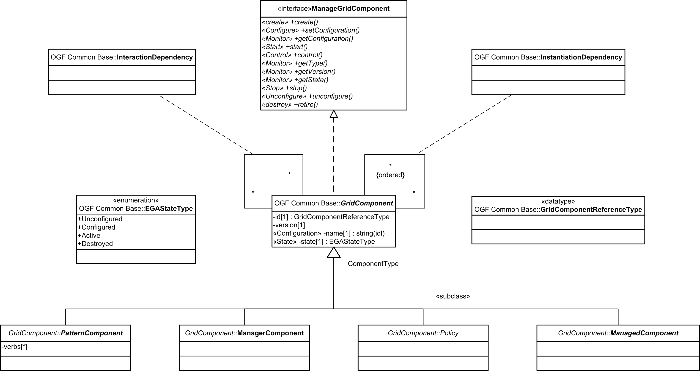
RM-WG Class & Relationship Model

Slide 11
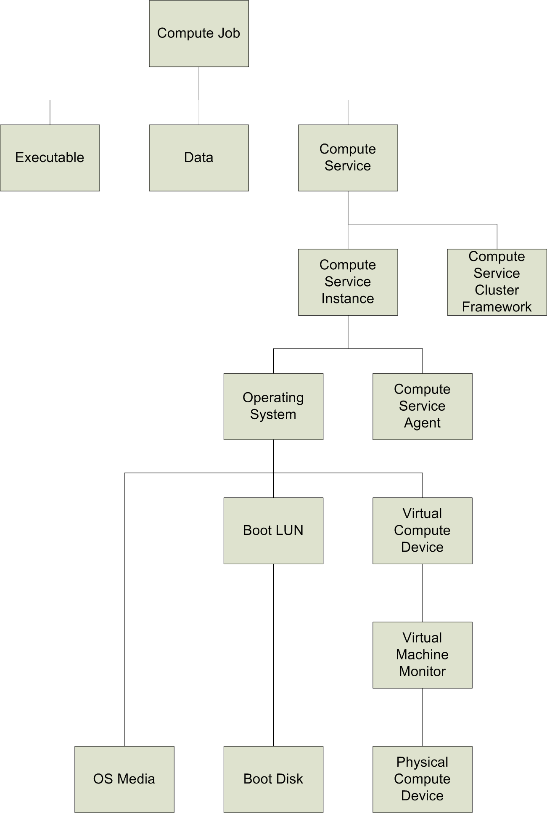
RM-WG Compute Resource

Slide 12
Full Copyright Notice
Copyright (C) Open Grid Forum (2007). All Rights Reserved.
This document and translations of it may be copied and furnished to others, and derivative works that comment on or otherwise explain it or assist in its implementation may be prepared, copied, published and distributed, in whole or in part, without restriction of any kind, provided that the above copyright notice and this paragraph are included on all such copies and derivative works.
The limited permissions granted above are perpetual and will not be revoked by the OGF or its successors or assignees.
Notes:
OGF Full Copyright Notice if necessary

