Slide 1



Data Service Specification: RDF(S) Ontology Access Strawman
Access Services for RDF Data Resources
Miguel Esteban Gutiérrez Univ. Politécnica de Madrid

Slide 2
OGF IPR Policies Apply
“I acknowledge that participation in this meeting is subject to the OGF Intellectual Property Policy.”
Intellectual Property Notices Note Well: All statements related to the activities of the OGF and addressed to the OGF are subject to all provisions of Appendix B of GFD-C.1, which grants to the OGF and its participants certain licenses and rights in such statements. Such statements include verbal statements in OGF meetings, as well as written and electronic communications made at any time or place, which are addressed to:
the OGF plenary session,
any OGF working group or portion thereof,
the OGF Board of Directors, the GFSG, or any member thereof on behalf of the OGF,
the ADCOM, or any member thereof on behalf of the ADCOM,
any OGF mailing list, including any group list, or any other list functioning under OGF auspices,
the OGF Editor or the document authoring and review process
Statements made outside of a OGF meeting, mailing list or other function, that are clearly not intended to be input to an OGF activity, group or function, are not subject to these provisions.
Excerpt from Appendix B of GFD-C.1: ”Where the OGF knows of rights, or claimed rights, the OGF secretariat shall attempt to obtain from the claimant of such rights, a written assurance that upon approval by the GFSG of the relevant OGF document(s), any party will be able to obtain the right to implement, use and distribute the technology or works when implementing, using or distributing technology based upon the specific specification(s) under openly specified, reasonable, non-discriminatory terms. The working group or research group proposing the use of the technology with respect to which the proprietary rights are claimed may assist the OGF secretariat in this effort. The results of this procedure shall not affect advancement of document, except that the GFSG may defer approval where a delay may facilitate the obtaining of such assurances. The results will, however, be recorded by the OGF Secretariat, and made available. The GFSG may also direct that a summary of the results be included in any GFD published containing the specification.”
OGF Intellectual Property Policies are adapted from the IETF Intellectual Property Policies that support the Internet Standards Process.
Notes:
IPR Notices Note Well for OGF meetings

Slide 3
Full Copyright Notice
Copyright (C) Open Grid Forum (2006-2007). All Rights Reserved.
This document and translations of it may be copied and furnished to others, and derivative works that comment on or otherwise explain it or assist in its implementation may be prepared, copied, published and distributed, in whole or in part, without restriction of any kind, provided that the above copyright notice and this paragraph are included on all such copies and derivative works.
The limited permissions granted above are perpetual and will not be revoked by the OGF or its successors or assignees.
Notes:
OGF Full Copyright Notice if necessary

Slide 4
Outline
Introduction
Motivation: Lessons learned from the Semantic Web
Current status
Future work
Notes:
Introduction
The RDF(S) Access Vision
How does this fit with the WS-DAI approach?
The motivation pit
Motivation: Lessons learned from the Knowledge Web Network of Excellence
The Knowledge Web NoE
Business Use-Case Analysis
Methodology
Summary
Results
Conclusions
Current status
Design criteria
Data resources
Interface organization
Proposed changes
Future work

Slide 5
Introduction The RDF(S) Access Vision
What is all about?
Providing an access mechanism to RDF(S) data sources
Two different means for interacting:
Query access: using SPARQL
Ontology access: using ontological primitives based on the RDF(S) model
Alternative, but not exclusive!
Use each one according to your needs…
Notes:
The RDF(S) access initiative is about providing an access mechanism to data defined by mean of RDF.
The objective is to develop a set of services which provide a standard access interface to RDF data, which can be used in the OGSA architecture regardless of the underlying physical infrastructure used for storing that data (Sesame, Jena, Kowari, Oracle…)
We have identified to different ways for interacting with RDF repositories:
- Via queries, as you will see later on.
- Via ontology access primitives, that is, using basic access methods based upon the model/formalism used for representing the data, in other words, taking into account the structures defined by RDF(S), and the relationships between them.
But having two alternative ways of interacting with the RDF repositories doesn’t mean that they are exclusive, on the contrary, they should be used simultaneously according to the concrete requirements of the client application.

Slide 6
Introduction How does this fit with the WS-DAI approach?
WS-DAI
Sets general pattern for realisations
Extensions for specific kinds of data resource
Query Strawman
Possible Future Realisations
WS-DAIR
WS-DAIX
WS-DAI-RDF
Ontology Strawman
Relational
SQL
XML
XQuery/XPath
SPARQL,
Ontology Ops
Notes:
The data access mechanism that we are developing sits below the WS-DAI specification. The
realizations will provide specialized methods that will take into account the special syntax and semantics
of the RDF(S) data and expose it appropriately, and will do it following the WS-DAI guidelines and
patterns for defining data access interfaces and services, like WS-DAIR does for relational databases
and WS-DAIX does for XML sources.

Slide 7
Introduction The motivation pit
Gathering momentum:
Need to engage the community …
… providing motivational use-cases
Motivational use-cases for the RDF(S) Query strawman:
Semantic Matchmaking using SPARQL
Large scale distributed RDF Database
No motivational use-cases for the RDF(S) Ontology strawman
Notes:
Critical mass is a sociodynamic term to describe the existence of sufficient momentum in a social system such that the momentum becomes self-sustaining and fuels further growth..
The minimum amount (of something) required to start or maintain a venture; "the battle for the computer market has now reached critical mass"; "there is now a critical mass of successful women to take the lead"; "they sold the business because it lacked critical mass"

Slide 8

Motivation
Work origins:
Ontology access provisioning in the context of the OntoGrid project …
… as the basis for applying Semantic Web “solutions” to the current Grid → The Semantic Grid ←
The motivation for using the specification has its roots in the motivation for using Semantic Web technologies in the real world
The Knowledge Web Network of Excellence has been working on this for almost 4 years now…
… let’s see the lessons we can learn from them.
Knowledge Web (KW) is Network of Excellence project funded by the European Commission 6th Framework Programme, which began on January 1st, 2004. Supporting the transition process of Ontology technology from Academia to Industry is the main and major goal of Knowledge Web.
The mission of Knowledge Web is to strengthen the European industry and service providers in one of the most important areas of current computer technology: Semantic Web enabled E-work and E-commerce. The project concentrates its efforts around the outreach of this technology to industry.

Slide 9
Motivation The Knowledge Web Network of Excellence
Training Material
Courses
Industry
Education
Use Cases
(Theoretical) Solutions
Research
Requirements
Tools
Technology Locks
Best Practices
Notes:
Movimiento:
Industria: casos de uso
Industria → Research: requirements & locks
Research: technology satisfying the requirements and solving locks
Research → Education: theoretical solutions, tools, best practices
Research → Industry: tools
Education: forma a futuros trabajadores en áreas teóricas y prácticas
Education→ Industria: trabajadores cualificados bien formados

Slide 10
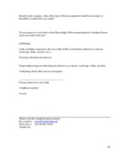

Motivation Business Use-Case Analysis: Methodology
16 business use cases collected:
Recruitment | Product lifecycle management | Geosciences project memory | Agent-based system for an insurance company
Multimedia content analysis and annotation | Data warehousing in healthcare | R&D support for coffee | DaimlerChrysler semantic web portal
Peer-to-peer eScience Portal | B2C marketplace for tourism | Co-ordination of real estate management | Specialized web portals for businesses
News aggregation service | Digital photo album management | Hospital information system | Integrated access to biological data
Industry representatives
+
Semantic Web Experts
50+ companies,
20 business sectors
Sectors analyzed
Aerospace | Automobile | Banking & Finance | Computing & Electronics
Consumer Goods | Distribution | Energy & Public Services | Environment
Food Industry | Government | Industry & Construction | Internet
Luxury Goods | Media & Communications | Pharmaceuticals & Helth | Service Industry
Sports | Technology Providers | Telecommunications | Transport & Logistics

Slide 11
Motivation Business Use-Case Analysis: Summary

Slide 12
Motivation Business Use-Case Analysis: Summary

Slide 13
Motivation Business Use-Case Analysis: Results
Tool Components for Development |  | Application Components for Deployment
Ontology Editor |  | Data Layer | Semantic Query Processor
Ontology Integration |  |  | Reasoner
Ontology Transforming |  |  | Wrapper
Ontology Extraction/Mining |  | Interface Layer | Annotation Editor
 |  |  | Instance Editor
 |  |  | Semantic Web Services Infrastructure | Service Directory
 |  |  |  | Service Discovery
 |  |  |  | Service Composition
Croscutting requirements
Ontology Languages
Storage Access
Version/Configuration Management
Scalability
Distribution
See D1.2.2: Semantic Web Framework Requirements Analysis
Notes:
A crucial factor for industry acceptance of a new IT technology is the availability of stable and interoperable tools and components for application development. The goal of D1.2.2 is to identify these components and describe their functionality and requirements.
D1.2.2: Semantic Web Framework Requirements Analysis
deliverable describes requirements for the most important ontology-based tools and components.
work builds on the results of the use-case analysis conducted which yielded a list of high-level knowledge-processing tasks and components
All primary tasks identified in deliverable D1.1.3 are covered in this document.

Slide 14
Motivation Business Use-Case Analysis: Results
Semantic Web Framework
Ontology
matcher
Web Service
discoverer
See D1.2.4: Architecture of the Semantic Web Framework
Alignment manipulation
Information directory manager
Web Service
selector
Alignment editor
Ontology repository
Web Service
composer
Ontology
editor
Ontology
evolution manager
Ontology
translator
Ontology discovery and ranking
Web Service
choreography engine
Data repository
Ontology
browser
Ontology
transformer
Instance
editor
Query answering
Ontology
evolution visualizer
Ontology localization and profiling
Web Service
process mediator
Alignment repository
Ontology selector
Data
translator
Manual annotation
Semantic
query
processor
Ontology
adaptation operators
Ontology
versioner
Metadata registry
Ontology
evaluator
Ontology
merger
Automatic annotation
Web Service
grounding
DATA
MANAGEMENT
Semantic
query
editor
Ontology view customization
Ontology
evolution strategy
Web service repository
Ontology
learner
Mediator generator
Ontology
populator
Web Service
profiling
DATA & METADATA
MANAGEMENT
QUERYING
AND
REASONING
ONTOLOGY DEVELOPMENT
& MANAGEMENT
ONTOLOGY CUSTOMIZATION
ONTOLOGY EVOLUTION
ONTOLOGY ALIGNMENT
ONTOLOGY INSTANCE
GENERATION
SEMANTIC
WEB
SERVICES

Slide 15
Motivation Lessons learned from the Semantic Web
Industry pull for Semantic (Web) technologies
Several industry use-cases presented
Industry requirements for Semantic (Web) technologies:
Ontology storage, retrieval & querying
Semantic Web (theoretical) Framework for developing Semantic Web (technologies-based) Applications
(Ontology) storage access as cross-cutting requirement
RDF(S) as interoperability enabler for Semantic Web technologies
These very same ideas might apply to the (Semantic) Grid

Slide 16
Current status Design criteria
Model-oriented design approach
Organization
Two layers:
Bulk access
Specialized access
Interface types:
Native interfaces: mimic components of the RDF(S) data model
Utility interfaces: provide additional functionalities that enhance usability
Message definition:
Direct data access:
Retrieval of directly associated information
Creation of new data (including attachments)
Deletion of existing data (including detachments)
Indirect data access
Delegation of access to services that provide specialized access to a subset of associated information
Notes:
Regarding the organization of the interfaces and operations, we have used the following criteria:
First we have splitted the interfaces in two layers, according to the granularity of the operations. There is a bulk layer in which we can create and delete instances and there is also a specialized layer where we manage the relationships between instances, and provide specific retrieval operations.
We have identified two types of services/interfaces, native ones which mimic the main classes of the RDF(S) data model and the utility services/interfaces. These ones are convenient abstractions that provide further functionalities that enhance the overall usability of the services.
Regarding to the operations themselves, we have left to direct data access those related to the retrieval, creation and deletion of data. Indirect data access has been used for moving from interfaces which provide coarse grained access to those that provide a specialized fine grained access.

Slide 17
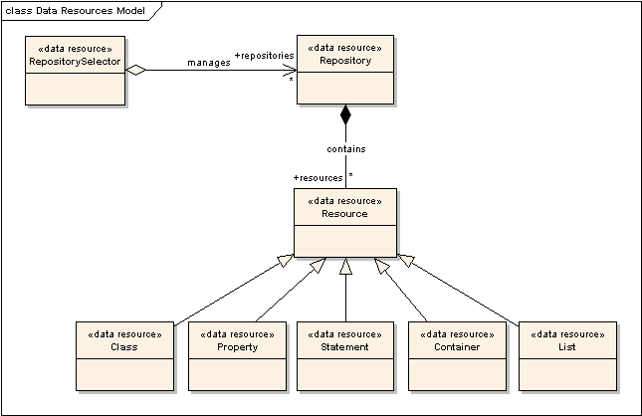
Current status Data resources
Notes:
Two kinds of data resources, from bottom to top:
Resources that mimic RDF(S) modelling elements:
General: Resource
Specific: Class, Property, Statement, Container, List
Convenience abstractions
Repository
RepositorySelector (collection)
Such level of granularity allows finer grain of control over the concrete parts of the data sets (access policies, read/write permissions, etc)
Resources as views of the data resource

Slide 18
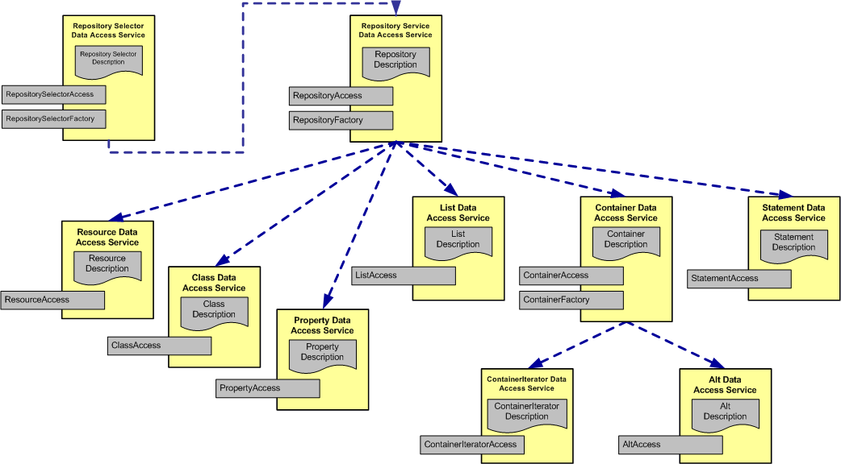
Current status Interface organization
Notes:
This picture shows which interfaces we have already identified and how they are organized.

Slide 19
Current status Summary
Model-based access operations
Following ontological engineering principles
Some figures:
13 interfaces provided (2 new, 1 removed)
85 operations available (40 operations less)
Notes:
Summaryzing, we have created a set of interfaces for accessing RDF that provide ontology-based operations for the task. We have provided interfaces that mimic the RDF(S) data model or abstract a useful set of functionalities that enhance the “user” experience…
All of this has been done following object orientation practices.
Some figures about the spec…

Slide 20
Current status Proposed Changes
Go for a profile-based specification:
Profile 0: RDF Basic Compliance
Repository Sets management
Repository Management
Resource Management
Profile 1: RDF Schema Compliance (Bare Vocabulary Definition)
Class Management
Property Management
Profile 2: RDF(S) Full Model Compliance
Statements Management
Container Management
List Management
Datatypes Management

Slide 21
Future work
Enhance motivational document with use-cases from Knowledge Web, OntoGrid & other projects
Finish specification:
Complete behavioural aspects:
Static properties
Configurable properties
Ellaborate the profile idea:
Separate the current specification functionalities (interfaces & messages) into profiles
Create a test suite
Align document with Query Strawman Document through the Glossary of Terms
Notes:
Adaptando los casos de uso para que demuestren también requisitos Grid.

Slide 22

Thanks for your attention, questions?

