Slide 1

DAIS Working Group
OGF21
Isao Kojima
Grid Technology Research Center
AIST
Japan

Slide 2

OGF IPR Policies Apply
“I acknowledge that participation in this meeting is subject to the OGF Intellectual Property Policy.”
Intellectual Property Notices Note Well: All statements related to the activities of the OGF and addressed to the OGF are subject to all provisions of Appendix B of GFD-C.1, which grants to the OGF and its participants certain licenses and rights in such statements. Such statements include verbal statements in OGF meetings, as well as written and electronic communications made at any time or place, which are addressed to:
    the OGF plenary session,
    any OGF working group or portion thereof,
    the OGF Board of Directors, the GFSG, or any member thereof on behalf of the OGF,
    the ADCOM, or any member thereof on behalf of the ADCOM,
    any OGF mailing list, including any group list, or any other list functioning under OGF auspices,
    the OGF Editor or the document authoring and review process
Statements made outside of a OGF meeting, mailing list or other function, that are clearly not intended to be input to an OGF activity, group or function, are not subject to these provisions.
Excerpt from Appendix B of GFD-C.1: ”Where the OGF knows of rights, or claimed rights, the OGF secretariat shall attempt to obtain from the claimant of such rights, a written assurance that upon approval by the GFSG of the relevant OGF document(s), any party will be able to obtain the right to implement, use and distribute the technology or works when implementing, using or distributing technology based upon the specific specification(s) under openly specified, reasonable, non-discriminatory terms. The working group or research group proposing the use of the technology with respect to which the proprietary rights are claimed may assist the OGF secretariat in this effort. The results of this procedure shall not affect advancement of document, except that the GFSG may defer approval where a delay may facilitate the obtaining of such assurances. The results will, however, be recorded by the OGF Secretariat, and made available. The GFSG may also direct that a summary of the results be included in any GFD published containing the specification.”
OGF Intellectual Property Policies are adapted from the IETF Intellectual Property Policies that support the Internet Standards Process.

Slide 3
Agenda
Update to the community Isao
RDF Specification Development
  WS-DAI RDF(S) Introduction Isao
  RDF(S) Ontology Specification Miguel
  RDF(S) Querying Specification Said
Discussion
Wrap up and Next Steps

Slide 4
WS DAI Specifications
OGF21 DAIS-Working Group

Slide 5
Specifications overview
WS-DAI
Sets general pattern
for DAIS realisations
WS-DAIR
WS-DAIX
WS-DAIO
Files
RDF
Draft at GGF14
Draft based on POSIX
Looking for a willing author
In discussion
Currently defined

Slide 6
DAIS-WG Documents
Recommendation Track:
  Web Services Data Access and Integration – The Core (WS-DAI) Specification, Version 1.0
  http://forge.gridforum.org/tracker/index.php?aid=1711
  Web Services Data Access and Integration – The Relational Realisation (WS-DAIR) Specification, Version 1.0
  http://forge.gridforum.org/tracker/index.php?aid=1712
  Web Services Data Access and Integration – The XML Realization
  http://forge.gridforum.org/tracker/index.php?aid=1713
Informational:
  Interoperability Testing for DAIS Working Group Specifications
    https://forge.gridforum.org/tracker/index.php?aid=1768

Slide 7
OGF Document Process: Recommendation
Draft
Proposed
Recommendation
Editor /
GFSG Review
Interoperability
Testing
Public Comment
Experimental
Document
Author
Revision
Elaborate Formal
Review Process
Editor /
GFSG Review

Slide 8
Status with Interoperability Testing
WS-DAI:
  Not directly applicable.
WS-DAIX:
  OGSA-DAI
  Ohio State University:
    Agreed to participate.
WS-DAIR:
  IBM:
    Implementation of earlier version
  OGSA-DAI .
WS-DAIR
Participants
Wanted

Slide 9
Summary
Changes requested in public comment were not extensive: changes have been made by the authors and circulated
Some additional comments were received from different sources; these have been reviewed for inclusion in the specifications where no major change was involved.
Specifications are now Provisional Recommendations .
Plan to complete experimental document for WS-DAI and WS-DAIX as fast as possible.
RDF realisation to be discussed further at this GGF.

Slide 10
Info
Dave Pearson (Oracle) is stepping down as the Co-Chair of the Group.
  Norman Paton is already retired as the another Co-Chair.
  Their contributions to the group are greatly appreciated.
Chair Position Vacancy
  To move the group forward to:
    Continue to complete WS-DAI,DAIR,DAIX document processes.
    Enhance WS-DAIs to support more functionalities
      CIM based Metadata?
    Support the Data “Integration” aspect of the group
      We just have “remote access” specs, not for integration
    Extend WS-DAI for other resources, such as RDF and files.
    Etc.

Slide 11
WS-DAI RDF(S)
Introduction
DAIS Working Group
Isao Kojima
Grid Technology Research Center
AIST
Japan

Slide 12
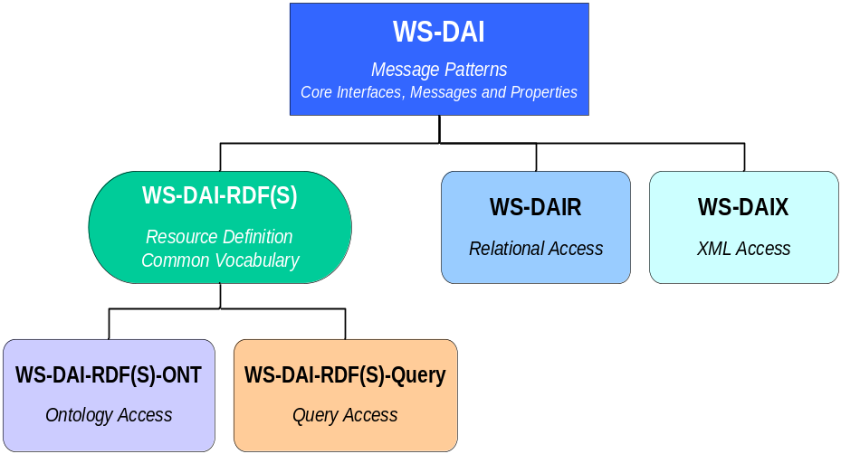
WS-DAI-RDF(S) Standard Structure
What is all about?
  Providing an access mechanism to RDF(S) data resources
New WS-DAI realization for RDF(S) databases
    which will consist of 2 complementary specifications
  RDF(S) Ontology Access
    Ontological Primitives based on RDF(S) model(as Class)
  RDF(S) Querying
    Query Language(SPARQL) for Instances
Motivation and Background
->Semantic Web and Grid Computing (please read the motivational document)
Use either or both
according to your needs

Slide 13
Grid Computing: Beyond XML
Grid Applications and Infrastructure will use
Semantic Web technology
    Ontology, Inference/Reasoning, etc.
Example:
Semantically enhanced Grid Resource Discovery System (presented later in this session)
  Use of Ontology and Inference for discovering/monitoring grid resources
    Resource description format: not XML, but RDF/OWL
    Resource discovery language: not Xpath/XQuery, but SPARQL

Slide 14
Need to support RDF data format by the Grid Infrastrucutre
  Semantic Web technology is mainly based on RDF-based format
    RDF, RDF Schema, OWL,OWL-S, SPARQL,,,,,
  Current Grid standard is mostly based on XML-based format.
    XMLSchema, Xpath, XQuery etc.
Grid Infrastructure should support RDF-based data

Slide 15
Semantic Web :
Need to achieve the Scalability
Semantic Web applications and tools should achieve the scalability as application grows.
Example:
Large scale Distributed RDF data for ubiquitous ID tag （also presented later in this session)
  Each ID tag is associated with various semantic information described with RDF
    Number of RDF data which will be created is huge
      = 1000 records will be created/stored per second and stored for 10 years.
      = 200byte/record x 300,000,000,000 = 60TB!
    The data is created in the distributed environment

Slide 16
Need to provide a distributed and scalable infrastructure for RDF databases
Distributed RDF database Technology
  Efficient distributed query processing for SPARQL
Terabyte scale of RDF storage
  Federated RDF databases and repositories
Grid-based RDF database is necessary to support large-scale semantic web applications

Slide 17
WS-DAI-RDF(S) Standard Structure
  Two complementary standards.
  RDF(S) Ontology Access
    Ontological Primitives based on RDF(S) model
    Focus on Class and its hierarchy,
    Provide API like handling method.
  RDF(S) Querying
    Query Language(SPARQL) f
    Focus on Instances
    Provide Query language interface
Alternative, but not exclusive!
Use either or both
according to your needs

Slide 18
Uniqueness of the Activity
  In OGF
    Currently only one activity to set the standards which handles RDF format
  Ontology Access
    No corresponding standards in W3C
  Querying
    W3C SPARQL and related standards.
    No indirect access is supported as in WS-DAI
  No such activity that supports both in a single framework.

Slide 19
DAIS for RDF: History
2006.02: GGF16 at Athens
  DAIS for RDF BOF: Share the Motivation
2006.05: GGF17 at Tokyo
  Charter Discussion
  Focus on RDF and RDF Schema (RDF(S))
  Scope/Roadmap/Deliverables
2006.06: RDF F2F at Edinburgh
  Decide to make an informational document
    Motivational Document : Structure Discussion
2006.09: GGF18 at Washington
  Motivational Doc Presented
2007.02：OGF19 at Chapel Hill, NC
  2 initial Specification Documents Presented
2007.05: OGF20 at Manchester
  Initial version of the “Glossary of the Terms” is presented
  More Use Cases Presented.

Slide 20
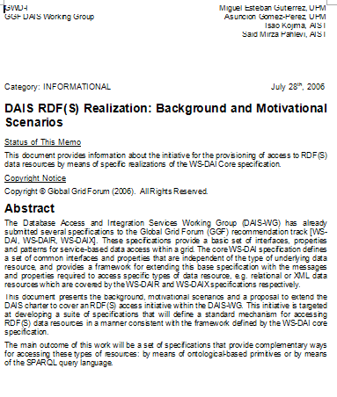
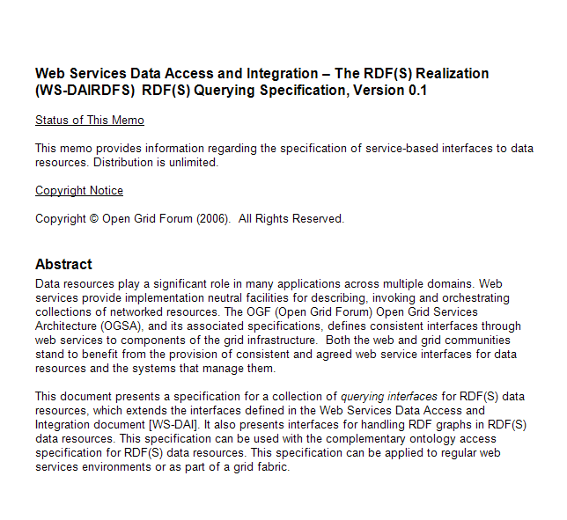
Current Documents
3 documents are on the forge
Please download and have a look
DAIS RDF(S) Background & Motivational Scenarios
WS-DAI RDF(S) Querying
WS-DAI RDF(S) Ontology Access
“Glossary of Terms” will be on the forge soon.
Any comments and feedbacks are welcome

Slide 21
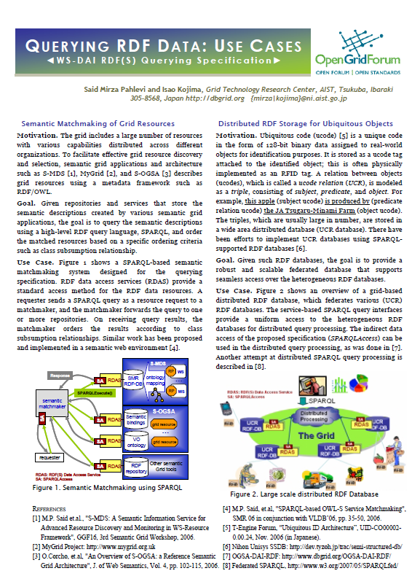
Progress after OGF20
Specification
  Ontology: Progress will be presented later
  Querying : Executive Summary is created
    Already on the forge(presented later in this session)
    To advertise our activity
        Motivation and a Brief Summary of the Spec.
        Introduction of 2 Use Cases.
        Currently only for the Querying Spec.
Document Updates
    Could not get good feedback at now.
Community
    Could not success to attract more people

Slide 22
Discussion Items
Technical Discussions
  Unify the Terms & Namespaces
  Start to make consistent with,
    Querying and Ontology
Document Procedure
  3 docs on the forge
  How to do with the 1st doc to submit?
  “Motivational Doc” to “Use Cases” doc?
How to enlarge the Community
  Small group (currently only 2) activity
  Need to have more contributors, volunteers, etc.
Set the schedule
Set the direction
to submit the 1st Doc
?

Slide 23
WS-DAI RDF(S) Ontology Access
OGF21 DAIS Working Group

Slide 24
WS-DAI RDF(S) Querying
Specification Overview & Use Cases
OGF21 DAIS Working Group

Slide 25
Discussions
OGF21

Slide 26
Technical Aspects
Ontology Spec
  Need to have
    More concrete document as a basis of the discussion
    Complete until the next OGF.
Querying Spec
  Seems to be stable from AIST point of view
    However, we could not get good feedbacks.
Start to make consitent or re-structure the spec
Terms & Namespaces
  Terms
    Need to be unified
    Initial version (presented in OGF20) of “Glossary of Terms” is very good.
    Should be on the forge as a discussion basis.
      Probably the overlap will be “Resource” .
  Namespaces
    Need to be unified.
    Not discussed at all

Slide 27
Document Procedure
Background & Scenario Document
  Only for presenting our motivation, not sufficient as a use case doc.
  Need to have more Use Cases
    We are now collecting Use cases
      -> Planned to complete until the next OGF meeting
Specification Documents
    Ontology: Need to complete an initial document
    Querying: Need to get feedbacks to fix or improve the spec.
    Both: Start the unification
Glossary of Terms
  Latest version should be on the forge
Executive Summary
  Already on the forge, however, It is not an OGF style document,

Slide 28
How to enlarge the community
Currently leaded only 2 groups
  AIST and UPM
    sufficient if both can continue to reach the implementation.
Situation
  Many semantic web/grid people focus on the high-level applications.
  Our activity is for the infrastructure which supports the applications.
More contributors wanted.

Slide 29
DAIS Working Group Summary
OGF21
Isao Kojima
Grid Technology Research Center
AIST
Japan

Slide 30
DAIS-Working Group
3 WS-DAI specs are at the final step.
  Core WS-DAI, Relational and XML
    Specs are completed
    Waiting for the reference implementations, especially for WS-DAIR
    - Some groups are interested.
RDF realization discussion is underway
  WS-DAI-RDF(S)
    Composed with 2 complementary specs(Ontology and Querying)
    AIST and UPM(Spain) is currently co-leading the activity.
        2 strawman docs and One motivational/UseCase doc are in discussion.
        Unifying the terms, namespaces,specs is started.
    Progress after OGF20
      More Use Cases,
      Profiling the Ontology Spec.
      Executive Summary
    At OGF21: Agreed to complete several docs until the next OGF
      Motivation & Use Case Doc with more Use Cases.
      Revised specs.
    Need to have more contributors and volunteers
David Pearson steps down as the Chair
  No Chairs at now

