Slide 1

GLUE 2.0
OGF 22 - Boston, 27 Feb 2008
Sergio Andreozzi (speaker)
Balazs Konya
Laurence Field
(updated after session part 1)

Slide 2

OGF IPR Policies Apply
“I acknowledge that participation in this meeting is subject to the OGF Intellectual Property Policy.”
Intellectual Property Notices Note Well: All statements related to the activities of the OGF and addressed to the OGF are subject to all provisions of Appendix B of GFD-C.1, which grants to the OGF and its participants certain licenses and rights in such statements. Such statements include verbal statements in OGF meetings, as well as written and electronic communications made at any time or place, which are addressed to:
    the OGF plenary session,
    any OGF working group or portion thereof,
    the OGF Board of Directors, the GFSG, or any member thereof on behalf of the OGF,
    the ADCOM, or any member thereof on behalf of the ADCOM,
    any OGF mailing list, including any group list, or any other list functioning under OGF auspices,
    the OGF Editor or the document authoring and review process
Statements made outside of a OGF meeting, mailing list or other function, that are clearly not intended to be input to an OGF activity, group or function, are not subject to these provisions.
Excerpt from Appendix B of GFD-C.1: ”Where the OGF knows of rights, or claimed rights, the OGF secretariat shall attempt to obtain from the claimant of such rights, a written assurance that upon approval by the GFSG of the relevant OGF document(s), any party will be able to obtain the right to implement, use and distribute the technology or works when implementing, using or distributing technology based upon the specific specification(s) under openly specified, reasonable, non-discriminatory terms. The working group or research group proposing the use of the technology with respect to which the proprietary rights are claimed may assist the OGF secretariat in this effort. The results of this procedure shall not affect advancement of document, except that the GFSG may defer approval where a delay may facilitate the obtaining of such assurances. The results will, however, be recorded by the OGF Secretariat, and made available. The GFSG may also direct that a summary of the results be included in any GFD published containing the specification.”
OGF Intellectual Property Policies are adapted from the IETF Intellectual Property Policies that support the Internet Standards Process.
Notes:
IPR Notices Note Well for OGF meetings

Slide 3
Focus and Goal
Approved at OGF 19 (Jan 2007)
Focus:
  facilitate interoperability between Grid infrastructures via common information models and reference implementation for describing Grid resources in response to use cases
Goal:
  define a use case document collecting use cases from different Grid projects/infrastructures
  define a conceptual model defining the abstract schema GLUE 2.0 satisfying the collected use cases.
  develop reference implementations

Slide 4
Relationship to other OGF WGs
BES/HPC
JSDL
SAGA
Used to describe
exposed resources
Used to express
requirements in
Common service descripton
for discovery API
GLUE
Used to describe
exposed resources
Should fit into the picture
GSM
OGSA Res.Mgt.
Should fit into the picture
Reference Model
SAGA:Simple Access Grid API
JSDL: Job Submission Description Language
GSM:Grid Storage Management
BES: Basic Execution Service

Slide 5
GLUE 2.0: the Model
Three Main Sub-Models:
  Main Entities:
    a model of Grid core entities from which service-specific models can be derived
  Computing Entities:
    a model for Computing Entities
  Storage Entitites:
    a model for Storage Entitites

Slide 6
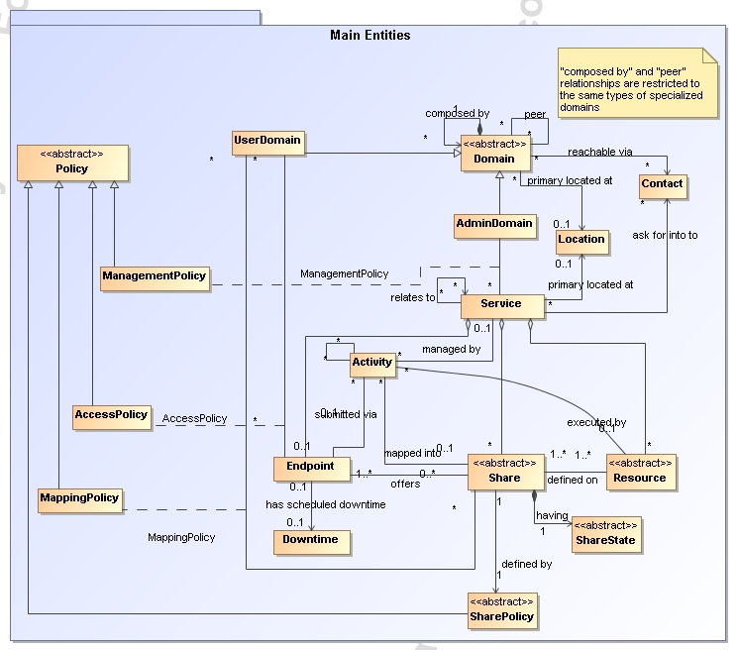

Slide 7
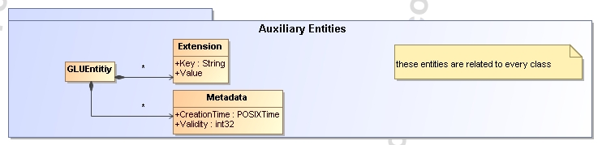

Slide 8
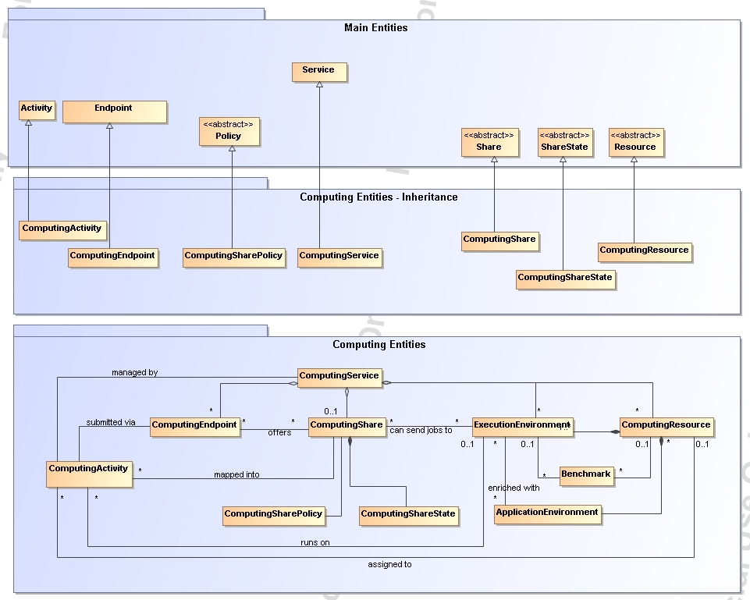

Slide 9
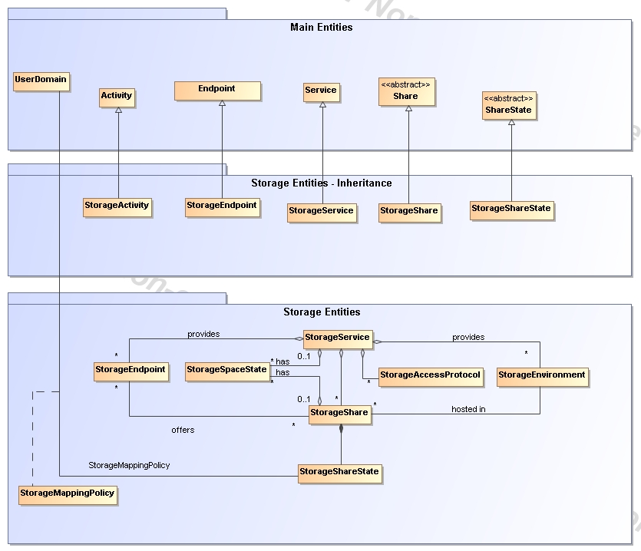

Slide 10
GLUE Sessions in OGF 22
  Wed 27 Feb, 9:00 am - 10:30 am
    Room William Dawes
    Agenda:
      Overview
      Main Entities
  Wed 27 Feb, 3:45 pm - 5:15 pm
    Room William Dawes
    Agenda:
      Computing entites
  Thu 28 Feb, 9:00 am - 10:30 am (EXTRA SESSION)
    Room Crispus Attucks
    Agenda:
      Renderings: XSD, LDAP, SQL, …
  Thu 28 Feb, 10:45 am - 12:15 pm
    Room Crispus Attucks
    Agenda
      Storage entities

Slide 11
Current Status
Since OGF 21
  More than 20 telecons
    Really active participation
      Storage-related people got heavily involved
    http://forge.ogf.org/sf/wiki/do/viewPage/projects.glue-wg/wiki/PhoneMeetings
  Documents
    GLUE 2.0 Specification (category recommendation)
      Draft 24 available (full draft)
      Three sub-models:
      Main entities, computing entities, storage entities (NEW)
    GLUE Use Cases (internal live document)
      New draft issued in January 2008
      Inputs always welcome
  First prototype renderings available
    XSD, SQL, LDAP
    on-going process
    useful for early evaluation, not for implementation yet

Slide 12
Roadmap Towards GLUE 2.0 Final
25-28 Feb 2008: OGF22 Sessions
  Discuss draft 24 + renderings
  Collect feedback and integrate in spec
31 Mar 08: WG Last Call
  Including renderings for XSD, SQL, LDAP
30 April 08: Public Comment
  Lasts 60 days for recommendation
31 Aug 08: Proposed Recommendation Status
  it includes final renderings for XSD, SQL, LDAP
  i.e., before OGF 24

Slide 13
Plans for Adoption
Interested in adopting
  OMII-Europe
  EGEE
  ARC
  TeraGrid
  UNICORE/DEISA
  D-Grid
  AustralianGrid
  NAREGI
  NGS
  OSG
  BREIN
  …

Slide 14
General Issues

Slide 15
Units
Do we use basic units or allow for multiples?
E.g.:
  MaxCPUTime: s or min
  MaxDiskSpace: B, KB, MB, GB?
    What about B, KiB, MiB, GiB?
Proposal:
  Use one type of unit per attributes
  Try to be uniform by category:
    E.g.: For disk space: GB
  Clarify in the spec GB vs. GiB
Consider to embed the unit in the attribute name:
  E.g. MaxCPUTime_s

Slide 16
Configuration vs. Policy
Reference Model:
  Policy defines the behavior of the GME and of the Grid itself
  Configuration attribute: define the internal behavior of the Grid Component
How this should be reflected in GLUE?
  SharePolicy
  Access/MappingPolicy
Proposal:
  SharePolicy attributes to be merged in Share class
    Keep state as separate
  For access/mappingPolicy, stay as it is now
  Refine definition of share

Slide 17
Environment and Resource
Consistency between main entities, computing entities and storage entities
  Share-Resource
  ComputingShare-ExecutionEnvironment-ComputingResource
  StorageShare-StorageEnvironment
  …

Slide 18
static vs. dynamic attributes
Some GLUE class has
  Static attributes
  Dynamic attributes
Developers often ask to decouple them for improving their measurement/distribution
At which level we should do this?
  Breaking classes?
  Extra column in table with S/D flag?

Slide 19
State models
Check consistencies of all state-related attributes
E.g.:
  Service: QualityLevel
  Endpoint: HealthState, ServingState
  ComputingShare: ServingState
  ApplicationEnvironment:
  ComputingActivity:
  StorageShare: Status

Slide 20
Enumeration
Check all the enumeration
  Closed vs. open
  Should use URN

Slide 21
Consistency check with other OGF models
TO DO
  JSDL 1.0
  BES and BES extensions
  Usage Records
not planned for OGF 22 sessions, just a reminder

Slide 22
Main Entities

Slide 23
Access/Mapping Policies
Define a basic scheme for AuthZ rules
E.g.:
<AccessPolicy>
  <Scheme>basic</Scheme>
  <Rule>/cms/production/*</Rule>
  <Rule>/atlas/production/*</Rule>
</AccessPolicy>

Slide 24
Computing Entities

Slide 25
MaxCPUTime

Slide 26
SAS Use Cases
http://forge.ogf.org/sf/sfmain/do/downloadAttachment/projects.glue-wg/wiki/UseCases?id=atch4434

Slide 27
ApplicationEnvironment
Check last comments from AustralianGrid
http://www.ogf.org/pipermail/glue-wg/2008-February/000367.html

Slide 28
ApplicationEnvironment Naming
How to define a uniform way to name application environments
Think of URN where
  Namespace
  Name
  Version ?
How to use this name in job description?
  Comment from Donal:
  http://www.ogf.org/pipermail/glue-wg/2007-December/000252.html
  Do you plan to construct a dictionary of Application names? If not, it's going to make finding Application Environment instances tricky in practice. This will also need to tie in with JSDL, HPC Profile and ACS groups. Maybe also OGSA Naming, though I believe they name something else. If you do, it probably should be in a separate document. (I'd suggest some sort of structured name so that you don't need to name everything!) It's also a shame that CIM hasn't done anything in this area that I can see...

Slide 29
CPUs/Slots/Seats
CPUs/Slots/Seats
  Consistency check

Slide 30
Storage Entities

Slide 31
StorageShare
To check consistencies

Slide 32
How to express computing resources close to storage
http://forge.ogf.org/sf/go/artf6120?nav=1

Slide 33
Full Copyright Notice
Copyright (C) Open Grid Forum (2008). All Rights Reserved.
This document and translations of it may be copied and furnished to others, and derivative works that comment on or otherwise explain it or assist in its implementation may be prepared, copied, published and distributed, in whole or in part, without restriction of any kind, provided that the above copyright notice and this paragraph are included on all such copies and derivative works.
The limited permissions granted above are perpetual and will not be revoked by the OGF or its successors or assignees.
Notes:
OGF Full Copyright Notice if necessary

