Slide 1

GLUE 2.0
OGF 22 - Boston, 27 Feb 2008
Sergio Andreozzi (speaker)
Balazs Konya
Laurence Field
(updated after session part 1 and 2)

Slide 2

OGF IPR Policies Apply
“I acknowledge that participation in this meeting is subject to the OGF Intellectual Property Policy.”
Intellectual Property Notices Note Well: All statements related to the activities of the OGF and addressed to the OGF are subject to all provisions of Appendix B of GFD-C.1, which grants to the OGF and its participants certain licenses and rights in such statements. Such statements include verbal statements in OGF meetings, as well as written and electronic communications made at any time or place, which are addressed to:
    the OGF plenary session,
    any OGF working group or portion thereof,
    the OGF Board of Directors, the GFSG, or any member thereof on behalf of the OGF,
    the ADCOM, or any member thereof on behalf of the ADCOM,
    any OGF mailing list, including any group list, or any other list functioning under OGF auspices,
    the OGF Editor or the document authoring and review process
Statements made outside of a OGF meeting, mailing list or other function, that are clearly not intended to be input to an OGF activity, group or function, are not subject to these provisions.
Excerpt from Appendix B of GFD-C.1: ”Where the OGF knows of rights, or claimed rights, the OGF secretariat shall attempt to obtain from the claimant of such rights, a written assurance that upon approval by the GFSG of the relevant OGF document(s), any party will be able to obtain the right to implement, use and distribute the technology or works when implementing, using or distributing technology based upon the specific specification(s) under openly specified, reasonable, non-discriminatory terms. The working group or research group proposing the use of the technology with respect to which the proprietary rights are claimed may assist the OGF secretariat in this effort. The results of this procedure shall not affect advancement of document, except that the GFSG may defer approval where a delay may facilitate the obtaining of such assurances. The results will, however, be recorded by the OGF Secretariat, and made available. The GFSG may also direct that a summary of the results be included in any GFD published containing the specification.”
OGF Intellectual Property Policies are adapted from the IETF Intellectual Property Policies that support the Internet Standards Process.
Notes:
IPR Notices Note Well for OGF meetings

Slide 3
Focus and Goal
Approved at OGF 19 (Jan 2007)
Focus:
  facilitate interoperability between Grid infrastructures via common information models and reference implementation for describing Grid resources in response to use cases
Goal:
  define a use case document collecting use cases from different Grid projects/infrastructures
  define a conceptual model defining the abstract schema GLUE 2.0 satisfying the collected use cases.
  develop reference implementations

Slide 4
Relationship to other OGF WGs
BES/HPC
JSDL
SAGA
Used to describe
exposed resources
Used to express
requirements in
Common service descripton
for discovery API
GLUE
To be consistent with
UR
Used to describe
exposed resources
Should fit into the picture
GSM
OGSA Res.Mgt.
Should fit into the picture
Reference Model
SAGA:Simple Access Grid API
JSDL: Job Submission Description Language
GSM:Grid Storage Management
BES: Basic Execution Service

Slide 5
GLUE 2.0: the Model
Three Main Sub-Models:
  Main Entities:
    a model of Grid core entities from which service-specific models can be derived
  Computing Entities:
    a model for Computing Entities
  Storage Entitites:
    a model for Storage Entitites

Slide 6
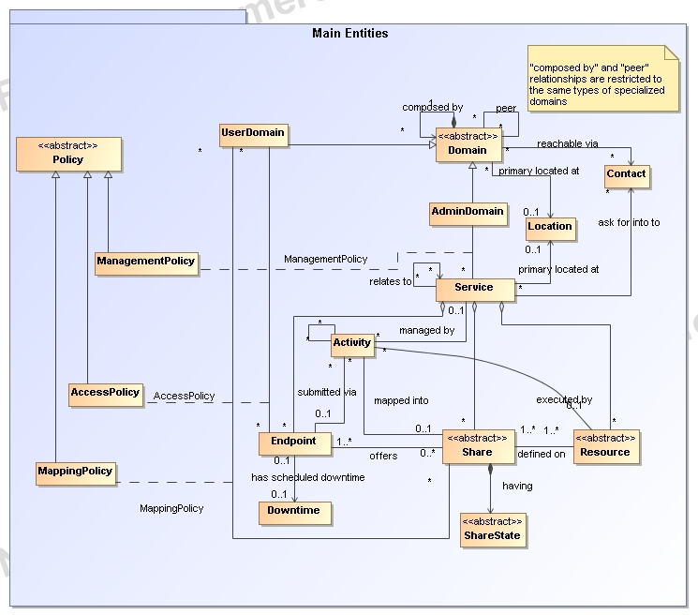
Updated after session 1

Slide 7
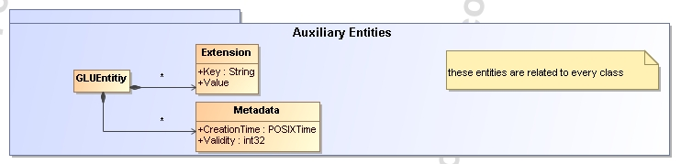

Slide 8
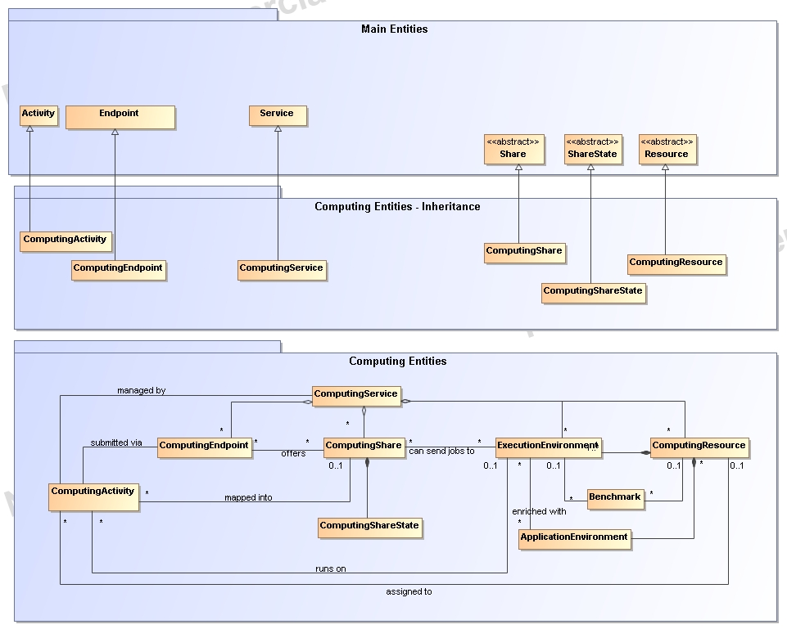
Updated after session 1

Slide 9
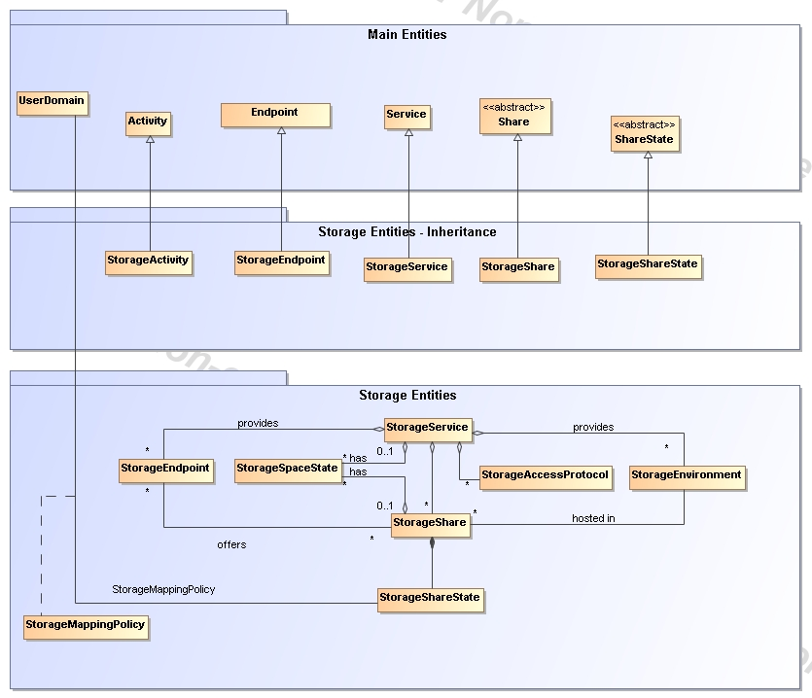

Slide 10
GLUE Sessions in OGF 22
  Wed 27 Feb, 9:00 am - 10:30 am
    Room William Dawes
    Agenda:
      Overview
      Main Entities
  Wed 27 Feb, 3:45 pm - 5:15 pm
    Room William Dawes
    Agenda:
      Computing entites
  Thu 28 Feb, 9:00 am - 10:30 am (EXTRA SESSION)
    Room Crispus Attucks
    Agenda:
      Renderings: XSD, LDAP, SQL, …
  Thu 28 Feb, 10:45 am - 12:15 pm
    Room Crispus Attucks
    Agenda
      Storage entities

Slide 11
Current Status
Since OGF 21
  More than 20 telecons
    Really active participation
      Storage-related people got heavily involved
    http://forge.ogf.org/sf/wiki/do/viewPage/projects.glue-wg/wiki/PhoneMeetings
  Documents
    GLUE 2.0 Specification (category recommendation)
      Draft 24 available (full draft)
      Three sub-models:
      Main entities, computing entities, storage entities (NEW)
    GLUE Use Cases (internal live document)
      New draft issued in January 2008
      Inputs always welcome
  First prototype renderings available
    XSD, SQL, LDAP
    on-going process
    useful for early evaluation, not for implementation yet

Slide 12
Roadmap Towards GLUE 2.0 Final
25-28 Feb 2008: OGF22 Sessions
  Discuss draft 24 + renderings
  Collect feedback and integrate in spec
31 Mar 08: WG Last Call
  Including renderings for XSD, SQL, LDAP
30 April 08: Public Comment
  Lasts 60 days for recommendation
31 Aug 08: Proposed Recommendation Status
  it includes final renderings for XSD, SQL, LDAP
  i.e., before OGF 24

Slide 13
Plans for Adoption
Interested in adopting
  OMII-Europe
  EGEE
  ARC
  TeraGrid
  UNICORE/DEISA
  D-Grid
  AustralianGrid
  NAREGI
  NGS
  OSG
  BREIN
  …

Slide 14
General Issues

Slide 15
Units
Do we use basic units or allow for multiples?
E.g.:
  MaxCPUTime: s or min
  MaxDiskSpace: B, KB, MB, GB?
    What about B, KiB, MiB, GiB?
Proposal:
  Use one type of unit per attributes
  Try to be uniform by category:
    E.g.: For disk space: GB
  Clarify in the spec GB vs. GiB
Consider to embed the unit in the attribute name:
  E.g. MaxCPUTime_s

Slide 16
Configuration vs. Policy
Reference Model:
  Policy defines the behavior of the GME and of the Grid itself
  Configuration attribute: define the internal behavior of the Grid Component
How this should be reflected in GLUE?
  SharePolicy
  Access/MappingPolicy
Proposal:
  SharePolicy attributes to be merged in Share class
    Keep state as separate
  For access/mappingPolicy, stay as it is now
  Refine definition of share

Slide 17
Environment and Resource
Consistency between main entities, computing entities and storage entities
  Share-Resource
  ComputingShare-ExecutionEnvironment-ComputingResource
  StorageShare-StorageEnvironment
  …
Proposal:
  Make storage Resource explicit
  No problem if the specialized resource is composed by sub-entities and the specialized share relates to these sub-entities in order to be defined

Slide 18
static vs. dynamic attributes
Some GLUE class has
  Static attributes
  Dynamic attributes
Developers often ask to decouple them for improving their measurement/distribution
At which level we should do this?
  Breaking classes?
  Extra column in table with S/D flag?

Slide 19
static vs. dynamic attributes
Comments:
  Splitting classes offer developers easer way to optimize
  Not splitting keeps the model simple
    Experience in SNMP showed that splitting create misunderstaing from users… losing of locality of properties of a class
Proposal:
  In general, we do not split static vs dynamic or config vs. state;
  This is a different dimension which should not be considered by the GLUE information model (related to the implementation)
  For consistency, we decide to merge share state in share
  As regards implementers, we do not address the issue of defining what attributes are configuration vs. state
  Implementers will make their own choice on how the measurement of attributes can be optimized for their system

Slide 20
Downtime
We model only zero or one next downtime per endpoint
We decide to merge the attributes with the endpoint
All of them are optional

Slide 21
State models
Check consistencies of all state-related attributes
E.g.:
  Service: QualityLevel
  Endpoint: HealthState, ServingState
  ComputingShare: ServingState
  ApplicationEnvironment:
  ComputingActivity:
  StorageShare: Status
not planned for OGF 22 sessions, just a reminder

Slide 22
Enumeration
Check all the enumeration
  Closed vs. open
  Should use URN/URI
Proposal:
  Guideline: use closed enumeration for concepts defined within GLUE, open for concepts which are defined by the outside world
  Recommend to use URN/URI for at least for open enumeration in order to offer namespacing

Slide 23
Consistency check with other OGF models
TO DO
  JSDL 1.0
  BES and BES extensions
  Usage Records
not planned for OGF 22 sessions, just a reminder

Slide 24
Main Entities

Slide 25
Access/Mapping Policies
Define a basic scheme for AuthZ rules
E.g.:
<AccessPolicy>
  <Scheme>basic</Scheme>
  <Rule>/cms/production/*</Rule>
  <Rule>/atlas/production/*</Rule>
</AccessPolicy>

Slide 26
Computing Entities

Slide 27
MaxCPUTime

Slide 28
SAS Use Cases
http://forge.ogf.org/sf/sfmain/do/downloadAttachment/projects.glue-wg/wiki/UseCases?id=atch4434
The application environment should satisfy
Check properties of job/computingActivity
  Especially timestamp-related attributes

Slide 29
Issue on ExecEnv and AppEnv
If I have two identical nodes, but only one can access a certain application environment, how do I represent it?
With the current model, you have to create two execution environments

Slide 30
ApplicationEnvironment
Check last comments from AustralianGrid
http://www.ogf.org/pipermail/glue-wg/2008-February/000367.html
Proposal:
  Improved Handle info via creation of dedicated class
  ParallelType: added
  NetworkInfo: covered by the presence of this attribute in the ExecEnv

Slide 31
ApplicationEnvironment Naming
How to define a uniform way to name application environments
Think of URN where
  Namespace
  Name
  Version ?
How to use this name in job description?
  Comment from Donal:
  http://www.ogf.org/pipermail/glue-wg/2007-December/000252.html
  Do you plan to construct a dictionary of Application names? If not, it's going to make finding Application Environment instances tricky in practice. This will also need to tie in with JSDL, HPC Profile and ACS groups. Maybe also OGSA Naming, though I believe they name something else. If you do, it probably should be in a separate document. (I'd suggest some sort of structured name so that you don't need to name everything!) It's also a shame that CIM hasn't done anything in this area that I can see...

Slide 32
ApplicationEnvironment Naming
Comments:
  HPC: application environment template
    Free form content; no guarantee that blast is the blast the you are looking for
  UNICORE:
    Free form name and free form version
Proposal:
  Do not define guidelines
  Just recommend to check consistencies with what is being defined in the computing services (BES/HPC), JSDL, … same name should be used

Slide 33
CPUs/Slots/Seats
CPUs/Slots/Seats
  Consistency check
DONE!!!

Slide 34
Storage Entities

Slide 35
StorageShare State
Merged Share State with Share for consistencies with general decision

Slide 36
How to express computing resources close to storage
http://forge.ogf.org/sf/go/artf6120?nav=1
Not discussed since storage-related people were not present

Slide 37
Renderings

Slide 38
How to model relationships
Simplify relationships between AppEnv and ExecEnv
  E.g.: having some default stating that all AppEnv are available to all ExecEnv without having to make explicit all the binary associations

Slide 39
How to model associations in XML
Current approach
  Extra entity which capture a binary association
Alternative
  Each entity lists as children elements all the ID of related entities
  There should be some wildcard to say ALL

Slide 40
Full Copyright Notice
Copyright (C) Open Grid Forum (2008). All Rights Reserved.
This document and translations of it may be copied and furnished to others, and derivative works that comment on or otherwise explain it or assist in its implementation may be prepared, copied, published and distributed, in whole or in part, without restriction of any kind, provided that the above copyright notice and this paragraph are included on all such copies and derivative works.
The limited permissions granted above are perpetual and will not be revoked by the OGF or its successors or assignees.
Notes:
OGF Full Copyright Notice if necessary

