Slide 1
Use of Policies to Enforce Collection Properties
Richard Marciano
Reagan Moore
University of North Carolina @ Chapel Hill
Data Intensive Cyber Environments (DICE) Center
Renaissance Computing Institute
{marciano,rwmoore}@email.unc.edu
http://dice.unc.edu

Slide 2
USE CASE:
(communication with Paul Watry, SHAMAN project)
… Multinational companies operating in different jurisprudence environments, where for example common law is different than public law.
A single federated preservation system would need to execute different policies for different jurisprudence environments.
A preservation system would need to be policy-driven…

Slide 3
An Environment with Heterogeneous Technologies
DSpace
Fedora
iRODS
dLibra
Eprints
Greenstone
Handle System

Slide 4
Sharing Data Across Repositories
Enabling inter-repository data management allows us to share data by connecting the repositories of:
Different groups, projects
Different institutions, locations
Different disciplines
Diverse types of data
Diverse hardware, software infrastructure

Slide 5
Data Management Challenges
Data driven research generates massive data collections
  Data sources are remote and distributed
  Collaborators are remote
  Wide variety of data types: observational data, experimental data, simulation data, real-time data, office products, web pages, multi-media
Collections contain millions of files
  Logical arrangement is needed for distributed data
  Discovery requires the addition of descriptive metadata
Long-term retention requires migration of output into a reference collection
  Automation of administrative functions is essential to minimize long-term labor support costs
  Creation of representation information for describing file context
  Validation of assessment criteria (authenticity, integrity)

Slide 6
To Manage Long-term Preservation
Define desired preservation properties
  Authenticity / Integrity / Chain of Custody / Original arrangement
  Life Cycle Data Requirements Guide
Implement preservation processes
  Appraisal / accession / arrangement / description / preservation / access
Manage preservation environment
  Minimize costs
  Validate assessment criteria to verify preservation properties

Slide 7
iRODS
iRODS - integrated Rule-Oriented Data System
A middleware providing functions to:
  manage distributed storages
  provide metadata support for digital preservation and search functions
  allow running distributed workflows to enforce system policies and harvest distributed computing power.
iRODS can be used for
  building datagrid
  building digital library
  building digital repositories

Slide 8
iRODS Business Rules
Implement Policies
Verify enforcement (audit trails)
Automate management of exploding data
  Let you handle petabytes in hundreds of millions of files
Each Rule defines
  Event, Condition, Action chains (micro-services, other Rules), Recovery chains
Rule types
  Atomic (immediate), Deferred, Periodic
Rules are executed by iRODS Rule Engine
  Applied where data is (server-side)

Slide 9
In the Pledge project [Smith 2007], policies are defined as:
  “A policy is typically a rule describing (or prescribing) the interactions of actions that take place within the archive, or a constraint determining when and by whom an action may be taken. For example, a policy could demand that every Item being submitted include an approved deposit license. Another policy might demand that every Bitstream in the asset store be checked for content integrity (i.e. checksum recomputed and compared with the checksum on record) at least once in every six months.“
Communications of the ACM Magazine [Berman, 2008], describes the need for repositories to incorporate mechanisms that implement and automate policies and regulations is identified:
  “The digital data generated by research, industry and governments over the next decade will be subject to increased regulation and evolving community formats, standards, and policies. This means the cyberinfrastructure (CI) developed to host and preserve it will need to incorporate mechanisms to enforce community policies and procedures like auditing, authentication, monitoring, and association of affiliated metadata. Emerging data CI and management environments and systems, including iRODS, LOCKSS, the Fedora Commons, and DSpace are beginning to develop and incorporate mechanisms that implement relevant policies and procedures. Over the next decade, the ability to automatically address, the requirements of policy and regulation will be needed to ensure that our data CI empowers rather than limits us.”

Slide 10
Repositories can collaborate not only through the exchange of content and metadata but also through the enforcement of preservation policies across repository boundaries.
A first scenario for repository integration between LOCKSS and iRODS that has been proposed would be:
  The same web content could be ingested into a LOCKSS box and an iRODS-enabled storage resource. LOCKSS policies could be implemented in iRODS as rules, such as the LOCKSS audit and repair protocol. Such an approach would allow both repositories to audit each other’s collections to ensure consistency, and would allow the repair of any missing or damaged content. This type of policy coupling would contribute to greater diversity in the implementation of LOCKSS network peers, and illustrates the value of policy-driven repository interoperability.
A second scenario for DSpace and iRODS policy-level integration that has been researched is [Smith, 2006]:
  “It is our assumption that archivists who manage digital archives work primarily at the policy level, however, preservation systems necessarily function at the rules level, which are specific to the particular capabilities required by the system, and the rules engine implemented by it. There is a need to standardize the policies and the protocol for transferring them between preservation environments. In this way, archivists can set policies and have the same policy mapped to multiple rules engines and enforced by multiple preservation environments... We believe that this will allow preservation environments to scale appropriately in the coming decades.” “One approach in combining DSpace and iRODS would be to implement a policy repository in DSpace (which could be done through an RDF triple-store), where policies can be associated with objects such as Items, Collections, Communities, etc., and can be put into a Dissemination Information Package (DIP) which is sent to a policy-aware storage repository such as iRODS.”
A third scenario (the current proposal) is illustrated through Fedora and iRODS policy integration exercises and prototypes [Fedora/iRODS Integration, 2008]:
  Expressing entities of Fedora’s FOXML object model in iRODS, such as key attributes, relationships, and behaviors would provide hooks for iRODS storage and policy enforcement through the iRODS rule repository and rule engine

Slide 11
Finding 1: The transfer of information packages between repositories is not sufficient to guarantee the integrity of the content. In addition, management policies from one repository need to be enforced in the repository where the content is replicated.
Finding 2: Enforcing behaviors and relationships as machine-actionable policies at a remote repository needs to be further researched, as well as other policy-based mechanisms for validating assessment criteria for successful repository integration.
Finding 3: Additional research is needed to explore the feasibility of repository-independent policy representations that lend themselves to interoperability, based upon tests of policy migration between archives.
What is the feasibility of repository interoperability at the policy level? Research questions to be addressed are:
Q1: Can a preservation environment be assembled from two existing repositories with differing management policies?
Q2: Can the policies of the federation be enforced across both repositories, ensuring consistent management of the archives?
Q3: Can policies be migrated between repositories, either by association of the policies with the storage repositories, or through control of repository procedures?
Q4: What fundamental mechanisms are needed within a repository to implement new policies?

Slide 12
Use Cases
Carolina Digital Repository: CDR
Invoking iRODS service in Fedora
iRODS Rule Engine
iRODS Server
Invoke a rule
Call a service
iRODS Rule Engine
iRODS Server
iRODS
Catalog
User
Fedora
(Event,
Condition,
Action chains,
Recovery chains)
iRODS Rule Engine
iRODS Server
iRODS Rule Engine
iRODS Server

Slide 13
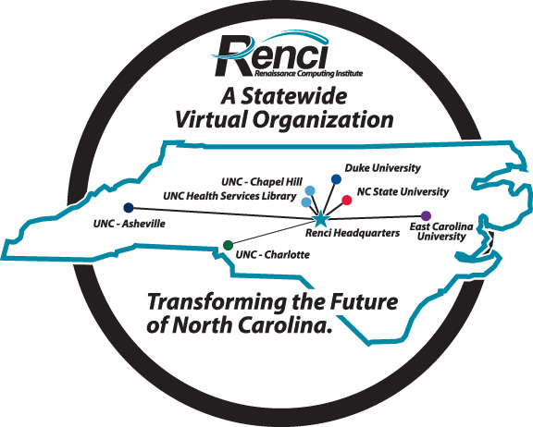
Overview of iRODS Architecture
RENCI Data Grid
Staff
Generate new visualization data
User
Access and display content
iRODS Data System
iRODS Metadata
Catalog
RENCI @ UNC Asheville
RENCI @ UNC Charlotte
RENCI @ Duke University
RENCI @ NC State University
RENCI @ ECU
RENCI @ UNC Chapel Hill
RENCI @ UNC Health Sciences Library
RENCI @ Europa Center

Slide 14

Building a Shared Collection
UNC @ Chapel Hill
NCSU
Duke
DB
Have collaborators at multiple sites, each with
different administration policies, different types
of storage systems, different naming conventions.
Assemble a self-consistent, persistent distributed shared collection

Slide 15
Use Cases
DCAPE: Distributed Custodial Archival Preservation Environments
  Build a distributed production preservation environment that meets the needs of archival repositories for trusted archival preservation services
  Develop preservation policies for state archives, university archives and cultural institutions
  Use iRODS to implement and deliver the resulting services

Slide 16
Overview of iRODS Architecture
Delivery of Preservation Services
Archivist A
Automatic replication service requested
Archivist B
Validation service for a collection
iRODS Data System
iRODS Metadata
Catalog
NC State Archives
NC State Library
Getty Research Inst.
Services can be invoked for automatic replication, generation of audit trails, e-mail notification of activity, ingestion of multiple files, format obsolescence, etc.

Slide 17


DCAPE: Distributed Custodial Preservation Center
Purpose:
Build a distributed production preservation environment that meets the needs of archival repositories for trusted archival preservation services
Distributed partnership of 11 institutions: 33 people
* STATES:
- California
- Kansas
- Michigan
- Kentucky
- North Carolina
- New York
* UNIVERSITIES:
- Tufts University
- West Virginia University
- UNC (SILS/RENCI)
* CULTURAL ENTITIES:
- Getty Research Institute
* INTERNATIONAL PARTNERS:
- Carleton University (Geomatics and Cartographic Research Centre)
Richard Marciano, Professor SILS
Reagan Moore, Professor SILS
Chien-yi Hou, Research Associate SILS
John Gallagher, Dir. of Research Mgt. and Admin RENCI
Kelly Eubank, Electronic Records Archivist
Druscie Simpson, IT Administrator
David Minor, Programmer
Ed Southern, GRB Admin
Jennifer Ricker, Digital Librarian

Slide 18
Use Cases
NARA Transcontinental Persistent Archive Prototype
  Federate 7 independent iRODS data grid: Each data grid manages its own resources and metadata catalog, applies its own policies
  Use iRODS federation mechanism to establish the policies under which data can be shared between the data grids.
  Control operations that a remote user is allowed to do within your data grid

Slide 19
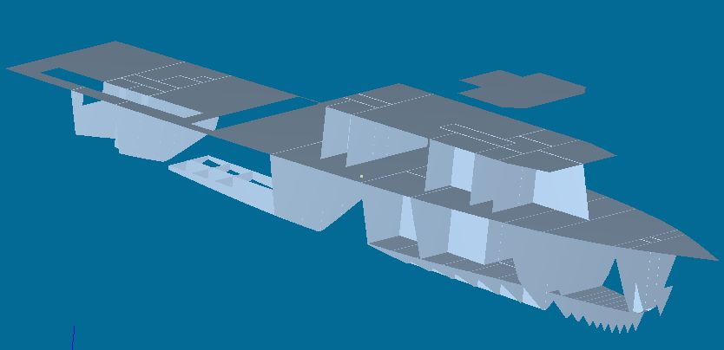
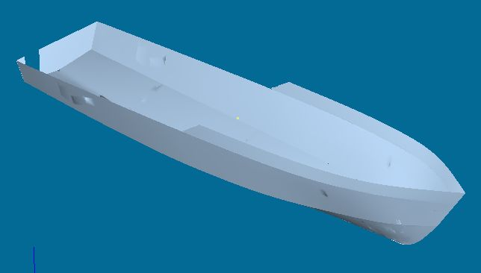
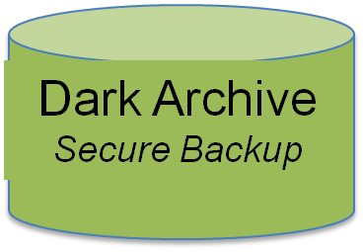
Overview of iRODS Architecture
Preserving Electronic Records with iRODS
Archivists
Use iRODS in
Preservation Workflow
Electronic
Engineering Drawings
iRODS Data System
iRODS Metadata
Catalog
Includes audit trails
Data Archive
Holds Electronic Records Collection
Archivists can use iRODS for preserving Electronic Records, from Appraisal to Access, with Rules enforcing trustworthy repository criteria with audits.

Slide 20
National Archives and Records Administration Transcontinental Persistent Archive Prototype
Federation of Seven Independent Data Grids
NARA I
NARA II
Georgia Tech
Rocket Center
U NC
U Md
UCSD
MCAT
MCAT
MCAT
MCAT
MCAT
MCAT
MCAT
Extensible Environment, can federate with additional research and education sites. Each data grid uses different vendor products.

