Slide 1
Network Services Interface
Working Group status update
Guy Roberts, 17th Mar 2010

Slide 2
OGF IPR Policies Apply
“I acknowledge that participation in this meeting is subject to the OGF Intellectual Property Policy.”
Intellectual Property Notices Note Well: All statements related to the activities of the OGF and addressed to the OGF are subject to all provisions of Appendix B of GFD-C.1, which grants to the OGF and its participants certain licenses and rights in such statements. Such statements include verbal statements in OGF meetings, as well as written and electronic communications made at any time or place, which are addressed to:
the OGF plenary session,
any OGF working group or portion thereof,
the OGF Board of Directors, the GFSG, or any member thereof on behalf of the OGF,
the ADCOM, or any member thereof on behalf of the ADCOM,
any OGF mailing list, including any group list, or any other list functioning under OGF auspices,
the OGF Editor or the document authoring and review process
Statements made outside of a OGF meeting, mailing list or other function, that are clearly not intended to be input to an OGF activity, group or function, are not subject to these provisions.
Excerpt from Appendix B of GFD-C.1: ”Where the OGF knows of rights, or claimed rights, the OGF secretariat shall attempt to obtain from the claimant of such rights, a written assurance that upon approval by the GFSG of the relevant OGF document(s), any party will be able to obtain the right to implement, use and distribute the technology or works when implementing, using or distributing technology based upon the specific specification(s) under openly specified, reasonable, non-discriminatory terms. The working group or research group proposing the use of the technology with respect to which the proprietary rights are claimed may assist the OGF secretariat in this effort. The results of this procedure shall not affect advancement of document, except that the GFSG may defer approval where a delay may facilitate the obtaining of such assurances. The results will, however, be recorded by the OGF Secretariat, and made available. The GFSG may also direct that a summary of the results be included in any GFD published containing the specification.”
OGF Intellectual Property Policies are adapted from the IETF Intellectual Property Policies that support the Internet Standards Process.
Notes:
IPR Notices Note Well for OGF meetings

Slide 3
Planes
Service Plane. The Service Plane is a plane in which services are requested and managed; these services include the Network Service. The Service Plane contains set Network Service Agents communicating using Network Service Interfaces.
Transport Plane. The Transport Plane contains is the set of physical resources that transport user data through the network. The Transport Plane forms the substrate over which Connections are allocated and provisioned.
Control and Management Planes. The Control Plane and/or Management Plane are not defined in this document, but follow common usage.
Network Services are negotiated and managed on the Service plane

Slide 4
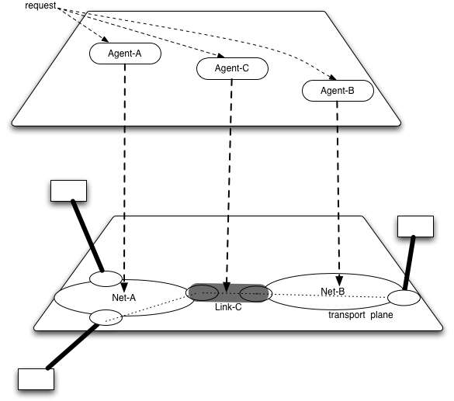
Planes
In a multi-operator environment, the transport resources exist on a single Transport Plane, each transport resource controlled by single Agent
The Agents may be interconnected on the Service Plane via the NSI interface. These agents may exchange requests.
Alternatively a middleware requestor agent may initiate a centralized Connection request.

Slide 5
Inter-Network service
The Service Plane is based on inter-Network resources only
The Network-internal topology is the responsibility of the network provider.
Connection
Point (STP?)
NSI Inter-Domain Abstract Topology
End point

Slide 6
Services
Network Service The Network Service is the service characterized by the set of functionality that is provided in an NSA. A Network Service can have many types, one of which is Connection Service.
Connection Service A Connection Service is a service that allows a Requester NSA to request and manage a Connection from a Provider NSA.
The NSI architecture provides a framework for many service types - the Connection Service is just one of these.

Slide 7
NSI architecture
Network Service Agent (NSA) The Network Service Agent is a concrete piece of software that sends and receives NSI Messages. The NSA includes a set of capabilities that allow Network Services to be delivered. Network Service Interface (NSI). The NSI is the interface between Requester NSAs and Provider NSAs. The NSI defines a set of interactions or transactions between these NSAs to realize a Network Service.
Requesting Agent
(RA)
NSA
An NSA acts in one of two possible roles relative to a particular instance of an NSI. When an NSA requests a service, it is called a Requester NSA. When an NSA realizes a service, it is called a Provider NSA.
Network Service
Interface
NSI Protocol Messages
NSA
Provider Agent
(PA)

Slide 8
Messages
NSI Message. A NSI Message is a structured unit of data sent between a Requester NSA and a Provider NSA.
NSI Message Threads. An NSI Message Thread is a group of messages that belong to both a single service type and a single Connection instance. (under discussion still)
A generic message format is required to support multiple service types

Slide 9
NSI architecture
Network Resource Manager (NRM).
The Network Resource Manager owns a particular set of transport resources and has ultimate responsibility for authorizing and managing the use of these resources. Each NRM has a one-to-one mapping to an NSA.
Requester Agent
NSA
NSI protocol
NSA
Provider Agent
NRM
Network Resource Manager (NRM)

Slide 10
Hierarchical message handling
Connection requests may be split into sub-requests and forwarded to appropriate NSAs
Network Service Agents need not always have an NRM.
Requester NSA does not need to be at end of Connections
Request Processing
Tree
B
NSI protocol
A
C
A
D
E
D
E
Network C
Network B

Slide 11
The connection service
The Connection Service is a service that allows users to request Connections from network providers. (Extensible to services other than connections)
Connection Service supports 2 modes:
Allows Grid middleware to request a Connection from a provider
Allows Connections to be built that transits multiple providers
Connection Service has the following commands:
Reserve
Provision
Release
Query

Slide 12
Connections
Connection A Connection is a conduit that transparently moves user information across a Network from an ingress point to an egress point. A Connection has a set of properties (for instance, capacity, or authorization, or start time).
Connection Identifier A Connection Identifier is a label unique to an NSI interface which can be used to identify a Connection for the purposes of request, instantiation and management.
A connection both exists on the transport plane and is negotiated on the service plane.

Slide 13
Inter-Network topology
Topology . The Topology used on the Service Plane includes only the inter-domain resources. The Topology describes the physical resources and their interconnection as well as the non-physical groupings of various components
Network. A Network includes all of the transport resources that that can be managed by a single NSA.
An additional item that describes the point at which two Networks are interconnected is in the process of being defined. (variously described as a point or STP)

Slide 14
Connection attributes
Each Connection is associated with a set of attributes. These include a Path and a set of performance parameters
Path. A Path is an ordered list of inter-Network Routing Objects.
Routing Object. A Routing Object may include a range of transport resources.
Performance parameters may include Bandwidth, latency, etc

Slide 15
Full Copyright Notice
Copyright (C) Open Grid Forum (2008-2010). All Rights Reserved.
This document and translations of it may be copied and furnished to others, and derivative works that comment on or otherwise explain it or assist in its implementation may be prepared, copied, published and distributed, in whole or in part, without restriction of any kind, provided that the above copyright notice and this paragraph are included on all such copies and derivative works.
The limited permissions granted above are perpetual and will not be revoked by the OGF or its successors or assignees.
Notes:
OGF Full Copyright Notice if necessary

