Slide 1

GLUE WG - Introduction
OGF30, Brussels – 28 Oct 2010
Sergio Andreozzi (EGI.eu)
Balazs Konya (Lund University)
Laurence Field (CERN)

Slide 2

OGF IPR Policies Apply
“I acknowledge that participation in this meeting is subject to the OGF Intellectual Property Policy.”
Intellectual Property Notices Note Well: All statements related to the activities of the OGF and addressed to the OGF are subject to all provisions of Appendix B of GFD-C.1, which grants to the OGF and its participants certain licenses and rights in such statements. Such statements include verbal statements in OGF meetings, as well as written and electronic communications made at any time or place, which are addressed to:
    the OGF plenary session,
    any OGF working group or portion thereof,
    the OGF Board of Directors, the GFSG, or any member thereof on behalf of the OGF,
    the ADCOM, or any member thereof on behalf of the ADCOM,
    any OGF mailing list, including any group list, or any other list functioning under OGF auspices,
    the OGF Editor or the document authoring and review process
Statements made outside of a OGF meeting, mailing list or other function, that are clearly not intended to be input to an OGF activity, group or function, are not subject to these provisions.
Excerpt from Appendix B of GFD-C.1: ”Where the OGF knows of rights, or claimed rights, the OGF secretariat shall attempt to obtain from the claimant of such rights, a written assurance that upon approval by the GFSG of the relevant OGF document(s), any party will be able to obtain the right to implement, use and distribute the technology or works when implementing, using or distributing technology based upon the specific specification(s) under openly specified, reasonable, non-discriminatory terms. The working group or research group proposing the use of the technology with respect to which the proprietary rights are claimed may assist the OGF secretariat in this effort. The results of this procedure shall not affect advancement of document, except that the GFSG may defer approval where a delay may facilitate the obtaining of such assurances. The results will, however, be recorded by the OGF Secretariat, and made available. The GFSG may also direct that a summary of the results be included in any GFD published containing the specification.”
OGF Intellectual Property Policies are adapted from the IETF Intellectual Property Policies that support the Internet Standards Process.
Notes:
IPR Notices Note Well for OGF meetings

Slide 3
Agenda
Introduction
Status of renderings
  XML Schema
  SQL
  LDAP (Laurence Field)
Deployment
  WLCG/gLite (Laurence Field)
  TeraGrid (JP Navarro)
AOB

Slide 4
Goal of GLUE WG
Define an information model
Conceptual model
Mapping to concrete data models
To enable:
Resource awareness
Resource discoverability
Resource requirements expression
Resource basic monitoring
Across different Grid infrastructures

Slide 5
GLUE 2.0 – conceptual model
Finalized in March 2009
  http://www.ogf.org/documents/GFD.147.pdf
After
  ~ 1.000 e-mails in the GLUE list
  ~ 100 hours of calls in
  ~ 60 telecons with avg 5 participants
  ~ 50 draft versions
  ~ 16 sessions in 7 OGF events
  ~ 100 issues during/after public comments

Slide 6
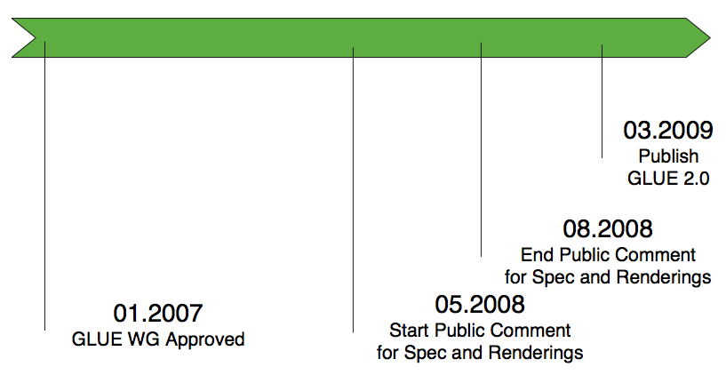
Timeline to GLUE 2.0 Conceptual Model

Slide 7
Projects who contribute/have contributed to GLUE 2.0
OMII-Europe
EGEE
KnowARC
TeraGrid
UNICORE
DEISA
D-Grid
AustralianGrid
NAREGI
NGS
OSG
BREIN
OGF-Europe
EMI
IGE

Slide 8
Renderings
Mapping to concrete data models
  Needed to actually create/manage/consume GLUE-based information in Grid services
Driven by community requirements
So far: XSD, LDAP, SQL
  draft available since GLUE 2.0 public comment

Slide 9
Who is Implementing GLUE 2.0
gLite: LDAP
UNICORE, ARC, TeraGrid: XSD
D-Grid: SQL
…
If you are adopting GLUE 2.0,
we want to listen to your story

Slide 10
Creating a rendering
What does it means:
  How to map global ID?
  How to map local ID?
  How to map a class/attribute?
  How to reprensent 1-to-* relationships?
  How to represent *-to-* relationships?
  How to map for efficient query?
  How to handle extensibility?
  …
Design choices depending on the data model; not a single solution

Slide 11
LDAP Rendering
OGF Draft: http://forge.ogf.org/sf/go/doc15518
Status: implementation mature, need final check to doc
Team (active in this period):
  Laurence Field, David Horat (CERN)
  Stephen Burke (STFC)
More details in L. Field presentation
  Other docs: CHEP presentation: Migration to the GLUE 2.0 Information Schema in the LCG/EGEE/EGI Production Grid (http://bit.ly/bW7dpV)

Slide 12
XSD Rendering
OGF XSD:http://forge.ogf.org/sf/go/doc15514
  Computing part aligned to GLUE 2.0 final
    http://forge.ogf.org/sf/go/doc15932
  Storage part needs work
Team (active in this period):
  S. Andreozzi (EGI.eu)
  Adrian Taga, Balazs Konya (ARC)
  Shiraz Menon (UNICORE)
  JP Navarro (TeraGrid)

Slide 13
SQL Schema Rendering
  SQL: http://forge.ogf.org/sf/go/doc15516
    Need to be aligned to final version
  Team (active in this period):
    Ilya Saverchenko, Emmanouil Paisios, Jarno Laitinen (LRZ.de)
  New version planned for beginning of Nov

Slide 14
Renderings
Going public comment by the end of the year for XSD, SQL, LDAP
Approved specs available by OGF31

Slide 15
Full Copyright Notice
Copyright (C) Open Grid Forum (2010). All Rights Reserved.
This document and translations of it may be copied and furnished to others, and derivative works that comment on or otherwise explain it or assist in its implementation may be prepared, copied, published and distributed, in whole or in part, without restriction of any kind, provided that the above copyright notice and this paragraph are included on all such copies and derivative works.
The limited permissions granted above are perpetual and will not be revoked by the OGF or its successors or assignees.
Notes:
OGF Full Copyright Notice if necessary

