Slide 1
TeraGrid’s GLUE 2 Implementation
JP Navarro, U. of Chicago/ANL
TeraGrid Grid Infrastructure Group
OGF 30
October 28, 2010
Notes:
NSF TeraGrid Review
January 10, 2006
Charlie Catlett (cec@uchicago.edu)

Slide 2
Overview
Initial Goals
  Provide information for meta-scheduling resource selection
  Provide information to the queue prediction services
  Provide information to the User Portal
Current Status
  Production on 11 of 16 TeraGrid HPC compute resources
Approach
  Implemented only the subset of GLUE2 TeraGrid needs
  Automatically gathered local resource manager information
  Integrate into TeraGrid’s Integrated Information Services “IIS”
October 28, 2010
OGF 30 - GLUE 2 Update

Slide 3
Solution Architecture
TeraGrid Local
Information Services
TeraGrid Wide
Information Services
Information Consumers
TeraGrid Meta-Scheduler
(Condor MatchMaker)
TeraGrid Batch Queue Predictor
(Karnak)
TeraGrid User Portal
Local Resource Manager/
Scheduler
…
October 28, 2010
OGF 30 - GLUE 2 Update
Notes:
NSF TeraGrid Review
January 10, 2006
Charlie Catlett (cec@uchicago.edu)
This is both a high-availability and high-throughput design
Dynamic DNS provides a 15 minute ttl in failover situations
Automated difference detection, manual synchronization

Slide 4
Schema
TeraGrid has its own XML Schema based on GLUE 2.0
  http://software.teragrid.org/pacman/ctss4/glue2/teragrid_glue_2.0_r01.xsd
This schema is flat
  Base element is Entities, parent to all other entities
  Entities are associated using IDs
Why a flat schema?
  Easier to compose and generate information
  Segregated public and private publishing (other segregation)
  Allow partial implementation/publishing w/o empty upper hierarchy
    <AdminDomain>… … …<ComputingActivity>
  Enables complex relationships / avoid arbitrary hierarchy
    <ComputingService><StorageService>
    <ExecutionEnvironment> -> <ComputingShare> or <Resource>
  Avoids content duplication
October 28, 2010
OGF 30 - GLUE 2 Update

Slide 5
XML Rendering
Private Entities
  <ComputingActivity>
    References <ComputingShare>
Public Entities
  <ComputingService>
    References <ComputingEndpoint>, <ComputingShare>, <ComputingManager>
  <ComputingEndpoint>
    References <ComputingService>
  <ComputingShare>
    References <ComputingService>
  <ComputingManager>
    References <ComputingService>, <ExecutionEnvironment>
  <ExecutionEnvironment>
    References <ComputingManager>
Complete repository view:
  http://info.teragrid.org/web-apps/xml/reg-cat-v1/name/GLUE2Info/
October 28, 2010
OGF 30 - GLUE 2 Update

Slide 6
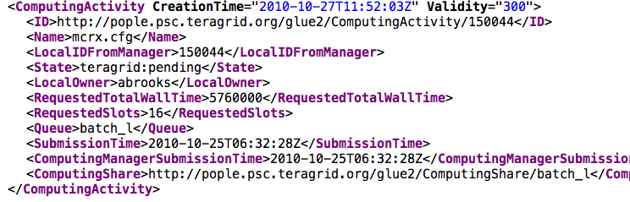
<ComputingActivity>
October 28, 2010
OGF 30 - GLUE 2 Update

Slide 7
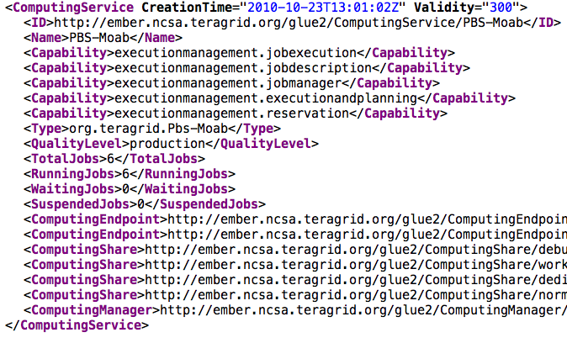
<ComputingService>
October 28, 2010
OGF 30 - GLUE 2 Update

Slide 8
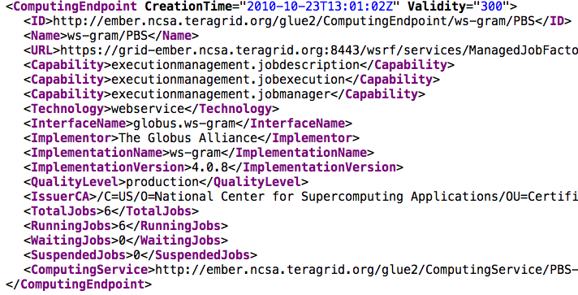
<ComputingEndpoint>
October 28, 2010
OGF 30 - GLUE 2 Update

Slide 9
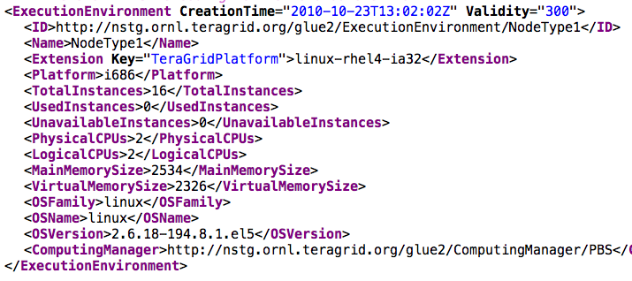
<ExecutionEnvironment>
October 28, 2010
OGF 30 - GLUE 2 Update

Slide 10
More Information
TeraGrid GLUE 2 Design and Coordination
  Warren Smith wsmith@tacc.utexas.edu
TeraGrid Information Services Coordination
  JP Navarro navarro@mcs.anl.gov
Public GLUE 2 Implementation
  http://software.teragrid.org/pacman/ctss4/glue2
TeraGrid Information Service
  http://info.teragrid.org/
October 28, 2010
OGF 30 - GLUE 2 Update

