Slide 1
Integrated Information Services
“IIS”
JP Navarro, U. of Chicago/ANL
OGF 30
October 28, 2010
Notes:
NSF TeraGrid Review
January 10, 2006
Charlie Catlett (cec@uchicago.edu)

Slide 2
Background
Several content standards exist
  OGF: GLUE 1.x, GLUE 2.0
    Grid Compute & Storage focus
  Common Information Model “CIM”
    Infrastructure management focus
  Universal Description Discovery and Integration “UDDI”
    Very large and heavy weight
  Others
Several implementations exist
  MDS2/LDAP
  MDS4: no longer supported
  CIM implementations
  UDDI implementations
October 29, 2010
OGF 30 - IIS Update

Slide 3
Motivation for IIS
Distributed cyber-infrastructures need information services
NSF TeraGrid->XD, NIH BIRN, NIH caBIG, Globus.org Services need a replacements for MDS4 information services
Research cyber-infrastructures don’t have a strategic solution
Internet technology has progressed but our implementations haven’t
October 29, 2010
OGF 30 - IIS Update

Slide 4
IIS Project Strategies
Tooling
  Integrate a set of established open source tools
  Leverage/adopt useful standards (W3C HTTP, XML; ECMA-262 JSON; OGF GLUE2)
Content format
  Leverage XML as the de-facto standard for information representation and exchange
  Native XML exchange and repository
  Support other viewing formats (JSON, CSV, etc.)
Schemas
  Support GLUE2
  Support arbitrary other schemas and registries
Interfaces
  Leverage REST as a simple and dominant distributed architectural style
  Support SOAP and other interfaces as required
Simple, modular, and extensible
  Internal design that makes it easy to integrate new tools
  Internal design that makes it easy to add new registries
October 29, 2010
OGF 30 - IIS Update

Slide 5
Activities thru Summer 2010
Developed a prototype registry service for NIH BIRN (2009)
  TeraGrid’s REST discovery APIs
  Apache CXF JAX-RS registration service with MyProxy authentication
Submitted a SDCI funding proposal to the NSF (Spring 2010)
  Partnership between Globus, caBIG, OSG Indiana University NOC
  Not funded
Tool evaluation (Summer 2010)
  Evaluated eXist XML repository (http://exist.sourceforge.net/)
  Evaluated Calabash XProc implementation (http://xmlcalabash.com/)
  XProc is under development as a W3C specification
  Evaluated xmlsh XML based scripting tool
  (http://www.xmlsh.org/HomePage)
  Evaluated Apache CXF JAX-RS server platform
  Evaluated RabbitMQ AMQP messaging implementation (http://www.rabbitmq.com/)
  AMQP is an open standard for messaging middleware (http://www.amqp.org/)
  We have identified other tools that we’d like to evaluate and integrate in the future
October 29, 2010
OGF 30 - IIS Update

Slide 6
Activities Fall 2010
Project startup
  New development and testing servers
  New SVN, Confluence, JIRA, and web home
Implement HelloWorld sample registries, share with everyone
  Apache CXF JAX-RS, XMLSH, eXist
  Apache CXF JAX-RS, XMLSH+XProc, eXist
  Apache CXF JAX-RS, eXist
Implement TeraGrid Capability Kit Registry
May demonstrate Globus.org Data Movement service Endpoint discovery
Collecting requirements from as many projects as possible
October 29, 2010
OGF 30 - IIS Update

Slide 7




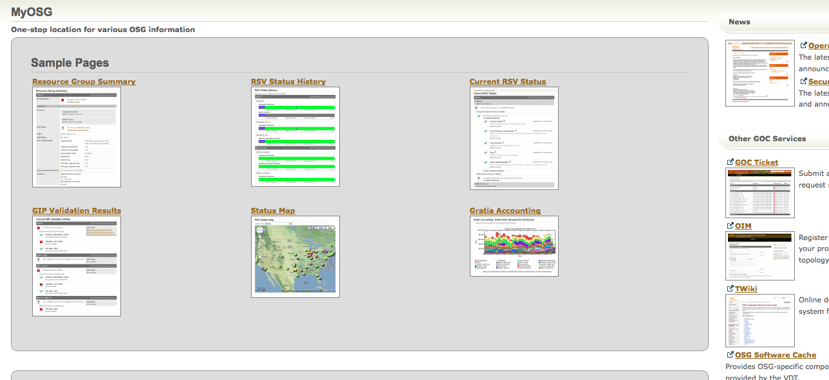
High-Level Design
Community-Tailored UI
Community Developed
UI
Meta-Schedulers,
Science Gateways,
Monitoring Systems (e.g. Inca),
Other software
IIS UI
Other IIS
Integrated Information Service API
ESB / Message Queue
Web App Server
Library
XML
DB
request/response
pub/sub
XML
Content
October 29, 2010
OGF 30 - IIS Update

Slide 8
Rough Functional Roadmap
Interaction Model
  Push, Pull, (Publish), Subscribe
Tooling
  Apache CXF JAX-RS, Apache CXF JAX-WS
Multi-registry support
  (Aggregation), Mirroring, High-availability/fault-tolerance
Interface richness
  Interface maps 1-1 to registry, complex interfaces
Content lifetime
  Soft-state, lifetime support
Security
  Public discovery
  Publish and discovery HTTPS Basic authentication (traditional, MyProxy, OpenID, …)
  Authorization
October 29, 2010
OGF 30 - IIS Update

