Slide 1

Network Services Interface
Abstracted vs Technology-Specific Attributes

Slide 2

OGF IPR Policies Apply
“I acknowledge that participation in this meeting is subject to the OGF Intellectual Property Policy.”
Intellectual Property Notices Note Well: All statements related to the activities of the OGF and addressed to the OGF are subject to all provisions of Appendix B of GFD-C.1, which grants to the OGF and its participants certain licenses and rights in such statements. Such statements include verbal statements in OGF meetings, as well as written and electronic communications made at any time or place, which are addressed to:
    the OGF plenary session,
    any OGF working group or portion thereof,
    the OGF Board of Directors, the GFSG, or any member thereof on behalf of the OGF,
    the ADCOM, or any member thereof on behalf of the ADCOM,
    any OGF mailing list, including any group list, or any other list functioning under OGF auspices,
    the OGF Editor or the document authoring and review process
Statements made outside of a OGF meeting, mailing list or other function, that are clearly not intended to be input to an OGF activity, group or function, are not subject to these provisions.
Excerpt from Appendix B of GFD-C.1: ”Where the OGF knows of rights, or claimed rights, the OGF secretariat shall attempt to obtain from the claimant of such rights, a written assurance that upon approval by the GFSG of the relevant OGF document(s), any party will be able to obtain the right to implement, use and distribute the technology or works when implementing, using or distributing technology based upon the specific specification(s) under openly specified, reasonable, non-discriminatory terms. The working group or research group proposing the use of the technology with respect to which the proprietary rights are claimed may assist the OGF secretariat in this effort. The results of this procedure shall not affect advancement of document, except that the GFSG may defer approval where a delay may facilitate the obtaining of such assurances. The results will, however, be recorded by the OGF Secretariat, and made available. The GFSG may also direct that a summary of the results be included in any GFD published containing the specification.”
OGF Intellectual Property Policies are adapted from the IETF Intellectual Property Policies that support the Internet Standards Process.
Notes:
IPR Notices Note Well for OGF meetings

Slide 3
The problem
An NSI service request should provide sufficient information to the network service agent for it to be able to build a circuit that meets the service requirements of the user.
How much technical detail is really needed to do this? Is it sufficient to simply nominate edge points and a bandwidth? Or do technology-specific parameters need to be specified?

Slide 4
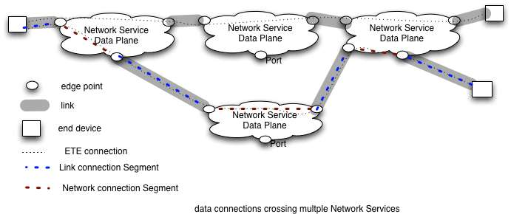
The target service
The successful ete connection will connect the end devices in a connection oriented way with a performance that meets the user needs in terms of:
  Throughput: bandwidth, packet loss ratio
  Timing characteristics: reordering, latency, jitter
  The transparency to client protocols

Slide 5
Principle of domain autonomy
It is expected that domain-internal decisions such as internal routing and technology use remain the decision of the domain
The NSI will only provide details to the domain of the edge-points and expected service level

Slide 6
Circuit attributes - throughput
Full characterization of throughput requires information on:
  Minimum bandwidth (b/s)
  Maximum packet loss rate
An awareness of technology may also be necessary, some examples:
  Ethernet: 10GE LAN phy vs. WAN phy
  SDH: payload rate vs. payload + overhead

Slide 7
Circuit attributes - timing
To fully characterise timing performance requires information on:
  Maximum latency (ms)
  Maximum jitter (s)

Slide 8
Protocol transparency
Protocol transparency is an important concept, it determines which protocols are blocked and which are dropped.
For example if an Ethernet service is requested does this mean that spanning tree frames and pause-frames should also be forwarded?

Slide 9
Ethernet
Ethernet becoming a ubiquitous as an interface type
Used many technologies:
  WDM/OTH
  SDH/SONET
  MPLS/Pseudowire
But Ethernet can mean different things to different people

Slide 10
Connection parameters
Proposed set of parameters for connection request
Globally unique connection name
Connection end-point addresses
Optional list of domain edge addresses
Optional Path start/end time
Technology abstracted performance characteristics, eg bandwidth, latency
Technology specific extensions for connection transparency

Slide 11
Category | Parameter | Type | Mandatory?
Id | Globally unique connection id | String | Yes
Addresses | A-end address | NML URN | Yes
 | Z-end address | NML URN | Yes
 | Set of N optional transit addresses | NML URN | No
Reservation | Start time | Time (default start asap) | No
 | End time | Time (default no end time) | No
Abstracted Performance parameters | Min. bandwidth | Integer: bps | Yes
 | Directionality | Enumerated: Uni/bi (default bi) | No
 | Redundancy | Boolean (default false) | No
 | Max. packet loss rate | Real: 0..1 | No
 | MTU size | Integer, 1..9600 | No
 | Max. Latency | Integer, milliseconds | No
Service type | Service technology | Enumerated: IEEE_802.3; IEEE_802.3q, IEEE_802.3ad MEF6_EPL, MEF6_EVPL, SDH/SONET | No
Technology extensions: Transparency | Ethernet service tag transparency | Enumerated: Vlan, MAC | No
 | SDH service transparency | Enumerated: MS section, VC-4, VC-4-Nc, | No

Slide 12
Full Copyright Notice
Copyright (C) Open Grid Forum (2008-2009). All Rights Reserved.
This document and translations of it may be copied and furnished to others, and derivative works that comment on or otherwise explain it or assist in its implementation may be prepared, copied, published and distributed, in whole or in part, without restriction of any kind, provided that the above copyright notice and this paragraph are included on all such copies and derivative works.
The limited permissions granted above are perpetual and will not be revoked by the OGF or its successors or assignees.
Notes:
OGF Full Copyright Notice if necessary

