Slide 1

Network Services Interface
Resource Selection
Chin Guok (ESnet)
Tomohiro Kudoh (Univ of Tokyo) John MacAuley (ESnet)
25th May 2015

Slide 2
About
In the current NSI Tree workflow, if segment requests to children NSAs are done in parallel, the selection of VLANs between the domains may result in contention with already used VLANs. To help alleviate this issue, we propose 3 solutions. These solutions may not be optimal, however they will use the existing CS protocol framework, and only require minute changes.

Slide 3

Issue
An AG may not know of VLANs already used by domains when it does its path computation
There is no good mechanism to help resolve VLAN conflicts or provide information to assist in a future selection of unused VLANs
uRA
AG
Segmented Requests
- Src A:VL400, Dst B:VL500*
- Src C:VL500*, Dst F:VL404
Request
- Src A:VL400, Dst F:VL404
AG
AG
Segmented Requests
- Src C:VL500*, Dst D:VL450
- Src E:VL450, Dst F:VL404
Segmented Request
- Src A:VL400, Dst C:VL500*
uPA
uPA
uPA
Source STP
Destination STP
A
B
C
D
E
F
Host
* VL500 already in use between B and C
Host

Slide 4
Proposed Solutions
The proposed solutions below are completely independent of each other and can be deployed in parallel
Resource availability information returned in reservation failed message
Resource negotiation in reservation phase
Resource availability query

Slide 5
Resource Availability in Reservation Failed Message
Resource availability is in context of reservation requests (e.g. available bandwidth, VLANs for the requested STP, for the start/end time of the request)
Resource availability is considered as a “hint” because no resources are held, and an immediate subsequent unrelated reservation request may reserve those resources (i.e. the longer the requester waits to act on the resource availability information, the less accurate it will be)
PA can limit amount of resource availability information is returned as it sees fit
Considerations to implement this solution:
  Description of available resources using existing schema
  Formalize field in reservation failed message
  Passing this information up the tree to the relevant requester (i.e. AGs are only interested in resource availability information for the segment SDPs that it requests)

Slide 6
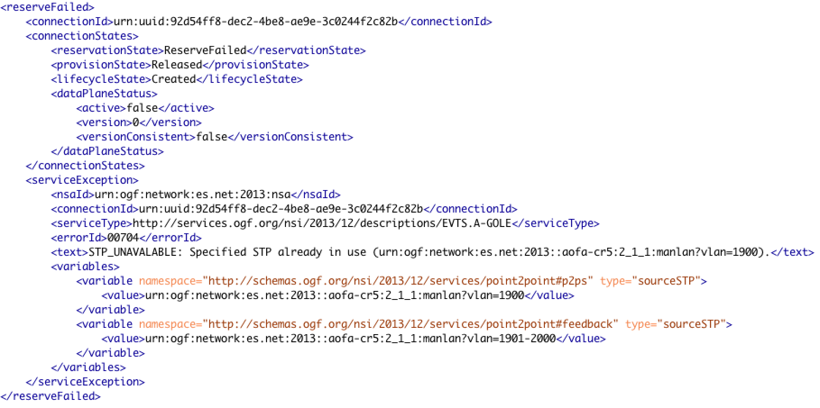
Feedback Option #1

Slide 7
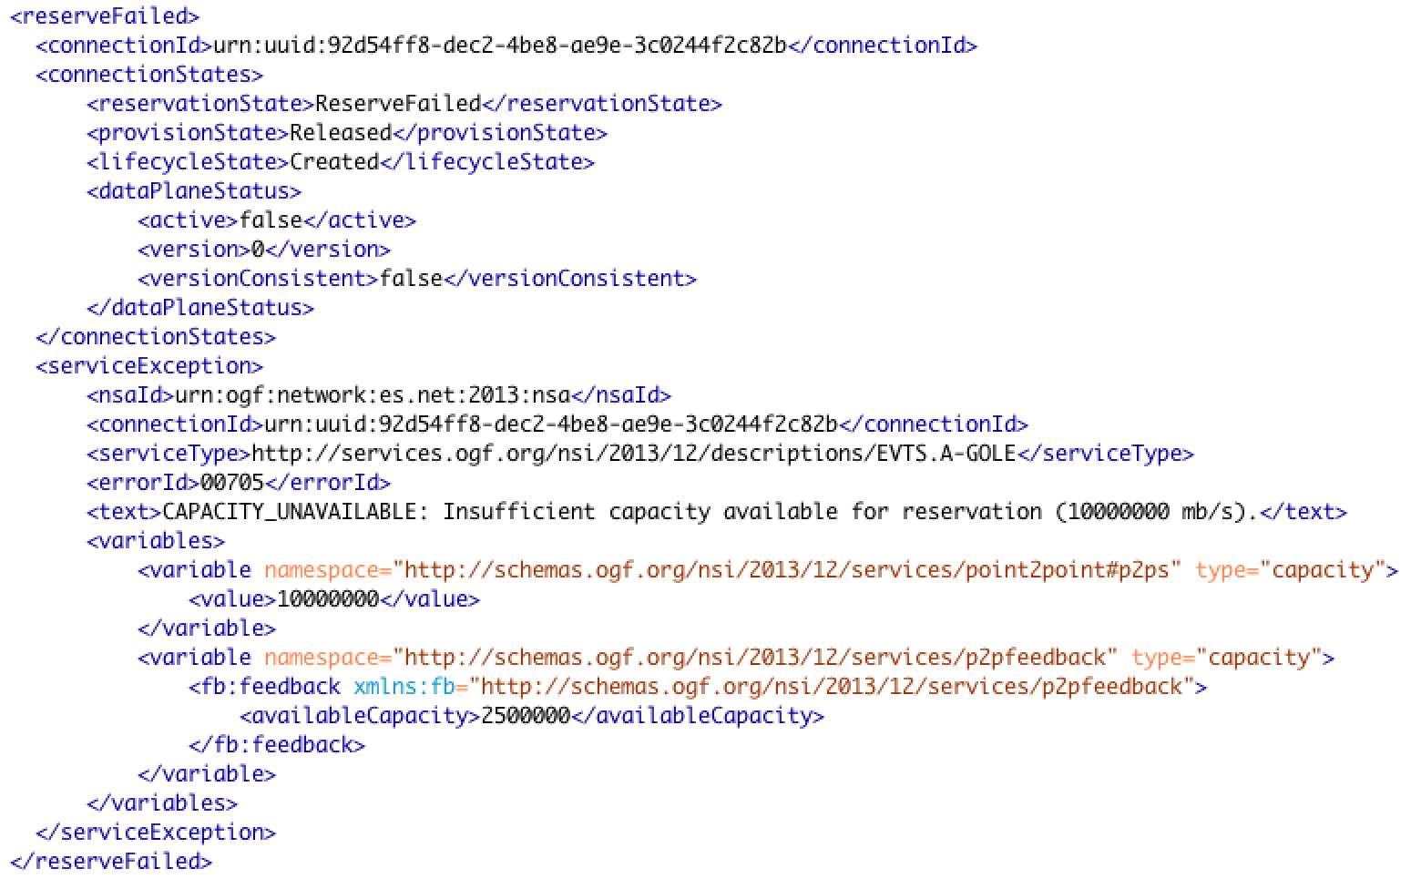
Feedback Option #2

Slide 8
Resource Negotiation in Reservation
Phase
Negotiate resources as part of the 2-phase commit, implying that resources are held during the reservation phase
PA can determine how much resources it is comfortable on holding as per the reservation requests (i.e. local policy enforcement)
Considerations to implement this solution:
  Modify reserve commit message to include instance of selected resource to reserve
Current Reservation Workflow
/* AG request STP B with VLAN range 400-500 */
reserveRequest(A:VL400, B:VL400-500, …)
/* uPA confirms STP B with VLAN 404 */
reserveConfirm(A:VL400, B:VL404, …)
/* AG commits uPA’s selection of B:VL404 */
reserveCommitRequest(…)
Proposed Reservation Workflow
/* AG request STP B with VLAN range 400-500 */
reserveRequest(A:VL400, B:VL400-500, …)
/* uPA confirms STP B with VLAN range 400-420 */
reserveConfirm(A:VL400, B:VL400-420, …)
/* AG commits VLAN 404 in uPA’s suggested range */
reserveCommitRequest(A:VL400, B:VL404, …)
AG
1
AG
1
1
2
2
1
2
2
3
3
uPA
3
uPA
3
A
B
A
B

Slide 9
Resource Query
Flexibility and scope of query is to be defined
May leverage existing reserve message to scope request intent
Query reply may be constrained to single or multiple dimensions (e.g. bandwidth, STP labels, etc)
Information is considered a “hint” because no resources are held
Considerations
  Definition of new messages
  How information should be passed/aggregated up a tree (e.g. select lowest common denominator for available bandwidth, etc)
  Flexibility of query message can substantially increase complexity

Slide 10
The Good, Bad, and the Ugly
Proposed Solution | Pros | Cons
Resource availability in reservation failed message | Does not change existing workflow No commitments or holding of resources PA can scope information it returns based on local policy and context | Information is temporal and accuracy diminishes in time Heavy-weight process to determine availability, esp. for a complex and densely reserved end-to-end path
Resource negotiation in reservation phase | Negotiation is done “inline” and selected resource is ensured when reserveCommit is sent PA can hold resources based on local policy and context | Minor change in existing workflow “Potential” resources are held for the duration of the reserveConfirm/reserveCommit phase
Resource query | Does not change existing workflow Lighter weight process to determine resource availability Can cater to more complex resource queries “Read-only” function implying support for concurrent queries | Need to define the resource query messages (can leverage existing reserve request) Information is temporal and accuracy diminishes in time

