Slide 1

Network Services Interface
NSA Description Document
John MacAuley, ESnet
22nd September 2014

Slide 2
Introduction
  The NSA Description Document provides syntax for describing metadata associated with Network Service Agents (NSA)
    Making the NSI protocol and its agents more self-descriptive, new features, protocols, or protocol versions can be added to agents within the network and then be discovered by peer agents through these meta-data documents.
  Contains information to drive peer NSA interface version discovery, feature discovery, control plane connectivity discovery, and managed network discovery
    Information conveyed in this document allows an NSA to perform basic protocol bootstrapping with minimal configuration by exposing an NSA’s identity, enabling version negotiation, and communicating protocol capabilities supported by that NSA.
  Currently implemented and running in a number of NSAs.

Slide 3
The <nsa> element
The <nsa> element is the parent element for the NSA Description Document.
An instance of this document must contain a single <nsa> element documenting the meta-data associated with the NSA.

Slide 4
NSA attributes
Parameter | M/O | Description
id | M | The globally unique NSA identifier for this resource.
version | M | The version of document based on date and time the entry was created at the source NSA.
expires | O | The date this version of the document expires and after which should no longer be considered valid.
anyAttribute | O | Permit inclusion of attributes from other namespaces for flexible extension without needing to update this schema definition.

Slide 5
NSA elements (1)
Parameter | M/O | Description
name | O | A descriptive name for this NSA. This value is typically used for display purposes.
softwareVersion | O | A descriptive string describing the NSA software type and version.
startTime | O | The time at which this NSA last started to provide uninterrupted service.
adminContact | O | A list of zero or more administrative contacts associated with this NSA.
location | O | The physical location of the logical NSA entity.
networkId | O | A list of zero or more network identifiers for which this NSA is providing the listed service interfaces and features.
interface | O | A list of zero or more NSI interfaces supported by the NSA.

Slide 6
NSA elements (2)
Parameter | M/O | Description
feature | O | A list of zero or more features supported by the NSA.
peersWith | O | A list of zero or more NSA identifiers enumerating peer NSA that have had a trusted control plane relationship provisioned with this NSA.
any element | O | Provides a flexible mechanism allowing additional elements to be provided from other namespaces without needing to update this schema definition.

Slide 7
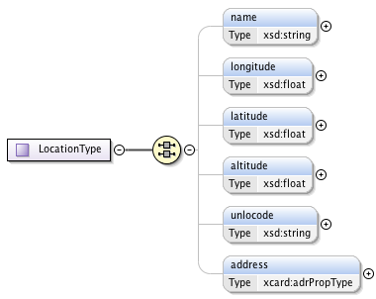
Location
Parameter | M/O | Description
name | O | A human readable string naming this location.
longitude | O | The longitude of the NSA in WGS84 coordinate system (in decimal degrees).
latitude | O | The latitude of the NSA in WGS84 coordinate system (in decimal degrees).
altitude | O | The altitude of the NSA in WGS84 coordinate system (in decimal meters).
unlocode | O | The UN/LOCODE location identifier for the NSA location.
address | O | The address of the NSA location specified in vCard address format.
The LocationType definition models the location elements of an NSA. A <location> is a reference to a geographical location or area for the NSA.

Slide 8
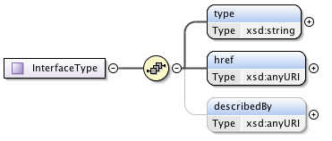
Interface
Parameter | M/O | Description
type | M | The unique string identifying the type and version of the NSA interface. Application Internet media types (Content-types) are used to identify the NSI interface, version, and supported encoding type.
href | M | Contains the protocol endpoint for the interface identified in this interface reference.
describedBy | O | This attribute contains a reference to the WSDL or WADL file corresponding to this interface's version (if available).
The InterfaceType definition models an NSA protocol interface. This type encapsulates the meta-data needed to determine the version, location, and schema associated with a specific NSA interface.

Slide 9
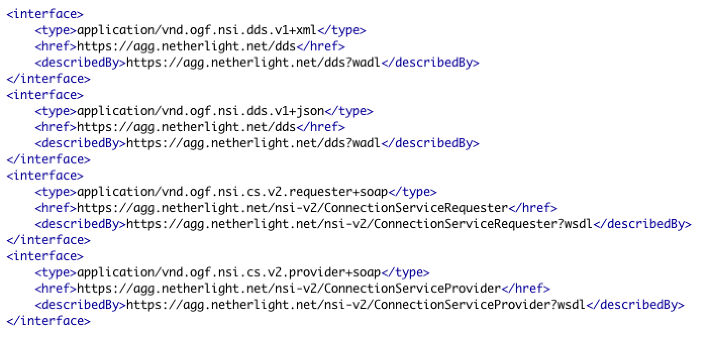
Interface example

Slide 10
Versioning
Version | Type | MIME Media Type
NSI CS version 1.0 | Provider | “application/vnd.ogf.nsi.cs.v1.provider+soap”
NSI CS version 1.0 | Requester | “application/vnd.ogf.nsi.cs.v1.requester+soap”
NSI CS version 1.1 | Provider | “application/vnd.ogf.nsi.cs.v1-1.provider+soap”
NSI CS version 1.1 | Requester | “application/vnd.ogf.nsi.cs.v1-1.requester+soap”
NSI CS version 2.0 | Provider | “application/vnd.ogf.nsi.cs.v2.provider+soap”
NSI CS version 2.0 | Requester | “application/vnd.ogf.nsi.cs.v2.requester+soap”
NSI Topology version 1.0 | Provider | “application/vnd.ogf.nsi.topology.v1+xml”
NSI Topology version 2.0 | Document | “application/vnd.ogf.nsi.topology.v2+xml”
NSA Description Document version 1.0 | Document | “application/vnd.ogf.nsi.nsa.v1+xml”
NSI Document Distribution Service version 1.0 | Requester/Provider | “application/vnd.ogf.nsi.dds.v1+xml”

Slide 11
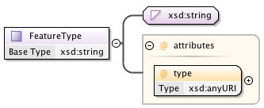
Feature
Parameter | M/O | Description
type | M | Identifies the type of feature modeled by the supplied value.
string | O | An optional value associated with the feature type.
The FeatureType definition is a simple type value pair used to model an NSA feature within the network. An NSA feature is a piece of metadata attached to the NSA Description Document that describes a specific capability offered by that NSA, or configuration value on that NSA, that is not specifically defined by an element in the NSA Description Document schema, but still needs to be communicated to requester agents within the network.
<feature type="org.ogf.nsi.cs.v2.commitTimeout">120</feature>

Slide 12
Formal feature definitions
We formally define three values to model an NSA's CS "role" within the network as shown below:
<feature type="org.ogf.nsi.cs.v2.role.aggregator"/>
<feature type="org.ogf.nsi.cs.v2.role.uPA"/>
<feature type="org.ogf.nsi.cs.v2.role.uRA"/>

Slide 13
In my mind
uRA
peersWith
peersWith
AG 1
AG 3
peersWith
uPA E
peersWith
peersWith
peersWith
peersWith
peersWith
AG 2
AG 3
AG 5
peersWith
peersWith
peersWith
peersWith
uPA A
uPA B
uPA C
uPA D
uPA <peersWith> not used in building directed control plane graph.

