Slide 1
EMS
ACS
Application
Archive
Application Repository
Candidate Set Generator (Work -Resource mapping)
Provisioning Deployment Configuration
Information Services
Execution Planning Services
Reservation
Service
Container
Job Manager
Accounting Services

Slide 2
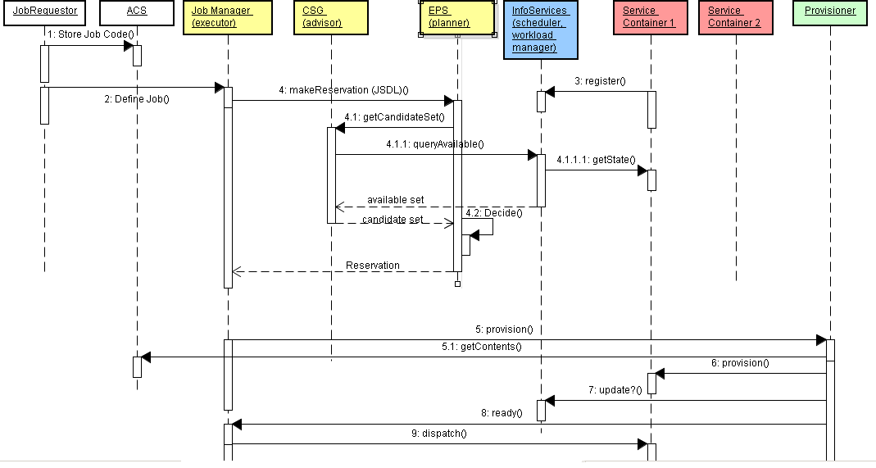
Use Case

Slide 3
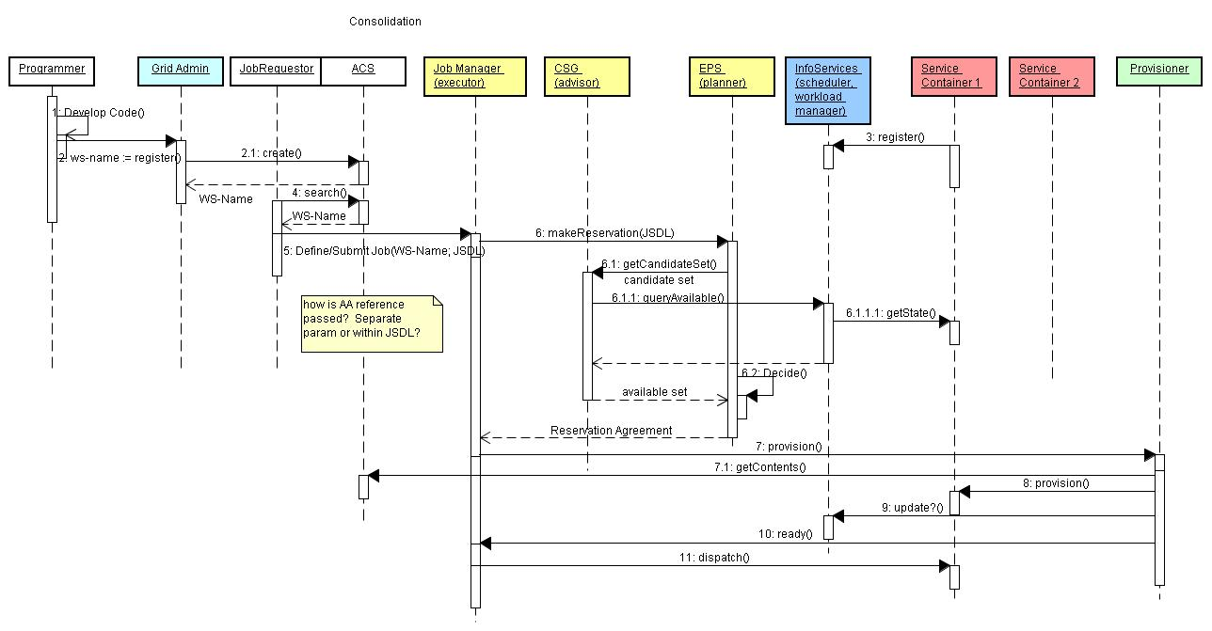
Revised diagram by Mike (Sept. 7)

