Slide 1
OGSA-Authz WG
OGF 21
Seattle Washington

Slide 2
Agenda
Note Well
Appoint note taker
Agenda Bashing
Progress of Existing Specs
  XACML Profile
  WS Trust Profile
New Specifications
  SAML Attribute Retrieval Profile
  SAML VO Attribute Profile
Project Progress Reports
  VOMS-PERMIS integration
  SAML Authz Service
  Grid-Shib Project
  Shintau
Future of the WG

Slide 3
Progress of Existing Specs
XACML profile
  Have added further text for obligations to the XACML profile to say how gridmap files can be replaced with obligations, and how coordination decision making can be enabled with obligations
WS-Trust profile
  No changes to this
Have updated the models and diagrams to make them more generic. Protocol flows are still the same, but more possibilities are allowed (see next 2 slides)

Slide 4
Access
Requestor
PEP
Push credentials
User Authn
Context Handler
Authentic
Name/ID
+ Credentials
[+meta info]
Authz request with Valid
Attributes
Get
credentials
Valid
Attributes
Authz
Decision
STS-I
CVS
PDP
Optional Pull
more credentials
or attribute assertions
Fig 1 PEP Context Handler – Push Credentials
AA
Access
Requestor
Push credentials
PEP
User Authn
Authentic Name/ID +
Credentials [+meta info]
Authz
Decision
Get
credentials
CVS
Context
Handler
Valid
Attributes
STS-I
Optional Pull
more credentials
or attribute assertions
AA
PDP
Fig 2 PDP Context Handler – Push Credentials
Notes:
Examples. Fig 1. PERMIS in Push Mode
Fig 2.GGF OGSA Authz Protocol

Slide 5
Access
Requestor
Unique Name/ID
PEP
User Authn
Context Handler
Valid
Attributes
Authz request with Valid
Attributes
Authz
Decision
Authentic name/ID [+meta info]
CVS
Pull
Credentials
or attribute
assertions
PDP
Fig 3 PEP Context Handler – Pull Credentials
AA
Access
Requestor
Name
PEP
User Authn
Authentic Name/ ID [+meta info]
Authz
Decision
Meta info may
contain URL,
VO name,
context info etc.
Authentic name/ID is the unique name of resource or subject or context
CVS
Context
Handler
Pull
Credentials
or attribute
assertions
Valid
Attributes
AA
PDP
Fig 4 PDP Context Handler – Pull Credentials
Notes:
Examples. Fig 3. PERMIS in Pull Mode. GT4 Grid Shib
Fig 4. GGF OGSA Authz Protocol

Slide 6
New Specifications
Attribute profiles
Attribute retrieval profile

Slide 7
VO SAML V2.0 Attribute Profile
Aim at defining a SAML V2.0 Profile for Virtual Organization attributes
  Attributes Name
  Will be according to the XACML Attribute Profile
Attributes
  Virtual Organization
  Group
  Role

Slide 8
VO SAML V2.0 Attribute Profile
Involved so far
  VOMS
  Chemomentum project
Someone else interested?
  May 2007 post from Takuya Mori on the WG list on the solution adopted in Naregi
Timeframe to define

Slide 9
OGSA Attribute Retrieval Service
OGSA Attribute Service
  SAML V2.0 Deployment Profile for X.509 Subject
    How the protocols and bindings work
    Format of SAML elements
  XACML Attribute Profile
WDSL available
  SAML specification describe protocol and bindings without mandating a port type
  Also the SAML TC has provided a non-normative WSD
  WSDL has facilitated the adoption of other OGF developed specs like BES

Slide 10
Specification type
Status type
  SAML V2.0 Deployment Profile for X.509 Subject is Draft Institutional standard
    Hopefully Institutional Standard soon
  XACML Attribute Profile is Institutional Standard
Adoption level
  Implemented
    VOMS has a prototype
  Interoperable soon?
    UNICORE folks working on something similar
    Shibboleth 2 on its way out, following that others may follow
Informational

Slide 11
Project Progress Reports
VOMS-PERMIS integration.
Using Valerio’s VOMS SAML Attribute server and a new PERMIS CVS module to pull the SAML assertions and validate them according to the PERMIS CVS policy
Architecture in next slide

Slide 12
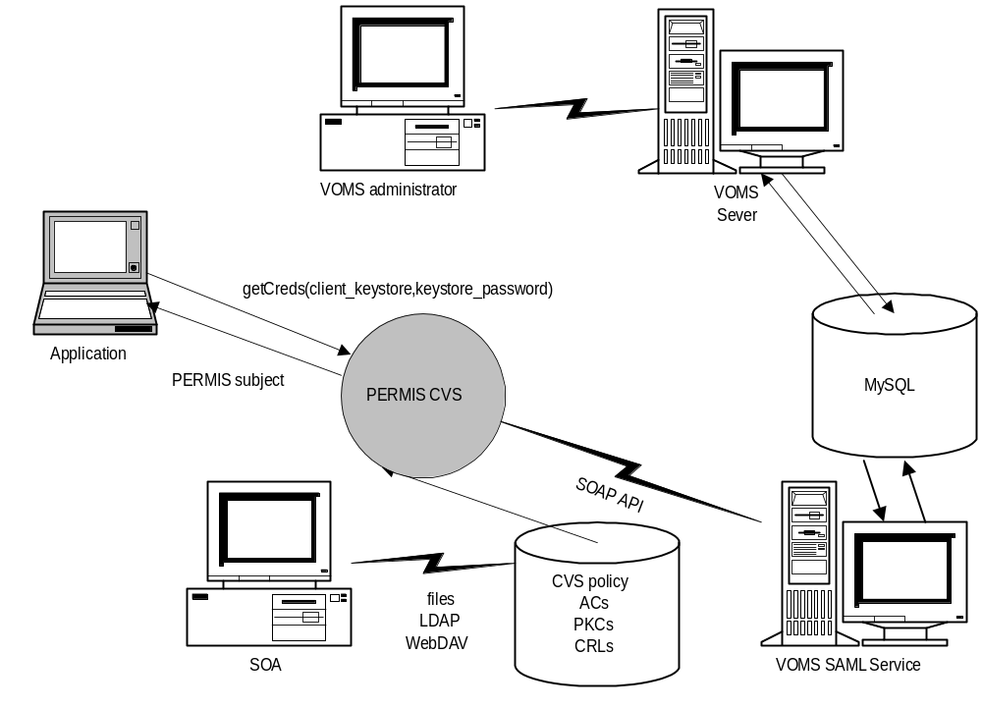
VOMS-PERMIS Architecture

Slide 13
XACML Authorization Service
G-Pbox is an authorization service following the XACML specification
  Developed in gLite
  Inclusion in the future gLite releases will be discussed in the next months
  One of its component is an XACML compliant Policy Decision Point
    Process xacml-context:Request agains a repository of XACML policies and returns and xacml-context:Response
Ongoing evolution towards SAML 2.0 profile of XACML

Slide 14
Authorization Service
Part of a wider effort for having interoperable authorization services between EGEE, OSG and Globus
  interface of the PDP is going to be according to the SAML 2.0 Profile of XACML
  Agreeing on common id (actions, obligations)
Some implementations ongoing
  GT providing a library
  G-Pbox
  gJAF

Slide 15
Grid-Shib Project Update
The GridShib Project continues to implement attribute push in the GridShib SAML Tools and GridShib for GT. This work is focused on a hybrid security token that we call an X.509-bound SAML Token, that is, a SAML assertion bound to an X.509 certificate, either a short-lived end entity certificate or a proxy certificate. The resulting "X.509-bound SAML Token Profile" is a straightforward extension of the WS-Security X.509 Token Profile, and therefore an implementation of the latter (such as Globus GSI Secure Message) is automatically an implementation of the former. This approach is advantageous since it obviates the need to implement yet another GSI wire protocol (such as WS-Security SAML Token Profile). Moreover, the same token works equally well at the transport level (GSI Transport).

Slide 16
Shintau Project. Conceptual Model
Introduce a Linking Service whose purpose is to hold uni-directional links between a user’s attributes from different IdPs
User will register with a Linking Service and link his attributes together, optionally providing an Link Release Policy to say which links can go to which SPs.
When user contacts an SP for a service, then Linking Service is used to directly or indirectly aggregate the attributes

Slide 17

Linking Service
IdP 1
4
3
UserX, Attr1, PID J, LS
2
1
Linking
Service
User1, IdP1, PID J, IdP2, PID M
5
7
6
IdP 2
UserA, Attr2, PID M, LS

Slide 18
UserID | PId | IdP
Fred | A=123 | Airmiles.com
Fred | EduX=u23@kent.ac.uk | Kent.ac.uk
Mary | ABC=456 | XYX Co
Fred | uid=123345 | Cardbank.com
Linking Table
UserID | SP | IDP
Fred | Books.co.uk | Kent.ac.uk
Fred | Books.co.uk | Cardbank.com
Mary | Books.co.uk | XYX Co
Fred | Cardbank.com | *
Fred | Compstore.com | Cardbank.com
Fred | Compstore.com | Airmiles.com
Fred | * | Kent.ac.uk
Link Release
Policy Table
Notes:
If the user connects via the LS, and picks an IDP to authenticate to, the LS could then ask, which of the following IDPs do you want to use for this SP (and pick from the Linking Table the full set of linked IDPs). The user can select several of these, along with a tick box “remember”, and the LS will add this subset to the Link Release Policy Table for this SP.

Slide 19
Accessing a Service with LS Aggregation
IdP 1
3
2. User redirected to chosen IdP
User Authn
4. IdP 1’s attributes +Authn token
Referral to Linking Service
1. Service Request
Service Provider
5. SP passes referral+Authn token
Linking
Service
6. Signed AAs from IdPs 2 and 3
7. IdP follows
link, passes
Authn token+
Referal
8. IDP2’s
Signed AAs
10. IDP3’s
Signed AAs
Attribute Requests 5,7,9 contain:
Authentication Assertion
+ Referral + Attribute Query
Responses contain attributes of
user using RID from authn assn
9. IdP
follows link
IdP 3
IdP 2

Slide 20
Contents of a Referral
A user ID that is the PId of the user, originally generated by the recipient IdP, and encrypted to the public key of the recipient IdP.
The name of the recipient IdP (or LS) that is the destination of the Referral.
A link to the authentication assertion that was created for this user session.
The name of the SP that requires the user’s attributes
The name of the initiator of the Referral (i.e. the authenticating IdP or LS)
The whole construct is digitally signed by the creator of the Referral (i.e. the authenticating IdP or LS)

Slide 21
Accessing a Service with SP Aggregation
IdP 1
3
2. User redirected to chosen IdP
User Authn
4. IdP 1’s attributes +
Referral to Linking Service
1. Service Request
Service Provider
5. SP follows referral
Linking
Service
6. Referrals to linked IdPs 2 and 3
7. SP follows referral
8. IDP2’s attributes
IdP 2
9. SP follows referral
10. IDP3’s attributes
IdP 3

Slide 22
Accessing a Service by User choosing LS
IdP 1
3. User redirected to chosen IdP
4. IdP 1’s Authn Assern
5. Attribute request for PID and
User attributes for SP
6. Attribute responses
User Authn
3,5
4,6
1. Service Request
Service Provider
2. User redirected to LS
Linking
Service
11. Signed AAs from IdPs 2 and 3
7. IdP follows
link
8. IDP2’s
Signed AAs
10. IDP3’s
Signed AAs
Attribute Requests 7,9 contain:
Authentication Assertion
+ Referral + Attribute Query
Responses contain attributes of
user using RID from authn assn
9. IdP
follows link
IdP 3
IdP 2

Slide 23
Trust Model
All IdPs trust the LS to hold their PIds securely
LS trusts each linked IdP to authenticate the user correctly, and to return the correct PId that is unique to this user
SP trusts LS to hold the established links securely
All linked IdPs must trust the authenticating IdP to authenticate the user correctly. (Each Referral is accompanied by an authentication assertion signed by the authenticating IdP, so each linked IdP can check this dynamically)
SP must trust the authenticating IdP to authenticate the user correctly
SP must trust each IdP to correctly generate and process Referrals and to only send attributes that pertain to the authenticated user that they are authoritative for. (Note that each attribute assertion can be signed by the sending IdP, so that the SP can dynamically validate this on receipt).

Slide 24
Privacy Model
User is in control of his/her privacy
User is given a unique random number for each session so SP cannot link user sessions together (except via attributes released by user)
User says which IdPs are linked together
User says which SPs can receive which linked attributes
Linking service does not know who the user is or what attributes the user holds.
Attribute assertions are encrypted by sending IdP for receiving SP, so intermediaries cannot see these attributes

Slide 25
Protocol Specification (in progress)
Linking Protocol is standard SAMLv2 authentication request protocol. IdP returns authentication assertion with PId as subject or random ID for subject plus attribute assertion containing the PId
Referral is proposed to be based on Liberty Alliance ID-WSF Identity Mapping Service where each IdP acts as a Identity Mapping Service
Each ID-WSF Identity Mapping Request comprises
i) the Sec Token of the request contains the Authn token from the authenticating IDP
ii) the Token Policy contains the ID of the user as known by the receiving IDP, along with the set of attributes that are being requested, and the name of the SP that needs them
The Response contains a set of Mapping Outputs, each mapping output being an attribute for the user (identified by the Authn token), encrypted to the SP.
Either the LS sends Identity Mapping Requests and collects all the Mapping Outputs from the Linked IDPs to return to the SP or SP can make the Identity Mapping Requests itself.

Slide 26
More information
Full requirements questionnaire results, plus conceptual and protocol design documents are available at
http://sec.cs.kent.ac.uk/shintau

