Slide 1
OGSA WSRF Basic Profile - Status
Hiro Kishimoto, Tom Maguire, Jem Treadwell, David Snelling
OGSA Status and Future, OGSA-WG #1
28 June, 2005 (GGF14 in Chicago) 10-11:30am

Slide 2
Basic Profile - Status
Largely complete
Submission in July
Proposed Recommendation
Waiting on WS-Notification to go to Committee Draft in OASIS (may wait for Public Review)
  Outlook 1st week of July, 05 (next week)

Slide 3
Basic Profile - Referenced Specifications
Web Services Addressing 1.0 – Core (WS-Addressing)
Web Services Base Faults 1.2 (WS-BaseFaults)
Web Services Base Notification 1.3 (WS-BaseNotification)
Web Services Resource Lifetime 1.2 (WS-ResourceLifetime)
Web Services Resource Properties 1.2 (WS-ResourceProperties)
Web Services Security: SOAP Message Security 1.0
Basic Profile 1.1
Basic Security Profile Version 1.0
HTTP Over TLS
The TLS Protocol Version 1.0

Slide 4
What’s in it?
Extension of WS-I Basic Profile 1.1 and WS-I Basic Security Profile 1.0
Includes protocol requirements for exposing state
Includes protocol requirements for lifetime management
Includes protocol requirements for notifications
Includes protocol requirements for security

Slide 5
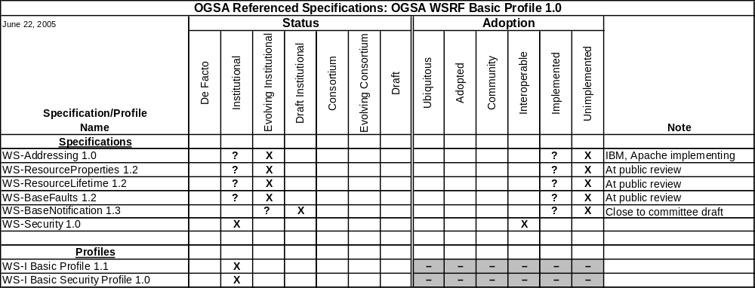
Status and Adoption Levels

Slide 6
More Information
Come to the OGSA WG #3 2:30-4:00 Wellington 2

