Slide 1
OGSA Data Architecture WG – Architecture Status
  Allen Luniewski, co-chair
OGSA-WG and fellow WGs F2F meetings in SF Bay Area
August 15-19, 2005

Slide 2
GGF Intellectual Property Policy
All statements related to the activities of the GGF and addressed to the GGF are subject to all provisions of Appendix B of GFD-C.1, which grants to the GGF and its participants certain licenses and rights in such statements. Such statements include verbal statements in GGF meetings, as well as written and electronic communications made at any time or place, which are addressed to any GGF working group or portion thereof,
Where the GFSG knows of rights, or claimed rights, the GGF secretariat shall attempt to obtain from the claimant of such rights, a written assurance that upon approval by the GFSG of the relevant GGF document(s), any party will be able to obtain the right to implement, use and distribute the technology or works when implementing, using or distributing technology based upon the specific specification(s) under openly specified, reasonable, non-discriminatory terms. The working group or research group proposing the use of the technology with respect to which the proprietary rights are claimed may assist the GGF secretariat in this effort. The results of this procedure shall not affect advancement of document, except that the GFSG may defer approval where a delay may facilitate the obtaining of such assurances. The results will, however, be recorded by the GGF Secretariat, and made available. The GFSG may also direct that a summary of the results be included in any GFD published containing the specification.

Slide 3
Agenda
Status
Architectural pillars
Cross-pillar issues
Use cases
Issues & Concerns

Slide 4
Status
Goal: informational document(s) only
Charter milestones
  First Draft – GGF 14 (DONE)
  Revised architecture document - GGF 15 (on track)
  Ready for public review – December 2005 (at risk)
  Final documents – Spring, 2006 (at risk)
Nominally weekly calls
  4-6 people on the calls
Slow summer progress

Slide 5
Architecture Pillars
Naming
Data description
Data transfer
Data access
Storage resource management
Replication
Cache services
Data federation
Metadata catalog & services

Slide 6
Naming
OGSA naming scheme
  RNS
  WS-Naming
  WS-Addressing

Slide 7
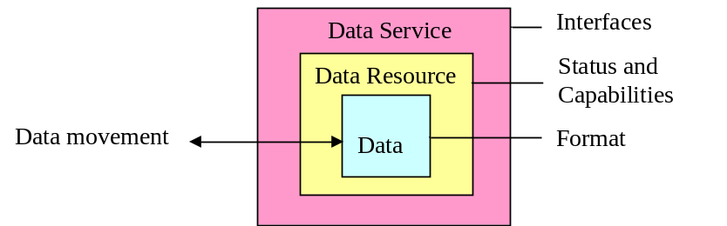
Data Description
Registry for descriptive information possible
Format:
  Type, structure, classification, organization
  May be well known or discovered at run time
Data resource:
  Sources and sinks of data
  Described by properties (“metadata”)
Service description
  WSDL

Slide 8
Data Transfer
Current model:
  Source, sink, “pipe”
  Data in transit is not a resource
  The “pipe” may be a resource (TBD)
Subject of much recent discussion
  WG for simple 1-1 transfer (Bill Allcock)
  Build more complex transfer paradigms from the 1-1
Do we transfer bits or structured data?
Do we transform data along the way?
How is a transfer created?

Slide 9
Client
Interfaces
Name Translation
Resource Selection
Interfaces
VO Level Data Movement
Interfaces
Interfaces
Data Resource
Data Resource
Interfaces
Interfaces
Interfaces
hosts
Data Resource
Data Resource
Data Resource
hosts
hosts
hosts

Slide 10
Data Access
Principles:
  Data access through a data service which fronts one or more data sources
  Results: returned, held at data service for future access, third party delivery
  Access properties:
    Type, writable, concurrent access allowed, sensitivity to change
    Transaction: initiation, isolation levels
    Lockable, status
Support for WS-DAI (DAIS), ByteIO

Slide 11
Storage Resource Management
Early draft
WS-Agreement to acquire storage
Storage resource properties:
  Type: file space, filesystem space
  Lifetime management
  Quota support?
  Security support?
  Encryption support?
  Maximal data guarantee level

Slide 12
Storage Resource Management
Storage Space Properties
  Size, space type, space partitions
  Access bandwidth, average access latency
  Lifetime
  Lifetime support?
  Volatile?
  Quota support?
  Security model: none Unix, ACL-POSIX, ACL-NTFS, ACL-OTHER
  Encrypted?
  Data guarantee level
  HSM?
  Cost
Management by site & virtual organization

Slide 13
Replication
Three components
  Data source, the data itself, 1 or more replicas
Master-slave & peer replication
Replica discovery
Replica validation
Replica consistency
  Latency
  Updates
The replication service is manageable

Slide 14
Cache Services
Caches may be private to a data service or created/known to applications
Cache coherence policies govern cache operation
  May be inherent or set by client
Differs from replication:
  Performance vs. availability
  Partial data vs. complete data

Slide 15
Data Federation
Federate multiple data services and sources into a single data service
  Filter “input” data
  Transform data
  Combine data
  Filter data for “export”
  One or more access/query mechanisms
  QoS policies to govern operation
    Response time, availability, currency of data, resilience to disasters (RTO, RPO)
Dynamic control of the above

Slide 16
Metadata Catalog & Services
Publishes annotations relating to services, their capabilities, and the resources they represent
Operations include:
  Publication & removal of metadata
  Manage the catalog (service) itself
  Service & resource discovery
  Annotation of metadata
  Subscription (notification) for changes

Slide 17
Cross Pillar Issues
Transactions
Security
Resource usage monitoring and metering?
Charging?

Slide 18
Transactions – Pixie Dust!
Excellent session at GGF-14 w/ TM-RG
Pick a transaction model
  WS-Coordination, WS-Transaction, …
Transaction context flows with each port call
No architectural impact
Services can choose to implement services or not
Transaction models have their own issues
  E.g., cross-organizational transaction coordination

Slide 19
Security
Discussions just beginning
Known issues
  Bridging between authentication/identity models at grid level and data source
  Granularity of security model at grid and data source

Slide 20
Placeholders
Data location management
Personal data service
Transformational services

Slide 21
Use Case Document
Early draft (partial) available
Template:
  Summary
  Scenarios
  Involved resources
  Functional design
  References
Data replication scenario
  Replication client initiated & managed
  Replication part of a data service implementation

Slide 22
Issues
Critical mass of participants
One document vs. collection of “white papers”
Unresolved technical issues
  Security
  Data transfer
Tracking related work

