Slide 1
OGSA Information Management Services status
OGSA-WG #9
GGF13 March 16, 2005 in Seoul
Abdeslem DJAOUI - OGSA Information Management Services Design Team

Slide 2
GGF Intellectual Property Policy
All statements related to the activities of the GGF and addressed to the GGF are subject to all provisions of Section 17 of GFD-C.1, which grants to the GGF and its participants certain licenses and rights in such statements. Such statements include verbal statements in GGF meetings, as well as written and electronic communications made at any time or place, which are addressed to any GGF working group or portion thereof,
Where the GFSG knows of rights, or claimed rights, the GGF secretariat shall attempt to obtain from the claimant of such rights, a written assurance that upon approval by the GFSG of the relevant GGF document(s), any party will be able to obtain the right to implement, use and distribute the technology or works when implementing, using or distributing technology based upon the specific specification(s) under openly specified, reasonable, non-discriminatory terms. The working group or research group proposing the use of the technology with respect to which the proprietary rights are claimed may assist the GGF secretariat in this effort. The results of this procedure shall not affect advancement of document, except that the GFSG may defer approval where a delay may facilitate the obtaining of such assurances. The results will, however, be recorded by the GGF Secretariat, and made available. The GFSG may also direct that a summary of the results be included in any GFD published containing the specification.

Slide 3
Outline
Part 1: OGSA Information Management Services (IMS) status
Part 2: INFOD and its relevance to OGSA IMS

Slide 4
IMS achievements/status
For OGSA V1:
  Some common architecture components as foundation for many capabilities: monitoring, discovery, messaging, logging, accounting, …
Post OGSA V1:
  Define direction of IMS
    What specifications are needed
    Explore common ground with other GGF groups/areas
      Discussion with InfoD, Data, EMS, resource management, NM, …
    Identification of INFOD as strong candidate specification for IMS
  Contributions to OGSA definition
    BP discussions
    Understanding IMS relation to Data, EMS, Resource management, ….
  IMS use cases contributed to INFOD
Current activity
  OGSA F2F’s and some “after midnight” calls.
  INFOD spec

Slide 5
Contributors to OGSA Information Management Services
Recently or up to V1:
  Bill Horn – IBM
      Architecture
      Logging requirements
  Hiro Kishimoto - Fujitsu
      Architecture
  Steve Fisher – RAL
      architecture
      Discovery, Monitoring and Logging requirements
  Abdeslem Djaoui - RAL
      Architecture
      Discovery, Monitoring and Logging requirements
      Liaison between InfoD WG and OGSA WG
Past
  James Magowan - IBM
  Paul Taylor – IBM
  GMA document authors (Telephone calls)

Slide 6
Overview of IMS Architecture
Based on Grid Monitoring Architecture
Distributed Directory:
Registrations
and Schemas
Producers
descriptions
Consumers
descriptions
Producers:
send
Messages
Consumers:
Receive
Messages
Messages directly from P to C

Slide 7
Workings with other WGs/Design teams
InfoD
  Have been fully drafted
Discussions
  Data
    Metadata
    Messaging/data transfer
  Resource Management
    Resource models and Vocabularies
  EMS
    Resource discovery and monitoring
  Network Monitoring
  CGS
  Semantics Web

Slide 8
On-going issues
Difference between Data and Information
  What is the extend of the overlap?
  What are the differences?
  Integration of Resource Models with IMS Vocabularies
Resource Management
OGSA-IMS post InfoD

Slide 9
Schedule until GGF14
INFOD specification
Start exploring OGSA IMS profile.
  Which specifications should be in the initial IMS profile?
  Candidates include:
    InfoD
    WS-BaseNotification?
    Ws-BrokeredNotification?
    Vocabulary management?
      Interoperability can not be achieved without a common vocabulary
    ….
  Is there a need for an IMS profile for OGSA?
  Who will do the IMS profile?

Slide 10
Part2 :Introduction to INFOD and relevance to OGSA IMS
INFOD Team:
  Vijay Dialani - IBM
  Abdeslem Djaoui - RAL
  Steve Fisher - RAL
  Dieter Gawlick - ORACLE
  Chris Kantarjiev -ORACLE
  Cecile Madsen - IBM
  Susan Malaika - IBM
  Shailendra Mishra - ORACLE

Slide 11
INFOD Objectives
Information Dissemination supports timely and efficient generation and dissemination of right information to the right consumers.
It is assumed that the information to be disseminated is created in response to an event and an objective is to give control on how events are defined
It is assumed that events are created in response to a state change and an objective is to give control on how state changes are defined

Slide 12
INFOD Motivation
Event based systems are becoming more common
  sensor based computing where sensors produce messages as a result of events
  message publishing from computing resources to help monitor and debug grid systems
Standards are being developed to describe interfaces that help support message based systems, e.g.,
  WS-Notification in Oasis, which describes interfaces for message publishers and brokers, to publish and filter messages; and for subscribers and consumers to express interest and consume messages
INFOD makes it possible to perform operations on events and state changes, as well as on messages, to enhance the dissemination of information in an event based system

Slide 13
INFOD points of control
Publishers
States
X
Events
X
Messages
X
Consumers
State changes can be defined so events are generated. Messages corresponding to events can also be defined and created. Consumers can then choose which messages they are interested in.

Slide 14
More on INFOD Motivation
Examples of INFOD capabilities
  Message subscribers and consumers have increased control, e.g.,
    subscribers can define dynamically what constitutes events that cause messages to be published
    subscribers can define dynamically what should appear in messages
  Message publishers have increased control, e.g.,
    publishers can target specific consumers
  Message filters and transformations can be applied flexibly, e.g.,
    filters can be applied at various stages
    filters can incorporate information from various data sources
  Critical data must be protected while providing efficient access to and distribution of these data with the required Quality Of Service (QoS)
    These relate to security, performance, scalability, reliability, transactional publications and consumptions, exactly once propagation to one or more consumers as well auditing and tracking

Slide 15
INFOD Disseminators
Publisher
Messages
Disseminators
Publisher
Messages
INFOD disseminators help with distributing messages
INFOD principals (e.g., Publishers, Disseminators, Consumers) can define message filters for any stage
INFOD components apply the appropriate filters at any stage
Messages
Messages
Consumer
Consumer

Slide 16
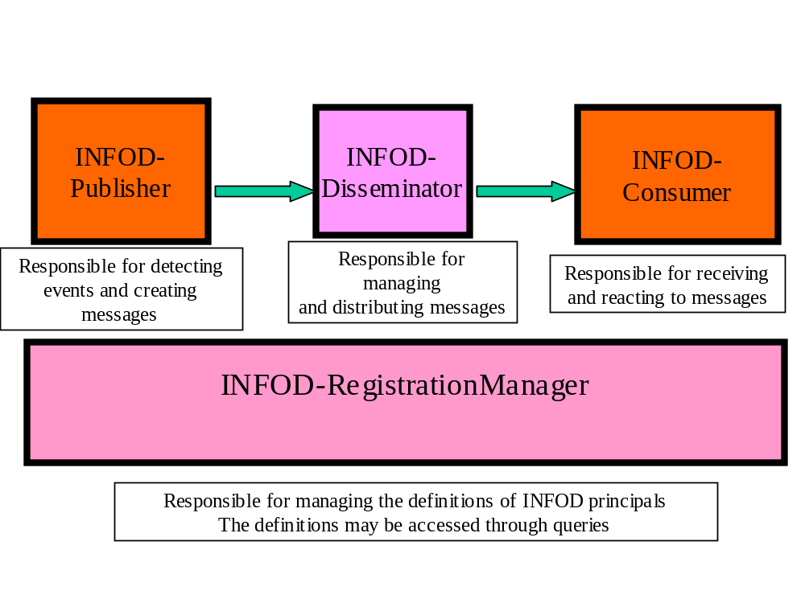
INFOD basic components

Slide 17
INFOD Registration Manager
The INFOD Registration Manager supports queries on INFOD principals’ descriptions, via the GetData and Evaluate operations typically from a disseminator or from a publisher to identify the messages of interest to a consumer
The INFOD Registration Manager also supports the dissemination of INFOD Registry changes to interested parties who have subscribed to registry changes, by invoking the INFOD Consumer Interface
Direct mapping from IFOD components to GMA and IMS components
  RegistrationManager acts as a finder service

Slide 18
INFOD Requirements and difference with WSN[1]
Publishers and Subscribers
R0: Subscribers must be able to select publishers of interest
R1. Subscribers must be able to select messages of interest
R2. Publishers must be able to select consumers of interest
R3. Publishers and subscribers must be able to use vocabulary management to select messages
R4. Subscribers may be able to specify the messages to be published in response to an event
R5. Subscribers may be able to define an event by querying one data source
R6. Subscribers may be able correlate events to form composite events by querying multiple data sources

Slide 19
INFOD Requirements and difference with WSN[2]
Consumers
R7. Consumers must be able to specify dynamically how and when messages are received
R8. Consumers may be able to limit the messages received
R9. Consumers may be able to retrieve past messages on request
Publishers, Subscribers and Consumers
R10. Publishers, Subscribers and Consumers must be able to define QoS
R11: Publishers, Subscribers, and Consumers may have Identity Management
Filters
R12. Filters must be able to be composed

Slide 20
Information Dissemination (INFOD) issues for OGSA
OUTSIDE THE SCOPE OF INFOD
Vocabulary management
  XML, SQL, RDF? OWL?
  Relation to CIM
Identity management
Transaction support
  Commitment has 2 stages: visibility and recoverability
  It must possible to specify that recoverability is needed or not before accessing a record – Talk to Dieter
INFOD would like to discuss these issues with the OGSA-WG
  INFOD to spell them out more clearly in the next few months
  Discuss details with OGSA-WG at GGF14

Slide 21
Summary
INFOD can be seen as dealing with a superset of WSN, WS-Eventing requirements
INFOD adds better control of what gets published
INFOD deals with QoS issues
INFOD seem to map ideally to OGSA IMS

