Slide 1

OGSA Platform Services
Fred Maciel
CMM-WG co-chair
© Global Grid Forum, 2003
All trademarks belong to their respective owners.

Slide 2
Background and Objectives
Introduce the new classification of services in the OGSA document
  Especially, the “platform services”
Discuss the classification and get feedback from you

Slide 3
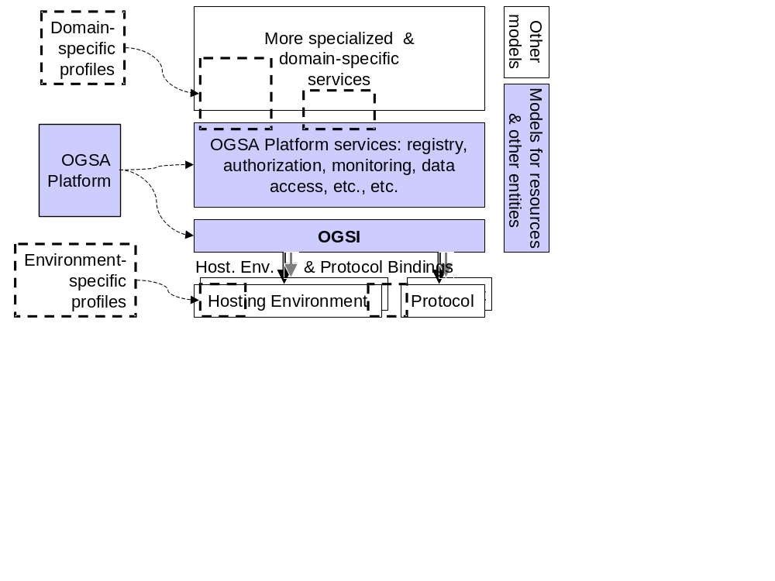
OGSA, circa February
Work since then has focused on classifying and detailing the “OGSA Platform services” above

Slide 4
The OGSA Service Taxonomy (1)
Services classified by purpose and functionality
User’s view of architecture
But where do OGSI, WS-Agreement, CMM, etc. fit?
Domain Specific Services
Program
Execution
Data Services
OGSA
Services
Core Services

Slide 5
The OGSA Service Taxonomy (2)
A possible solution: a separate dimension (below)
A better solution: a second classification
Platform
Services
Domain Specific Services
Program
Execution
Data Services
Core Services

Slide 6
The OGSA Hierarchy
Organizes services according to relationships
  “Uses”: accesses interface to use functionality
  “Extends”: gets functionality by extending portTypes
Provider’s view of architecture
OGSA
Services
Platform
Services
CMM
OGSI

Slide 7
The Platform Services
Mainly used through “Extends” relationships
Provide functionalities that are:
  Common to many services
  Basic
OGSA
Services
Platform
Services
CMM
OGSI

Slide 8
Current Status
The hierarchy classification and platform services are new concepts
  Still being discussed in the OGSA-WG
Platform services and all relationships are still to be defined
  Current candidates: OGSI, CMM, WS-Agreement, OGSI data services (or parts of it)
  Future: also security, policy, and information services
We are looking forward to your feedback (and participation)

Slide 9
Summary of Classifications and Nomenclature
Domain-specific services
Service taxonomy
(user’s view)
Program
Data
Core services
OGSA
Services
Service hierarchy
(provider’s view)
Platform
Services
CMM
OGSI

Slide 10
Copyright Notice
Copyright (C) Global Grid Forum (2003). All Rights Reserved.
This document and translations of it may be copied and furnished to others, and derivative works that comment on or otherwise explain it or assist in its implementation may be prepared, copied, published and distributed, in whole or in part, without restriction of any kind, provided that the above copyright notice and this paragraph are included on all such copies and derivative works. However, this document itself may not be modified in any way, such as by removing the copyright notice or references to the GGF or other organizations, except as needed for the purpose of developing Grid Recommendations in which case the procedures for copyrights defined in the GGF Document process must be followed, or as required to translate it into languages other than English.
The limited permissions granted above are perpetual and will not be revoked by the GGF or its successors or assigns.
This document and the information contained herein is provided on an "AS IS" basis and THE GLOBAL GRID FORUM DISCLAIMS ALL WARRANTIES, EXPRESS OR IMPLIED, INCLUDING BUT NOT LIMITED TO ANY WARRANTY THAT THE USE OF THE INFORMATION HEREIN WILL NOT INFRINGE ANY RIGHTS OR ANY IMPLIED WARRANTIES OF MERCHANTABILITY OR FITNESS FOR A PARTICULAR PURPOSE.

Slide 11
Intellectual Property Rights and Notices
The GGF takes no position regarding the validity or scope of any intellectual property or other rights that might be claimed to pertain to the implementation or use of the technology described in this document or the extent to which any license under such rights might or might not be available; neither does it represent that it has made any effort to identify any such rights. Copies of claims of rights made available for publication and any assurances of licenses to be made available, or the result of an attempt made to obtain a general license or permission for the use of such proprietary rights by implementers or users of this specification can be obtained from the GGF Secretariat.
The GGF invites any interested party to bring to its attention any copyrights, patents or patent applications, or other proprietary rights which may cover technology that may be required to practice this recommendation. Please address the information to the GGF Executive Director.

