Slide 1
Defining the Grid: An Introduction to the
Open Grid Services Architecture
A webcast by the GGF’s OGSA™ working group
April 26, 2006
OGSA is a trademark of the Global Grid Forum

Slide 2
Admin stuff
Plan:
  Event: Wed April 26th, 2pm US Eastern, 90 minutes
  Speakers/panel join at 1:30pm
  Run through with HP facilitator (Tanya) – Mon 4/24, 5pm
  Final slide review – OGSA telecon, Mon 4/17
  Dry run – TBD
Registration:
  Register now at: http://www.presentationselect.com/hpinvent/detailsl.asp#1188
  Speakers & panel must not register here (details later)
  Advertise now
  Max 150 registrations

Slide 3
Structure
Welcome & admin info – Tanya
Introduce Andrew & OGSA-WG – Jem
Presentation Part 1: Grid
?? Q&A 1 (Andrew – clarification questions)
Presentation Part 2: OGSA
Introduce panel, then Q&A 2 (Panel)
?? Poll (during Q&A – any other time?)
Wrap-up – Tanya

Slide 4
Panel
Andrew
Hiro
Jem
Tom/Dave S?
Dave Berry (no)
Frank?
Others? (need profile & security support)
Need names this week

Slide 5
Poll Questions
Do we want to do polls?
Are you familiar with OGSA?
  No
  I’ve heard of it, but I’m not sure what it is
  I’ve read the Roadmap and/or the Architecture
  I’ve read most or all of the OGSA documents
How important to you is it that OGSA is an open standard with participation from multiple organizations?
Is your organization using grid technology today?
Is your organization planning to use grid technology?
What type of organization? (research, industrial, commercial, finance, computer software or hardware supplier)
What OGSA capabilities are most important to you?
Was this session useful to you?

Slide 6
Agenda
An Overview of Grid Computing
The Open Grid Services Architecture
OGSA In Detail
OGSA & The Standards Landscape
Making it Happen: The OGSA Working Group
Summary

Slide 7
An Overview of
Grid Computing

Slide 8
A Grid Computing Timeline
US Grid Forum formed at SC ‘98
Grid Forums merge, form GGF
I-Way: SuperComputing ‘95
European & AP Grid Forums
OGSA-WG formed
“Physiology” paper
“Anatomy” paper
OGSA v1.0
…
1995 | ’96 | ’97 | ’98 | ’99 | 2000 | ’01 | ’02 | ’03 | ’04 | ’05 | 2006
  NAREGI ??
  UK e-Science program starts
DARPA funds Globus Toolkit
EU funds UNICORE project
US DoE pioneers grids for scientific research
NSF funds National Technology Grid
NASA starts Information Power Grid
UVa starts Legion project
  Today:
  Grid solutions are common for HPC
  Grid-based business solutions are becoming common
  Required technologies & standards are evolving
Notes:
Grid began in high-performance technical computing as a way to share widespread computing resources
1994 – 1995 Argonne National Lab & University of Illinois at Chicago formed “I‑WAY” for SuperComputing ’95 (SC95):
Led by Ian Foster
Linked 11 high-speed networks into a “national computing grid”
1997 Globus Toolkit development funded by DARPA*
Then:
US Dept. of Energy pioneered use of grids for scientific research
National Science Foundation funded National Technology Grid
NASA began its Information Power Grid
1998 Grid sessions at SC98 resulted in formation of the US Grid Forum:
Define and promote grid standards and best practices
2000 US Grid Forum merged with European & Asia-Pacific Grid Forums to form the Global Grid Forum (GGF):
Produced many grid standards and specifications
17th GGF conference in May 2006
Participation from major vendors and the grid community
Today:
Grid solutions are common for high-performance computing
Commercial organizations expect grid-based business solutions:
Adoption is in its early stages
Required technologies & standards are evolving
Mainstream adoption expected in the next few years

Slide 9


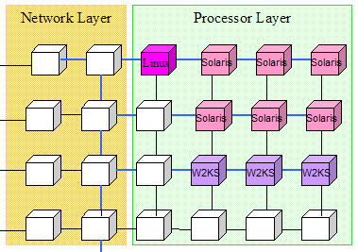
What is a Grid?
A grid is a system consisting of
  Distributed but connected resources and
  Software and/or hardware that provides and manages logically seamless access to those resources to meet desired objectives
Web
server
License
Data Center
Cluster
Workstation
Supercomputer
Server
Handheld
Database
Printer
R2AD

Slide 10
How Are Grids Used?
E-Business
E-Science
High-performance computing
Collaborative design
High-energy physics
Financial modeling
Data center automation
Life sciences
Drug discovery
Collaborative data-sharing

Slide 11
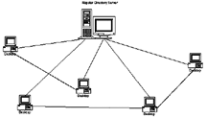
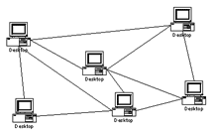
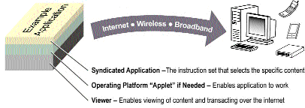
Some Characteristics of Grids
Numerous
resources
Ownership by mutually
distrustful organizations
& individuals
Connected by
heterogeneous,
multi-level networks
Different security
requirements
& policies
Different resource
management
policies
Unreliable resources and environments
Geographically
separated
Resources are
heterogeneous

Slide 12
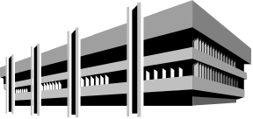


Some Characteristics of Grids
Numerous
resources
Ownership by mutually
distrustful organizations
& individuals
Connected by
heterogeneous,
multi-level networks
Different security
requirements
& policies
Different resource
management
policies
Unreliable resources and environments
Geographically
separated
Resources are
heterogeneous

Slide 13


Some Characteristics of Grids
Numerous
resources
Ownership by mutually
distrustful organizations
& individuals
Connected by
heterogeneous,
multi-level networks
Different security
requirements
& policies
Different resource
management
policies
Unreliable resources and environments
Geographically
separated
Resources are
heterogeneous

Slide 14


Some Characteristics of Grids
Numerous
resources
Ownership by mutually
distrustful organizations
& individuals
Connected by
heterogeneous,
multi-level networks
Different security
requirements
& policies
Different resource
management
policies
Unreliable resources and environments
Geographically
separated
Resources are
heterogeneous

Slide 15
Some Characteristics of Grids
Numerous
resources
Ownership by mutually
distrustful organizations
& individuals
Connected by
heterogeneous,
multi-level networks
Different security
requirements
& policies
Different resource
management
policies
Unreliable resources and environments
Geographically
separated
Resources are
heterogeneous

Slide 16

Some Characteristics of Grids
Numerous
resources
Ownership by mutually
distrustful organizations
& individuals
Connected by
heterogeneous,
multi-level networks
Different security
requirements
& policies
Different resource
management
policies
Unreliable resources and environments
Geographically
separated
Resources are
heterogeneous

Slide 17

Some Characteristics of Grids
Numerous
resources
Ownership by mutually
distrustful organizations
& individuals
Connected by
heterogeneous,
multi-level networks
Different security
requirements
& policies
Different resource
management
policies
Unreliable resources and environments
Geographically
separated
Resources are
heterogeneous

Slide 18

Some Characteristics of Grids
Numerous
resources
Ownership by mutually
distrustful organizations
& individuals
Connected by
heterogeneous,
multi-level networks
Different security
requirements
& policies
Different resource
management
policies
Unreliable resources and environments
Geographically
separated
Resources are
heterogeneous

Slide 19
Grid & Related Paradigms
Notes:
Grids
Grids often cross management/ownership boundaries
Usually include heterogeneous hardware & software
Pooled resources dynamically assigned for short-term use
Scale ranges from a few nodes to many thousands
Clusters
Multiple computers working cooperatively
Typically homogeneous hardware & software
Close proximity
Often tightly coupled – e.g. shared memory, high-speed interconnect
Distributed computing
Nodes loosely connected by network
May be geographically distant
Centrally managed
Utility computing
Computing services used with no knowledge of the infrastructure
Resource usage billed and paid for like any other utility service
Grid can be the underlying technology of utility computing

Slide 20
Grid & Related Paradigms
Cluster
Tightly coupled
Homogeneous
Cooperative working
Notes:
Grids
Grids often cross management/ownership boundaries
Usually include heterogeneous hardware & software
Pooled resources dynamically assigned for short-term use
Scale ranges from a few nodes to many thousands
Clusters
Multiple computers working cooperatively
Typically homogeneous hardware & software
Close proximity
Often tightly coupled – e.g. shared memory, high-speed interconnect
Distributed computing
Nodes loosely connected by network
May be geographically distant
Centrally managed
Utility computing
Computing services used with no knowledge of the infrastructure
Resource usage billed and paid for like any other utility service
Grid can be the underlying technology of utility computing

Slide 21
Grid & Related Paradigms
Distributed Computing
Loosely coupled
Heterogeneous(?)
Central management
Cluster
Tightly coupled
Homogeneous
Cooperative working
Notes:
Grids
Grids often cross management/ownership boundaries
Usually include heterogeneous hardware & software
Pooled resources dynamically assigned for short-term use
Scale ranges from a few nodes to many thousands
Clusters
Multiple computers working cooperatively
Typically homogeneous hardware & software
Close proximity
Often tightly coupled – e.g. shared memory, high-speed interconnect
Distributed computing
Nodes loosely connected by network
May be geographically distant
Centrally managed
Utility computing
Computing services used with no knowledge of the infrastructure
Resource usage billed and paid for like any other utility service
Grid can be the underlying technology of utility computing

Slide 22
Grid & Related Paradigms
Distributed Computing
Loosely coupled
Heterogeneous(?)
Central management
Cluster
Tightly coupled
Homogeneous
Cooperative working
Notes:
Grids
Grids often cross management/ownership boundaries
Usually include heterogeneous hardware & software
Pooled resources dynamically assigned for short-term use
Scale ranges from a few nodes to many thousands
Clusters
Multiple computers working cooperatively
Typically homogeneous hardware & software
Close proximity
Often tightly coupled – e.g. shared memory, high-speed interconnect
Distributed computing
Nodes loosely connected by network
May be geographically distant
Centrally managed
Utility computing
Computing services used with no knowledge of the infrastructure
Resource usage billed and paid for like any other utility service
Grid can be the underlying technology of utility computing

Slide 23
Grid & Related Paradigms
Distributed Computing
Loosely coupled
Heterogeneous(?)
Central management
Cluster
Tightly coupled
Homogeneous
Cooperative working
Grid Computing
Loosely coupled
Heterogeneous
Large scale
Distributed management
Notes:
Grids
Grids often cross management/ownership boundaries
Usually include heterogeneous hardware & software
Pooled resources dynamically assigned for short-term use
Scale ranges from a few nodes to many thousands
Clusters
Multiple computers working cooperatively
Typically homogeneous hardware & software
Close proximity
Often tightly coupled – e.g. shared memory, high-speed interconnect
Distributed computing
Nodes loosely connected by network
May be geographically distant
Centrally managed
Utility computing
Computing services used with no knowledge of the infrastructure
Resource usage billed and paid for like any other utility service
Grid can be the underlying technology of utility computing

Slide 24
Grid & Related Paradigms
Distributed Computing
Loosely coupled
Heterogeneous
Central management
Cluster
Tightly coupled
Homogeneous
Cooperative working
Grid Computing
Loosely coupled
Heterogeneous
Large scale
Distributed management
Utility Computing
Computing “services”
No knowledge of provider
Enabled by grid technology
Notes:
Grids
Grids often cross management/ownership boundaries
Usually include heterogeneous hardware & software
Pooled resources dynamically assigned for short-term use
Scale ranges from a few nodes to many thousands
Clusters
Multiple computers working cooperatively
Typically homogeneous hardware & software
Close proximity
Often tightly coupled – e.g. shared memory, high-speed interconnect
Distributed computing
Nodes loosely connected by network
May be geographically distant
Centrally managed
Utility computing
Computing services used with no knowledge of the infrastructure
Resource usage billed and paid for like any other utility service
Grid can be the underlying technology of utility computing

Slide 25
Key Requirements for Grid Middleware
Notes:
Grids
Grids often cross management/ownership boundaries
Usually include heterogeneous hardware & software
Pooled resources dynamically assigned for short-term use
Scale ranges from a few nodes to many thousands
Clusters
Multiple computers working cooperatively
Typically homogeneous hardware & software
Close proximity
Often tightly coupled – e.g. shared memory, high-speed interconnect
Distributed computing
Nodes loosely connected by network
May be geographically distant
Centrally managed
Utility computing
Computing services used with no knowledge of the infrastructure
Resource usage billed and paid for like any other utility service
Grid can be the underlying technology of utility computing

Slide 26
Key Requirements for Grid Middleware
Wide distribution
Fault-tolerant
Secure
Manage complexity
Notes:
Grids
Grids often cross management/ownership boundaries
Usually include heterogeneous hardware & software
Pooled resources dynamically assigned for short-term use
Scale ranges from a few nodes to many thousands
Clusters
Multiple computers working cooperatively
Typically homogeneous hardware & software
Close proximity
Often tightly coupled – e.g. shared memory, high-speed interconnect
Distributed computing
Nodes loosely connected by network
May be geographically distant
Centrally managed
Utility computing
Computing services used with no knowledge of the infrastructure
Resource usage billed and paid for like any other utility service
Grid can be the underlying technology of utility computing

Slide 27
Key Requirements for Grid Middleware
Wide distribution
Fault-tolerant
Secure
Manage complexity
Modular
Composable
Scalable
Extensible
Notes:
Grids
Grids often cross management/ownership boundaries
Usually include heterogeneous hardware & software
Pooled resources dynamically assigned for short-term use
Scale ranges from a few nodes to many thousands
Clusters
Multiple computers working cooperatively
Typically homogeneous hardware & software
Close proximity
Often tightly coupled – e.g. shared memory, high-speed interconnect
Distributed computing
Nodes loosely connected by network
May be geographically distant
Centrally managed
Utility computing
Computing services used with no knowledge of the infrastructure
Resource usage billed and paid for like any other utility service
Grid can be the underlying technology of utility computing

Slide 28
Key Requirements for Grid Middleware
Wide distribution
Fault-tolerant
Secure
Manage complexity
Modular
Composable
Scalable
Extensible
Interoperable
Standards-based
Transparent support for legacy components
Notes:
Grids
Grids often cross management/ownership boundaries
Usually include heterogeneous hardware & software
Pooled resources dynamically assigned for short-term use
Scale ranges from a few nodes to many thousands
Clusters
Multiple computers working cooperatively
Typically homogeneous hardware & software
Close proximity
Often tightly coupled – e.g. shared memory, high-speed interconnect
Distributed computing
Nodes loosely connected by network
May be geographically distant
Centrally managed
Utility computing
Computing services used with no knowledge of the infrastructure
Resource usage billed and paid for like any other utility service
Grid can be the underlying technology of utility computing

Slide 29
Some Examples of Grids
HPC/Academic (e.g. CERN)
Andrew

Slide 30
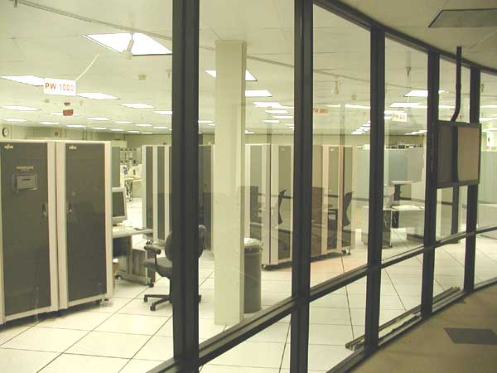
Some Examples of Grids
Commercial/Collaboration (e.g. Airbus)
Andrew

Slide 31
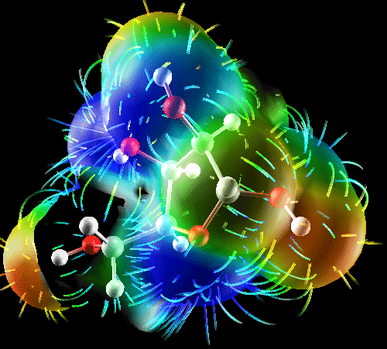
Some Examples of Grids
Community/Data sharing (e.g. NDMA mammography)
Andrew

Slide 32
The Open Grid Services
Architecture

Slide 33
Three Generations of Grid
1st Generation
  Local "Metacomputers“
    Distributed file systems
    Site-wide single sign-on
  "Metacenters" explored issues of inter-organizational integration
  Totally custom-made, top-to-bottom: proofs of concept
2nd Generation
  Utilize software services and communications protocols developed by grid projects: Condor, Globus, UNICORE, Legion, etc.
  Need significant customization to deliver complete solution
  Interoperability is still very difficult
3rd Generation
  A set of common interface specifications supports the interoperability of discrete, independently developed services
  Both competition and interoperability, not only among applications and toolkits, but among implementations of key services
Standardization is key for third-generation grids!
Replace with
next slide sequence
Source: Charlie Catlett

Slide 34
Three Generations of Grid
Source: Charlie Catlett

Slide 35

Three Generations of Grid
  Local "Metacomputers“
    Distributed file systems
    Site-wide single sign-on
  "Metacenters" explore inter-organizational integration
  Totally custom-made, top-to-bottom: proofs of concept
1
Source: Charlie Catlett

Slide 36
Three Generations of Grid
  Local "Metacomputers“
    Distributed file systems
    Site-wide single sign-on
  "Metacenters" explore inter-organizational integration
  Totally custom-made, top-to-bottom: proofs of concept
1
  Utilize software services and communications protocols developed by grid projects:
    Condor, Globus, UNICORE, Legion, etc.
  Need significant customization to deliver complete solution
  Interoperability is still very difficult!
2
Source: Charlie Catlett

Slide 37

Three Generations of Grid
  Local "Metacomputers“
    Distributed file systems
    Site-wide single sign-on
  "Metacenters" explore inter-organizational integration
  Totally custom-made, top-to-bottom: proofs of concept
1
  Utilize software services and communications protocols developed by grid projects:
    Condor, Globus, UNICORE, Legion, etc.
  Need significant customization to deliver complete solution
  Interoperability is still very difficult!
2
  Common interface specifications support interoperability of discrete, independently developed services
  Competition and interoperability among applications, toolkits, and implementations of key services
3
Source: Charlie Catlett

Slide 38
Three Generations of Grid
  Local "Metacomputers“
    Distributed file systems
    Site-wide single sign-on
  "Metacenters" explore inter-organizational integration
  Totally custom-made, top-to-bottom: proofs of concept
1
  Utilize software services and communications protocols developed by grid projects:
    Condor, Globus, UNICORE, Legion, etc.
  Need significant customization to deliver complete solution
  Interoperability is still very difficult!
2
  Common interface specifications support interoperability of discrete, independently developed services
  Competition and interoperability among applications, toolkits, and implementations of key services
3
Standardization is key for third-generation grids!
Source: Charlie Catlett

Slide 39
Three Generations of Grid
  Local "Metacomputers“
    Distributed file systems
    Site-wide single sign-on
  "Metacenters" explore inter-organizational integration
  Totally custom-made, top-to-bottom: proofs of concept
1
You are here!
  Utilize software services and communications protocols developed by grid projects:
    Condor, Globus, UNICORE, Legion, etc.
  Need significant customization to deliver complete solution
  Interoperability is still very difficult!
2
  Common interface specifications support interoperability of discrete, independently developed services
  Competition and interoperability among applications, toolkits, and implementations of key services
3
Standardization is key for third-generation grids!
Source: Charlie Catlett

Slide 40
OGSA
OGSA: An open, service-oriented architecture (SOA)
  Resources as first class entities
  Dynamic service/resource creation and destruction
Build grids from small number of standards-based components
  Replaceable, coarse-grained
  E.g. schedulers
Customizable
  Support for dynamic, domain-specific content, ...
  Within the same standardized framework
Built on a Web services infrastructure

Slide 41
OGSA Capabilities
Execution Management
Job description & submission
Scheduling
Resource provisioning
Data Services
Common access facilities
Efficient & reliable transport
Replication services
Resource Management
Discovery
Monitoring
Control
OGSA
Software
Information Services
Registry
Notification
Logging/auditing
Self-Management
Xxx
xxx
Security
Cross-organizational users!
Trust nobody!
Authenticate everybody!
Authorized access only!
OGSA “profiles”
Web services foundation
Notes:
This is a build slide – it relates very closely to the earlier “Characteristics” summary.
Network: An essential element
Resources: Computer systems, storage, etc.
The panels each relate to a key grid capability that is reflected in OGSA, the Globus Toolkit, and any comprehensive collection of grid middleware.
Security – not much more to say
Resource management:
We need a way to discover what resources are available to use
We need some way to enable them to be monitored by all grid administrators
Common control may/may not be possible – depends on the policy of the various organizations
Information:
Need a central place to advertise/locate available services
Common notification of changes in state, e.g. resources come online, failures etc.
Logging and auditing necessary for tracking, for chargeback (sometimes), and maybe for legal reasons
Execution:
Need a common way to describe jobs in terms of what to run, and what resources they need (CPU time, platform, storage, etc.)
If resources aren’t available now then locate & reserve them and plan to use them as other jobs finish
Provisioning services are needed to allocate storage, put right OS & software on disks etc.
Data:
Data may be stored in different formats – e.q. relational databases, flat files – and data services can provide a common interface regardless of how they’re stored.
Transport: It may be necessary to move large amounts of data around the grid, e.g. because a job has to access a dataset frequently and randomly, and it’s better to have it close than make each access across a network (depends on the nature of the job, of course). Using standard ftp may be too slow – grid ftp services can split the transfer into parallel streams and provide restart capability in case some part of the transfer fails.
Replication: If the same data is used frequently from different places it may be more efficient to replicate some or all of it at different locations. This needs to be managed – a replica is a cache, and it needs to be kept in sync with the authoritative version.
Accounting:
If we’re charging then need to keep accurate records of resource usage, and have a way to charge the users.
Finally: all the blue bits are functions of the grid middleware
So the orange bits are the essential elements of a grid

Slide 42
A Simple Service-oriented Grid
Andrew
Job-Submit service
Registry service
Grid middleware services
Scheduling service
Advertise
Notify
CPU Resource
Virtualized resources
Compute
service
Data
service
Application
service
Printer service
Notes:
This is not intended to conform to any particular model (i.e. don’t say it’s an OGSA-conformant grid!)
Resources are represented by services, which start up and make themselves known to the registry
Scheduling service and job-submit service also register
User at the console submits a job (there’s an assumption here that the user has direct access to the job service – in reality the user might access a portal, which would contact the registry to discover the submit service, or maybe the portal *is* simply an interface to the job service)
Job service parses the job description, discovers the scheduling service and requests the required resources
Scheduler matches resources according to type, capacity, availability etc., and schedules the job to run once the necessary resources are available
Scheduler responds to the job service to let it know that the job is scheduled – submit service reports back to user
Job (eventually) is run, and the results are reported to the job service, and relayed to the user
Notification arrow shows that the resources also can send notifications to the management console to report status changes
[The idea of the management console submitting jobs is not very realistic – better to show a separate user console, accessing a portal]

Slide 43

Why Use an SOA?
Andrew
Logical view
Coarse-grained, reusable functionality
Extensibility
Platform-neutral
Logical view
  Provide an abstracted and logical view of desired functionality
Coarse-grained, reusable behaviors
  Encapsulate complex behaviors inside of services
    (e.g. fault tolerance, parallelism)
  Service composition to construct new behaviors
Extensibility
  Provides a natural framework and constructs for extending functionality
Platform-neutral
  Interactions and functionality constructed in a standardized, platform-agnostic manner

Slide 44
SOA & Web Services: Key Benefits
Flexible:
  Service can be located on any server, relocated as necessary
  Prospective clients find it through its registry entry
Scalable:
  Services can be added and removed as demand varies
Replaceable:
  Implementations can be updated without disruption to users
  Original interfaces must be preserved
Fault-tolerant:
  On failure, clients query registry for alternate services
Interoperable:
  Growing number of industry standards
Andrew

Slide 45
Why Use Web Services?
Strong industry support
Speed time to value
  Harness robust development tools for Web services
  Reduce learning ramp and implementation fragmentation
Embrace and extend
  Leverage the significant effort in developing and driving consensus on standards
  Focus limited resources on augmenting & adding standards in areas where needed
Andrew

Slide 46
Virtualizing Resources
Access
Common Interfaces
Disks
Tapes
Printers
Computers
Web
Services
Resource-specific Interfaces
Physical
resources
Notes:
Physical resources may come from many different vendors, so different disks may have different interfaces
Virtualization layer provides common interfaces for all devices, and specialized ones as needed for certain classes – knows the specific interfaces of individual devices, and transforms requests and responses from/to the common format as needed
Management software is simplified because it only needs to know how to deal with device classes – not individual devices.
Grids typically include heterogeneous resources:
Hardware platforms and operating systems
Databases
Applications with similar functions
…
Virtualization techniques
Hide the details and differences of similar resources
Allow them to be viewed and/or manipulated in a common way
Web services enable virtualization
Provide uniform access through service interfaces
Enable integration and common management

Slide 47
Service-oriented Grids
SOA & Web services fit grid’s objectives:
  Highly scalable, heterogeneous environments
  Flexibility and high availability of services
  Inherent support for many other grid issues:
    Dynamic addition/removal of resources
    Secure distributed access
    Management of disparate resources
Evolutionary path for grid computing:
  From ad hoc components to a standardized, service-oriented architecture
  Use services to:
    Virtualize grid resources
    Implement grid middleware capabilities
  Growing set of relevant standards
Solid foundation for enterprise-class grids:
  Vendors are implementing service interfaces
Andrew

Slide 48
OGSA
In Detail

Slide 49
OGSA Capabilities
Don’t edit this slide – it’s a copy!!
Execution Management
Job description & submission
Scheduling
Resource provisioning
Data Services
Common access facilities
Efficient & reliable transport
Replication services
Resource Management
Discovery
Monitoring
Control
OGSA
Information Services
Registry
Notification
Logging/auditing
Self-Management
Xxx
xxx
Security
Cross-organizational users!
Trust nobody!
Authenticate everybody!
Authorized access only!
OGSA “profiles”
Web services foundation
Notes:
This is a build slide – it relates very closely to the earlier “Characteristics” summary.
Network: An essential element
Resources: Computer systems, storage, etc.
The panels each relate to a key grid capability that is reflected in OGSA, the Globus Toolkit, and any comprehensive collection of grid middleware.
Security – not much more to say
Resource management:
We need a way to discover what resources are available to use
We need some way to enable them to be monitored by all grid administrators
Common control may/may not be possible – depends on the policy of the various organizations
Information:
Need a central place to advertise/locate available services
Common notification of changes in state, e.g. resources come online, failures etc.
Logging and auditing necessary for tracking, for chargeback (sometimes), and maybe for legal reasons
Execution:
Need a common way to describe jobs in terms of what to run, and what resources they need (CPU time, platform, storage, etc.)
If resources aren’t available now then locate & reserve them and plan to use them as other jobs finish
Provisioning services are needed to allocate storage, put right OS & software on disks etc.
Data:
Data may be stored in different formats – e.q. relational databases, flat files – and data services can provide a common interface regardless of how they’re stored.
Transport: It may be necessary to move large amounts of data around the grid, e.g. because a job has to access a dataset frequently and randomly, and it’s better to have it close than make each access across a network (depends on the nature of the job, of course). Using standard ftp may be too slow – grid ftp services can split the transfer into parallel streams and provide restart capability in case some part of the transfer fails.
Replication: If the same data is used frequently from different places it may be more efficient to replicate some or all of it at different locations. This needs to be managed – a replica is a cache, and it needs to be kept in sync with the authoritative version.
Accounting:
If we’re charging then need to keep accurate records of resource usage, and have a way to charge the users.
Finally: all the blue bits are functions of the grid middleware
So the orange bits are the essential elements of a grid

Slide 50
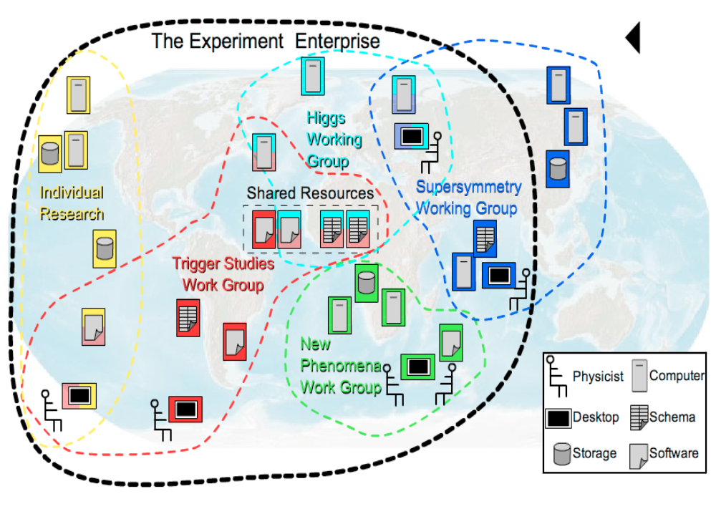
Security Services
Authorization, roles, and access privileges
  Locally (site) managed
  SAML and XACML Basis
  Credential mapping provided by implementations.

Slide 51
Security
Built on WS-Security standards, XACML, SAML
Working with Security areas in GGF
  Working on authorization attributes for grids
Two profiles:
  Resolves interplay between WS-Addressing and WS-Security
  Provide certificate startup
  OGSA Basic Security Profile - Core
  OGSA Basic Security Profile - Secure Channel

Slide 52
Execution management …

Slide 53
Describing a Job: JSDL
Job Submission Description Language
A mechanism for describing a job
(Andreas supply slide…)

Slide 54
JSDL:
Identifies the job
  Name, owner, authorization etc.
Specifies requirements
  Application (binaries)
  Execution environment
  Input/Output files
JSDL
JOB

Slide 55
Configuration & Deployment
CDDLM
provides a right-shaped slot to fit the job
….

Slide 56
Execution Management Services
Basic problem: provision, execute/instantiate and manage services/resources (including legacy applications) in a grid
  Some use cases
    start up a cache service; on-demand, utility computing; start up and manage a set of legacy applications
Example questions to address:
  Where can a service execute?
  Where should the service execute?
  Prepare the service to execute
  Get the service executing
  Manage (monitor, restart, move, etc.)
Andrew (graphical build to make all the pieces come together??)

Slide 57
EMS – Executing a Job
Dynamic and static system information
Andrew
Candidate Set Generator
(Work -Resource mapping)
Provisioning
  Deployment
  Configuration
4
3
2
Information Services
Execution Planning Services
Reservation
5
1
6
Service
Container
Job Manager
7
Accounting Services
0

Slide 58
Distributed naming – required properties
Unique
Provide identity
Comparable
Location portable
Widely adopted
Scalable – high performance
Extensible
Dynamic binding
….
Two- and three-level name schemes dominate

Slide 59
Naming – Three-Level Schemes
Human –> abstract –> address
In OGSA:
  Human -> address and Human -> abstract naming levels will likely be handled by the Resource Naming Service (RNS) being developed by the GGF GFS-WG
  AbstractName -> address is being handled by the GGF WS-Naming efforts
    Initial thinking: EPR annotated with AbstractName URI and optional resolution handle
  Form of AbstractName is under discussion
    Initial proposal: Abstract name is a URI or IRI
    Other proposals: Context-oriented, like job numbers/id
Andrew

Slide 60
Data Services
Use case driven
Many different data “types” and use scenarios from HEP to business intelligence
Strong consensus emerging with some issues still around meta-data and information dissemination
OGSA-ByteIO, RNS, and DAI are leading efforts
Dave B – 2-4 slides?

Slide 61
Resource Management
Provides a framework to integrate resource management functionality:
  interfaces, services, information models, etc.
Enables integrated discovery, monitoring, control, etc.
Domain-specific capabilities
Application-
specific
OGSA
High-level
management
services
(GGF)
Execution
Management
services
Data
services
Security
services
WSDM, WS-Management
Access to
manageability
(OASIS, DMTF)
WSRF/WSN, WS-Transfer/Eventing
Resources
Information
models (DMTF,
SNIA, etc.)

Slide 62
Other OGSA Capabilities
Information Services
Jem
Self-Management

Slide 63
Profiles
Define a usage pattern and include specifications developed by working groups both within and external to GGF
Issue: How mature and widely adopted?
OGSA Profiles are styled on the WS-I profile
Three “in the pipe”
  OGSA WSRF Basic Profile – an extension of WS-I
  OGSA Basic Security Profile
  OGSA Basic Security - Secure Channel Profile
Expected Profiles
  Data
  Execution Management
Discuss content & placement w/Tom & Jay

Slide 64
OGSA Profiles
Normatively define OGSA
Based on WS Interoperability (WS-I) profiles:
Prescribe use of a set of specifications for limited purposes
Vendors claim conformance to specific OGSA Profiles:
  “my scheduler conforms to OGSA Basic Execution Mgmt Profile 1.0”

Slide 65
OGSA and the
Standards Landscape

Slide 66
Specifications Landscape: April 2006
Warning: Data may be inaccurate!
SYSTEMS
MANAGEMENT
GRID
COMPUTING
UTILITY
COMPUTING
Use Cases &
Applications
Distributed query processing
Data Centre
Collaboration
Persistent Archive
ASP
Multi Media
VO Management
OGSA Self Mgmt
OGSA-EMS
WS-DAI
Information
WSDM
Discovery
GGF-UR
WS-BaseNotification
Naming
Core Services
Privacy
Trust
GFD-C.16
WSRF-RP
WSRF-RL
Data Model
WSRF-RAP
WS-Security
SAML/XACML
X.509
Base Profile
WS-Addressing
HTTP(S)/SOAP
WSDL
CIM/JSIM
Data Transport
Hole
Gap
Evolving
Standard

Slide 67




OGSA-related Standards Bodies
GGF (Global Grid Forum)
  Overall architecture for grid computing
  OGSA, CDDLM, WS-Agreement, …
OASIS (Organization for the Advancement of Structured Information Standards)
  Middleware/Web services focused
  WSRF, WS-Notification, WSDM, WS-Security…
DMTF (Distributed Management Task Force)
  Management and Information models (CIM)
  Server management
  WS-CIM
W3C (WWW Consortium)
  WS-Addressing
Not a complete list!
Logos are trademarks or service marks of their respective owners.
Notes:
Also mention W3C – apart from all the obvious internet standards they are responsible for WS-Addressing. Should be added to this slide. Also we did mention W3C on an earlier slide.

Slide 68
Making It Happen:
The OGSA Working Group

Slide 69
The OGSA Working Group
History:
  Proposed at GGF4 (2/02)
  Working group created (9/02)
  Declared as GGF’s “flagship architecture” at GGF10 (3/04)
Getting it done:
  Over 300 mailing list subscribers
  Twice-weekly teleconferences
  Regular face-to-face meetings
  Collaboration with other working groups and SDOs
Contributors
  Industry
  Government
  Academia

Slide 70
OGSA Process
Use Case Driven
  21 Detailed Use Cases (~ 6 pages each)
    Tier 1 Available at: http://www.ggf.org/documents/GWD-I-E/GFD-I.029.pdf
Distributed Specification and Standardization
  Identify and/or develop open and accessible standard specifications
  Active current work in GGF, OASIS, W3C, and DMTF.
“Design Team” Working Model
  Facilitate cross fertilization within and outside GGF.
  Avoid redundant work applicable efforts
  Focus mind share (the most valuable commodity)
    e.g. DAIS-WG and OGSA-Data Design Team
  Design teams: EMS, Resource Mgmt., Security, Information Svc.
Iterative Refinement
  Abstract service evolving to concrete specifications
Documents:
  OGSA: Use Cases, Informal Specification, Recommendation

Slide 71
OGSA Aims & Perspective
Goals
  Interoperable solutions for grid-based applications
  Addressing loosely coupled distributed computing
Approach
  Standardization at the architectural level
    Understand & describe the elements of the spectrum of grid systems and models
    Develop the architectural framework for standards in service-oriented grids
    Similar to profiling
  Use existing standards and technology where possible
    Validate current standards for applicability in grids
  Use case-driven gap analysis – gaps filled proactively:
    Provide direction/motivation for new standards activity
    Leverage & collaborate with other SDOs
Philosophy
  Can’t do it all – extensibility
  Separation of policy and mechanism

Slide 72

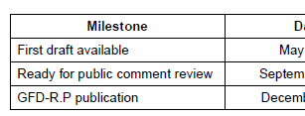
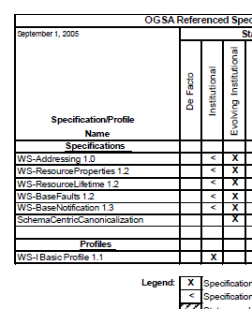
OGSA Roadmap
Defines OGSA as:
  An architectural process
  A set of specifications & profiles
  OGSA software
For each OGSA-related document:
  Schedule
  Dependencies
Publication:
  v1.0 published September ’05 (GFD.53)
  Next version in progress

Slide 73
OGSA Use Cases Document
Purpose
Brief description
Publication:
  v1.0 published 11/04 (document-id)

Slide 74
OGSA Architecture Document
Describes the architecture
Defines requirements, infrastructure, capabilities
v1.0 published 3/05
v1.5 in public comment 4/06

Slide 75
OGSA Schedule
2004
2005
2006
Base document
OGSA-WG
Architecture V1.0 (GFD-I.30)
OGSA-WG
V1.5
Scenarios & service descriptions
Data architecture
OGSA-Data
WSRF Basic Profile
OGSA-WG
Recommended
profile
JSDL (GFD-R-P.56)
JSDL
ByteIO
OGSA-ByteIO
Normative
specifications
Basic Execution Service
OGSA-BES
RNS
GFS
WS-DAI
WS-DAI
Left edge: public comment start, Right edge: GFD publication

Slide 76
Projects
??? List some projects that are actively using or contributing to OGSA – per the roadmap – to show that we have real participation
Hiro

Slide 77
Grid Direction
Pervasive adoption
  Education & Research
  Industry
  Commercial
  Grid technology in every data center
Utility computing
  On-demand service model
  Based on grid technology
  Everything is virtual
  Andrew

Slide 78
Summary
Building robust, distributed, applications is a challenge with a number of significant issues that need to be solved.
Interoperability is key! Thus OGSA is defining a set of core services designed to work together – but at the same time providing implementation flexibility.
We do not think the current set is the end of the road – just the beginning!
Andrew

Slide 79

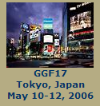

Useful Links
http://ggf.org
http://forge.gridforum.org/projects/ogsa-wg

Slide 80
GGF Full Copyright Notice
Copyright (C) Global Grid Forum (2005, 2006). All Rights Reserved.
This document and translations of it may be copied and furnished to others, and derivative works that comment on or otherwise explain it or assist in its implementation may be prepared, copied, published and distributed, in whole or in part, without restriction of any kind, provided that the above copyright notice and this paragraph are included on all such copies and derivative works. However, this document itself may not be modified in any way, such as by removing the copyright notice or references to the GGF or other organizations, except as needed for the purpose of developing Grid Recommendations in which case the procedures for copyrights defined in the GGF Document process must be followed, or as required to translate it into languages other than English.
The limited permissions granted above are perpetual and will not be revoked by the GGF or its successors or assigns.
This document and the information contained herein is provided on an "AS IS" basis and THE GLOBAL GRID FORUM DISCLAIMS ALL WARRANTIES, EXPRESS OR IMPLIED, INCLUDING BUT NOT LIMITED TO ANY WARRANTY THAT THE USE OF THE INFORMATION HEREIN WILL NOT INFRINGE ANY RIGHTS OR ANY IMPLIED WARRANTIES OF MERCHANTABILITY OR FITNESS FOR A PARTICULAR PURPOSE."

Slide 81
Backup Slides

Slide 82
OGSA Document Structure
OGSA
Roadmap
OGSA
Architecture
OGSA
Use Cases
inform
and
guide
Root document
Scenario
Service
Description
feedback
Informational
Modeling
guidelines
inform
and
guide
consistent
Proposed
recommendation
feedback
Candidate Profile
Profile
OGSA-WG documents
Information
models
Documents produced
by other GGF WGs
or other SDOs
refer
Actual
specs

Slide 83
OGSA-* WG
CY
2002
2003
2004
2005
2006
OGSA-WG
Use Cases
Arch 1.0
Roadmap
OGSA-Data WG
OGSA
debut
OGSA-AuthZ WG
OGSA-RSS WG
OGSA-BES WG
OGSA-ByteIO WG
WSRF BP 1.0
OGSI-WG
OGSI 1.0
WSRF TC
WSRF 1.0
WSRF
OGSA-Naming WG

Slide 84
W3C: World-Wide Web Consortium
W3C is an international consortium where Member organizations, a full-time staff, and the public work together to develop Web standards.
Founded in 1994, ~80 published recommendations, staff on 3 continents
Members of W3C range from leading technology companies to non-profit organisations and individuals.
Best known for fundamental web standards, including:
XML
XML Schema
XHTML
XSL/XSLT
MathML
SSML
CCS
OWL
Several working groups are relevant to grid standards projects including:
WS-Addressing
WSDL 2.0
Binary data

Slide 85
DMTF: Distributed Management Task Force
DMTF is an industry organization leading the development of management standards and integration technology.
Founded in 1992
Best known for standards that address system management in enterprise and Internet environments, including:
CIM
WBEM
DMI
Several working groups are relevant to grid standards projects including:
CIM Core
Utility Computing
Server Management

Slide 86
OASIS: Organization for the Advancement of Structured Information Standards
OASIS is a member-led, international nonprofit standards consortium concentrating on structured information and global e-business standards
Founded in 1993, ~65 projects, staff on 3 continents
Members of OASIS are
  Vendors, users, academics and governments
  Organizations, individuals and industry groups
Best known for e-business standards that address real world business requirements, including
UDDI
SAML
ebXML
WS-Security
WSRP
WS-Reliability
SPML
XACML
UBL
Host for key grid standards projects including
WSDM
WSRF
WS-N

Slide 87
E.g. OGSA-Data Working Group
Brings together:
  Domain experts within OGSA
  Chairs of other WG/RGs
Output is included in OGSA specification

Slide 88
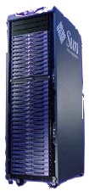
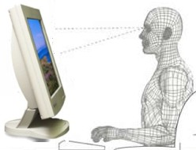

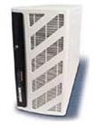
Typical Grid Layers
Grid-Enabled Applications
Grid
Development
Grid Visualization
Grid Workflow
EMS
- Grid RPC
- Grid MPI
- MDA
Scheduler
Manager
Packaging -ACS
Grid Security
Grid Middleware Engine
Grid VMs, Cache
High Performance & Secure Grid Networking
Physical Network Layer
Org-A
Org-B
Org-C
Org-D
Source: Adapted from NaReGI-PSE National Grid Initiative slides from GGF - ACS-WG, OGSA Standardization Process

Slide 89
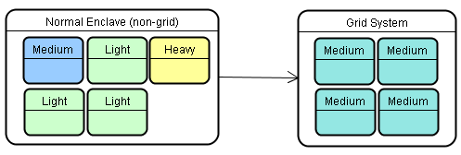
Grid Operating Environment (GOE)
Dynamic Automated Virtual Global Grid
The Grid Operating Environment is a concept infrastructure framework and system supporting secure coordinated resource sharing between geographically dispersed, heterogeneous and dynamic virtual organizations.
R2AD
Dynamic Automated Virtual Global Grid
Autonomic management is provided by the Service Oriented Grid Infrastructure based on OGSA.
Source: http://www.r2ad.com/presentations/DoDSoftwareTransformation-v2.pdf

Slide 90


Some Characteristics of Grids
Numerous
resources
Ownership by mutually
distrustful organizations
& individuals
Connected by
heterogeneous,
multi-level networks
Different security
requirements
& policies
Different resource
management
policies
Unreliable resources and environments
Geographically
separated
Resources are
heterogeneous

