Slide 1
Defining the Grid: An Introduction to the
Open Grid Services Architecture
A webcast by the GGF’s OGSA™ working group
April 26, 2006
OGSA is a trademark of the Global Grid Forum

Slide 2
GGF Full Copyright Notice
Copyright (C) Global Grid Forum (2005, 2006). All Rights Reserved.
This document and translations of it may be copied and furnished to others, and derivative works that comment on or otherwise explain it or assist in its implementation may be prepared, copied, published and distributed, in whole or in part, without restriction of any kind, provided that the above copyright notice and this paragraph are included on all such copies and derivative works. However, this document itself may not be modified in any way, such as by removing the copyright notice or references to the GGF or other organizations, except as needed for the purpose of developing Grid Recommendations in which case the procedures for copyrights defined in the GGF Document process must be followed, or as required to translate it into languages other than English.
The limited permissions granted above are perpetual and will not be revoked by the GGF or its successors or assigns.
This document and the information contained herein is provided on an "AS IS" basis and THE GLOBAL GRID FORUM DISCLAIMS ALL WARRANTIES, EXPRESS OR IMPLIED, INCLUDING BUT NOT LIMITED TO ANY WARRANTY THAT THE USE OF THE INFORMATION HEREIN WILL NOT INFRINGE ANY RIGHTS OR ANY IMPLIED WARRANTIES OF MERCHANTABILITY OR FITNESS FOR A PARTICULAR PURPOSE."

Slide 3
Admin stuff
Plan:
  Run through with HP facilitator (Tanya) – Mon 4/24, 5pm
  Event: Wed April 26th, 2pm US Eastern, 90 minutes
  Speakers/panel join at 1:30pm
Registration:
  Register now at: http://www.presentationselect.com/hpinvent/detailsl.asp#1188
  Speakers & panel must not register here (details later)
  Advertise now
  Max 150 registrations

Slide 4
Structure
Welcome & admin info – Tanya
Introduce Andrew & OGSA-WG – Jem
Presentation Part 1: Grid
?? Q&A 1 (Andrew – clarification questions)
Presentation Part 2: OGSA
Introduce panel, then Q&A 2 (Panel)
?? Poll (during Q&A – any other time?)
Wrap-up – Tanya

Slide 5
Panel
Andrew
Hiro
Jem
Tom M (?)
Dave S (?)
Chris Jordan
Frank
Jay (?)

Slide 6
Poll Questions
Are you familiar with OGSA?
  No
  I’ve heard of it, but I’m not sure what it is
  I’ve read the Roadmap and/or the Architecture
  I’ve read most or all of the OGSA documents
How important to you is it that OGSA is an open standard with participation from multiple organizations?
Is your organization using grid technology today?
Is your organization planning to use grid technology?
What type of organization? (research, industrial, commercial, finance, computer software or hardware supplier)
What OGSA capabilities are most important to you?
Was this session useful to you?

Slide 7
Agenda
An Overview of Grid Computing
The Open Grid Services Architecture
A Closer Look at OGSA
The Standards Landscape
The OGSA Working Group
Summary

Slide 8
An Overview of
Grid Computing

Slide 9
A Grid Computing Timeline
US Grid Forum forms at SC ‘98
Grid Forums merge, form GGF
I-Way: SuperComputing ‘95
European & AP Grid Forums
OGSA-WG formed
“Physiology” paper
“Anatomy” paper
OGSA v1.0
…
1995 | ’96 | ’97 | ’98 | ’99 | 2000 | ’01 | ’02 | ’03 | ’04 | ’05 | 2006
  Japan government funds:
  Business Grid project
  NAREGI project
  UK e-Science program starts
DARPA funds Globus Toolkit & Legion
EU funds UNICORE project
US DoE pioneers grids for scientific research
NSF funds National Technology Grid
NASA starts Information Power Grid
  Today:
  Grid solutions are common for HPC
  Grid-based business solutions are becoming common
  Required technologies & standards are evolving
Notes:
Grid began in high-performance technical computing as a way to share widespread computing resources
1994 – 1995 Argonne National Lab & University of Illinois at Chicago formed “I‑WAY” for SuperComputing ’95 (SC95):
Led by Ian Foster
Linked 11 high-speed networks into a “national computing grid”
1997 Globus Toolkit development funded by DARPA*
Then:
US Dept. of Energy pioneered use of grids for scientific research
National Science Foundation funded National Technology Grid
NASA began its Information Power Grid
1998 Grid sessions at SC98 resulted in formation of the US Grid Forum:
Define and promote grid standards and best practices
2000 US Grid Forum merged with European & Asia-Pacific Grid Forums to form the Global Grid Forum (GGF):
Produced many grid standards and specifications
17th GGF conference in May 2006
Participation from major vendors and the grid community
Today:
Grid solutions are common for high-performance computing
Commercial organizations expect grid-based business solutions:
Adoption is in its early stages
Required technologies & standards are evolving
Mainstream adoption expected in the next few years

Slide 10


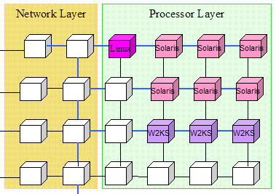
What is a Grid?
A grid is a system consisting of
  Distributed but connected resources and
  Software and/or hardware that provides and manages logically seamless access to those resources to meet desired objectives
Web
server
License
Handheld
Server
Supercomputer
Workstation
Cluster
Data Center
Database
Printer
R2AD

Slide 11
Grid & Related Paradigms
Cluster
Tightly coupled
Homogeneous
Cooperative working
Notes:
Grids
Grids often cross management/ownership boundaries
Usually include heterogeneous hardware & software
Pooled resources dynamically assigned for short-term use
Scale ranges from a few nodes to many thousands
Clusters
Multiple computers working cooperatively
Typically homogeneous hardware & software
Close proximity
Often tightly coupled – e.g. shared memory, high-speed interconnect
Distributed computing
Nodes loosely connected by network
May be geographically distant
Centrally managed
Utility computing
Computing services used with no knowledge of the infrastructure
Resource usage billed and paid for like any other utility service
Grid can be the underlying technology of utility computing

Slide 12
Grid & Related Paradigms
Distributed Computing
Loosely coupled
Heterogeneous
Central management
Cluster
Tightly coupled
Homogeneous
Cooperative working
Notes:
Grids
Grids often cross management/ownership boundaries
Usually include heterogeneous hardware & software
Pooled resources dynamically assigned for short-term use
Scale ranges from a few nodes to many thousands
Clusters
Multiple computers working cooperatively
Typically homogeneous hardware & software
Close proximity
Often tightly coupled – e.g. shared memory, high-speed interconnect
Distributed computing
Nodes loosely connected by network
May be geographically distant
Centrally managed
Utility computing
Computing services used with no knowledge of the infrastructure
Resource usage billed and paid for like any other utility service
Grid can be the underlying technology of utility computing

Slide 13
Grid & Related Paradigms
Distributed Computing
Loosely coupled
Heterogeneous
Central management
Cluster
Tightly coupled
Homogeneous
Cooperative working
Grid Computing
Large scale
Multi-organizational
Cross-geography
Distributed management
Notes:
Grids
Grids often cross management/ownership boundaries
Usually include heterogeneous hardware & software
Pooled resources dynamically assigned for short-term use
Scale ranges from a few nodes to many thousands
Clusters
Multiple computers working cooperatively
Typically homogeneous hardware & software
Close proximity
Often tightly coupled – e.g. shared memory, high-speed interconnect
Distributed computing
Nodes loosely connected by network
May be geographically distant
Centrally managed
Utility computing
Computing services used with no knowledge of the infrastructure
Resource usage billed and paid for like any other utility service
Grid can be the underlying technology of utility computing

Slide 14
Grid & Related Paradigms
Distributed Computing
Loosely coupled
Heterogeneous
Central management
Cluster
Tightly coupled
Homogeneous
Cooperative working
Grid Computing
Large scale
Multi-organizational
Cross-geography
Distributed management
Utility Computing
Computing “services”
No knowledge of provider
Enabled by grid technology
Notes:
Grids
Grids often cross management/ownership boundaries
Usually include heterogeneous hardware & software
Pooled resources dynamically assigned for short-term use
Scale ranges from a few nodes to many thousands
Clusters
Multiple computers working cooperatively
Typically homogeneous hardware & software
Close proximity
Often tightly coupled – e.g. shared memory, high-speed interconnect
Distributed computing
Nodes loosely connected by network
May be geographically distant
Centrally managed
Utility computing
Computing services used with no knowledge of the infrastructure
Resource usage billed and paid for like any other utility service
Grid can be the underlying technology of utility computing

Slide 15
How Are Grids Used?
High-performance computing
Collaborative design
E-Business
High-energy physics
Financial modeling
Data center automation
Life sciences
E-Science
Drug discovery
Collaborative data-sharing

Slide 16
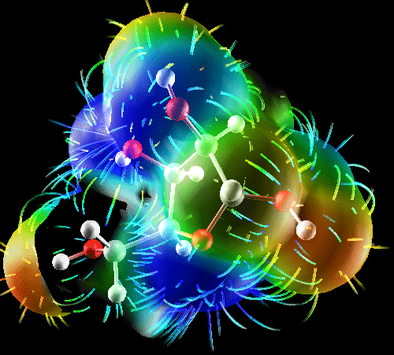
Grids In Use: E-Science Examples
Data sharing and integration
  Life sciences, sharing standard data-sets, combining collaborative data-sets
  Medical informatics, integrating hospital information systems for better care and better science
  Sciences, high-energy physics
Simulation-based science and engineering
  Earthquake simulation
Capability computing
  Life sciences, molecular modeling, tomography
  Engineering, materials science
  Sciences, astronomy, physics
High-throughput, capacity computing for
  Life sciences: BLAST, CHARMM, drug screening
  Engineering: aircraft design, materials, biomedical
  Sciences: high-energy physics, economic modeling

Slide 17
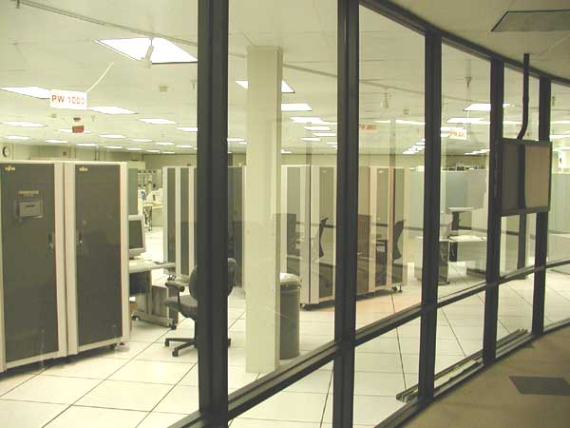
Grids In Use: E-Business Examples
High-throughput computing
  Aircraft design
  Drug discovery
  Electronic design automation
Financial services
  Portfolio modeling
  Data integration
Large-scale collaboration
  Aircraft design
  Automobile design
Enterprise Information Integration (EII)
  Banking
  Drug discovery
  Collaborative engineering

Slide 18
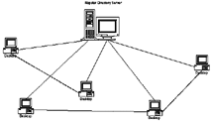
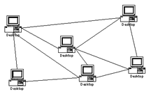
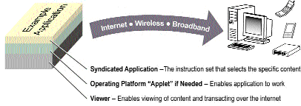
Some Characteristics of Grids
Numerous
resources
Owned by multiple organizations & individuals
Connected by
heterogeneous,
multi-level networks
Different security
requirements
& policies
Different resource
management
policies
Unreliable
resources and environments
Geographically
separated
Resources are
heterogeneous

Slide 19
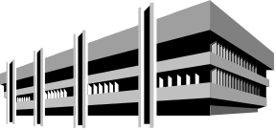


Some Characteristics of Grids
Numerous
resources
Owned by multiple organizations & individuals
Connected by
heterogeneous,
multi-level networks
Different security
requirements
& policies
Different resource
management
policies
Unreliable
resources and environments
Geographically
separated
Resources are
heterogeneous

Slide 20


Some Characteristics of Grids
Numerous
resources
Owned by multiple organizations & individuals
Connected by
heterogeneous,
multi-level networks
Different security
requirements
& policies
Different resource
management
policies
Unreliable
resources and environments
Geographically
separated
Resources are
heterogeneous

Slide 21


Some Characteristics of Grids
Numerous
resources
Owned by multiple organizations & individuals
Connected by
heterogeneous,
multi-level networks
Different security
requirements
& policies
Different resource
management
policies
Unreliable
resources and environments
Geographically
separated
Resources are
heterogeneous

Slide 22
Some Characteristics of Grids
Numerous
resources
Owned by multiple organizations & individuals
Connected by
heterogeneous,
multi-level networks
Different security
requirements
& policies
Different resource
management
policies
Unreliable
resources and environments
Geographically
separated
Resources are
heterogeneous

Slide 23

Some Characteristics of Grids
Numerous
resources
Owned by multiple organizations & individuals
Connected by
heterogeneous,
multi-level networks
Different security
requirements
& policies
Different resource
management
policies
Unreliable
resources and environments
Geographically
separated
Resources are
heterogeneous

Slide 24

Some Characteristics of Grids
Numerous
resources
Owned by multiple organizations & individuals
Connected by
heterogeneous,
multi-level networks
Different security
requirements
& policies
Different resource
management
policies
Unreliable
resources and environments
Geographically
separated
Resources are
heterogeneous

Slide 25

Some Characteristics of Grids
Numerous
resources
Owned by multiple organizations & individuals
Connected by
heterogeneous,
multi-level networks
Different security
requirements
& policies
Different resource
management
policies
Unreliable
resources and environments
Geographically
separated
Resources are
heterogeneous

Slide 26
Key Requirements for Grid Middleware
Notes:
Grids
Grids often cross management/ownership boundaries
Usually include heterogeneous hardware & software
Pooled resources dynamically assigned for short-term use
Scale ranges from a few nodes to many thousands
Clusters
Multiple computers working cooperatively
Typically homogeneous hardware & software
Close proximity
Often tightly coupled – e.g. shared memory, high-speed interconnect
Distributed computing
Nodes loosely connected by network
May be geographically distant
Centrally managed
Utility computing
Computing services used with no knowledge of the infrastructure
Resource usage billed and paid for like any other utility service
Grid can be the underlying technology of utility computing

Slide 27
Key Requirements for Grid Middleware
Wide distribution
Fault-tolerant
Secure
Manage complexity
Notes:
Grids
Grids often cross management/ownership boundaries
Usually include heterogeneous hardware & software
Pooled resources dynamically assigned for short-term use
Scale ranges from a few nodes to many thousands
Clusters
Multiple computers working cooperatively
Typically homogeneous hardware & software
Close proximity
Often tightly coupled – e.g. shared memory, high-speed interconnect
Distributed computing
Nodes loosely connected by network
May be geographically distant
Centrally managed
Utility computing
Computing services used with no knowledge of the infrastructure
Resource usage billed and paid for like any other utility service
Grid can be the underlying technology of utility computing

Slide 28
Key Requirements for Grid Middleware
Wide distribution
Fault-tolerant
Secure
Manage complexity
Modular
Composable
Scalable
Extensible
Notes:
Grids
Grids often cross management/ownership boundaries
Usually include heterogeneous hardware & software
Pooled resources dynamically assigned for short-term use
Scale ranges from a few nodes to many thousands
Clusters
Multiple computers working cooperatively
Typically homogeneous hardware & software
Close proximity
Often tightly coupled – e.g. shared memory, high-speed interconnect
Distributed computing
Nodes loosely connected by network
May be geographically distant
Centrally managed
Utility computing
Computing services used with no knowledge of the infrastructure
Resource usage billed and paid for like any other utility service
Grid can be the underlying technology of utility computing

Slide 29
Key Requirements for Grid Middleware
Wide distribution
Fault-tolerant
Secure
Manage complexity
Modular
Composable
Scalable
Extensible
Interoperable
Standards-based
Transparent support for legacy components
Notes:
Grids
Grids often cross management/ownership boundaries
Usually include heterogeneous hardware & software
Pooled resources dynamically assigned for short-term use
Scale ranges from a few nodes to many thousands
Clusters
Multiple computers working cooperatively
Typically homogeneous hardware & software
Close proximity
Often tightly coupled – e.g. shared memory, high-speed interconnect
Distributed computing
Nodes loosely connected by network
May be geographically distant
Centrally managed
Utility computing
Computing services used with no knowledge of the infrastructure
Resource usage billed and paid for like any other utility service
Grid can be the underlying technology of utility computing

Slide 30
Three Generations of Grid
Source: Charlie Catlett

Slide 31

Three Generations of Grid
  Local “metacomputers“
    Distributed file systems
    Site-wide single sign-on
  "Metacenters" explore inter-organizational integration
  Totally custom-made, top-to-bottom: proofs-of-concept
1
Source: Charlie Catlett

Slide 32
Three Generations of Grid
  Local “metacomputers“
    Distributed file systems
    Site-wide single sign-on
  "Metacenters" explore inter-organizational integration
  Totally custom-made, top-to-bottom: proofs-of-concept
1
  Utilize software services and communications protocols developed by grid projects:
    Condor, Globus, UNICORE, Legion, etc.
  Need significant customization to deliver complete solution
  Interoperability is still very difficult!
2
Source: Charlie Catlett

Slide 33

Three Generations of Grid
  Local “metacomputers“
    Distributed file systems
    Site-wide single sign-on
  "Metacenters" explore inter-organizational integration
  Totally custom-made, top-to-bottom: proofs-of-concept
1
  Utilize software services and communications protocols developed by grid projects:
    Condor, Globus, UNICORE, Legion, etc.
  Need significant customization to deliver complete solution
  Interoperability is still very difficult!
2
  Common interface specifications support interoperability of discrete, independently developed services
  Competition and interoperability among applications, toolkits, and implementations of key services
3
Source: Charlie Catlett

Slide 34
Three Generations of Grid
  Local “metacomputers“
    Distributed file systems
    Site-wide single sign-on
  "Metacenters" explore inter-organizational integration
  Totally custom-made, top-to-bottom: proofs-of-concept
1
  Utilize software services and communications protocols developed by grid projects:
    Condor, Globus, UNICORE, Legion, etc.
  Need significant customization to deliver complete solution
  Interoperability is still very difficult!
2
  Common interface specifications support interoperability of discrete, independently developed services
  Competition and interoperability among applications, toolkits, and implementations of key services
3
Standardization is key for third-generation grids!
Source: Charlie Catlett

Slide 35
Three Generations of Grid
  Local “metacomputers“
    Distributed file systems
    Site-wide single sign-on
  "Metacenters" explore inter-organizational integration
  Totally custom-made, top-to-bottom: proofs of concept
1
We are here!
  Utilize software services and communications protocols developed by grid projects:
    Condor, Globus, UNICORE, Legion, etc.
  Need significant customization to deliver complete solution
  Interoperability is still very difficult!
2
  Common interface specifications support interoperability of discrete, independently developed services
  Competition and interoperability among applications, toolkits, and implementations of key services
3
Standardization is key for third-generation grids!
Source: Charlie Catlett

Slide 36
The Open Grid Services
Architecture

Slide 37
The Open Grid Services Architecture
An open, service-oriented architecture (SOA)
  Resources as first-class entities
  Dynamic service/resource creation and destruction
Built on a Web services infrastructure
Resource virtualization at the core
Build grids from small number of standards-based components
  Replaceable, coarse-grained
  e.g. brokers
Customizable
  Support for dynamic, domain-specific content…
  …within the same standardized framework

Slide 38
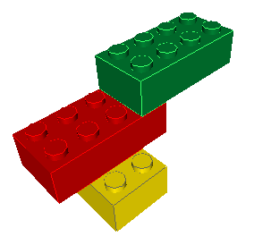
Why Use an SOA?
Logical view of capabilities
Relatively coarse-grained functions
Reusable and composable behaviors
Encapsulation of complex operations
Naturally extendable framework
Platform-neutral
  machine and OS

Slide 39
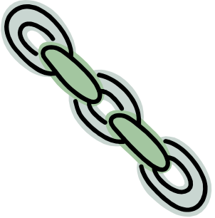
SOA & Web Services: Key Benefits
SOA
Flexible
  Locate services on any server
  Relocate as necessary
  Prospective clients find services using registries
Scalable
  Add & remove services as demand varies
Replaceable
  Update implementations without disruption to users
Fault-tolerant
  On failure, clients query registry for alternate services
Web Services
Interoperable
  Growing number of industry standards
Strong industry support
Reduce time-to-value
  Harness robust development tools for Web services
  Decrease learning & implementation time
Embrace and extend
  Leverage effort in developing and driving consensus on standards
  Focus limited resources on augmenting & adding standards as needed

Slide 40
Virtualizing Resources
Access
Type-specific interfaces
Computers
Storage
Sensors
Applications
Information
Common Interfaces
Web
services
Resource-specific Interfaces
Resources
Notes:
Physical resources may come from many different vendors, so different disks may have different interfaces
Virtualization layer provides common interfaces for all devices, and specialized ones as needed for certain classes – knows the specific interfaces of individual devices, and transforms requests and responses from/to the common format as needed
Management software is simplified because it only needs to know how to deal with device classes – not individual devices.
Grids typically include heterogeneous resources:
Hardware platforms and operating systems
Databases
Applications with similar functions
…
Virtualization techniques
Hide the details and differences of similar resources
Allow them to be viewed and/or manipulated in a common way
Web services enable virtualization
Provide uniform access through service interfaces
Enable integration and common management

Slide 41
A Service-Oriented Grid
Job-Submit Service
Registry Service
Grid middleware services
Brokering Service
Advertise
Notify
CPU Resource
Compute
Service
Data
Service
Application
Service
Printer Service
Virtualized resources
Notes:
This is not intended to conform to any particular model (i.e. don’t say it’s an OGSA-conformant grid!)
Resources are represented by services, which start up and make themselves known to the registry
Scheduling service and job-submit service also register
User at the console submits a job (there’s an assumption here that the user has direct access to the job service – in reality the user might access a portal, which would contact the registry to discover the submit service, or maybe the portal *is* simply an interface to the job service)
Job service parses the job description, discovers the scheduling service and requests the required resources
Scheduler matches resources according to type, capacity, availability etc., and schedules the job to run once the necessary resources are available
Scheduler responds to the job service to let it know that the job is scheduled – submit service reports back to user
Job (eventually) is run, and the results are reported to the job service, and relayed to the user
Notification arrow shows that the resources also can send notifications to the management console to report status changes
[The idea of the management console submitting jobs is not very realistic – better to show a separate user console, accessing a portal]

Slide 42
OGSA:
A Closer Look

Slide 43
OGSA Capabilities
Execution Management
Job description & submission
Scheduling
Resource provisioning
Data Services
Common access facilities
Efficient & reliable transport
Replication services
Resource Management
Discovery
Monitoring
Control
OGSA
Self-Management
Self-configuration
Self-optimization
Self-healing
Information Services
Registry
Notification
Logging/auditing
Security
Cross-organizational users
Trust nobody
Authorized access only
OGSA “profiles”
Web services foundation
Notes:
This is a build slide – it relates very closely to the earlier “Characteristics” summary.
Network: An essential element
Resources: Computer systems, storage, etc.
The panels each relate to a key grid capability that is reflected in OGSA, the Globus Toolkit, and any comprehensive collection of grid middleware.
Security – not much more to say
Resource management:
We need a way to discover what resources are available to use
We need some way to enable them to be monitored by all grid administrators
Common control may/may not be possible – depends on the policy of the various organizations
Information:
Need a central place to advertise/locate available services
Common notification of changes in state, e.g. resources come online, failures etc.
Logging and auditing necessary for tracking, for chargeback (sometimes), and maybe for legal reasons
Execution:
Need a common way to describe jobs in terms of what to run, and what resources they need (CPU time, platform, storage, etc.)
If resources aren’t available now then locate & reserve them and plan to use them as other jobs finish
Provisioning services are needed to allocate storage, put right OS & software on disks etc.
Data:
Data may be stored in different formats – e.q. relational databases, flat files – and data services can provide a common interface regardless of how they’re stored.
Transport: It may be necessary to move large amounts of data around the grid, e.g. because a job has to access a dataset frequently and randomly, and it’s better to have it close than make each access across a network (depends on the nature of the job, of course). Using standard ftp may be too slow – grid ftp services can split the transfer into parallel streams and provide restart capability in case some part of the transfer fails.
Replication: If the same data is used frequently from different places it may be more efficient to replicate some or all of it at different locations. This needs to be managed – a replica is a cache, and it needs to be kept in sync with the authoritative version.
Accounting:
If we’re charging then need to keep accurate records of resource usage, and have a way to charge the users.
Finally: all the blue bits are functions of the grid middleware
So the orange bits are the essential elements of a grid

Slide 44
Execution Management
3. Select from or deploy
required resources
1. Describe the job
JSDL
Job
Job
2. Submit the job
4. Manage the job

Slide 45
Describing a Job Submission: JSDL
Job Submission Description Language
  A language for describing the requirements of jobs for submission
  Declarative description
A JSDL document describes the job requirements
  Job identification information
  Application (e.g., executable, arguments)
  Required resources (e.g., CPUs, memory)
  Input/output files
Job
JSDL
IT Infrastructure

Slide 46



Configuration & Deployment
Prepare the infrastructure so that the job can execute
  Provide a right-shaped slot to fit the job
Main parts:
  Configuration Description Language (CDL) provides declarative definition of system configuration
  Deployment service carries out configuration requests to deploy and configure the system
Prepare
CDL
IT Infrastructure

Slide 47
Execution Management Services (EMS)
The basic problem
  Provision, execute/instantiate and manage services/resources (including legacy applications) in a grid
Some use-cases
  Start up a cache service
  On-demand, utility computing
  Start up and manage a set of legacy applications
Issues to address
  Where can a service execute?
  Where should the service execute?
  Prepare the service to execute
  Get the service executing
  Manage (monitor, restart, move, etc.)

Slide 48
Data Services
The basic problem
  Manage, transfer and access distributed data services and resources
Some use-cases
  Replicating data for performance and reliability using high-performance data transfer
  Federating distributed data via a common access interface
  Managing file-based data and corresponding relational metadata
Issues to address
  Many different data “types” and protocols
  Multiple possible use-cases, from high-energy physics to business
  How can we describe the data?
  How can we find the data?
  Where is the data needed?

Slide 49
Basic Data Interfaces
Storage Management
  e.g. Storage Resource Management (SRM)
Data Access
  e.g. ByteIO, Data Access & Integration (DAI)
Data Transfer
  e.g. Data Movement Interface Specification (DMIS)
  Various protocols (e.g. GridFTP)
Metadata catalog
Replica management
Cache management

Slide 50
Basic Data Services
Non-OGSA client APIs & other services
Transfer
Registries
Storage Management
e.g. Data Management
Other Data Services
Data Resources
Data Resources
Transfer Protocols
Managed Storage

Slide 51
Composite Data Services
Non-OGSA client APIs & other services
Replication
Federation
Cache
Data Services
Data
Service 1
Data
Service 2
Data Service n

Slide 52
Resource Management
Provides a framework to integrate resource management functions
  interfaces, services, information models, etc.
Enables integrated discovery, monitoring, control, etc.
Domain-specific capabilities
Application-
specific
OGSA
High-level
management
services
(GGF)
Execution
Management
services
Data
services
Security
services
WSDM, WS-Management
Access to
manageability
(OASIS, DMTF)
WSRF/WSN, WS-Transfer/Eventing
Resources
Information
models (DMTF,
SNIA, etc.)

Slide 53
Self-Management
Self-configuration: Automatically adapt to changes in the environment:
  e.g. Deploy/undeploy resources as load changes
Self-optimization: Automatically tune system to best meet user or business needs
  Uses service-level agreements (SLAs)
Self-healing: Automatically detect & correct problems
  Component failures
  Security violations
  etc.
SLA
Policy
Policy
Self-
Management
Monitoring
Action
Analysis
Policy
Policy
Policy
Projection

Slide 54
Information Services
Provide management and access facilities for information about applications and resources in the grid environment
Information
Services
Registry
Service
discovery
Load
balancing
Problem
determination
Asynchronous
notification
Producers
Consumers
Execution
management
Retrieval
Accounting
Reliable
Secure
Efficient
Resource
reservation
Logger
Application
monitoring

Slide 55
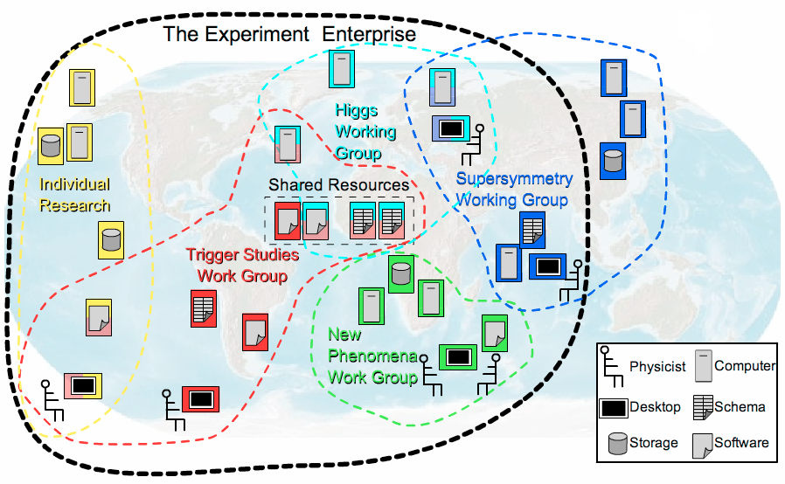
Security Services
Authorization, roles, and access privileges
  Locally (site) managed
  Based on SAML and XACML security standards
  Implementations provide credential mapping
Working with GGF Security Area groups
  Authorization attributes for grids
Developing OGSA security profiles
WS-Security
PKI
certificate
OGSA
security profiles
WS-Addressing

Slide 56
OGSA Profiles
The normative definition of OGSA
  Styled on WS-I profiles to promote interoperability
  Define specific usage patterns
    e.g. execution management
  Basis for claims of conformance
    “My scheduler conforms to the OGSA Execution Management Profile…”
Include specifications developed by GGF and by other bodies
  Issue: How mature and widely adopted?
  OGSA Profile Definition document provides guidelines
OGSA WSRF Basic Profile
Execution Mgmt Profile
OGSA Basic Security Profile – Core
HPC Profile
Data Profile
OGSA Basic Security Profile – Secure Channel
Others…
In the pipeline
Early stages
In the future

Slide 57
OGSA and the
Standards Landscape

Slide 58
Specifications Landscape: April 2006
Warning: Volatile data!
SYSTEMS
MANAGEMENT
GRID
COMPUTING
UTILITY
COMPUTING
Use Cases &
Applications
Distributed query processing
Data Centre
Collaboration
Persistent Archive
ASP
Multi Media
VO Management
OGSA Self Mgmt
OGSA-EMS
WS-DAI
Information
WSDM
Discovery
GGF-UR
WS-BaseNotification
Naming
Core Services
Privacy
Trust
GFD-C.16
WSRF-RP
WSRF-RL
Data Model
Web Services
Foundation
WSRF-RAP
WS-Security
SAML/XACML
X.509
WS-Addressing
HTTP(S)/SOAP
WSDL
CIM/JSIM
Data Transport
Hole
Gap
Evolving
Standard

Slide 59




Related Standards Bodies
GGF (Global Grid Forum)
  Overall architecture for grid computing
  OGSA, CDDLM, WS-Agreement, …
OASIS (Organization for the Advancement of Structured Information Standards)
  Middleware/Web services focused
  WSRF, WS-Notification, WSDM, WS-Security…
DMTF (Distributed Management Task Force)
  Management and Information models (CIM)
  Server management
  WS-CIM
W3C (WWW Consortium)
  WS-Addressing
Not a complete list!
Logos are trademarks or service marks of their respective owners.
Notes:
Also mention W3C – apart from all the obvious internet standards they are responsible for WS-Addressing. Should be added to this slide. Also we did mention W3C on an earlier slide.

Slide 60
Making It Happen:
The OGSA Working Group

Slide 61

The OGSA Working Group
History
  Established September 2002
  Declared GGF’s “flagship architecture” March 2004
Getting it done
  Over 300 mailing-list subscribers
  Twice-weekly teleconferences
  Regular face-to-face meetings
  Collaboration with other working groups and standards organizations
Contributors
  Industry
  Government
  Academia

Slide 62
Aims & Perspective
Goals
  Interoperable solutions for grid-based applications
  Addressing loosely coupled distributed computing
Approach
  Standardization at the architectural level
    Understand & describe the elements of grid systems and models
    Develop architectural framework for standards in service-oriented grids
    Similar to profiling
  Use existing standards and technology where possible
    Validate current standards for applicability in grids
  Use case-driven gap analysis – gaps filled proactively
    Provide direction/motivation for new standards activity
    Leverage & collaborate with other standards organizations
Philosophy
  Can’t do it all – extensibility
  Separation of policy and mechanism

Slide 63
The OGSA Process
Use case-driven
  21 detailed use cases
Distributed specification and standardization
  Identify and/or develop open and accessible standard specifications
  Active work in GGF, OASIS, W3C, and DMTF
“Design team” working model
  Facilitate cross-fertilization within and outside GGF
  Avoid redundant efforts
  Focus mind-share (the most valuable commodity!)
    e.g. DAIS and OGSA-Data working groups
  Design teams: Execution Management, Resource Management, Security, Information Services
Iterative refinement
  Abstract service evolving to concrete specifications

Slide 64

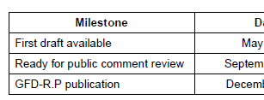
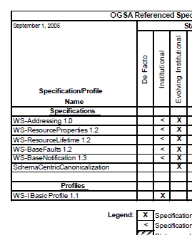
The OGSA Roadmap
Defines OGSA as:
  An architectural process
  A set of specifications & profiles
  OGSA software
For each OGSA-related document:
  Schedule
  Dependencies
Publication:
  v1.0 published September ’05 (GFD.53)
  Next version in progress

Slide 65
Published OGSA Documents
2004
2005
2006
✓
Use Cases (GFD-I.29)
Base document
✓
Architecture V1.0 (GFD-I.30)
✓
Glossary V1.0 (GFD-I.44)
✓
Resource Management
(GFD-I.45)
Roadmap (GFD-I.53)
✓
Guideline
Profile Definition (GFD-I.59)
✓
Service description
Profile
Specification
JSDL (GFD-R-P.56)
✓

Slide 66
OGSA Schedule
2005
2006
Architecture V1.5
Glossary V1.5
Base document
Roadmap V1.1
Guideline
Modeling guideline
Service description
EMS arch scenarios
Data architecture
WSRF Basic Profile
Basic Security Profiles
Profile
HPC Profile
ByteIO
Basic Execution Service
Specification
Container info-model
WS-Naming
Public comment start
GFD publication

Slide 67

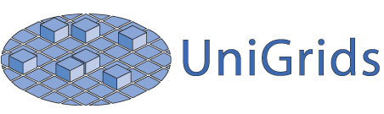







OGSA-Based Open-Source Grids
Numerous grid projects are implementing
OGSA components

Slide 68
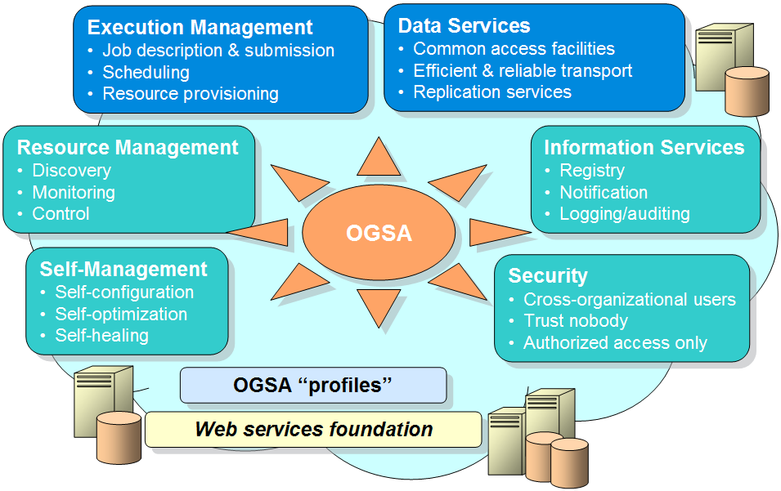
Summary
Building robust, distributed, applications is a challenge!
  Significant issues need to be solved
Interoperability is key!
  OGSA is defining a set of core services
    Designed to work together…
    …but with implementation flexibility
The current set of services is not the end of the road – just the beginning!

Slide 69

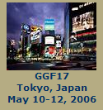

For More Information…
http://www.ggf.org
http://forge.gridforum.org/projects/ogsa-wg

Slide 70
Backup Slides

Slide 71
Three Generations of Grid
1st Generation
  Local "Metacomputers“
    Distributed file systems
    Site-wide single sign-on
  "Metacenters" explored issues of inter-organizational integration
  Totally custom-made, top-to-bottom: proofs of concept
2nd Generation
  Utilize software services and communications protocols developed by grid projects: Condor, Globus, UNICORE, Legion, etc.
  Need significant customization to deliver complete solution
  Interoperability is still very difficult
3rd Generation
  A set of common interface specifications supports the interoperability of discrete, independently developed services
  Both competition and interoperability, not only among applications and toolkits, but among implementations of key services
Standardization is key for third-generation grids!
Source: Charlie Catlett

Slide 72
OGSA Document Structure
OGSA
Roadmap
OGSA
Architecture
OGSA
Use Cases
inform
and
guide
Root document
Scenario
Service
Description
feedback
Informational
Modeling
guidelines
inform
and
guide
consistent
Proposed
recommendation
feedback
Candidate Profile
Profile
OGSA-WG documents
Information
models
Documents produced
by other GGF WGs
or other SDOs
refer
Actual
specs

Slide 73
OGSA-* WG
CY
2002
2003
2004
2005
2006
OGSA-WG
Use Cases
Arch 1.0
Roadmap
OGSA-Data WG
OGSA
debut
OGSA-AuthZ WG
OGSA-RSS WG
OGSA-BES WG
OGSA-ByteIO WG
WSRF BP 1.0
OGSI-WG
OGSI 1.0
WSRF TC
WSRF 1.0
WSRF
OGSA-Naming WG

Slide 74
W3C: World-Wide Web Consortium
W3C is an international consortium where Member organizations, a full-time staff, and the public work together to develop Web standards.
Founded in 1994, ~80 published recommendations, staff on 3 continents
Members of W3C range from leading technology companies to non-profit organisations and individuals.
Best known for fundamental web standards, including:
XML
XML Schema
XHTML
XSL/XSLT
MathML
SSML
CCS
OWL
Several working groups are relevant to grid standards projects including:
WS-Addressing
WSDL 2.0
Binary data

Slide 75
DMTF: Distributed Management Task Force
DMTF is an industry organization leading the development of management standards and integration technology.
Founded in 1992
Best known for standards that address system management in enterprise and Internet environments, including:
CIM
WBEM
DMI
Several working groups are relevant to grid standards projects including:
CIM Core
Utility Computing
Server Management

Slide 76
OASIS: Organization for the Advancement of Structured Information Standards
OASIS is a member-led, international nonprofit standards consortium concentrating on structured information and global e-business standards
Founded in 1993, ~65 projects, staff on 3 continents
Members of OASIS are
  Vendors, users, academics and governments
  Organizations, individuals and industry groups
Best known for e-business standards that address real world business requirements, including
UDDI
SAML
ebXML
WS-Security
WSRP
WS-Reliability
SPML
XACML
UBL
Host for key grid standards projects including
WSDM
WSRF
WS-N

Slide 77
E.g. OGSA-Data Working Group
Brings together:
  Domain experts within OGSA
  Chairs of other WG/RGs
Output is included in OGSA specification

Slide 78
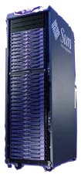
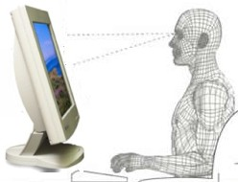

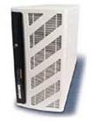
Typical Grid Layers
Grid-Enabled Applications
Grid
Development
Grid Visualization
Grid Workflow
EMS
- Grid RPC
- Grid MPI
- MDA
Scheduler
Manager
Packaging -ACS
Grid Security
Grid Middleware Engine
Grid VMs, Cache
High Performance & Secure Grid Networking
Physical Network Layer
Org-A
Org-B
Org-C
Org-D
Source: Adapted from NaReGI-PSE National Grid Initiative slides from GGF - ACS-WG, OGSA Standardization Process

Slide 79
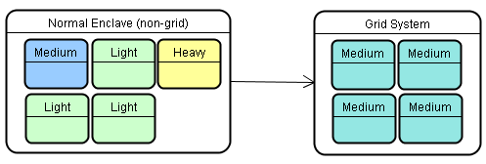
Grid Operating Environment (GOE)
Dynamic Automated Virtual Global Grid
The Grid Operating Environment is a concept infrastructure framework and system supporting secure coordinated resource sharing between geographically dispersed, heterogeneous and dynamic virtual organizations.
R2AD
Dynamic Automated Virtual Global Grid
Autonomic management is provided by the Service Oriented Grid Infrastructure based on OGSA.
Source: http://www.r2ad.com/presentations/DoDSoftwareTransformation-v2.pdf

Slide 80


Some Characteristics of Grids
Numerous
resources
Ownership by mutually
distrustful organizations
& individuals
Connected by
heterogeneous,
multi-level networks
Different security
requirements
& policies
Different resource
management
policies
Unreliable resources and environments
Geographically
separated
Resources are
heterogeneous

Slide 81
Grid Direction
Pervasive adoption
  Education & Research
  Industry
  Commercial
  Grid technology in every data center
Utility computing
  On-demand service model
  Based on grid technology
  Everything is virtual
  Andrew

Slide 82
Distributed naming – required properties
Unique
Provide identity
Comparable
Location portable
Widely adopted
Scalable – high performance
Extensible
Dynamic binding
….
Two- and three-level name schemes dominate

Slide 83
Naming – Three-Level Schemes
Human –> abstract –> address
In OGSA:
  Human -> address and Human -> abstract naming levels will likely be handled by the Resource Naming Service (RNS) being developed by the GGF GFS-WG
  AbstractName -> address is being handled by the GGF WS-Naming efforts
    Initial thinking: EPR annotated with AbstractName URI and optional resolution handle
  Form of AbstractName is under discussion
    Initial proposal: Abstract name is a URI or IRI
    Other proposals: Context-oriented, like job numbers/id
Andrew

