Slide 1
Let’s hear your questions
Question utility - anytime
Live telephone questions - at end of presentation
?

Slide 2

Introducing our presenters
Andrew Grimshaw
Q&A support
  Hiro Kishimoto
  Tom Maguire
  Chris Jordan
  Frank Siebenlist
  David Snelling
  Jem Treadwell
  Jay Unger

Slide 3
Polling question #1
How familiar are you with OGSA? (choose one)
  Very familiar
  Somewhat familiar
  Limited knowledge
  No knowledge
√
√√
√√√

Slide 4
Polling question #2
What is your interest in OGSA? (choose all that apply)
Application manager, architect or developer
Grid software developer or provider
Active member of GGF
Active member of a standards development organization other than GGF
Member of IT staff in an organization
deploying or planning to deploy a grid
Student
Press/analyst
√
√√
√√√

Slide 5
Defining the Grid: An Introduction to the
Open Grid Services Architecture
A webcast by the GGF’s OGSA™ working group
April 26, 2006
OGSA is a trademark of the Global Grid Forum

Slide 6
GGF Full Copyright Notice
Copyright (C) Global Grid Forum (2005, 2006). All Rights Reserved.
This document and translations of it may be copied and furnished to others, and derivative works that comment on or otherwise explain it or assist in its implementation may be prepared, copied, published and distributed, in whole or in part, without restriction of any kind, provided that the above copyright notice and this paragraph are included on all such copies and derivative works. However, this document itself may not be modified in any way, such as by removing the copyright notice or references to the GGF or other organizations, except as needed for the purpose of developing Grid Recommendations in which case the procedures for copyrights defined in the GGF Document process must be followed, or as required to translate it into languages other than English.
The limited permissions granted above are perpetual and will not be revoked by the GGF or its successors or assigns.
This document and the information contained herein is provided on an "AS IS" basis and THE GLOBAL GRID FORUM DISCLAIMS ALL WARRANTIES, EXPRESS OR IMPLIED, INCLUDING BUT NOT LIMITED TO ANY WARRANTY THAT THE USE OF THE INFORMATION HEREIN WILL NOT INFRINGE ANY RIGHTS OR ANY IMPLIED WARRANTIES OF MERCHANTABILITY OR FITNESS FOR A PARTICULAR PURPOSE."

Slide 7
Agenda
An Overview of Grid Computing
The Open Grid Services Architecture
A Closer Look at OGSA
The Standards Landscape
The OGSA Working Group
Summary

Slide 8
An Overview of
Grid Computing

Slide 9
A Grid Computing Timeline
US Grid Forum forms at SC ‘98
Grid Forums merge, form GGF
I-Way: SuperComputing ‘95
European & AP Grid Forums
OGSA-WG formed
“Physiology” paper
“Anatomy” paper
OGSA v1.0
…
1995 | ’96 | ’97 | ’98 | ’99 | 2000 | ’01 | ’02 | ’03 | ’04 | ’05 | 2006
  Japan government funds:
  Business Grid project
  NAREGI project
  UK e-Science program starts
DARPA funds Globus Toolkit & Legion
EU funds UNICORE project
US DoE pioneers grids for scientific research
NSF funds National Technology Grid
NASA starts Information Power Grid
  Today:
  Grid solutions are common for HPC
  Grid-based business solutions are becoming common
  Required technologies & standards are evolving
Notes:
Grid began in high-performance technical computing as a way to share widespread computing resources
1994 – 1995 Argonne National Lab & University of Illinois at Chicago formed “I‑WAY” for SuperComputing ’95 (SC95):
Led by Ian Foster
Linked 11 high-speed networks into a “national computing grid”
1997 Globus Toolkit development funded by DARPA*
Then:
US Dept. of Energy pioneered use of grids for scientific research
National Science Foundation funded National Technology Grid
NASA began its Information Power Grid
1998 Grid sessions at SC98 resulted in formation of the US Grid Forum:
Define and promote grid standards and best practices
2000 US Grid Forum merged with European & Asia-Pacific Grid Forums to form the Global Grid Forum (GGF):
Produced many grid standards and specifications
17th GGF conference in May 2006
Participation from major vendors and the grid community
Today:
Grid solutions are common for high-performance computing
Commercial organizations expect grid-based business solutions:
Adoption is in its early stages
Required technologies & standards are evolving
Mainstream adoption expected in the next few years

Slide 10


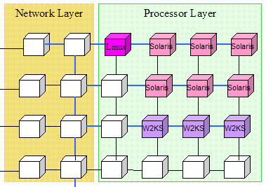
What is a Grid?
A grid is a system consisting of
  Distributed but connected resources and
  Software and/or hardware that provides and manages logically seamless access to those resources to meet desired objectives
Web
server
License
Handheld
Server
Supercomputer
Workstation
Cluster
Data Center
Database
Printer
R2AD

Slide 11
Grid & Related Paradigms
Cluster
Tightly coupled
Homogeneous
Cooperative working
Notes:
Grids
Grids often cross management/ownership boundaries
Usually include heterogeneous hardware & software
Pooled resources dynamically assigned for short-term use
Scale ranges from a few nodes to many thousands
Clusters
Multiple computers working cooperatively
Typically homogeneous hardware & software
Close proximity
Often tightly coupled – e.g. shared memory, high-speed interconnect
Distributed computing
Nodes loosely connected by network
May be geographically distant
Centrally managed
Utility computing
Computing services used with no knowledge of the infrastructure
Resource usage billed and paid for like any other utility service
Grid can be the underlying technology of utility computing

Slide 12
Grid & Related Paradigms
Distributed Computing
Loosely coupled
Heterogeneous
Central management
Cluster
Tightly coupled
Homogeneous
Cooperative working
Notes:
Grids
Grids often cross management/ownership boundaries
Usually include heterogeneous hardware & software
Pooled resources dynamically assigned for short-term use
Scale ranges from a few nodes to many thousands
Clusters
Multiple computers working cooperatively
Typically homogeneous hardware & software
Close proximity
Often tightly coupled – e.g. shared memory, high-speed interconnect
Distributed computing
Nodes loosely connected by network
May be geographically distant
Centrally managed
Utility computing
Computing services used with no knowledge of the infrastructure
Resource usage billed and paid for like any other utility service
Grid can be the underlying technology of utility computing

Slide 13
Grid & Related Paradigms
Distributed Computing
Loosely coupled
Heterogeneous
Central management
Cluster
Tightly coupled
Homogeneous
Cooperative working
Grid Computing
Large scale
Multi-organizational
Cross-geography
Distributed management

Slide 14
Grid & Related Paradigms
Distributed Computing
Loosely coupled
Heterogeneous
Central management
Cluster
Tightly coupled
Homogeneous
Cooperative working
Grid Computing
Large scale
Multi-organizational
Cross-geography
Distributed management
Utility Computing
Computing “services”
No knowledge of provider
Enabled by grid technology

Slide 15
How Are Grids Used?
High-performance computing
Collaborative design
E-Business
High-energy physics
Financial modeling
Data center automation
Life sciences
E-Science
Drug discovery
Collaborative data-sharing

Slide 16
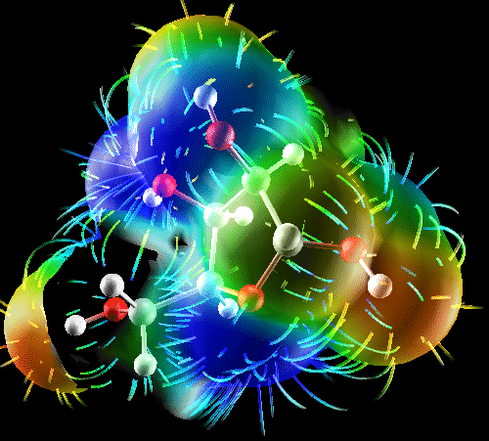
Grids In Use: E-Science Examples
Data sharing and integration
  Life sciences, sharing standard data-sets, combining collaborative data-sets
  Medical informatics, integrating hospital information systems for better care and better science
  Sciences, high-energy physics
Simulation-based science and engineering
  Earthquake simulation
Capability computing
  Life sciences, molecular modeling, tomography
  Engineering, materials science
  Sciences, astronomy, physics
High-throughput, capacity computing for
  Life sciences: BLAST, CHARMM, drug screening
  Engineering: aircraft design, materials, biomedical
  Sciences: high-energy physics, economic modeling

Slide 17
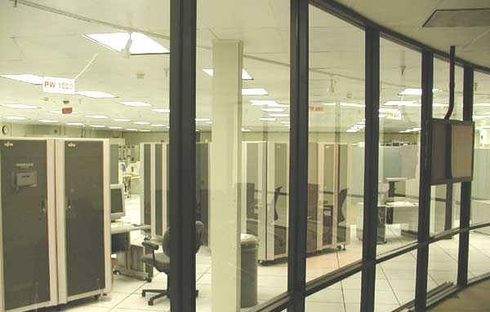
Grids In Use: E-Business Examples
High-throughput computing
  Aircraft design
  Drug discovery
  Electronic design automation
Financial services
  Portfolio modeling
  Data integration
Large-scale collaboration
  Aircraft design
  Automobile design
Enterprise Information Integration (EII)
  Banking
  Drug discovery
  Collaborative engineering

Slide 18
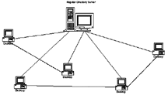
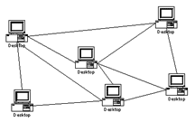
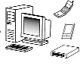
Some Characteristics of Grids
Numerous
resources
Owned by multiple organizations & individuals
Connected by
heterogeneous,
multi-level networks
Different security
requirements
& policies
Different resource
management
policies
Unreliable
resources and environments
Geographically
separated
Resources are
heterogeneous

Slide 19
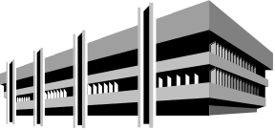


Some Characteristics of Grids
Numerous
resources
Owned by multiple organizations & individuals
Connected by
heterogeneous,
multi-level networks
Different security
requirements
& policies
Different resource
management
policies
Unreliable
resources and environments
Geographically
separated
Resources are
heterogeneous

Slide 20


Some Characteristics of Grids
Numerous
resources
Owned by multiple organizations & individuals
Connected by
heterogeneous,
multi-level networks
Different security
requirements
& policies
Different resource
management
policies
Unreliable
resources and environments
Geographically
separated
Resources are
heterogeneous

Slide 21


Some Characteristics of Grids
Numerous
resources
Owned by multiple organizations & individuals
Connected by
heterogeneous,
multi-level networks
Different security
requirements
& policies
Different resource
management
policies
Unreliable
resources and environments
Geographically
separated
Resources are
heterogeneous

Slide 22
Some Characteristics of Grids
Numerous
resources
Owned by multiple organizations & individuals
Connected by
heterogeneous,
multi-level networks
Different security
requirements
& policies
Different resource
management
policies
Unreliable
resources and environments
Geographically
separated
Resources are
heterogeneous

Slide 23

Some Characteristics of Grids
Numerous
resources
Owned by multiple organizations & individuals
Connected by
heterogeneous,
multi-level networks
Different security
requirements
& policies
Different resource
management
policies
Unreliable
resources and environments
Geographically
separated
Resources are
heterogeneous

Slide 24

Some Characteristics of Grids
Numerous
resources
Owned by multiple organizations & individuals
Connected by
heterogeneous,
multi-level networks
Different security
requirements
& policies
Different resource
management
policies
Unreliable
resources and environments
Geographically
separated
Resources are
heterogeneous

Slide 25

Some Characteristics of Grids
Numerous
resources
Owned by multiple organizations & individuals
Connected by
heterogeneous,
multi-level networks
Different security
requirements
& policies
Different resource
management
policies
Unreliable
resources and environments
Geographically
separated
Resources are
heterogeneous

Slide 26
Key Requirements for Grid Middleware

Slide 27
Key Requirements for Grid Middleware
Wide distribution
Fault-tolerant
Secure
Manage complexity

Slide 28
Key Requirements for Grid Middleware
Wide distribution
Fault-tolerant
Secure
Manage complexity
Modular
Composable
Scalable
Extensible

Slide 29
Key Requirements for Grid Middleware
Wide distribution
Fault-tolerant
Secure
Manage complexity
Modular
Composable
Scalable
Extensible
Interoperable
Standards-based
Transparent support for legacy components

Slide 30
Three Generations of Grid
Source: Charlie Catlett

Slide 31

Three Generations of Grid
  Local “metacomputers“
    Distributed file systems
    Site-wide single sign-on
  "Metacenters" explore inter-organizational integration
  Totally custom-made, top-to-bottom: proofs-of-concept
1
Source: Charlie Catlett

Slide 32
Three Generations of Grid
  Local “metacomputers“
    Distributed file systems
    Site-wide single sign-on
  "Metacenters" explore inter-organizational integration
  Totally custom-made, top-to-bottom: proofs-of-concept
1
  Utilize software services and communications protocols developed by grid projects:
    Condor, Globus, UNICORE, Legion, etc.
  Need significant customization to deliver complete solution
  Interoperability is still very difficult!
2
Source: Charlie Catlett

Slide 33

Three Generations of Grid
  Local “metacomputers“
    Distributed file systems
    Site-wide single sign-on
  "Metacenters" explore inter-organizational integration
  Totally custom-made, top-to-bottom: proofs-of-concept
1
  Utilize software services and communications protocols developed by grid projects:
    Condor, Globus, UNICORE, Legion, etc.
  Need significant customization to deliver complete solution
  Interoperability is still very difficult!
2
  Common interface specifications support interoperability of discrete, independently developed services
  Competition and interoperability among applications, toolkits, and implementations of key services
3
Source: Charlie Catlett

Slide 34
Three Generations of Grid
  Local “metacomputers“
    Distributed file systems
    Site-wide single sign-on
  "Metacenters" explore inter-organizational integration
  Totally custom-made, top-to-bottom: proofs-of-concept
1
  Utilize software services and communications protocols developed by grid projects:
    Condor, Globus, UNICORE, Legion, etc.
  Need significant customization to deliver complete solution
  Interoperability is still very difficult!
2
  Common interface specifications support interoperability of discrete, independently developed services
  Competition and interoperability among applications, toolkits, and implementations of key services
3
Standardization is key for third-generation grids!
Source: Charlie Catlett

Slide 35
Three Generations of Grid
  Local “metacomputers“
    Distributed file systems
    Site-wide single sign-on
  "Metacenters" explore inter-organizational integration
  Totally custom-made, top-to-bottom: proofs of concept
1
We are here!
  Utilize software services and communications protocols developed by grid projects:
    Condor, Globus, UNICORE, Legion, etc.
  Need significant customization to deliver complete solution
  Interoperability is still very difficult!
2
  Common interface specifications support interoperability of discrete, independently developed services
  Competition and interoperability among applications, toolkits, and implementations of key services
3
Standardization is key for third-generation grids!
Source: Charlie Catlett

Slide 36
The Open Grid Services
Architecture

Slide 37
The Open Grid Services Architecture
An open, service-oriented architecture (SOA)
  Resources as first-class entities
  Dynamic service/resource creation and destruction
Built on a Web services infrastructure
Resource virtualization at the core
Build grids from small number of standards-based components
  Replaceable, coarse-grained
  e.g. brokers
Customizable
  Support for dynamic, domain-specific content…
  …within the same standardized framework

Slide 38
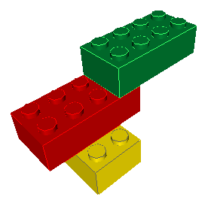
Why Use an SOA?
Logical view of capabilities
Relatively coarse-grained functions
Reusable and composable behaviors
Encapsulation of complex operations
Naturally extendable framework
Platform-neutral
  machine and OS

Slide 39
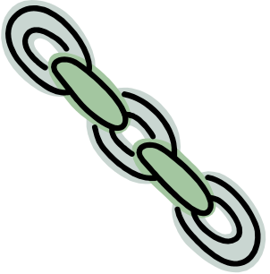
SOA & Web Services: Key Benefits
SOA
Flexible
  Locate services on any server
  Relocate as necessary
  Prospective clients find services using registries
Scalable
  Add & remove services as demand varies
Replaceable
  Update implementations without disruption to users
Fault-tolerant
  On failure, clients query registry for alternate services
Web Services
Interoperable
  Growing number of industry standards
Strong industry support
Reduce time-to-value
  Harness robust development tools for Web services
  Decrease learning & implementation time
Embrace and extend
  Leverage effort in developing and driving consensus on standards
  Focus limited resources on augmenting & adding standards as needed

Slide 40
Virtualizing Resources
Access
Type-specific interfaces
Computers
Storage
Sensors
Applications
Information
Common Interfaces
Web
services
Resource-specific Interfaces
Resources

Slide 41
A Service-Oriented Grid
Job-Submit Service
Registry Service
Grid middleware services
Brokering Service
Advertise
Notify
CPU Resource
Compute
Service
Data
Service
Application
Service
Printer Service
Virtualized resources

Slide 42
OGSA:
A Closer Look

Slide 43
OGSA Capabilities
OGSA
OGSA “profiles”
Web services foundation

Slide 44
OGSA Capabilities
Execution Management
Job description & submission
Scheduling
Resource provisioning
OGSA
OGSA “profiles”
Web services foundation

Slide 45
OGSA Capabilities
Execution Management
Job description & submission
Scheduling
Resource provisioning
Data Services
Common access facilities
Efficient & reliable transport
Replication services
OGSA
OGSA “profiles”
Web services foundation

Slide 46
OGSA Capabilities
Execution Management
Job description & submission
Scheduling
Resource provisioning
Data Services
Common access facilities
Efficient & reliable transport
Replication services
Resource Management
Discovery
Monitoring
Control
OGSA
OGSA “profiles”
Web services foundation

Slide 47
OGSA Capabilities
Execution Management
Job description & submission
Scheduling
Resource provisioning
Data Services
Common access facilities
Efficient & reliable transport
Replication services
Resource Management
Discovery
Monitoring
Control
OGSA
Self-Management
Self-configuration
Self-optimization
Self-healing
OGSA “profiles”
Web services foundation

Slide 48
OGSA Capabilities
Execution Management
Job description & submission
Scheduling
Resource provisioning
Data Services
Common access facilities
Efficient & reliable transport
Replication services
Resource Management
Discovery
Monitoring
Control
OGSA
Self-Management
Self-configuration
Self-optimization
Self-healing
Information Services
Registry
Notification
Logging/auditing
OGSA “profiles”
Web services foundation

Slide 49
OGSA Capabilities
Execution Management
Job description & submission
Scheduling
Resource provisioning
Data Services
Common access facilities
Efficient & reliable transport
Replication services
Resource Management
Discovery
Monitoring
Control
OGSA
Self-Management
Self-configuration
Self-optimization
Self-healing
Information Services
Registry
Notification
Logging/auditing
Security
Cross-organizational users
Trust nobody
Authorized access only
OGSA “profiles”
Web services foundation

Slide 50
Execution Management
The basic problem
  Provision, execute and manage services/resources in a grid
  Allow for legacy applications
3. Select from or deploy
required resources
1. Describe the job
CDL
JSDL
Job
Job
2. Submit the job
4. Manage the job

Slide 51
Describing a Job Submission: JSDL
Job Submission Description Language (JSDL)
  A language for describing the requirements of jobs for submission
  Declarative description
A JSDL document describes the job requirements
  Job identification information
  Application (e.g., executable, arguments)
  Required resources (e.g., CPUs, memory)
  Input/output files
Job
JSDL
IT Infrastructure

Slide 52



Configuration & Deployment: CDL
Prepare the infrastructure so that the job can execute
  Provide a right-shaped slot to fit the job
Main parts:
  Configuration Description Language (CDL) provides declarative definition of system configuration
  Deployment service carries out configuration requests to deploy and configure the system
CDL
Prepare
IT Infrastructure

Slide 53
Data Services
The basic problem
  Manage, transfer and access distributed data services and resources
Some use-cases
  Replicating data for performance and reliability using high-performance data transfer
  Federating distributed data via a common access interface
  Managing file-based data and corresponding relational metadata
Issues to address
  Many different data “types” and protocols
  Multiple possible use-cases, from high-energy physics to business
  How can we describe the data?
  How can we find the data?
  Where is the data needed?

Slide 54
Basic Data Interfaces
Storage Management
  e.g. Storage Resource Management (SRM)
Data Access
  e.g. ByteIO, Data Access & Integration (DAI)
Data Transfer
  e.g. Data Movement Interface Specification (DMIS)
  Various protocols (e.g. GridFTP)
Metadata catalog
Replica management
Cache management

Slide 55
Basic Data Services
Non-OGSA client APIs & other services
Transfer
Registries
Storage Management
e.g. Data Management
Other Data Services
Data Resources
Data Resources
Transfer Protocols
Managed Storage

Slide 56
Composite Data Services
Non-OGSA client APIs & other services
Replication
Federation
Cache
Data Services
Data
Service 1
Data
Service 2
Data Service n

Slide 57
Resource Management
Provides a framework to integrate resource management functions
  interfaces, services, information models, etc.
Enables integrated discovery, monitoring, control, etc.
Domain-specific capabilities
Application-
specific
OGSA
High-level
management
services
(GGF)
Execution
Management
services
Data
services
Security
services
WSDM, WS-Management
Access to
manageability
(OASIS, DMTF)
WSRF/WSN, WS-Transfer/Eventing
Resources
Information
models (DMTF,
SNIA, etc.)

Slide 58
Self-Management
Self-configuration: Automatically adapt to changes in the environment:
  e.g. Deploy/undeploy resources as load changes
Self-optimization: Automatically tune system to best meet user or business needs
  Uses service-level agreements (SLAs)
Self-healing: Automatically detect & correct problems
  Component failures
  Security violations
  etc.
SLA
Policy
Policy
Self-
Management
Monitoring
Action
Analysis
Policy
Policy
Policy
Projection

Slide 59
Information Services
Provide management and access facilities for information about applications and resources in the grid environment
Information
Services
Registry
Service
discovery
Load
balancing
Problem
determination
Asynchronous
notification
Producers
Consumers
Execution
management
Retrieval
Accounting
Reliable
Secure
Efficient
Resource
reservation
Logger
Application
monitoring

Slide 60
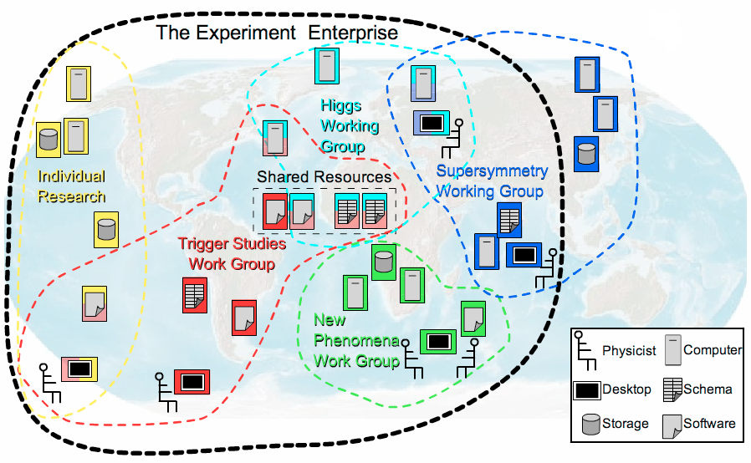
Security Services
Authorization, roles, and access privileges
  Locally (site) managed
  Based on SAML and XACML security standards
  Implementations provide credential mapping
Working with GGF Security Area groups
  Authorization attributes for grids
Developing OGSA security profiles
WS-Security
PKI
certificate
OGSA
security profiles
WS-Addressing

Slide 61
OGSA Profiles
The normative definition of OGSA
  Styled on WS-I profiles to promote interoperability
  Define specific usage patterns
    e.g. execution management
  Basis for claims of conformance
    “My scheduler conforms to the OGSA Execution Management Profile…”
Include specifications developed by GGF and by other bodies
  Issue: How mature and widely adopted?
  OGSA Profile Definition document provides guidelines
OGSA WSRF Basic Profile
Execution Mgmt Profile
OGSA Basic Security Profile – Core
HPC Profile
Data Profile
OGSA Basic Security Profile – Secure Channel
Others…
In the pipeline
Early stages
In the future

Slide 62
OGSA and the
Standards Landscape

Slide 63
Specifications Landscape: April 2006
Warning: Volatile data!
SYSTEMS
MANAGEMENT
GRID
COMPUTING
UTILITY
COMPUTING
Use Cases &
Applications
Distributed query processing
Data Centre
Collaboration
Persistent Archive
ASP
Multi Media
VO Management
OGSA Self Mgmt
OGSA-EMS
WS-DAI
Information
WSDM
Discovery
GGF-UR
WS-BaseNotification
Naming
Core Services
Privacy
Trust
GFD-C.16
WSRF-RP
WSRF-RL
Data Model
Web Services
Foundation
WSRF-RAP
WS-Security
SAML/XACML
X.509
WS-Addressing
HTTP(S)/SOAP
WSDL
CIM/JSIM
Data Transport
Hole
Gap
Evolving
Standard

Slide 64




Related Standards Bodies
GGF (Global Grid Forum)
  Overall architecture for grid computing
  OGSA, CDDLM, WS-Agreement, …
OASIS (Organization for the Advancement of Structured Information Standards)
  Middleware/Web services focused
  WSRF, WS-Notification, WSDM, WS-Security…
DMTF (Distributed Management Task Force)
  Management and Information models (CIM)
  Server management
  WS-CIM
W3C (WWW Consortium)
  WS-Addressing
Not a complete list!
Logos are trademarks or service marks of their respective owners.

Slide 65
Making It Happen:
The OGSA Working Group

Slide 66

The OGSA Working Group
History
  Established September 2002
  Declared GGF’s “flagship architecture” March 2004
Getting it done
  Over 300 mailing-list subscribers
  Twice-weekly teleconferences
  Regular face-to-face meetings
  Collaboration with other working groups and standards organizations
Contributors
  Industry
  Government
  Academia

Slide 67
Aims & Perspective
Goals
  Interoperable solutions for grid-based applications
  Addressing loosely coupled distributed computing
Approach
  Standardization at the architectural level
    Understand & describe the elements of grid systems and models
    Develop architectural framework for standards in service-oriented grids
    Similar to profiling
  Use existing standards and technology where possible
    Validate current standards for applicability in grids
  Use case-driven gap analysis – gaps filled proactively
    Provide direction/motivation for new standards activity
    Leverage & collaborate with other standards organizations
Philosophy
  Can’t do it all – extensibility
  Separation of policy and mechanism

Slide 68
The OGSA Process
Use case-driven
  21 detailed use cases
Distributed specification and standardization
  Identify and/or develop open and accessible standard specifications
  Active work in GGF, OASIS, W3C, and DMTF
“Design team” working model
  Facilitate cross-fertilization within and outside GGF
  Avoid redundant efforts
  Focus mind-share (the most valuable commodity!)
    e.g. DAIS and OGSA-Data working groups
  Design teams: Execution Management, Resource Management, Security, Information Services
Iterative refinement
  Abstract service evolving to concrete specifications

Slide 69

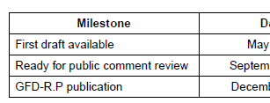
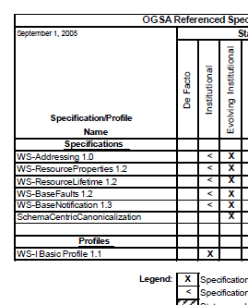
The OGSA Roadmap
Defines OGSA as:
  An architectural process
  A set of specifications & profiles
  OGSA software
For each OGSA-related document:
  Schedule
  Dependencies
Publication:
  v1.0 published September ’05 (GFD.53)
  Next version in progress

Slide 70
Published OGSA Documents
2004
2005
2006
✓
Use Cases (GFD-I.29)
Base document
✓
Architecture V1.0 (GFD-I.30)
✓
Glossary V1.0 (GFD-I.44)
✓
Resource Management
(GFD-I.45)
Roadmap (GFD-I.53)
✓
Guideline
Profile Definition (GFD-I.59)
✓
Service description
Profile
Specification
JSDL (GFD-R-P.56)
✓

Slide 71
OGSA Schedule
2005
2006
Architecture V1.5
Glossary V1.5
Base document
Roadmap V1.1
Guideline
Modeling guideline
Service description
EMS arch scenarios
Data architecture
WSRF Basic Profile
Basic Security Profiles
Profile
HPC Profile
ByteIO
Basic Execution Service
Specification
Container info-model
WS-Naming
Public comment start
GFD publication

Slide 72

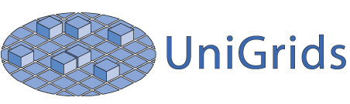







OGSA-Based Open-Source Grids
Numerous grid projects are implementing
OGSA components

Slide 73
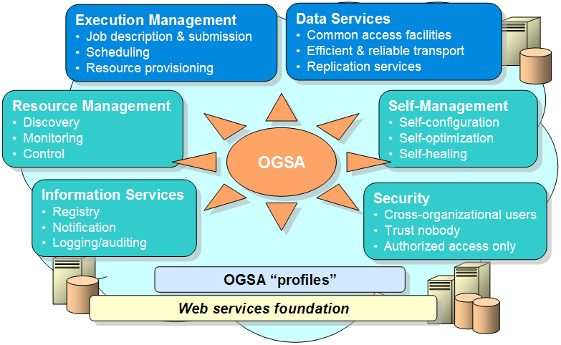
Summary
Building robust, distributed, applications is a challenge!
  Significant issues need to be solved
  Grids address the challenges

Slide 74
Summary
Building robust, distributed, applications is a challenge!
  Significant issues need to be solved
  Grids address the challenges
Interoperability is key!
OGSA is defining a set of core services
  Designed to work together…
  …but with implementation flexibility

Slide 75
Summary
Building robust, distributed, applications is a challenge!
  Significant issues need to be solved
  Grids address the challenges
Interoperability is key!
OGSA is defining a set of core services
  Designed to work together…
  …but with implementation flexibility
The current set of services is not the end of the road – just the beginning!

Slide 76

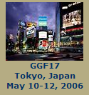

For More Information…
http://www.ggf.org
http://forge.gridforum.org/projects/ogsa-wg

Slide 77

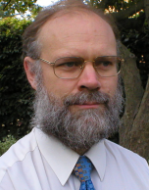


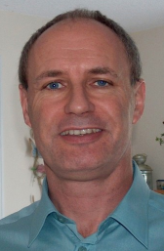

Questions
?
?
Andrew Grimshaw
University of Virginia
Hiro Kishimoto
Fujitsu, Tokyo
David Snelling
Fujitsu, London
?
?
?
Frank Siebenlist
Argonne National Lab,
San Francisco Bay Area
Chris Jordan
National Science Foundation,
USA
Jem Treadwell
HP, New Jersey
Jay Unger
IBM, Maryland

Slide 78
Are we on target?
Please fill out the evaluation form

Slide 79


