Slide 1
Agreement-based Grid Service Management
(OGSI-Agreement)
Asit Dan
John Rofrano
Editors:
K. Czajkowski (USC/ISI),
A. Dan, J Rofrano (IBM),
S. Tuecke, ANL
M. Xu (Platform)

Slide 2
Use of OGSI-Agreement
The two main applications envisioned for OGSI-Agreement services are:
  Managed operation of applications or domain-specific services,
    whether first-class Grid services or second-class legacy components,
    for example, to control the policies and “service-level agreements” which parameterize or affect service-provider behavior.
  Managed creation of such services,
    for example, through the orchestrated deployment and instantiation of supporting Grid services or other service-providing entities.

Slide 3
Meeting of the Minds: motivating use case scenarios
Platform Computing:
  Job submission can be viewed as a resource usage agreement
  Use of existing LSF job submission parameters
Globus:
  Orchestrated deployment of supporting grid services (SNAP); use of existing resource usage agreements for complex task submission
  One round agreement creation (negotiation protocol)
IBM:
  Use of Service level agreement (WSLA) in managing services
  Use of WS-Policy in expressing client requirements and grouping agreement terms
  Use of offer & counter-offer in negotiation

Slide 4
OGSI-Agreement Actors
Agreement Initiator
  The initial requestor that creates the agreement
  May not be the eventual consumer of the service
Agreement Provider
  Negotiates and creates the Agreement
  Agreement may depend on prior agreements (e.g., advanced reservation)
Application Service Providers
  Provides the service that the agreement is about
  Service may exist prior to an agreement creation, or the service is created as a result of an agreement creation, e.g., job submission

Slide 5
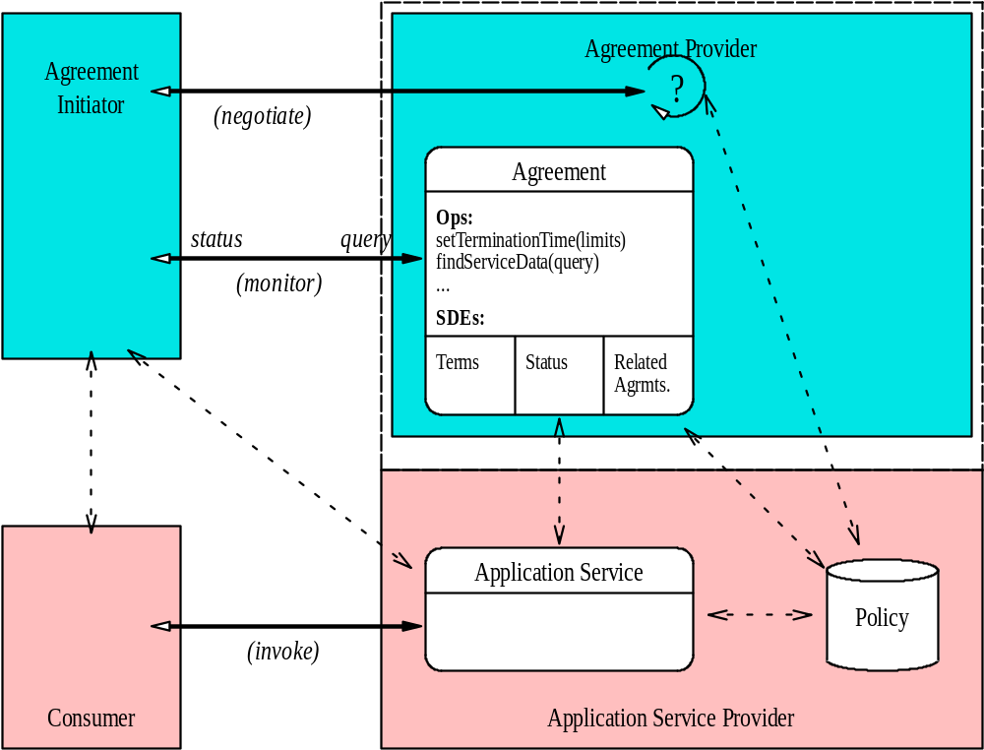
OGSI-Agreement Flows

Slide 6
OGSI-Agreement Lifecycle
Agreement creation
  gsa:AgreementFactory extends ogsi:Factory interface
  A set of agreement terms are passed for agreement creation
  May result in creation of an agreement with observed terms, or a fault with additional information (for further negotiation)
Agreement lifetime
  ogsi:terminationTime as the agreement termination time
  Monitored terms are exposed as SDE
  Agreement terms can be renegotiated
Agreement termination
  Normal termination of commitment
  Initiator cancellation of agreement terms
  Provider initiated due to inability or unwillingness to satisfy commitments
  Penalties may apply to either parties
Agreement Audit and Finalization
  Agreement state/accounting information after agreement termination

Slide 7
OGSI-Agreement Artifacts
Two new portTypes
  AgreementFactory: to create an agreement
  Agreement: to modify agreement terms
Agreement terms and SDE for monitoring
Agreement relationships
Simple negotiation (one round)

Slide 8
Extensible OGSI-Agreement Agreement Terms
gsa:AgreementType
  Use of WS-Policy assertions in agreement definition
gsa:TermType
  Use of wsp:Usage and gsa:negotiability for term state definition
  Extended to define agreement terms (i.e., WSLA)
gsa:ContextType
  Defines party information, service reference and related agreements
ogsi:terminationTime
  Used for agreement lifetime
gsa:MonitoringCriteriumType
  Details on notification & monitored terms exposed to client as SDE
gsa:TerminationCriteriumType
  Conditions and penalties for termination
  Details of finalization (e.g., how audit info can be accessed)

Slide 9
OGSI-Agreement Term Attributes
gsa:Negotiability=“…”
  gsa:Fixed
    Can not be changed by provider or client
  gsa:Negotiable
    May have an associated constraints
    Observed terms can be changed in the future
wsp:Usage=“…”
  wsp:Required
    Required by client, if not met results in a fault
  wsp:Observed
    Observed by provider
  wsp:Optional
    Desired by client, provider may observe or ignore
  wsp:Ignored
    Ignored by provider

Slide 10
OGSI-Agreement Terms as WS-Policy Assertions
<wsp:Policy>
<wsp:ExactlyOne wsp:Usage="wsp:Required">
<ns:term1 wsp:Preference="1" gsa:Negotiability="gsa:Fixed">
...
</ns:term1>
<ns:term2 wsp:Preference="100" gsa:Negotiability="gsa:Fixed">
...
</n2:term2>
<wsp:ExactlyOne>
</wsp:Policy>
The example specifies two term each of which are not negotiable agsm:Negotiability="gsa:Fixed") but you only have to satisfy one of them (<wsp:ExactlyOne>) and I'd prefer you satisfy the second one (wsp:Preference="100").

Slide 11
OGSI-Agreement Negotiation
Simple one pass negotiation (1 round trip)
No conversational state maintained
Request is either satisfied or denied with feedback on why it failed
  Requestor could send a new request fixing why it failed
  This is NOT a continuation of the previous request but an entirely new request from the service provider’s perspective

Slide 12
OGSI-Agreement Relationships: dependency & composite agreements
Agreements can be composed of other agreements
  Example: Agreement to run a job contains an agreement for CPU usage and another agreement for storage space
Uses ServiceGroup to represent relationship
  Need to investigate use of CMM

Slide 13
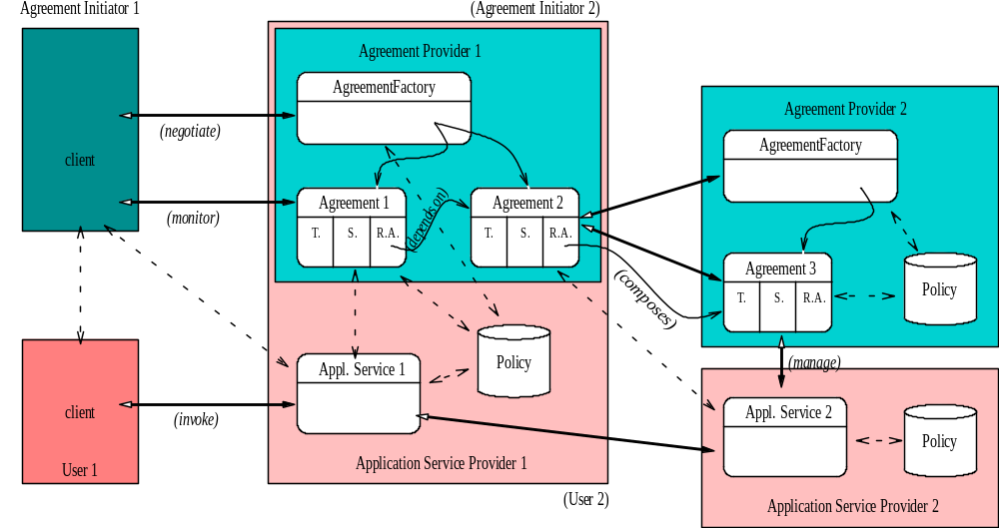
Agreement Dependency & Composition

