Slide 1
OGSI-Agreement
Agreement-Based Grid Service Management

Slide 2
Introduction
Service Management
  Slight generalization of SNAP
  The managed service provider model
Negotiation of Agreements
  Management for Federations
Maps to traditional Jobs
Maps to Advance Reservation

Slide 3
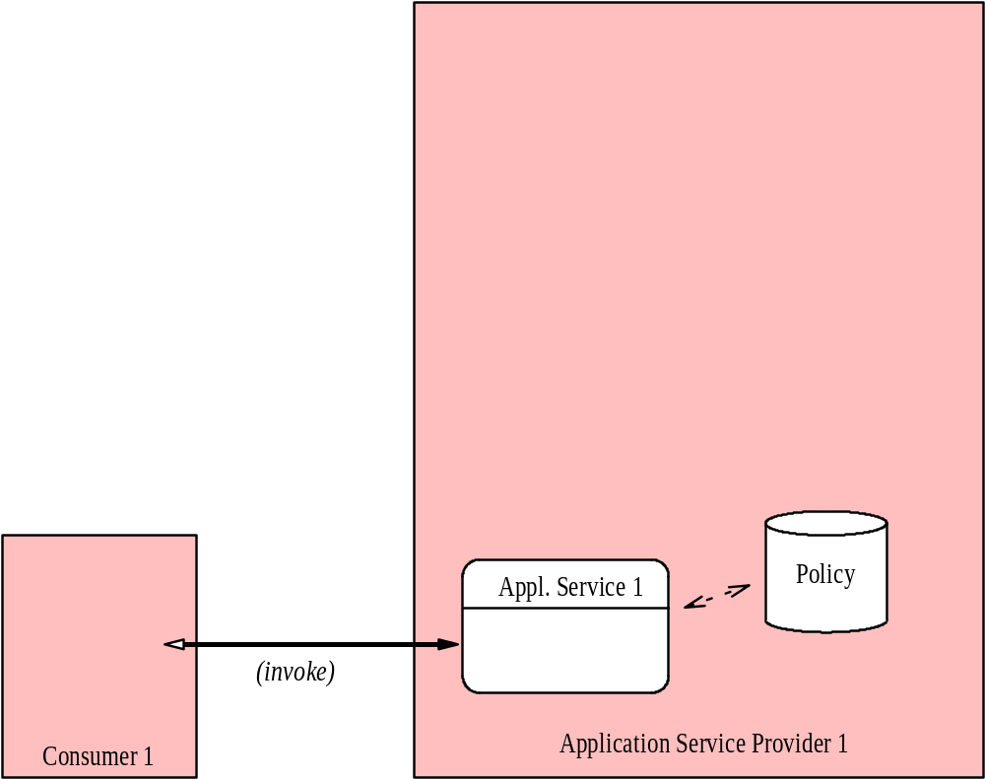
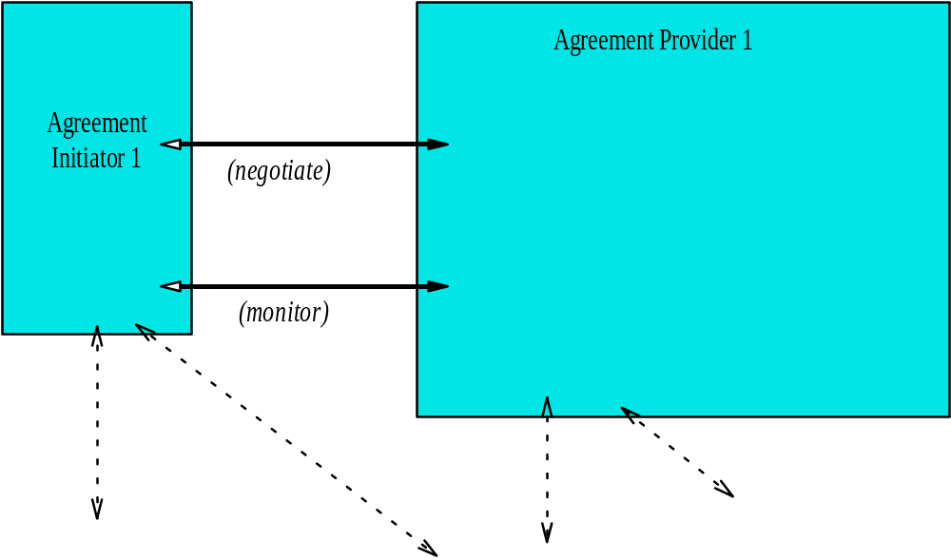
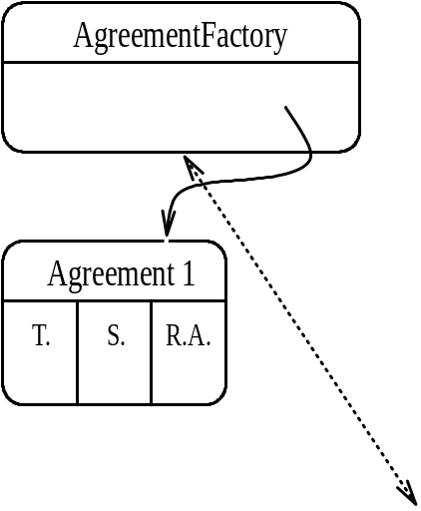
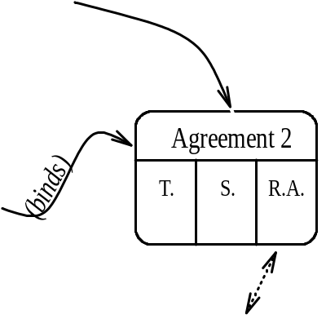
Managed Services

Slide 4
Agreement-based Jobs
Agreement represents “queue entry”
  Commitment with job parameters etc.
Agreement Provider
  i.e. Job scheduler/Queuing system
  Management interface to service provider
Service Provider
  i.e. scheduled resource (compute nodes)
Service is the Job computation

Slide 5
Advance Job Reservation
Reservation is a “pre-agreement”
  Agreement to facilitate future Job Agreement
  Abstracted terms
    Characterizes virtual resource needed for Job
    May not need full job terms
Job Agreement almost as usual
  Additional reservation ID input
  Agreement depends on reservation
    Revocation/cancellation may be transitive

Slide 6
OGSI-Agreement
Generic/extensible negotiation model
  Agreement envelopes domain-specific Terms
  Agreement supports extensible monitoring
  AgreementFactory parent to Agreement
Reuse OGSI mechanisms
  Specializes ogsi:Factory pattern
  Resilient lifetime negotiation for Agreements
  ServiceData for monitoring/introspection

Slide 7
Two-level Negotiation
Course-grained Create() for Agreement
  Batch negotiation of complex terms
  Conventional fault/response model
Fine-grained Renegotiate() mechanism
  A method of Agreement service
  Allows complex multi-message negotiation
  Admits some dynamic terms
  Requires more care for soundness

Slide 8
What’s Missing
Lots of details need thought/expansion
No domain-specific terms included
  Same scope as GRAAP charter
  Someone else needs to define terms
    For jobs
    For computer reservations
    For other cool stuff
Nice background or “primer” material
  OGSI-Agreement jumps right into details

Slide 9
Suggested Direction
Adjust GRAAP milestones
  Adopt OGSI-Agreement
  Develop primer/motivation material
Conduct interim meetings before GGF9
  Focused face-to-face discussions
  Multi-day meetings
  Successful model for OGSI-WG…

