Slide 1
Dynamic SLAs
Discussion
Omer Rana,
School of Computer Science, Cardiff

Slide 2
Requirements
Limitations of a single agreement
  Modifications since agreement was in place
Cost of doing re-establishment
  Not fully aware of operating environment
Flexibility in describing Service Level Objectives
  Not sure what to ask for (not fully aware of the environment in which operating)

Slide 3
What is a “Dynamic Agreement”
Case 1: Static Agreement
  Identify Service Description Terms,
  Guarantee Terms, and
  Service Level Objectives (SLOs)
Case 2: Dynamic Agreement
  Identify Service Description Terms,
  Guarantee Terms: defined as ranges or as functions
  Service Level Objectives: defined as ranges or as functions

Slide 4
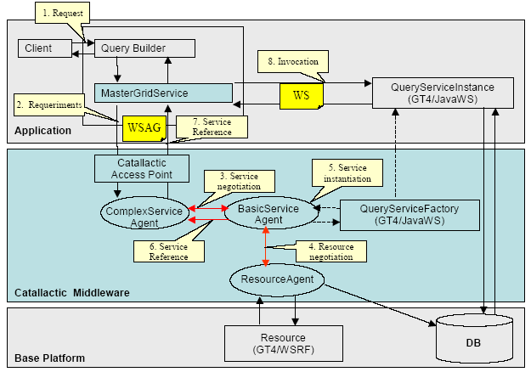
EU-Catnets

Slide 5
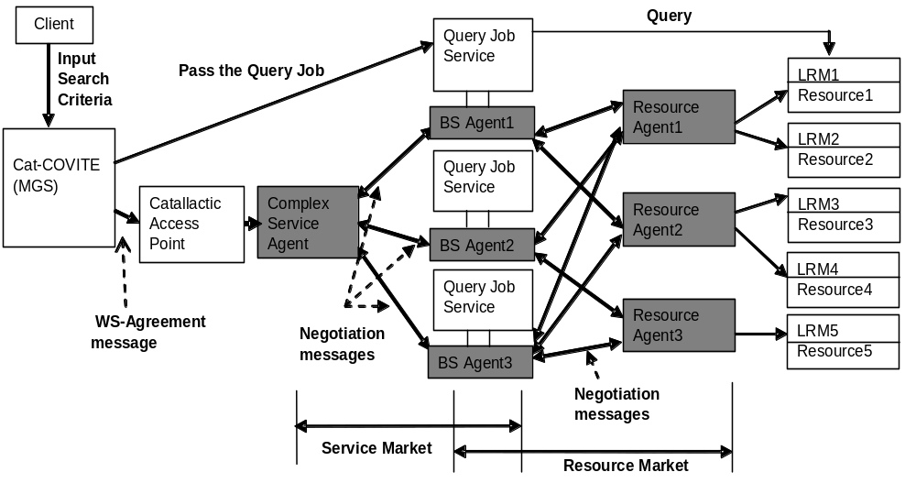
Cat-COVITE markets and Catallactic Agents for Query Services

Slide 6
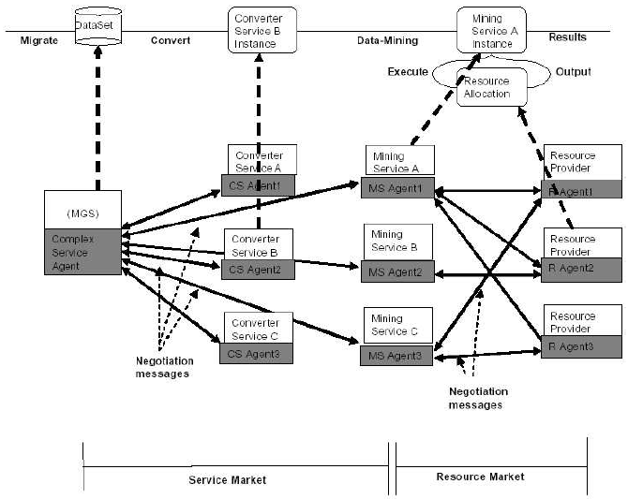
Cat-COVITE for Data Mining Services

Slide 7
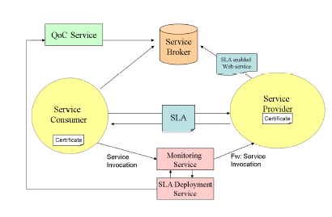
SLA Compliance (WS-QoC)

Slide 8





SLA Deployment
SDS has two primarily functions: SLA activation and SLA termination.
SLA activation
SLA termination
SLA
Verify SLA
Distribute SLO
QoC Service
Receipt

Slide 9
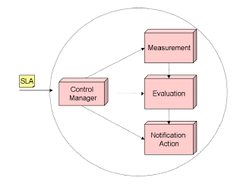
Monitoring Service
maintains run-time information
on the metrics that are part of the SLA.
MS is responsible for monitoring service invocations, detecting any violation of service level objectives and sending action guarantees to responsible parties.
MS Architecture:
propagates the obligations between the
Subcomponents and control the
interaction between them.
Compares measured SLA parameters
against the thresholds defined in the
SLA and notify the Action Service..
Notifies the responsible
parties.

Slide 10
QoC
Its role is to update the QoC metrics associated with a set of services.
For each QoS metric, the QoC service computes the difference between the predicted or suggested value, and the actual value delivered.
We can therefore consider the SLA to be a set: SLA = {m¹, ...,m^{k}} of metrics that need to be satisfied.
Receipt from SDS
Compute QoC
Service Broker

Slide 11

Computing QoC
The projected value m_{p} is the value that the service consumer and provider have agreed upon, and is defined in the SLA.
The actual value m_{a} is the value that the service provider delivers, and is measured by the monitoring service
In the context of an SLA, therefore, we can determine ∆M for the i^{th} metric (1 < i < k) – leading to:
This normalised value allows us to ensure that we can fairly compare (within some limited bound) different metrics.
A positive value occurs when the actual value is less than the projected value, and vice versa.

Slide 12

Computing QoC … 2
Not all metrics are likely to be of the same significance to a user.
we can prioritize each metric – and therefore also the difference observed for that metric (between the actual and the predicted values).
This leads us to the concept of a weighted (by !i) normalised difference for a given metric, hence:

Slide 13
SLA Usage
How can trust information be acquired based on interaction between service users and providers
How can trust information be used in the context of service composition (such as a workflow session)

Slide 14
The Rating Phase (cont..)
Rating the Reliability of a service (cont..).
A service user rates service behaviour by examining the terms in the SLA with his observation during service execution.
As users cannot monitor the service execution directly, users compute the estimated execution time t_{est.}
∆t = t_{gen} - t_{est}
Elements of a SLA
Time Difference
Actual
Execution
Time
Estimated Time

Slide 15


The Rating Phase
Rating the Reliability of a service.
A user sends a service request to invoke a particular service.
SLA
Invoking the service
based on SLA
SLA established
Negotiate SLA
SLA Violation
Service
RMS
SLA violation implies that the service was not executed successfully.
The user sends feedback to the RMS.
The feedback is one the following values: { -2, -1, 0, 1, 2}

Slide 16
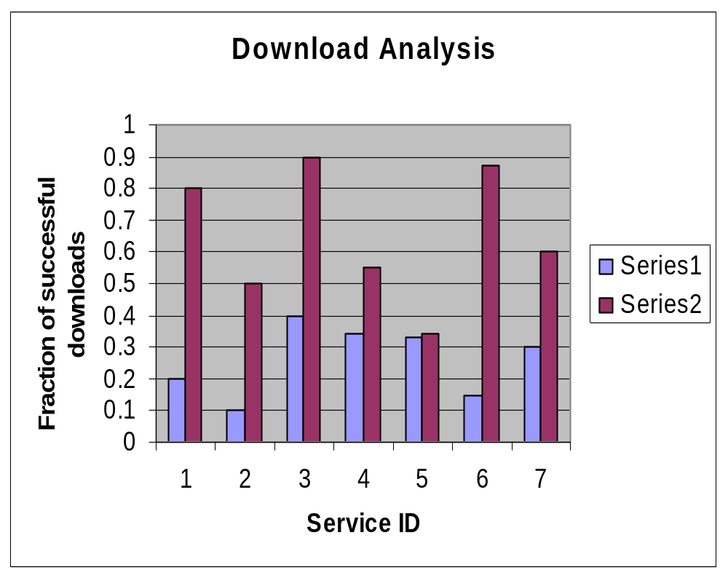
One shot
downloads
Series 1:
Standard
Download
Series 2:
With Trust
Rating
Simulation:
7 services
2 clients
100 downloads

Slide 17
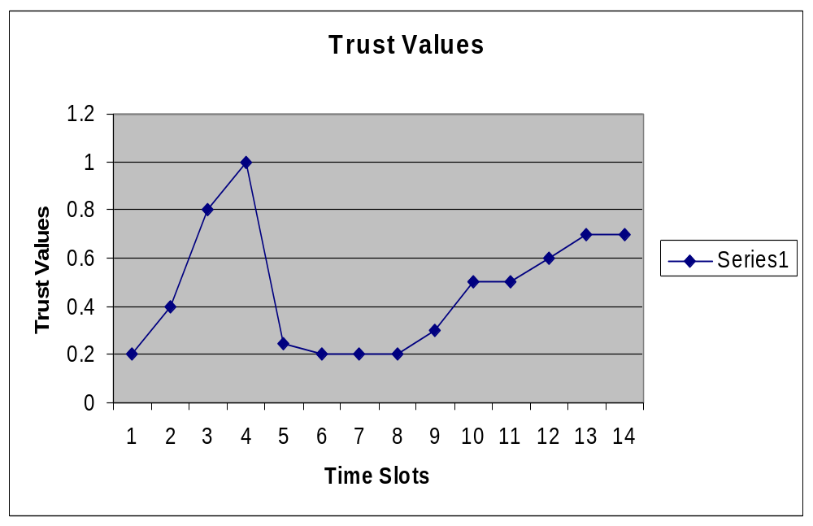
Time Slot = 1 minute interval

