Slide 1
WS-Agreement
Port Types and Operations
03/2004
presented by Alain Andrieux
USC Information Sciences Institute
alain@isi.edu

Slide 2
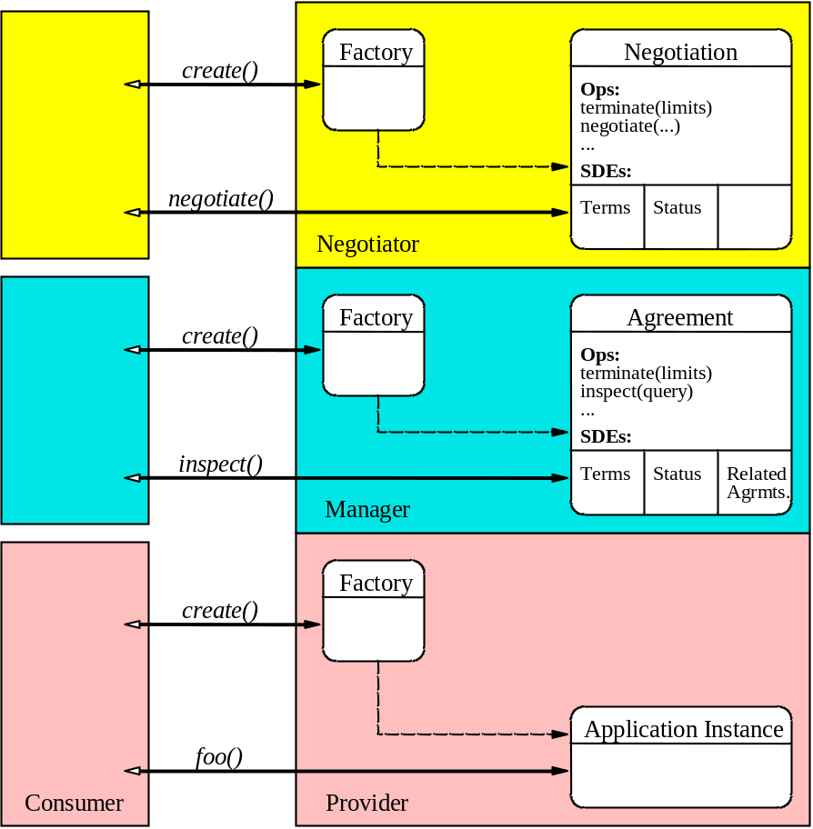
Layered Conceptual Model
Notes:
Nego layer is optional. Decouples nego functioanlity from agreement creation so makes nego optional and swappable.
1. Agreement layer is used to create an agreement in one shot (no multi-round negotiation).
2. Optional negotiation layer adds negotiation capabilities for existing agreement. Also should make it easy to create
Negotiated agreement in one pass (as oppose to calling both layers sequentially).

Slide 3
Using WS-Agreement
On case-by-case basis:
  Choose factory model(s):
    Choose idiomatic operations from spec; or
    Define new domain-specific operations
Design variants:
  One factory per layer
  NegotiatedAgreementFactory
  FooAgreementFactory
  NegotiatedFooAgreementFactory
Notes:
Compose ops: same reuse approach mandated by WSRF for ex. GetResourceProperty etc…

Slide 4
One Factory per Layer
Set of canonical factory port types
AgreementFactory operation:
  create an Agreement with a set of terms
NegotiationFactory operations:
  create a Negotiation for an existing Agreement
  create a Negotiation and an Agreement with a set of terms
Notes:
Create a negotiation is for negotiating an existing agreement. In order to start negotiation on a

Slide 5
NegotiatedAgreementFactory
Has operations:
  create an Agreement with a set of terms
  create a Negotiation for an existing Agreement
  create a Negotiation and an Agreement with a set of terms
→ Just a composition of the operations

Slide 6
FooAgreementFactory
Has operation:
  create an Agreement-aware service
  (e.g. service with obligations and Agreement interface)
Signature is domain-specific
  Input is Offer + service parameters
  Output is Agreement EPR + service “stuff”
→ Out of scope for WS-Agreement spec

Slide 7
NegotiatedFooAgreementFactory
Also out of scope

Slide 8
Content of the Specification
The 3 creation operations
  meant to be composed (via copy-paste?)
  packaged in canonical port types AgreementFactory and NegotiationFactory
Agreement and Negotiation port types
public state of final port types:
  Compose resource properties; or
  Reuse entire Resource document definitions
  (wsrp:ResourceProperties attribute)

Slide 9
Symmetric Patterns
An advanced topic not covered today
Further motivation for provider to responder renaming.
Symmetric agreement and/or negotiation
  Service endpoints “on both sides”
  Broader range of signaling patterns
  Requires support in factory methods
Please hold questions till the end

Slide 10
AgreementFactory Operation
createAgreement
  Role: Create new Agreement
  in one shot (no negotiation)
  Input: Desired agreement terms
  [Initiator Agreement EPR]
  Output: New Agreement EPR
  Faults: “nothing created” (and why)
Notes:
TODO: Add examples
/wsag:createAgreementInput/initiatorAgreementEPR
This optional element is an endpoint reference (EPR) providing a contact point EPR1 where the invoked party can send messages pertaining to this negotiated Agreement. The invoked party MUST NOT invoke operations on EPR1 after returning a fault on this operation.
/wsag:createAgreementInput/offer
The agreement offer made by the sending party. It MUST satisfy the constraints explicated in one or more of the templates the AgreementFactory exposes. Also, the offer MUST NOT contain negotiability constraints (they do not make sense here since the invoked party is not supposed to, and cannot, reply to this request with a counter-offer).
The contents of the response message are further described as follows:
/wsag:createAgreementResponse/createdAgreementEPR
This is the EPR to a newly created Agreement bearing the same observed terms. This element MUST appear.
There is no multi-round negotiation here (or you can view the desired agreement terms as a first offer that will either be accepted as is, or rejected altogether).
The Agreement represents a contract accepted by both parties. However refinement of the contract may occur through renegotiation as long as the negotiation layer is implemented and exposed. It is done through a Negotiation EPR in the default negotiation model proposed by the specification.

Slide 11
Agreement Operations
none from WS-Agreement specification
WS-ResourceProperties query operations such as GetResourceProperty
→ read-only access to WS-Agreement- specified resource properties

Slide 12
NegotiationFactory Operations (1)
createNegotiation
  Role: Create Negotiation for an existing Agreement
  Input: Existing Agreement EPR
  [First offer] [Initiator Negotiation EPR]
  Output: New Negotiation EPR
  [Counter-offer]
  Faults: “nothing created” (and why)
offer = terms + offer type + negotiability constraints
Notes:
/wsag:createNegotiationInput/initiatorNegotiationEPR
This optional element provides a contact point EPR1 where the invoked party can send messages pertaining to this stateful negotiation (this is applicable only in the case of a symmetric deployment of the wsag:Negotiation port type).
/wsag:createNegotiationInput/existingAgreementEPR
This is the contact point EPR2 of the existing wsag:Agreement to which the wsag:Negotiation to create MUST be related. This element MUST appear.
/wsag:createNegotiationInput/firstOffer
This is the initial offer to start the negotiation with. This is a shorthand for calling the negotiation operation at the returned wsag:Negotiation EPR. If the offer is accepted a counter-offer will be returned. This element MAY be omitted to start a named conversation with no initial state.
/wsag:createNegotiationInput/firstOffer/@commitment
This is the offer type of the agreement offer.
RESPONSE:
/wsag:createNegotiationResponse/createdNegotiationEPR
This is an endpoint reference EPR3 to a wsag:Negotiation service where the initiator can send messages pertaining to this stateful negotiation. The wag:Negotiation MUST be related to the input wsag:Agreement at EPR2.
/wsag:createNegotiationResponse/counterOffer
This is the agreement offer in response of the optional initial offer.
/wsag:createNegotiationResponse/counterOffer/@commitment
This attribute specifies the offer type of the response offer. The value is governed by the negotiation protocol state machine.

Slide 13
NegotiationFactory Operations (2)
createNegotiatedAgreement
  Role: Create Agreement and Negotiation to modify it
  Input: [First offer]
  [Initiator Agreement EPR]
  [Initiator Negotiation EPR]
  Output: New Agreement EPR
  New Negotiation EPR
  [Counter-offer]
  Faults: “nothing created” (and why)
offer = terms + offer type + negotiability constraints
Notes:
Issues: no mandatory argument…
The contents of the input message are further described as follows:
/wsag:createNegotiatedAgreementInput/initiatorNegotiationEPR
This optional element provides a contact point EPR1 where the invoked party can send messages pertaining to this stateful negotiation. This is applicable only in the case of a symmetric deployment of the wsag:Negotiation port type.
/wsag:createNegotiatedAgreementInput/agreementEPR
This is the optional contact point EPR2 of an existing wsag:Agreement to which the wsag:Negotiation referenced by EPR1 MUST be related. This is applicable only in the case of a symmetric deployment of the wsag:Agreement port type.
/wsag:createNegotiatedAgreementInput/offer
This is the initial offer to start the negotiation with. If the offer is accepted a new wsag:Agreement EPR will be returned as well as the EPR of the new wsag:Negotiation.
/wsag:createNegotiatedAgreementInput/offer/@commitment
This is the offer type of the agreement offer.
RESPONSE:
/wsag:createNegotiatedAgreementResponse/createdNegotiationEPR
This is an endpoint reference EPR3 to a wsag:Negotiation service where the initiator can send messages pertaining to this stateful negotiation.
/wsag:createNegotiatedAgreementResponse/createdAgreementEPR
This is an endpoint reference EPR4 to a newly created wsag:Agreement service which terms can be negotiated by sending messages to EPR3.
/wsag:createNegotiatedAgreementResponse/counterOffer
This is the counter-offer. This element MAY appear, in which case the agreement MAY include extra negotiability constraints that the next offer sent by the initiator MUST comply with.
/wsag:createNegotiatedAgreementResponse/counterOffer/@commitment
This attribute specifies the offer type of the response offer. This attribute MUST appear in the counter-offer. The value is governed by the negotiation protocol state machine.

Slide 14
Negotiation Operations
Negotiate
  Role: Accept or reject an offer on the related Agreement
  Input: Offer
  Output: Counter-offer
  Faults: “operation failed” or
  “negotiation aborted”
  (and why)
offer = terms + offer type + negotiability constraints

Slide 15
Offer Types and Negotiation State
initiatorSolicited
responderCommitted
terminal
fault
advisory
observed
responderSolicited
initiatorCommitted
Notes:
TODO add dashed messages ; dash upper right corner one too.
There are six types of offer than can be provided to, or returned from negotiation operations in the WS-Agreement model. For simplicity, each offer type corresponds directly to a state in the negotiation state machine, as depicted in Figure 6.
Note: we define the responder as the party that is invoked by the initiator.
Negotiation Protocol State Machine. The advisory start state is changed to solicited or committed by one of the parties sending an appropriate offer. The terminal observed state is reached by acceptance from one of the committed states. The terminal fault state is reached by explicit termination or by terminal faults. A synchronous continuing fault invalidates a state change implied by the faulted offer.
The six message types are represented as follows:
Advisory offers bear the wsag:advisory value and indicate no obligations or restrictions on further negotiation.
Soliciting offers indicate no obligations but require that a counter-offer be committed. There are role-specific solicitation offer types:
Committing offers indicates that the sender is obligated to the offer terms if the recipient decides to observe. There are role-specific commitment offer types:
Accepting offers bears the wsag:observed value and indicates that the sender accepts the offer that has been committed by the recipient.
Termination uses the underlying WS-RF termination mechanisms and indicates a destruction of all shared Negotiation, Agreement, or Renegotiation state. Third-party resolution, outside the scope of WS-Agreement, may still be used to resolve obligations from terminated Agreements.
Rejection uses the underlying WS-RF fault mechanisms to signal rejection of an offer, without losing the shared state that existed prior to the rejected offer.

Slide 16
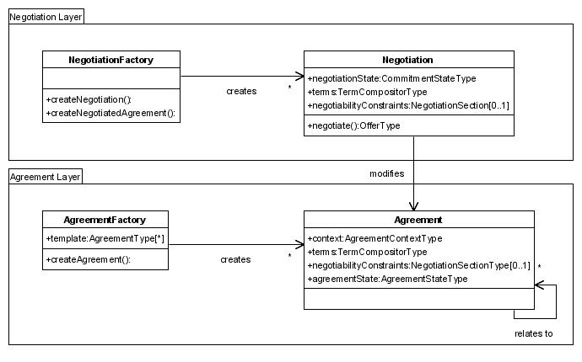
Resource Property Distribution
Notes:
“+” signs mean read-only in service interface.

Slide 17
Issues - Discussion
When should the content of the agreement document, e.g. terms, be replicated as individual resource properties?
  Is the related Agreement resource property redundant with the equivalent field on AgreementContext? Remove the latter?
Should AgreementContext be part of an Agreement template?
Karl: yes templatification is good idea.
Resolution: template still wsag:AgreementType
Agreement state (preObserved/Observed/postObserved) would allow separation of agreement and negotiation specs.
→ Heiko to propose something
Negotiability Constraints in Agreement: useful for negotiation from existing agreement. Agreement layer should have no knowledge of negotiation, so how to model this? Negotiation spec to introduce subtype of Agreement with this additional resource property?

