Slide 1
GÉANT2 E2E Circuit Monitoring
Slides from a talk by
Otto Kreiter, DANTE

Slide 2
E2E monitoring
UP/DOWN status monitored across domains for p2p circuits
15 domains have deployed the MPs (measurement points)
Visualization tool developed by GN2-JRA4
  actively used by the E2ECU and NRENs
Encouraging the different domains to include sub-wavelengths info in their MP/MA (ie. GE connections)
Sandbox: http://cnmdev.lrz-muenchen.de/e2e/lhc/

Slide 3
E2E Coordination Unit
E2ECU DOES :-
  Monitor End-to-End circuit
  Send alerts about outages
  & maintenance
  Manage information flow
  between domains
E2ECU receives fault alerts from :-
  End-to-End Monitoring System
  NOCs by email
These entities can send tickets to E2ECU :-
  Campus Network Administrators
  NREN NOCs
  GEANT2 NOC
Tickets sent out to parties involved in a particular project, except e.g. research scientists themselves.

Slide 4
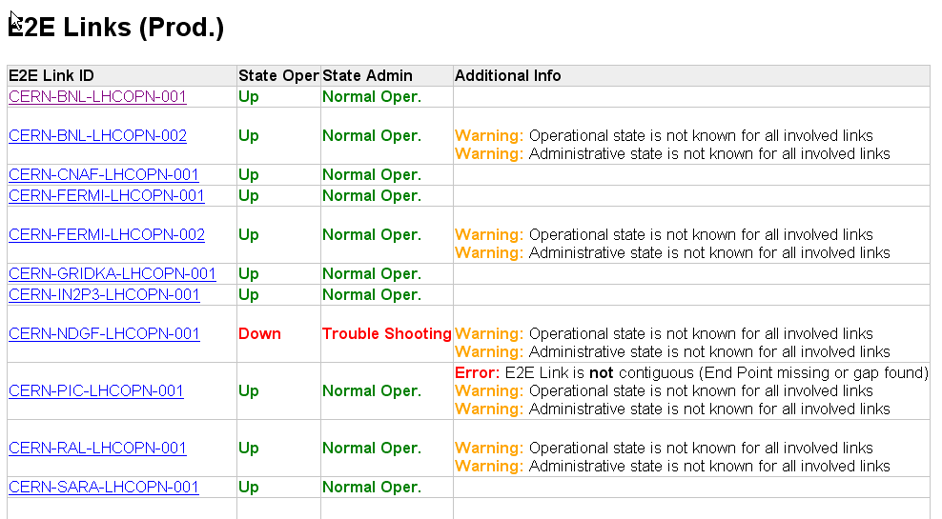

Slide 5
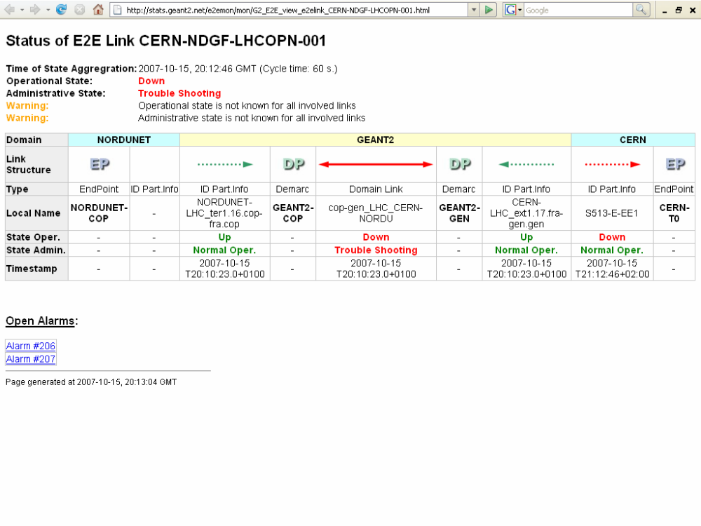

Slide 6
Monitoring summary
E2ECU fully serving the p2p community of LHC & IGTMD
  Deisa on his way
Ready to uptake other projects – EXPRES VLBI
Involved domains should install the required MP and MAs or
Should list the GE p2p links as well (currently mostly wavelengths are shown)
EXPRES may be interested in the MDM service

