Slide 1
UCLP Service Interface
Darcy Quesnel
www.canarie.ca
darcy.quesnel@canarie.ca

Slide 2
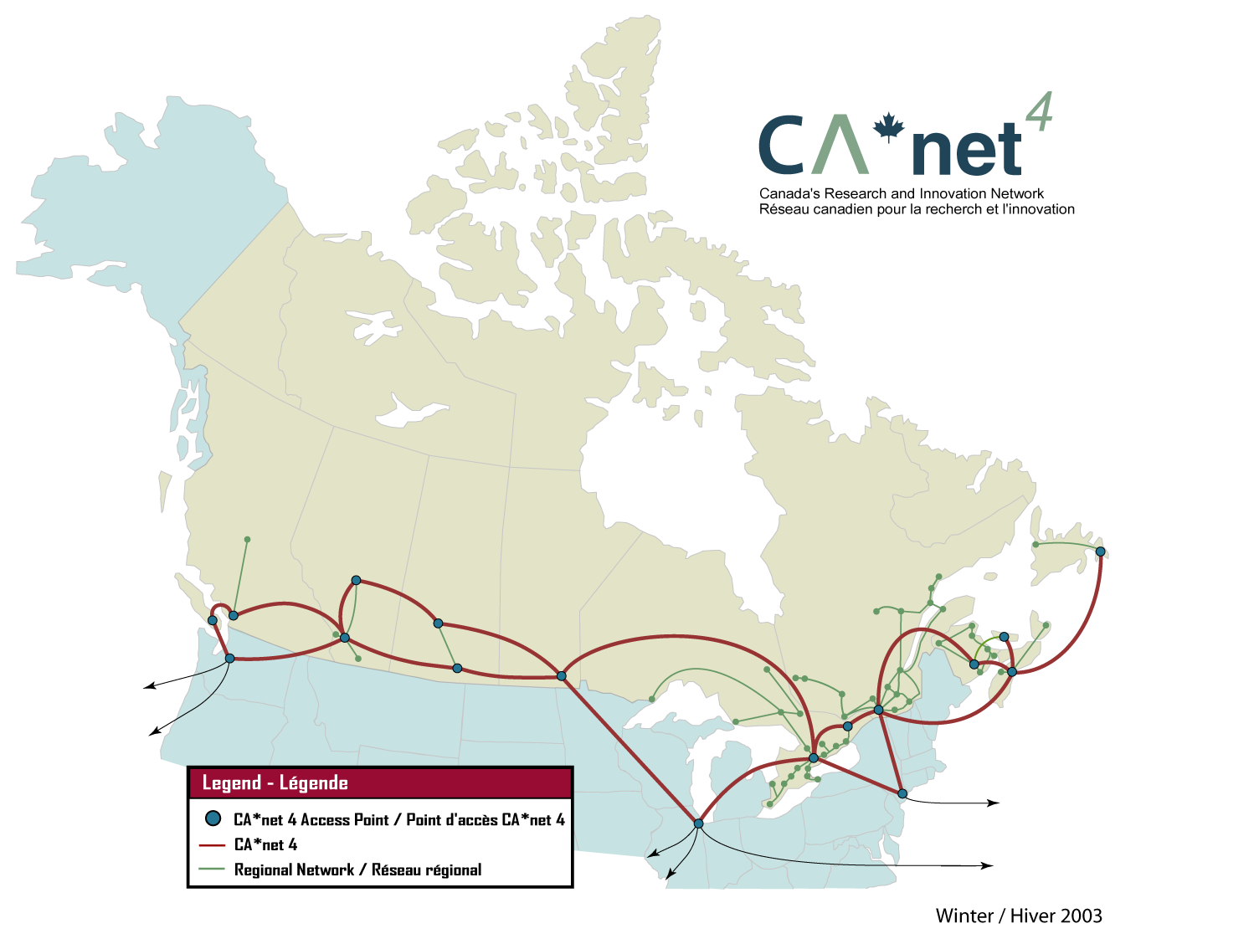

Slide 3
What we are doing with CA*net 4
CA*net 4 is made up of many parallel application-empowered or customer-empowered specific networks
  Computer back planes (WestGrid)
  High energy physics network
Extends the architecture of GigaPOP’s that connect a small number of R&E institutions to a much finer scale with many parallel application-empowered networks connecting individual researchers and/or applications
  With added feature that the application or user can dynamically manage their own IP network topology
  Wavelengths and switches are partitioned such that application-empowered networks can control their own partition and incorporate alarms, topology, and discovery into their IP network
  Not a replacement for for routed networks – increases the direct peering mesh of the routed network

Slide 4
What we are doing with CA*net 4
Held an open CFP for User-Controlled LightPath projects
Funded 3 groups (+ 1)
  U. Waterloo, U. Ottawa and CRC, and U. Carleton
  (UQAM, unfunded)
They were tasked with writing a service that could provision lightpaths across CA*net 4
  Talks TL1 to Cisco 15454’s
  Exposes a web service interface
Using a TL1 proxy (from MonFox) to enforce separation and containment when testing each of these solutions without affecting current applications

Slide 5


What we are doing with CA*net 4
Customer
Administrator
Grid
Application
HTTP
HTTP
User Access Layer
SOAP/HTTP
SOAP/HTTP
Service Provisioning Layer
RMI
Resource Management Layer
TL1

Slide 6



What we are doing with CA*net 4
Local
Border
Router
AS 6509
AS10786
AS8111
ons-ott01
1/15/1
ons-mon01
ons-fre01
ons-hal01
GbE/14/2
4/15/1
1/14/1
20/15/1
4/14/1
GbE/14/1
GbE/4/2
Destination
8/16/1
8/17/1
20/14/1
x.x.x.1
WS/SOAP
2
3
Lightpath Creation Agent
LPO I/F
LPO I/F
LPO I/F
LPO I/F
7
LPOS Factory
LPOS Factory
LPOS Factory
LPOS Factory
LPO
LPO
LPO
LPO
LPO
LPO
LPO
LPO
LPO I/F
LPO I/F
AS 6509 factories
LPO I/F
LPO I/F
4
LPO I/F
6
LPO I/F
LPOS Server
LPO I/F
Factory resolver
LPO I/F
5
AAA
AS6509 LPOS
LightPath Object
Registry
Channel/slot/port/
Advertises LPO service between AS10786 and AS8111

Slide 7

What we are doing with CA*net 4
Taiwan
Ireland
Taiwan control switch directly using UCLP software
User controlled topology
Seattle
NYC
CA*net 4
GigaPOP
STAR LIGHT

Slide 8
What we could do at GGF
Work across domains !
Work across different implementations (GMPLS, …)
Develop a common interface
  Our current draft WSDL is based on O-UNI
  Explore ITU Y.1312 (Layer 1 VPN)
How do we do end-to-end concatenation across domains and implementations?

Slide 9
What we could do at GGF
Is this interesting?
In what context does this fit?
  draft-ghpn-netservices-* ?

