Slide 1


GGF10, Berlin
March 12th, 2004
GRIDJIT Service
A New Service Paradigm
Gigi Karmous-Edwards & Steve Thorpe

Slide 2
Agenda
Overview of Just In Time (JIT)
Discuss relevance to high-demand Grid application (i.e. remote visualization steering).
GridJIT Service Architecture and GridJIT WSDL
Single PC demo - emulate source and destination workstations and an optical JIT Switch (processing JIT Signals).

Slide 3
What is JIT?
JIT is a simple signaling protocol and control plane
Key Features of JIT:
  JIT signaling provides a mechanism to set up end-to-end network connections
    Payload can be as small as packets to long lived light paths
  Detached header from the payload
    Allowing the switch to complete header processing and configuration prior to payload arrival.
    Providing a mechanism for future bufferless networks
  Tell & Go (TAG) protocol instead of Tell & Wait
    Optimistic protocol – round trip time NOT necessary – but possible
  Hop-by-hop path set-up
    w/ alternate next-hops at each node for each destination

Slide 4
What exists today?
Existing implementation of GridJIT Service
  Grid application initiated network connection
  User initiated network connection
MCNC-RDI has an open JIT signaling specification
JITPAC (JIT Protocol Accelerator Controller) prototype is currently implemented in hardware (fast message processing), also have a software version
JITPAC currently interfaces to several switches via TL1 , etc. (COTS)
  Currently talking to several vendors for interface development

Slide 5
JIT provides a migration path from today’s infrastructure to tomorrow’s optical advances
Works with today’s infrastructure
    Add Drop Multiplexers
    Multi-protocol service platforms
    All-photonic switches
    Satellite
    Exploring wireless, free-space optics, etc. (more to explore)
        and is …
… Poised for emerging optical technological advances:
  Bufferless All-photonic switched networks
  Nano-sec optical switch configuration times
  In-expensive wavelength conversion technology
  fine-grain lambda multiplexing

Slide 6
JIT signaling
Example of JIT w/ OXC
Separation of Control
Plane from Data Plane
Application/user initiated
Control message
Signaling
host client
OEO
OEO
host client
X
- -
Payload
Control signal created
Cross connection,
awaiting data payload
Control signal has not been processed yet, but will arrive ahead of payload by time = offset delay

Slide 7
Advantages of JIT in an all-photonic network
Application controlled multiplexing – variable payload
  Bursty data DOES NOT have to conform to the network’s statistical multiplexing
    TDM – fixed time slots
    ATM – fixed cell size
Reduces data latency – no buffering
Reduces network complexity – no buffering
Complete Data independence from network
  No payload processing at intermediate nodes
  Nodes are independent of:
    modulation format
    Encoding
    Protocol at higher layer

Slide 8
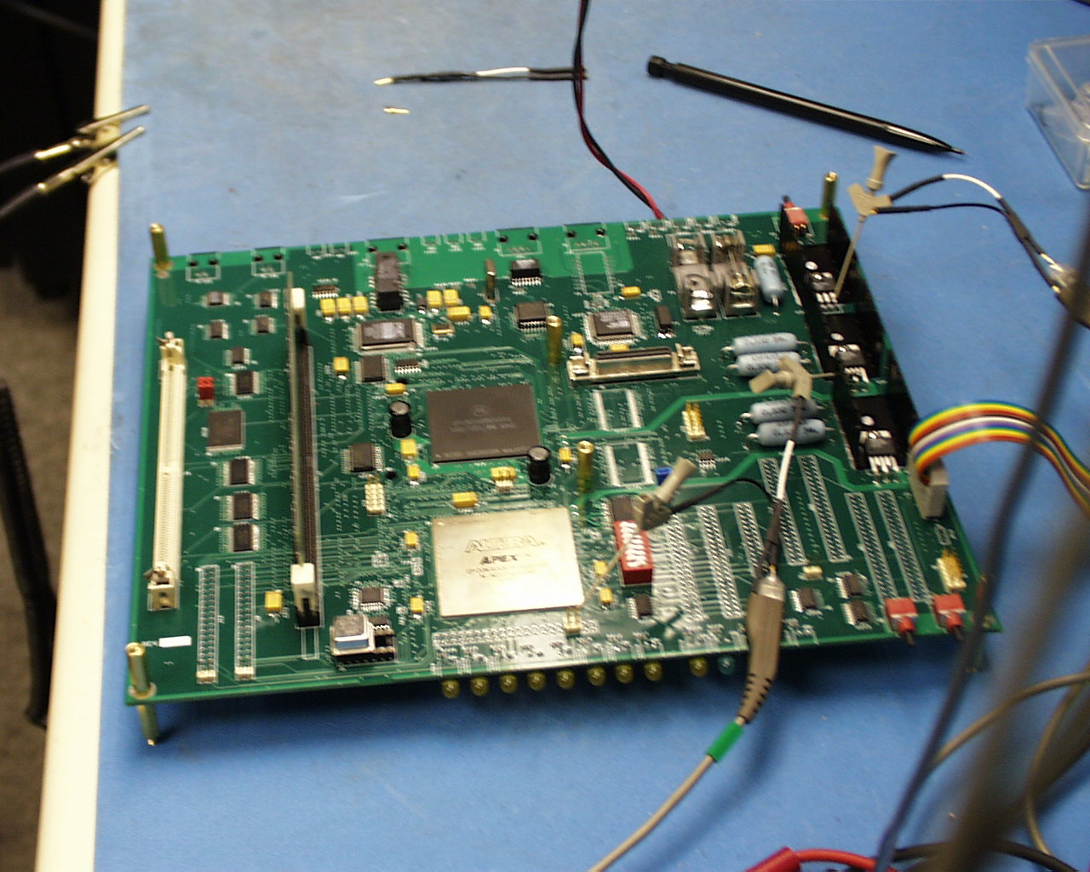
Hardware prototype

Slide 9
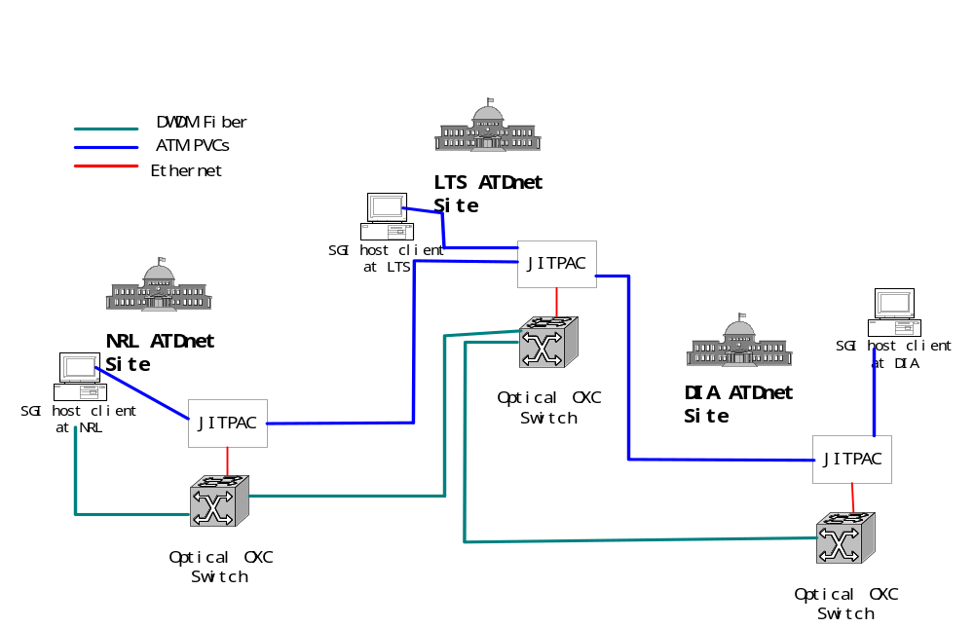
JIPACs Deployed in ATDnet Testbed in DC
Since Oct. 2002

Slide 10
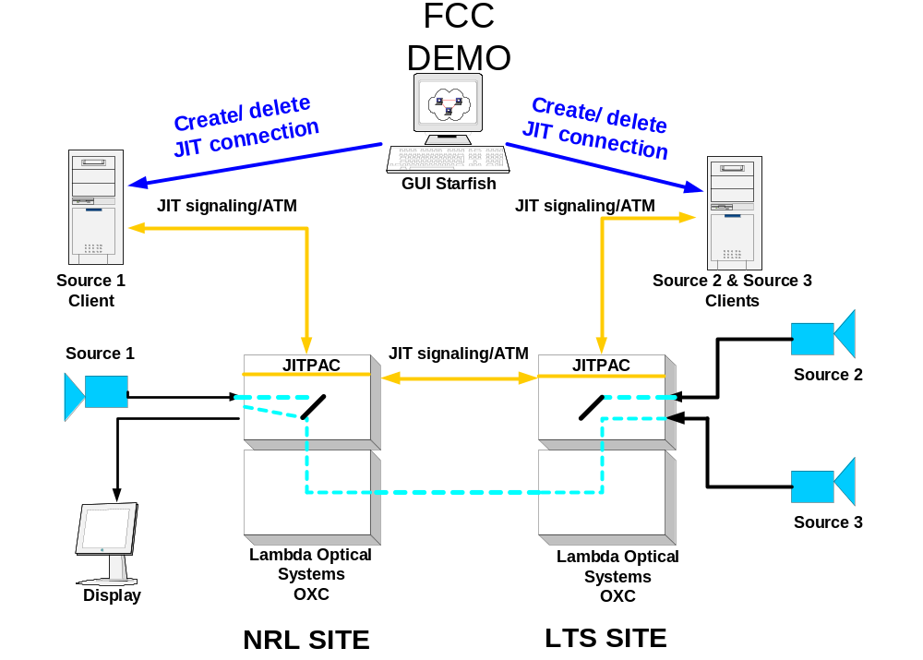
ATDnet FCC Demonstration

Slide 11
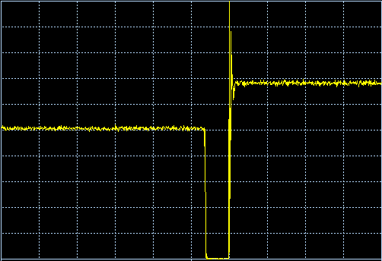
JIT FCC Demo Results
Source #2
Source #1
Optical Signal Power
Time (100 msec/div)

Slide 12
Why very fast provisioning is useful?
When an application needs to share scarce network resource …
  example: multiple streams over one optical channel (lambda)
Then, sub-lambda provisioning will allow more efficient use of the scarce resource.
The smaller the time scale for connection set-up, the finer the granularity for multiplexing over the single wavelength.
This clearly holds an advantage for Grid applications such as parallelizable remote visualization steering …

Slide 13
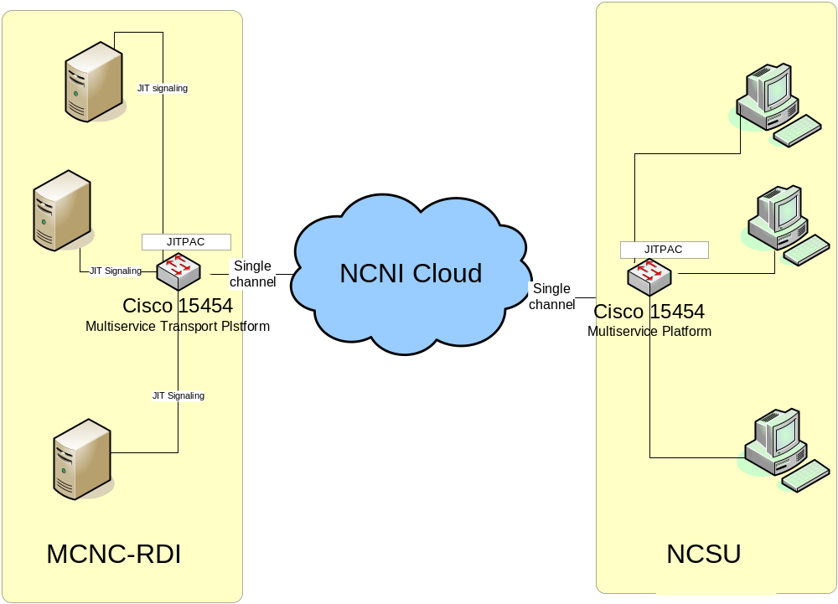
Remote Visualization Steering

Slide 14
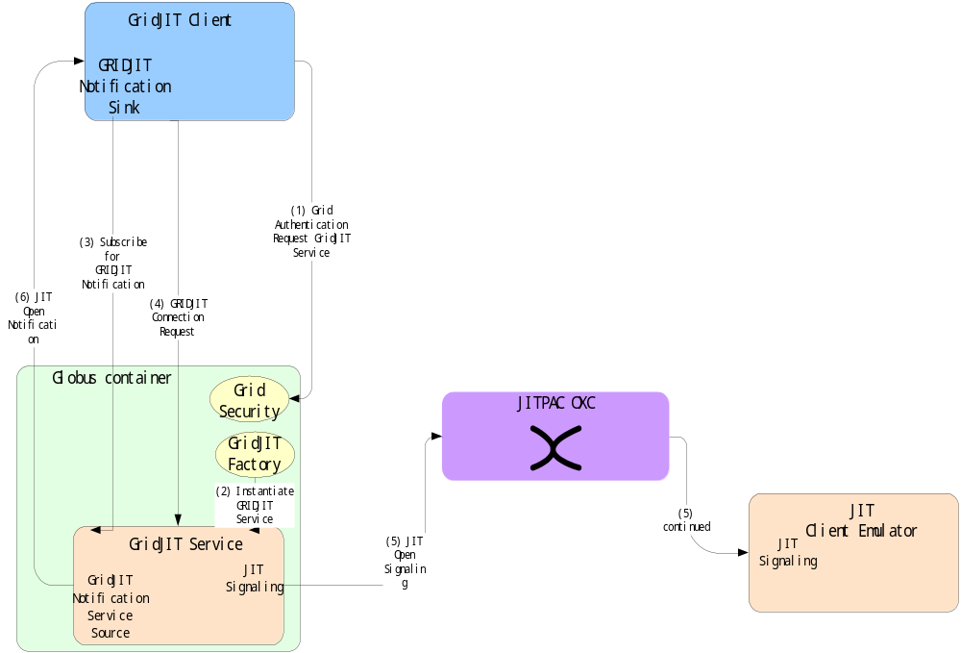

Slide 15
GridJIT WSDL
portType name GridJITPortType
operation names
executeGridJITGetMyAddress
  input message – IP address
  output message – JIT address
executeGridJITOpenLightPat
  input message – setup message data structure
  output message – JIT call reference
executeGridJITCloseLightPath
  input message – JIT call reference
  output message –

Slide 16
GridJIT WSDL
<complexType name="JITConnection">
<sequence>
<element name="callReference" type="jit:JITCallReference"/>
<element name="srcIPAddress" type="jit:IPAddress"/>
<element name="destIPAddress" type="jit:IPAddress"/>
<element name="srcJITAddress" type="xsd:string"/>
<element name="destJITAddress" type="xsd:string"/>
<element name="channel" type="jit:LamdaIndex"/>
<element name="duration" type="xsd:unsignedInt"/>
<element name="active" type="xsd:boolean"/>
<element name="errorCode" type="xsd:unsignedInt"/>
<element name="errorString" type="xsd:string"/>
<element name="serviceHandle" type="ogsi:HandleType"/>
</sequence>
</complexType>

Slide 17
Acknowledgements
JIT Inventor
  Ray McFarland
JIT Specification and Implementation
  Under the leadership of Dan Stevenson MCNC-RDI:
Ilia Baldine ,Hongjie Xin, Xiaoyong Wu ,Mike Pratt, Mark Cassada,
Raghu Uppali, Gigi Karmous-Edwards, Stephanie Bryant
Steve Thorpe, Bonnie Hurst ,Arnold Bragg, Joel Hernandez
  North Carolina University
Harry Perros, George Rouskas
• additional tips from:
Keith Jackson (SWIG), Borja (Tutorial)
• Sponsors:
– NASA under award NAG2-1467
– The US Intelligence Community under ARDA contracts
MDA 904-00-C-2133 and MDA 904-02-C-0482

