Slide 1
Grids in Asia Pacific
What has been done? and what hasn’t?
Yoshio Tanaka
Grid Technology Research Center,
AIST, Japan

Slide 2
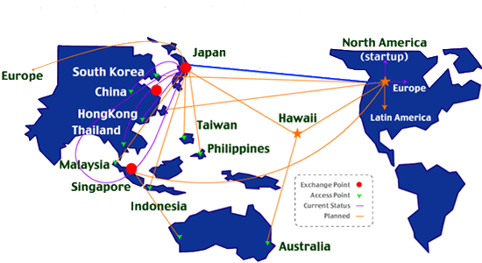
ApGrid: Asia Pacific Partnership for Grid Computing
Open community for Grid researchers in Asia Pacific
ApGrid can be
  A meeting point for all Asia-Pacific Grid researchers
  A communication channel to the GGF, and other grid communities (e.g. TeraGrid, UK-eScience, EUGrid, etc.)
  A pool for finding international project partners
India
15 countries, 49 organizations

Slide 3













ApGrid Testbed – unique features –
Truly (naturally) multi national/political/institutional VO beyond boundaries
  Not an application-dedicated testbed – general platform
  Diversity of languages, culture, policy, interests, …
Grid BYO – Grass roots approach
  Each institution contributes his resources for sharing
  Not a single source funded for the development
Physical resources
  Most contributed resources are small-scale clusters
  Networking is there, however the bandwidth is not enough
We can
  have experiences on running international VO
  verify the feasibility of this approach for the testbed development
言語と文字

Slide 4
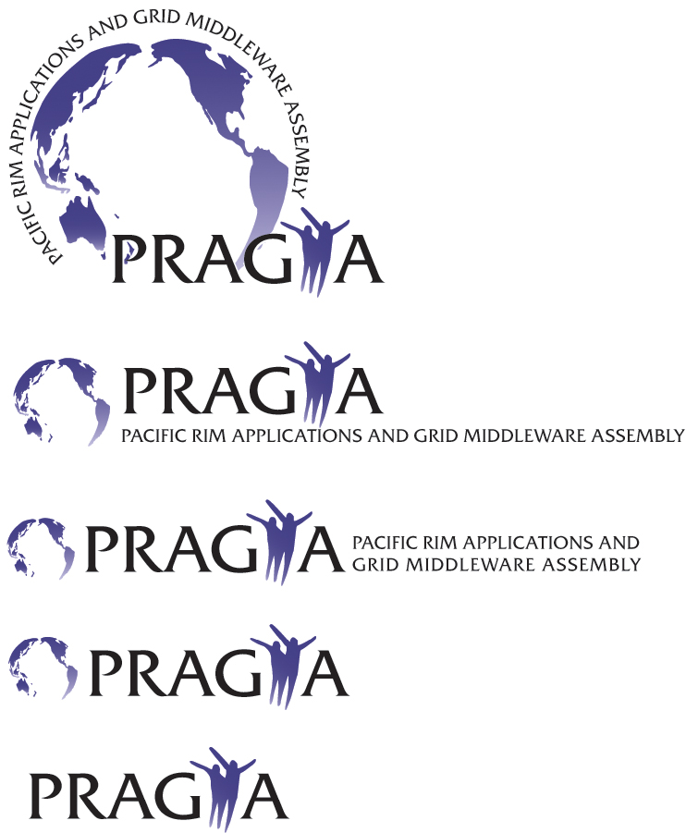
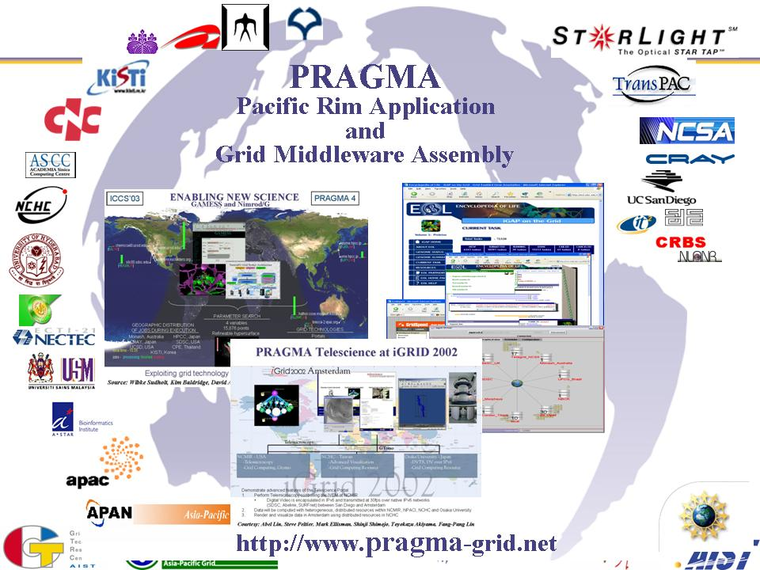
Pacific Rim Application and Grid Middleware Assembly
NSF-funded project lead by UCSD/SDSC.
1st workshop was held in March 2002.
Establish sustained collaborations and advance the use of the Grid technologies for applications.
Expected outcomes:
  Advance scientific applications
  Increase productive and effective use of the grid by researchers and scientists in the Pacific Rim
  Increase interoperability of grid middleware in Pacific Rim and throughout the world
Tightly collaborating with ApGrid.
Having workshops 2~3 times a year.

Slide 5

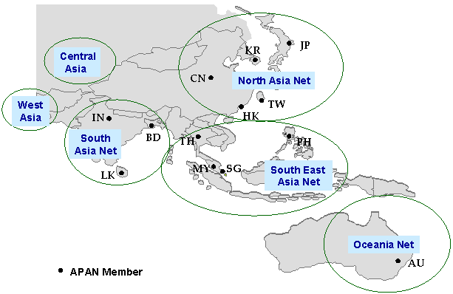
Non-profit international consortium established on 3 June 1997.
Being a high-performance network for R&D on advanced next generation applications and services.
Providing an advanced networking environment for the research and education community in Asia-Pacific.
Promoting global collaboration.
Tightly collaborating with TransPAC.
Having meetings twice a year.

Slide 6
























ApGrid/PRAGMA Testbed
Architecture, technology
  Based on GT2
    Allow multiple CAs
    Build MDS Tree
  Grid middleware/tools from Asia Pacific
    Ninf-G (GridRPC programming)
    Nimrod-G (parametric modeling system)
    SCMSWeb (resource monitoring)
    Grid Data Farm (Grid File System), etc.
Status
  26 organizations (10 countries)
  27 clusters (1674 CPUs)

Slide 7
Users, Applications and Experiences
Users
  Participants of both/either ApGrid and/or PRAGMA
Applications
  Scientific Computing
    Quantum Chemistry, Molecular Energy Calculations, Astronomy, Climate Simulation, Molecular Biology, Structural Biology, Ecology and Environment, SARS Grid, Neuroscience, Tele Science, …
Experiences
  Successful resource sharing between more than 25sites in the application level.
  Lessons Learned
    We have to pay much efforts for initiation
      Installation of GT2/JobManager, CA, firewall, etc.
    Difficulties caused by the bottom-up approach
      Resources are not dedicated
      Incompatibility between different version of software
    Performance problems
      MDS, etc.
    Instability of resources
    Key issue is sociological rather than technical

Slide 8
An experiment using Grid-enabled climate simulation
Climate simulation is used as a test application to evaluate progress of resource sharing between institutions
Climate simulation is developed using GridRPC system called Ninf-G
  Ninf-G is developed using Globus C and Java API.
  Layered in the same level of MPICH-G2
We can confirm achievements of
  Globus-level resource sharing
    Globus is correctly installed
    Queuing systems/job-manager work well
    Mutual authentication based on GSI
  Application-level resource sharing
    Network configuration of the cluster
    (note that most clusters use private IP addresses for backend nodes)
    Coordinated use of resources by applications

Slide 9
Necessary steps for the deployment
Apply my account to each site
Asked to add my entry to grid-mapfile
Test globusrun
  authentication
    Is my CA trusted? Do I trust your CA?
    Is my entry in grid-mapfile?
  DNS lookup
    reverse lookup is used for server authentication
  firewall / TCP Wrapper
    Can I connect to the Globus gatekeeper?
    Can the globus jobmanager connect to my machine?
  jobmanager
    Is the queuing system (eg. pbs, sge) installed correctly?
    Does jobmanager script work as expected?
In case of TeraGrid
  Obtained my user certificate from TeraGrid CA (NCSA CA)
  Asked TITECH and KISTI to trust NCSA CA
  It was not feasible to ask TeraGrid to trust AIST GTRC CA

Slide 10
Necessary steps for the deployment (cont’d)
Install Ninf-G2
  Two frequently occurred problems due to inappropriate installation of GT2 SDK
  Ninf-G2 links SDK libraries for GRAM, DATA, and INFO
    All SDK libraries are expected to be built from source bundles
    All SDK libraries are expected to be built using the same flavor
  If SDK is built from binary bundles, we need to ask rebuild SDK from source bundles
  Sample build flavor in GT2 manual:
    GRAM and DATA: gcc32dbg
    INFO: gcc32dbgpthr
  Need to ask additional installation of INFO SDK with gcc32dbg
    For GT2: simply run gpt-build for INFO SDK bundle with gcc32dbg
    For GT3.0: need to modify install-gt3 script
    For GT3.2: no smart solution ☹
In case of TeraGrid
  built all SDK bundles under my home directory

Slide 11
Necessary steps for the deployment (cont’d)
Install and test the climate simulation
  Can Ninf-G server program connect to the client?
  If private IP addresses are used for backend nodes, NAT must be available
  Does the application run correctly?

Slide 12
Lessons Learned
We have to pay much efforts for initiation
  Troubles in installation of GT2/PBS/jobmanger-pbs
    Firewall?
    Possible reasons for authentication error
      CA Cert is not placed in /etc/grid-security
      My entry is not appeared in grid-mapfile
      Reverse lookup failed or the returned hostname does not match to the hostname in hostcert
        Add host entries in /etc/hosts in our resources
      Time is not synchronized between a client and a server
        Change configuration of the system to refer a NTP server
      CRL is expired
    Possible reasons for errors in PBS
      failed in rsh/ssh from/to server to/from backend nodes
        .rhosts, ssh key, mismatch of hostname
      pbs_rcp was located in NFS mounted (nosuid) volume
      bugs in jobmanager scripts

Slide 13
Lessons Learned (cont’d)
MDS is not scalable and still unstable
  Performance is not good
    GIIS lookup takes several ten seconds ~ minutes
  Some parameters in grid-info-slapd.conf such as sizelimit, timeout, cahcettl, etc., should be set to appropriate values depends on your environment (number of registered objects, network performance between GRISes and GIISes, etc.).

Slide 14
Lessons Learned (cont’d)
Difficulties caused by the grass-roots approach.
  It is not easy to keep the GT2 version coherent between sites.
    Some sites are still using GT2.0 since their application is built on the old version of CoG.
    It is not easy to catch up frequent version up of the Globus Toolkit.
  Most resources are not dedicated to the ApGrid Testbed. (though this is a common problem for Grids)
    There may be busy resources
    Need grid level scheduler, fancy Grid reservation system?

Slide 15
Lessons Learned (cont’d)
Requirements depend on the middleware and application
  For Ninf-G2
    GT2 SDK must be built from source bundles
    GT2 SDK must be built using the same flavor
    NAT must be available for private IP address nodes
  For other Ninf-G2 applications
    Intel Fortran Compiler is necessary
    GAMESS or Gaussian is necessary
  In addition to the common software stack, we need to install software according to the requirements by the application.

Slide 16
Lessons Learned (cont’d)
The testbed was unstable
  Unstable / poor network
  System maintenance (incl. version up of software) without notification
    realized when the application would fail.
    it worked well yesterday, but I’m not sure whether it works today
  Grid middleware should take care of this instability.

Slide 17
Observations
Still being a “grass roots” organization
  Less administrative formality
    cf. PRAGMA, APAN, APEC/TEL, etc.
    Difficulty in establishing collaboration with others
  Unclear membership rules
    Join/leave, membership levels
    Rights/Obligations
  Vague mission, but already collected (potentially) large computing resources

Slide 18
Observations (cont’d)
Duplication of efforts on “similar” activities
  Organization-wise
    APAN - participation by country
    PRAGMA – most organizations are overlapped
  Operation-wise
    ApGrid testbed vs PRAGMA-resource
      may cause confusion
      technically, the same approach
    Multi-grid federation
  Network-wise
    Primary APAN – TransPAC
      Skillful engineering team

Slide 19
Observations (cont’d)
Two severe problems
  Lack of human resources
    Few person must take care of everything
      Cluster management, GT2 installation, software development, research…
    Nobody is dedicated on this efforts (ApGrid)
  Have interests, but less motivation for doing hard work
    Everybody is interested in Grid, but Grid is still difficult to use
      How can I develop Grid-enabled application?
      Is it easy to make my application Grid-enabled?
      How can I access to Grid?

Slide 20
Summary of current status
Difficulties are caused by not technical problems but sociological/political problems
Each site has its own policy
  account management
  firewalls
  trusted CAs
  …
Differences in interests
  Application, middleware, networking, etc.
Differences in culture, language, etc.
  Human interaction is very important

Slide 21
Summary of current status (cont’d)
What has been done?
  Resource sharing between 26 sites (1674cpus are used by Ninf-G application)
  Use GT2 as a common software
What hasn’t?
  Formalize “how to use the Grid Testbed”
    I could use, but it is difficult for others
      I was given an account at each site by personal communication
    Provide documentation
  Keep the testbed stable
  Build an environment for helping users
    helpdesk
    training
    …

Slide 22
What’s the role of ApGrid?
Deploy middleware on all institutions to support easy implementation of resource sharing and development/execution of Grid applications
  Define minimum requirements for middleware
  Define recommended configuration of the middleware
Keep the testbed as stable as possible
Define and authorize security policy in Asia Pacific.
Collaboration with PRAGMA and APAN is definitely necessary for tackling with these issues.

Slide 23
Towards a production Grid
Grid technology is still too difficult to use.
In order to solve this problem, ApGrid, PRAGMA, and APAN will collaborate on the following activities:
  publishing Grid documents
  running the production grid
  support for Applications
  organizing meetings
  building knowledge center
  running Asia Pacific Grid PMA

Slide 24
Summary
It is tough work to make resources available for applications
  many steps
It is tough to keep the testbed stable
Many issues to be solved toward a production Grid
  Technical
    local and global scheduler
    dedication / reservation / co-allocation
  Political
    CA policy
    How can I get an account on your site?
  Both
    Coordination of middlewares
Tight collaboration between ApGrid, PRAGMA, and APAN is definitely necessary for running production Grid in Asia Pacific.

